Slide 1
pointers

Slide 2
pointer
Pointer is variable used to store address of variable
e.g int a=5;
int *b=(int*)&a; //ptr typecast
Double pointer:
Store address of another pointer
Int **c =&b;

Slide 3
example
#include <stdio.h>
int main()
{
int a=10;
int *b=&a;
int **c=&b;
printf("%d\n",*b);
printf("%d\n",c); // addr of b
printf("%d\n",*c); // b value - addr of a
printf("%d\n",**c); //a value
return 0;
}

Slide 4
Size of ptr and ptr type cast
Int * ptr
Char *ptr
Float * ptr
Double * ptr
Void * ptr
For any pointer 4 byte if 32 bit , 8 byte if 64 bit
Location increament will vary depends data type
Float c=10.54;
Int a=(int)c;
Int * ptr =(int *) & a;

Slide 5
Pointer types
Null -> int *p=0;
Dangling
Wild -> int *p;
Void/generic ptr ->void *ptr =(void*)&p

Slide 6
Dangling ptr
int *fun()
{
int a=10; //to avoid dangling ptr use static variable
return &a;
}
int main()
{
/*** dangling ptr in dynamic mem ***********/
// int * ptr2=malloc(10);
// free(ptr2);
// *ptr2=10;
// printf("no dangling ptr");
/*** *********** ***********/
/*** dangling ptr in static mem ***********/
// int * p = fun();
// printf("%d",*p);
// return 0;
/*** *********** ***********/
}

Slide 7
qus
Pointer?
Double pointer?
Call by value vs call by reference. e.g
Pointer types?
Null ptr
Wild ptr
Dangling ptr
How to avoid dangling ptr
How to avoid wild ptr
Void ptr
Generic pointer
Size of void ptr
Near pointer
Far pointer
Huge pointer
Dynamic memory allocation? types ? Explanation
Malloc vs calloc
Why realloc used
Use of free

Slide 8
qus
Static vs dynamic mem allocation
Memory leak
Stack overflow.e.g int a[5]; //20byte a[5]=10;
Heap overflow.e.g
Core dump
Segmentation fault
Function ptr
How to enable dynamic mem allocation in c
Size of ptr in 32bit and 64bit
Char ptr vs int ptr
How dereference structure ptr ptr->mem (*ptr).mem .->
Ptr to array vs arry ptr
Ptr vs array
Memory fragmentation
Limitation of ptrs
Array ptr dereference->1d,2d,3d
What is memory management
What is in text segment?

Slide 9
Double ptr
int main()
{
int a=10; //20 a addr
int * p=&a; //30 p addr
int ** ptr=&p;
printf("address of a : %d",&a);
printf("\naddress of p : %d",&p);
printf("\n%d",**ptr); //10
printf("\n%d",*ptr); // addr of a
printf("\n%d",ptr); //addr of p
}

Slide 10
Call by value
//call by value
void swap(int a,int b)
{
int temp=a;
a=b;
b=temp;
//printf("a:%d b:%d",a,b); //o/p 2,1
}
void main()
{
int a=1,b=2;
swap(a,b);
printf("a:%d b:%d",a,b); //o/p 1,2
}

Slide 11
Call by ref
//call by reference
void swap(int *a,int *b)
{
int temp=*a;
*a=*b;
*b=temp;
//printf("a:%d b:%d",a,b); //o/p 2,1
}
void main()
{
int a=1,b=2;
swap(&a,&b);
printf("a:%d b:%d",a,b); //o/p 2,1
}

Slide 12
Difference between ++*p, *p++ and *++p
C program using expression ++*p :
#include <stdio.h>
int main()
{
int arr[5] = {100,200,300,400,500};
int *p = arr;
++*p; //inc val
printf("arr[0] = %d, arr[1] = %d, *p = %d", arr[0], arr[1], *p);
return 0;
}

Slide 13
C program using expression *p++ :
#include <stdio.h>
int main()
{
int arr[5] = {100,200,300,400,500};
int *p = arr;
*p++; //inc addr
printf("arr[0] = %d, arr[1] = %d, *p = %d", arr[0], arr[1], *p);
return 0;
}

Slide 14
C program using expression *++p :
#include <stdio.h>
int main()
{
int arr[5] = {100,200,300,400,500};
int *p = arr;
*++p; //inc addr
printf("arr[0] = %d, arr[1] = %d, *p = %d", arr[0], arr[1], *p);
return 0;
}

Slide 15
Find bug
#include <stdio.h>
int main()
{
char *a = "hello";
printf("%s\n",a);
return 0;
}

Slide 16
Arr vs ptr
#include <stdio.h>
int main()
{
int * a = "hai";
a[0]= 'b';
printf("%c\n",a[0]); //char out
return 0;
}
#include <stdio.h>
int main()
{
int * a = "hai";
a[0]= 'b';
printf("%s\n",a); //string out
return 0;
}

Slide 17
Arr vs ptr
#include <stdio.h>
//int array
int main()
{
int a[] = {‘h’,’e’,’l’,’l’,’o’};
a[0]= 'b';
printf("%c\n",a[0]); //char out
return 0;
}
//char array
#include <stdio.h>
int main()
{
char a[] = “hello”;
a[0]= 'b';
printf("%s\n",a); //string out
return 0;
}

Slide 18
Ptr to array
#include<stdio.h>
#define ARRAY_SIZE 5
int main()
{
int arr[ARRAY_SIZE] = {1,2,3,4,5};
int i = 0;
// Pointer to an array of integers
int (*ptr)[ARRAY_SIZE];
// Points to the whole array arr.
ptr = &arr;
for(i=0; i< ARRAY_SIZE ; ++i)
{
printf(" arr[%d] = %d\n",i,(*ptr)[i]);
}
return 0;
}

Slide 19
Array pointer
#include <stdio.h>
int main()
{
int a = 10;
int b = 20;
int c = 30;
int i = 0;
// Creating an array of integer pointers
// and initializing it with integer variables address
int *arr[3] = {&a,&b,&c};
// printing values using pointer
for (i = 0; i < 3; ++i)
{
printf("Value of arr[%d] = %d\n", i, *arr[i]);
}
return 0;
}

Slide 20
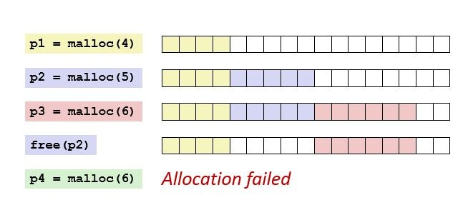
Memory fragmentation

Slide 21
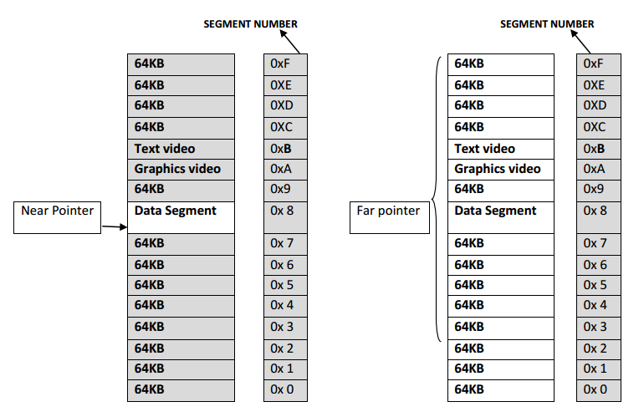
Far ptr vs near ptr

Slide 22
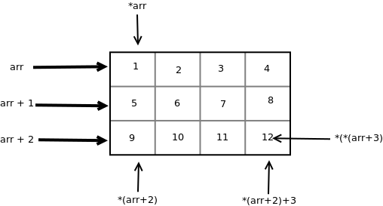
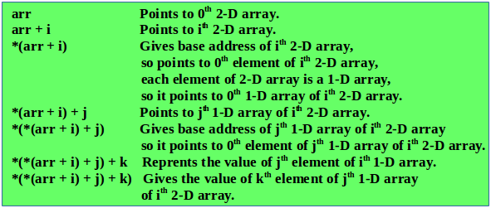
Multi dimention array using ptr

Slide 23
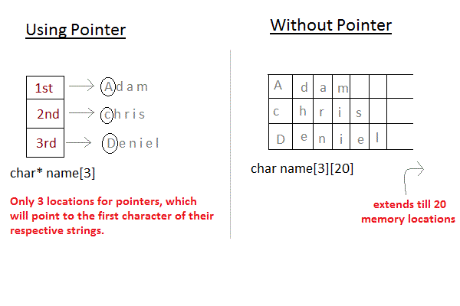
String Ptr vs array

