Slide 1
Functions

Slide 2
function
Block of code that perform specific task
Syntax:
Return_type function name(arguments)
{
Statements;
}

Slide 3
Function declaration and definition
Void msg(); //function declaration
Void main() //called function
{
msg(); //calling function
}
Void msg() //function definition
{
Statement;
}

Slide 4
Function types
Types - build in/standard library/predefine and user define function
User define function types
Without arg with return
Without arg without return
With arg with return
With arg without return

Slide 5
Actual argument vs formal argument
Void msg(int,int); //formal arg
Void main()
{
int a,b;
msg(a,b); //actual arg
}
Void msg(int x,int y) //formal arg
{
Statement;
}

Slide 6
Recursion function
Function call inside function is recursion
It used to simplify code size and to do complex program in a simple way
Disadvantage is more stack frame create and reduce execution speed

Slide 7
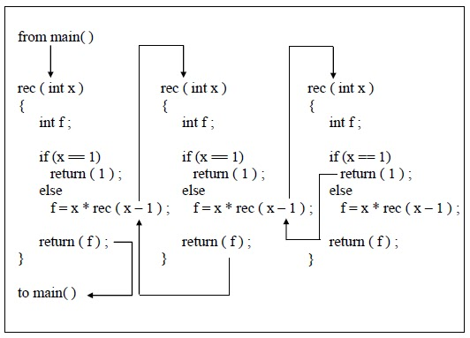
Recursion flow

Slide 8
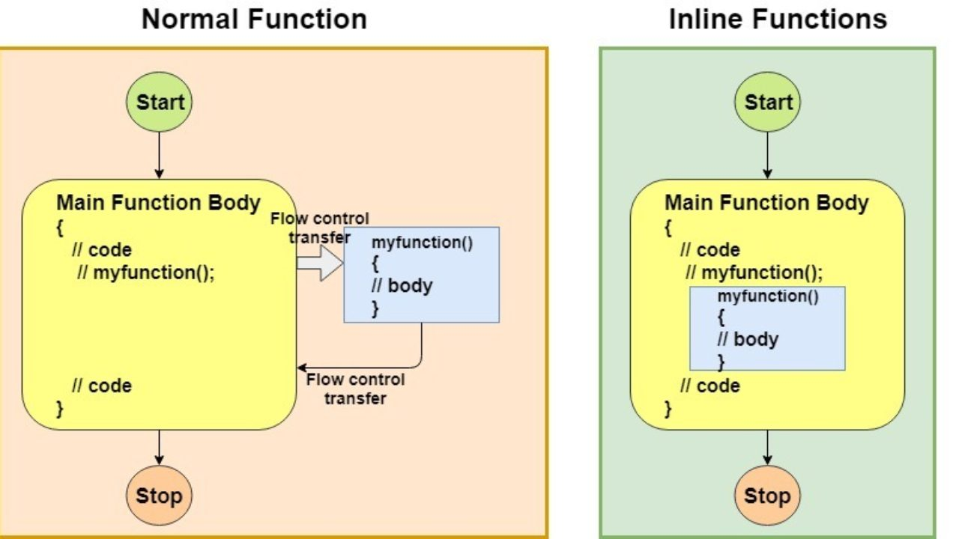
Inline function
Inline function is a function used to make complier execution fast by replace function contents using inline keyword

Slide 9
Call by value vs call by reference
int msg(int);
Void main()
{
int b=1
msg(b);
pf(b);
}
Int msg(int a) {
a=10
Return a;
}

Slide 10
call by reference
int msg(int*);
Void main()
{
int b=1
msg(&b);
pf(b);
}
Int msg(int *a) {
*a=10
Return a;
}

Slide 11
tasks
Calculator
Atm balance
Currency check ->5000rs(no.of 2000,no.of 500,no.of 100)
Sum of numbers using recursion

