Slide 1
CAN

Slide 2
CAN(CONTROL AREA NETWORK
developed by bosch in 1980 for automotive industry
2 wire serial asynchronous protocol(CAN H,CAN L)
Multi master protocol
Max distance 40m if 1MBPS , 250m if 250kbps
Max speed -1mbps
Message based protocol
half duplex data transmission
Sent data in differential signal
Upto 127 nodes can connect on can bus
Can bus has hot-plugging feature (i.e) we can connect node while can bus in working

Slide 3
continue
high speed, high noise immunity,error detection
Auto retransmission,error confinement
No host and target communication (i.e) no source and destination address
Broadcast type communication
It reduce connection complicity

Slide 4
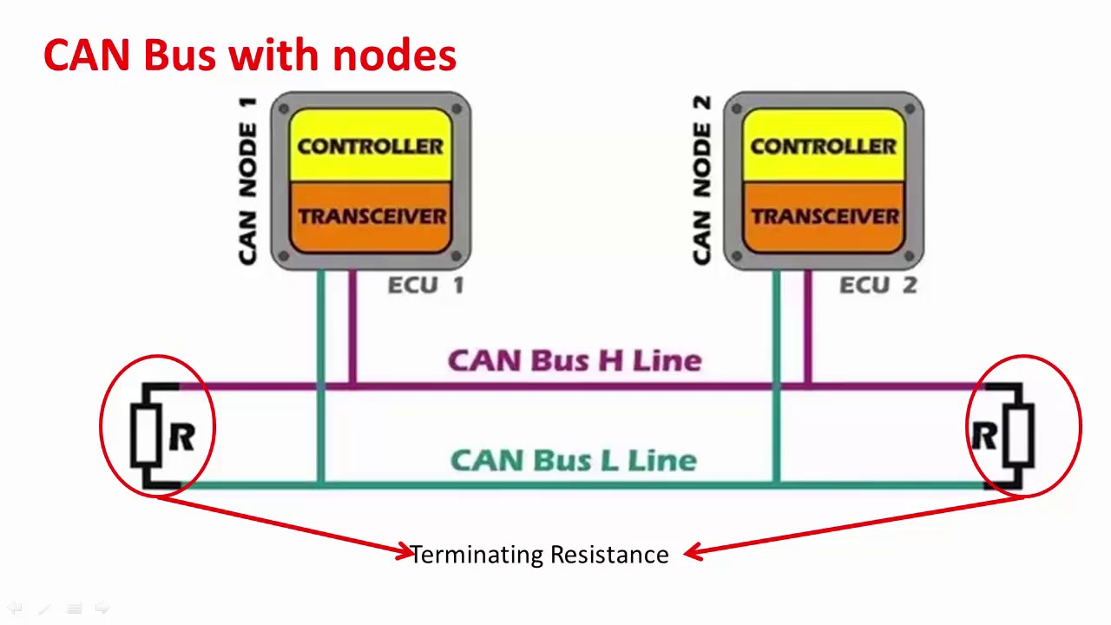
CAN BUS

Slide 5
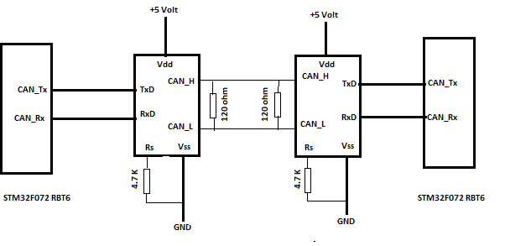

Slide 6
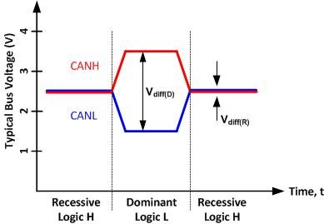
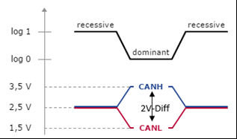
Can signalling

Slide 7
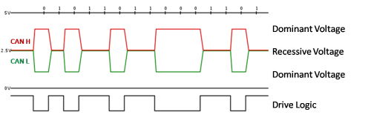
can-bus volt levels

Slide 8
Can frames
Data frame
Remote frame
Error frame
Overload frame

Slide 9
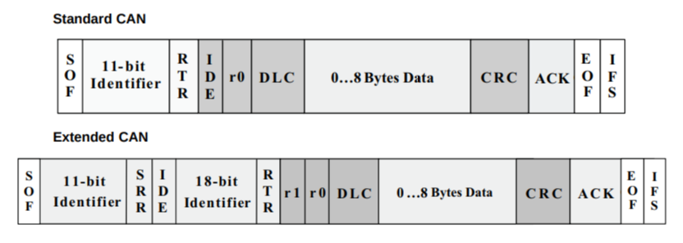
DATA FRAME-Standard can & Extended can
SOF (start-of-frame) bit – indicates the beginning of a message with a dominant (logic 0) bit.
Arbitration ID – identifies the message and indicates the message's priority. Frames come in two formats -- standard, which uses an 11-bit arbitration ID, and extended, which uses a 29-bit arbitration ID.
SRR-substitute remote request = The SRR bit is the Substitute Remote Request, which in case of, standard data frame and extended data frame, when both messages have equal base identifier, then standard data frame has higher priority and hence it indicates the bit is always a recessive bit
IDE (identifier extension) bit – allows differentiation between standard and extended frames.

Slide 10
RTR (remote transmission request) bit – serves to differentiate a remote frame from a data frame. A dominant (logic 0) RTR bit indicates a data frame. A recessive (logic 1) RTR bit indicates a remote frame.
DLC (data length code) – indicates the number of bytes the data field contains.
Data Field – contains 0 to 8 bytes of data.
CRC (cyclic redundancy check) – contains 15-bit cyclic redundancy check code and a recessive delimiter bit. The CRC field is used for error detection.
ACK (Acknowledgement) slot – any CAN controller that correctly receives the message sends an ACK bit at the end of the message. The transmitting node checks for the presence of the ACK bit on the bus and reattempts transmission if no acknowledge is detected. National Instruments Series 2 CAN interfaces have the capability of listen-only mode. Herein, the transmission of an ACK bit by the monitoring hardware is suppressed to prevent it from affecting the behavior of the bus.
CAN Signal – an individual piece of data contained within the CAN frame data field. You also can refer to CAN signals as channels. Because the data field can contain up to 8 bytes of data, a single CAN frame can contain 0 to 64 individual signals (for 64 channels, they would all be binary).
The IFS (Inter Frame Space) marks the space of time that is necessary for the CAN controller to transfer a correct received frame from the bus andler to the corresponding place in the message buffer area. Bus it not used. Every bus node is allowed to start a message transfer

Slide 11
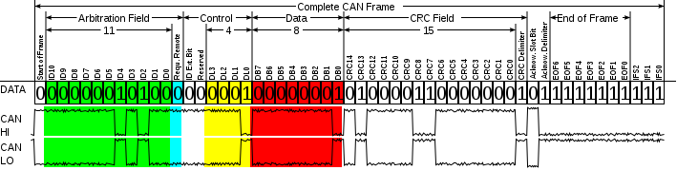
CAN FRAME

Slide 12
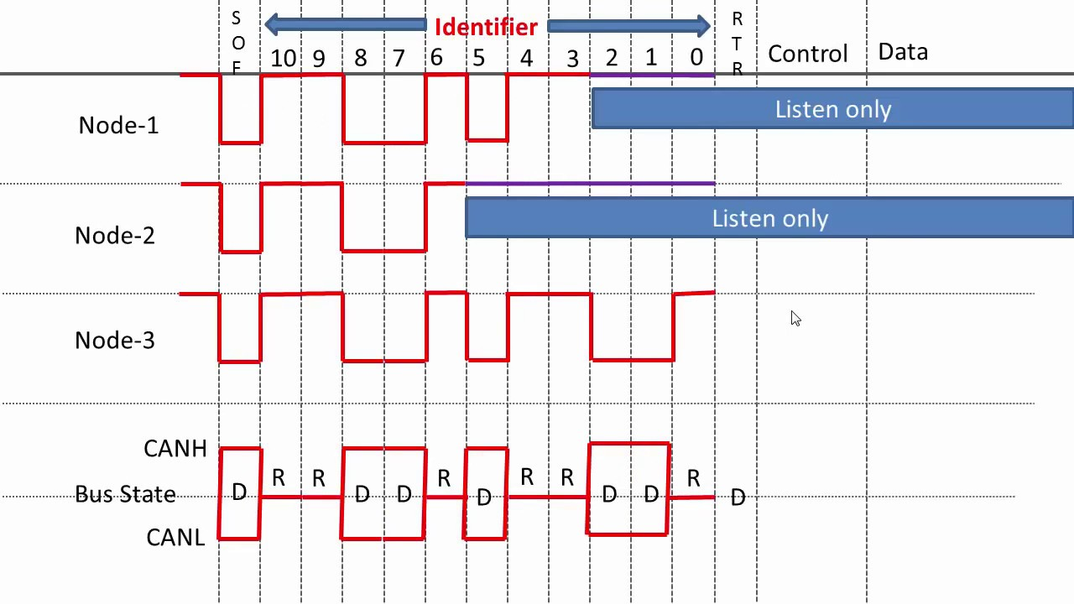
Can arbitration

Slide 13
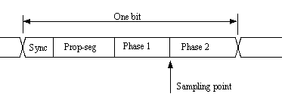
Can bit timing

Slide 14
BAUD RATE
BAUD RATE = 1/BIT TIME
BIT TIME = (1/CAN CLK) * NO.OF TIME QUANTAS(PROPAGATION DELAY+PHASE SEG 1+PHASE SEG 2+SJW) )
E.G: CAN PCLK=20MHZ,1 MPBS BAUD
PRE=2,NO.OF.TIME=10
CAN CLK = CAN PCLK/PRE = 20MHZ/2 =10MHZ
BIT TIME=(1/ CAN CLK ) * NO.OF TIME
= (1/10MHZ) * 10 = 0.1 US * 10 = 1US
BAUD RATE = 1/1US = 1MbPS

