Slide 1
EMBEDDED SYSTEMS

Slide 2
What – Why –Where
Combination of software and hardware
Software(low level-asm and high level language-c,c++,java are used)
Hardware(digital electronics and ckts)
Single chip in-build wrapped circuits
To overcome electronics drawbacks- power, cost ,develop time,size
Used in automotive,medical,aero,automation,robotics..etc

Slide 3
Piller of embedded systems
Microcontroller
Microprocessor

Slide 4
MCU vs MPU
MCU | MPU
Inbuild RAM,ROM,I/O,peripheral | External memory and I/O
Cant extend memory,limited memory | Can extend
Os optional | Os must
Special purpose apps | General purpose apps
RISC | CISC
E.g- oven,ac,fridge,washing machine | Computer,mobiles
PIC,ARM,AVR,renesas,TI,NXP | Rpi,Beagle bone black

Slide 5
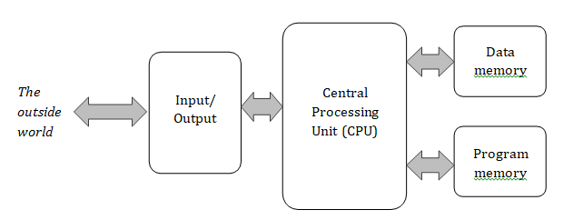
Example

Slide 6
MCU architectures types
Von-numann --single memory unit for PM and DM (program and data memory,single address bus and data bus for memory
Hardvard –separate memory bus for program and data memory

Slide 7
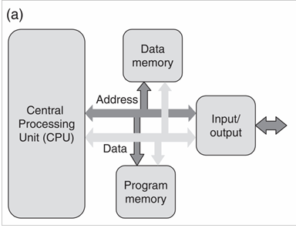
Von-numann architecture

Slide 8
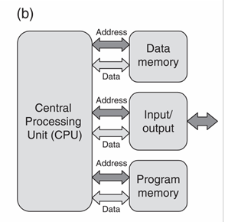
Hardvard architecture

Slide 9
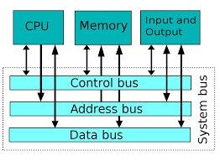
Bus
Address bus -unidirection
Data bus -bidirection
Control bus -bidirectional ,1bit read/write operation
System bus combine all bus

Slide 10
Memory types
Program memory
Program Memory/flash memory/instructions memory/non volatile memory/
ROM,PROM,EPROM,EEPROM,FLASH(nand and nor flash)
NAND – block write ,erase ,read
NOR –block erase ,bit read and write
Data memory
Data Memory –SRAM vs DRAM
EEPROM -bit erase, read and write

Slide 11
Memory

Slide 12
Instruction set
RISC –reduced instruction set computer ,used in mini application, less power,easy design,fast
CISC -complex instruction set computer ,used in large application - more power,design complex,slow

Slide 13
PIC16F877A
Microchip
Small,mid,large family type
Small-10,12
Mid-16,18
Large -24,32
8 bit vs 16 bit vs 32bit
Core specifications
GPIO pin details
Registers

Slide 14
Core specification
Program memory -8kb ,100000 R/W
Data memory -368 bytes
EEPROM -256 bytes 10,00,000 R/W
Address bus -13bit
Data bus -8 bit
40 pin ic ,33 I/O pins
Peripharals –3 timer,2 channel CCP,10bit ADC 8channel,1 uart,1 spi,1 i2c
Power -5v
Clock
Int clk-max 4mhz
Ext clk -4mhz to 20 mhz

Slide 15
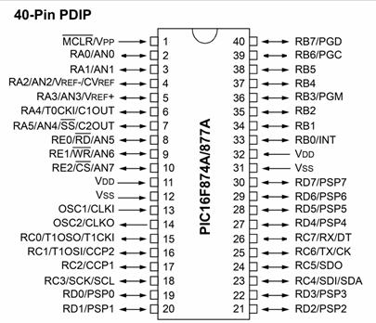
Pin details
A - 6 PINS (D/A)
B - 8 PINS (D)
C - 8 PINS(D)
D - 8 PINS(D)
E – 3 PINS(D/A)

Slide 16
Registers
GPR vs SPR (stored in RAM )
TRISx (x=A,B,C,D,E) - input/output control
PORTx (x=A,B,C,D,E) – on/off control
Input -1
Output-0
On-1
Off-0

