Slide 1
ADC Module -10 BIT

Slide 2
Analog vs digital
Analog signals - temp,light,sound,air,current,voltage
Analog sensor - temp,current,volt,current,LDR,pressure
Digital sensor-IR,PIR ,proximity ,photoelectric sensor

Slide 3
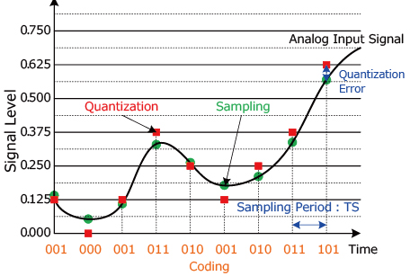
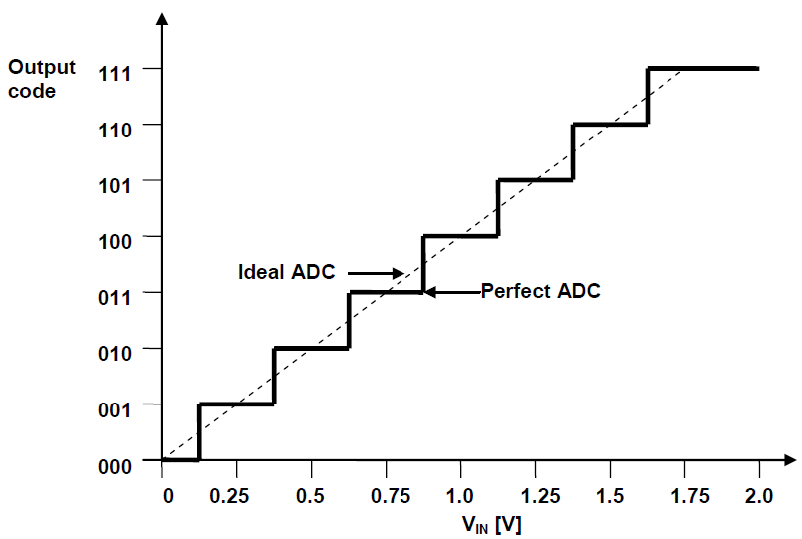
PCM techniques
Sampling
Quantization
Binary encoder

Slide 4
Adc types
Flash - high speed ,low accuracy e.g video, radar
Dual slope - low speed, high accuracy e.g multimeter
SAR- successive approximation register –medium speed ,medium accuracy e.g MCU,sensors

Slide 5
VOLTAGE REF TABLE FOR 3-BIT SAR
SAMPLING | BINARY NUMBER | VOLTAGE
0 | 000 | 0V
1 | 001 | 0.7V
2 | 010 | 1.4V
3 | 011 | 2.1V
4 | 100 | 2.8V
5 | 101 | 3.5V
6 | 110 | 4.1V
7 | 111 | 4.9V

Slide 6
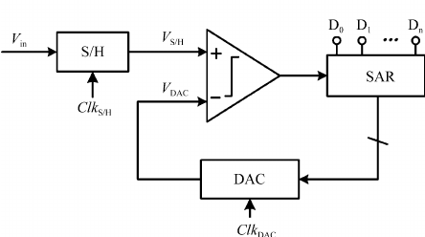
3bit SAR
3.5v
VIN >= VREF = 1
VIN < VREF = 0
2.8v
100
110
4.1v
101
3.5v

Slide 7
Registers
ADCON0
ADCON1
ADRESL
ADRESH
CONTROL REGISTERS
STORAGE REGISTERS

Slide 8
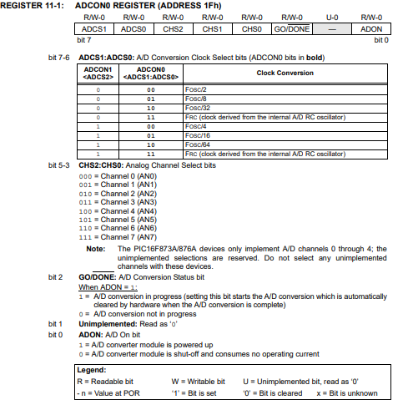
ADCON0

Slide 9
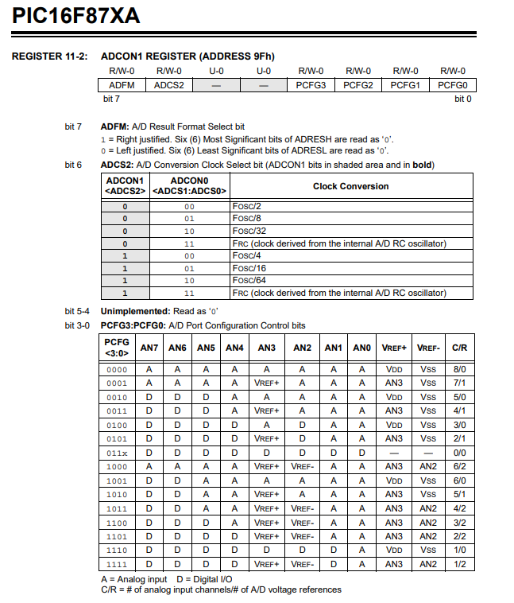
ADCON1

Slide 10
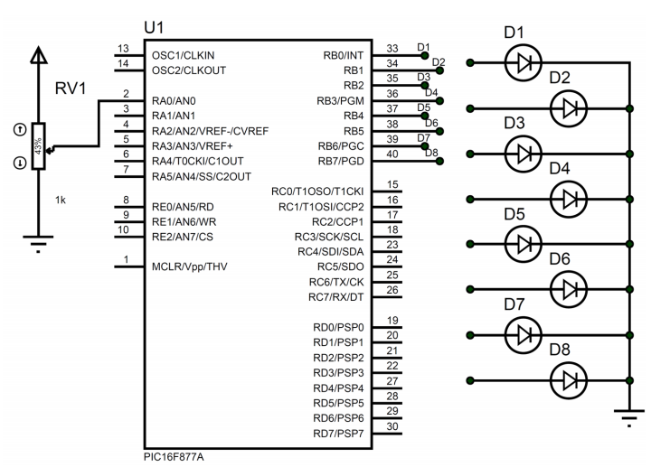
ADC interface

Slide 11
Program Procedure
Adc register configure
Adc converstion start
Wait until conversion complete
Fetch adc data from adc storage registers

