Slide 1
Communication protocols

Slide 2
communication protocol?
Set of rules to communicate(send/receive data) between two devices using wire/wireless(medium/channel)

Slide 3
Types
Wireless –wifi,bt,zigbee,gsm/gprs
wire
Serial(1bit)
Parallel (8bit)
Data transmission methods
Simplex-tx or rx
Half duplex-tx & rx
Full duplex –tx & rx simultaneous
Asynchronous
(no clk)
UART
CAN
Synchronous(clk)
USART
SPI
I2C

Slide 4
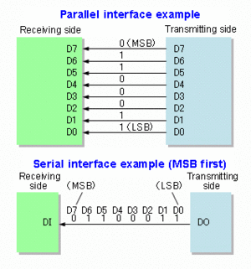
Serial vs parallel

Slide 5
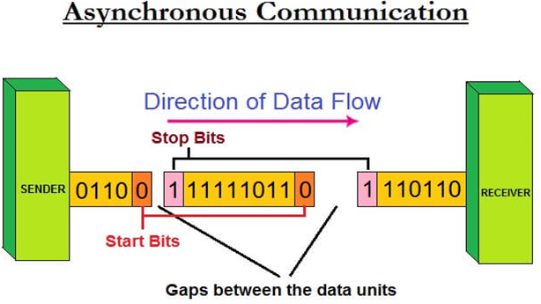
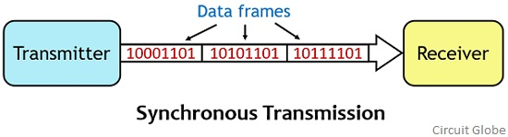
Synchronous vs Asynchronous

Slide 6
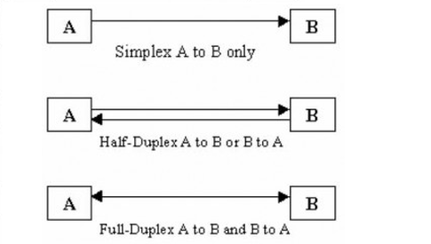
Data tramission types

Slide 7
UART
Universal asynchronous receiver and transmitter
2 wire Serial asynchronous protocol
Full duplex/half duplex
Max distance 15m(rs232)
Baud rate 9600bit/s
Application ->gsm/bt/wifi/rfid

Slide 8
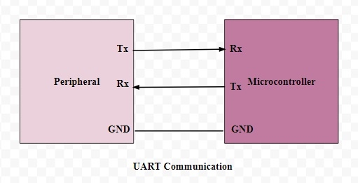
MCU to MCU/other UART Device interface
RC7
RC6
Pin details
RC6/TX -output
RC7/RX -input

Slide 9
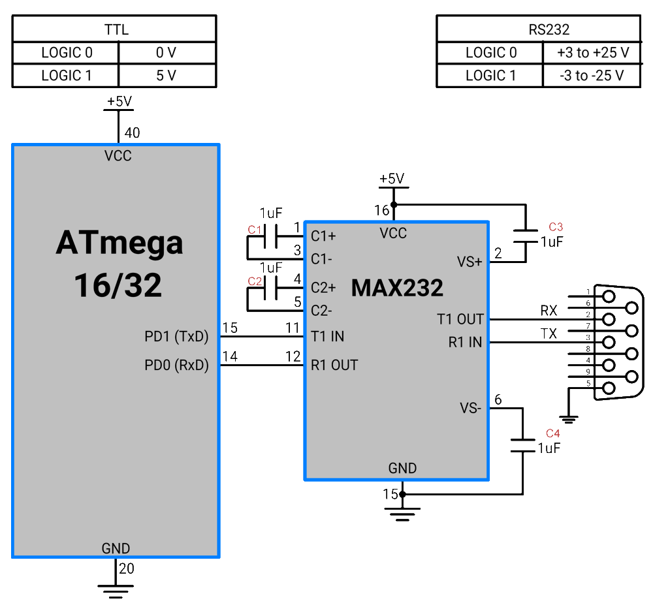
MCU with PC interface

Slide 10
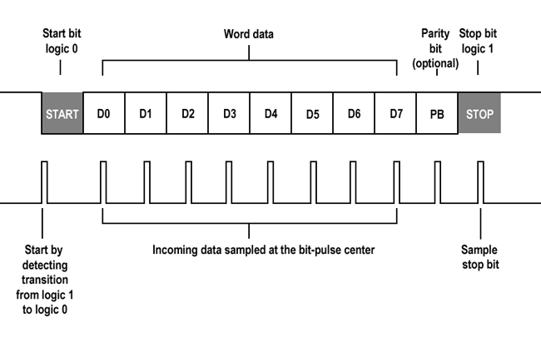
UART frame

Slide 11
Continue…
UART frame congiration
Idle ->clock high
Start bit -> 1 bit clk low
Data bits -> 8bit /9bit
Parity bit ->1 bit even/odd
Stop bit ->1 bit clk high
Baud rate-9600bit/sec
Tx/Rx pin configuration in TRISC

Slide 12
Baud rate calcuation
Baud rate = FOSC / (64 *(x+1)) if BRGH=0
Baud rate = FOSC / (16 *(x+1)) if BRGH=1
X+1 = FOSC/ 16*Baud rate
X+1 = 4mhz /(16*9600)
X=26-1 =25
SPBRG = x
1 bit time = 1/9600 =104us

Slide 13
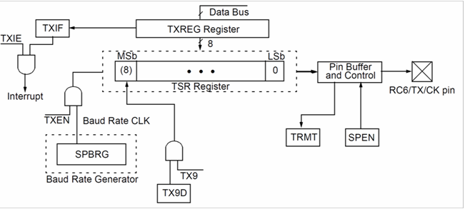
Tx block diagram

Slide 14
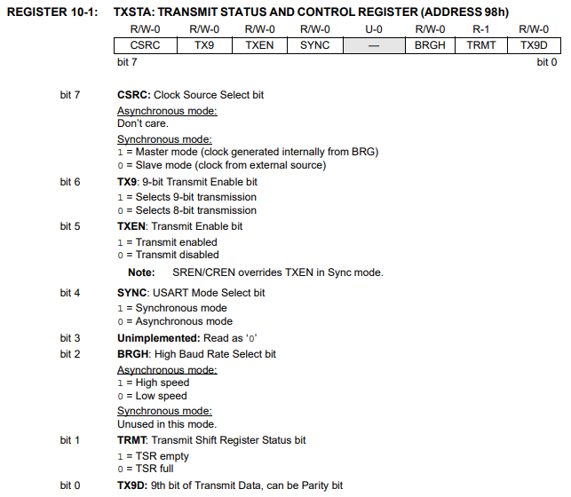
Tx registers

Slide 15
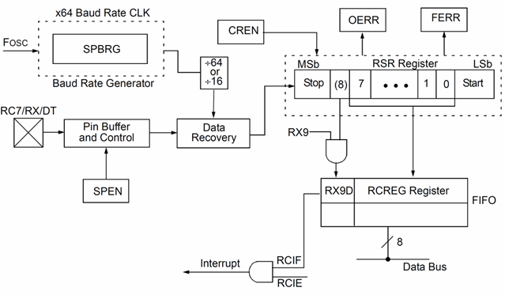
Rx block diagram

Slide 16
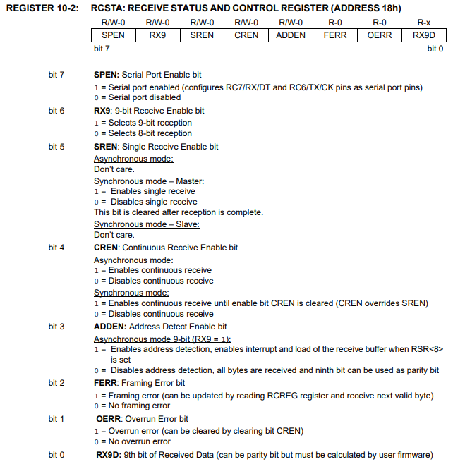
Rx registers

Slide 17
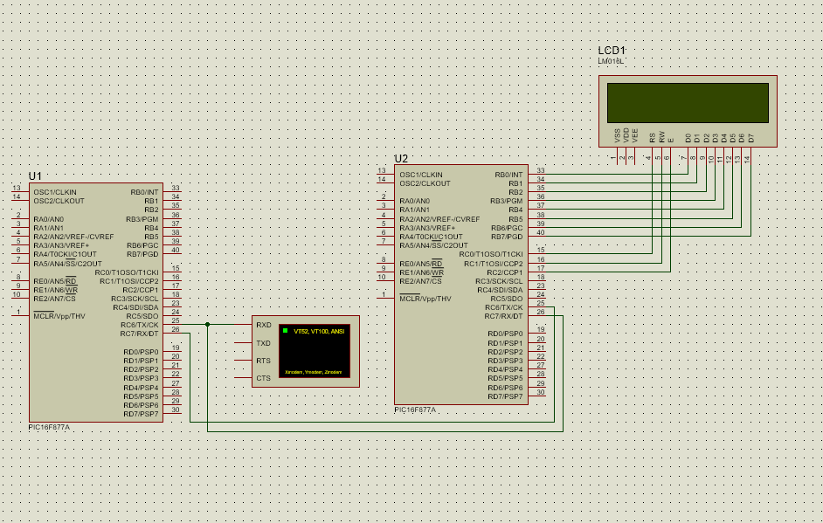
UART with PIC

Slide 18
Tx code
TRISC6=0; //tx output
TRISC7=1; //rx input
TXSTA=0x26; //tx register
RCSTA=0x80; //serail port enable
SPBRG=25; //baud rate generator

Slide 19
Rx code
TRISC6=0;
TRISC7=1;
TXSTA=0x26;
RCSTA=0x90; //Continuous Receive Enable bit
SPBRG=25;

Slide 20
Possible Errors
Software errors
Over run error -> if rx reg receive bytes repeat
Under run error ->tx buffer empty ,stop bit append if not append ,not idle high error occur
Framing error ->if rx reg receive bytes repeat or stop bit not occur
Parity error ->parity bits mismatch
Break condition ->if stop bit not occur for long time
Harware errors
Tx,rx,gng connection on both tx and rx devices and supply 5v
Baud rate 9600 std
Distance within 15m
Tx,rx pin output and input config and connection
Delay for each bit transmission should correct

Slide 21
Tasks
Mcu to mcu
Mcu to gsm/gprs (sim800a/c)
Mcu to rfid (em-18)
Mcu to gps(NEO-6M )
Mcu to Mcu to bluetooth(hc-05)
Mcu to wifi(esp8266)

