Slide 1
i2c

Slide 2
I2c (inter integrate circuit)
2 wire serial synchronous protocol(SDA,SCL)
Multi master multi slave connection
Max distance 10cm
Max speed 100khz-or 400khz
Software Address based protocol
127 slaves can connect in 7bit slave address ,1023 slaves can connect in 10 bit slave address
Half duplex data transmission only
2 operating mode
Master (tx /rx )
Slave (tx /rx )

Slide 3
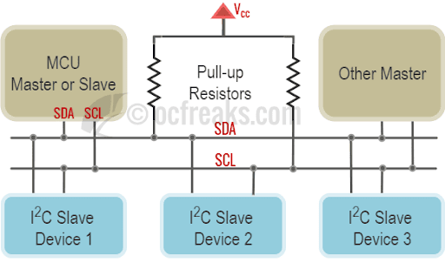
I2c bus
1k -400khz
2.2k (100-400khz)
4.7k -100khz

Slide 4
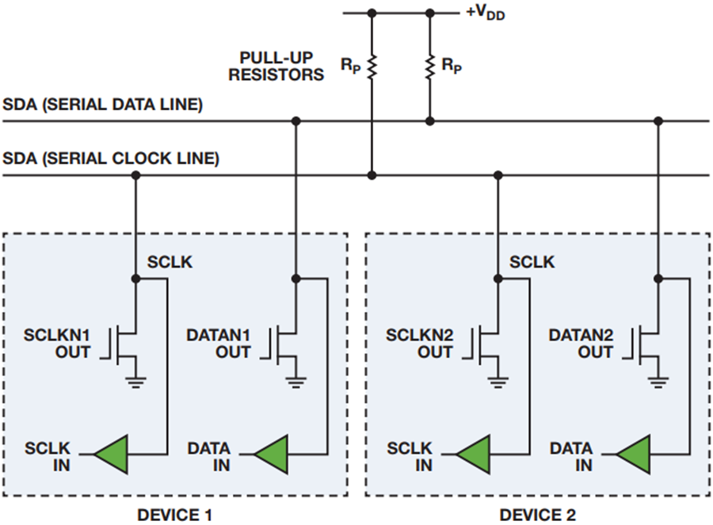
I2c bus circuit

Slide 5
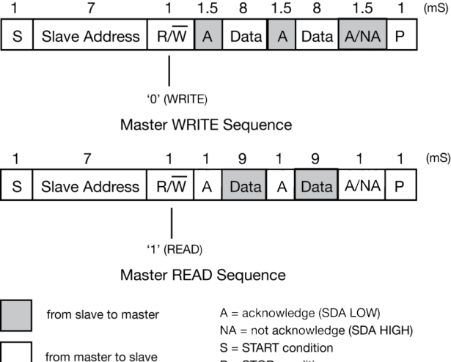
I2c frames format

Slide 6
I2c frames

Slide 7
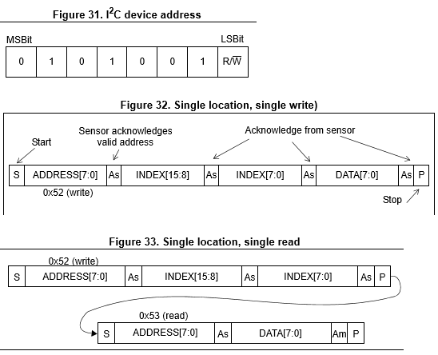
I2c frame

Slide 8
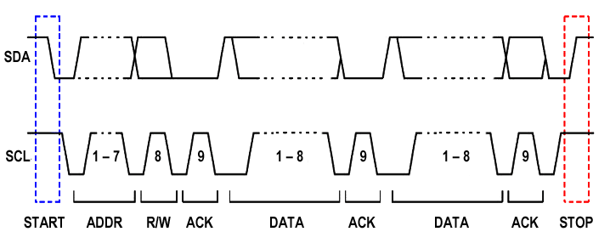
I2c frame clocks

Slide 9
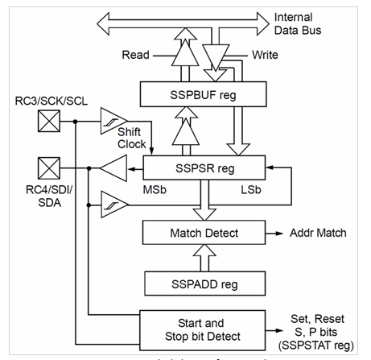
I2c block

Slide 10
I2c registers
SSPADD
clk generator for master,
slave address storage for slaves
SSPBUF
SSPCON →to choose modes
SSPCON2
SSPSTAT

Slide 11
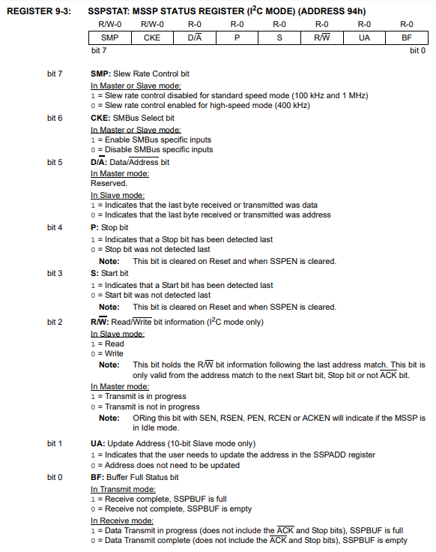
SSPSTAT

Slide 12
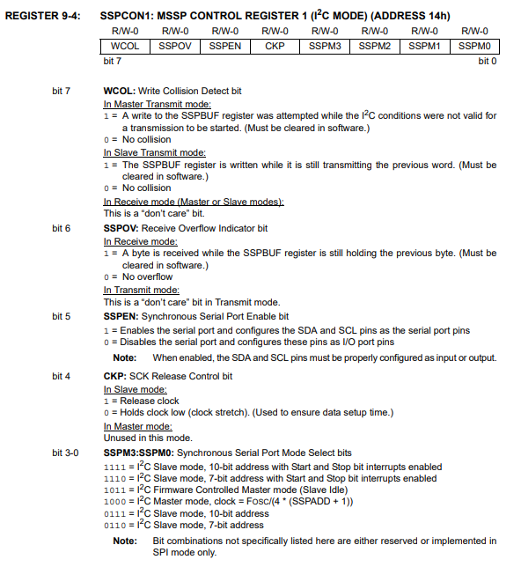
SSPCON

Slide 13
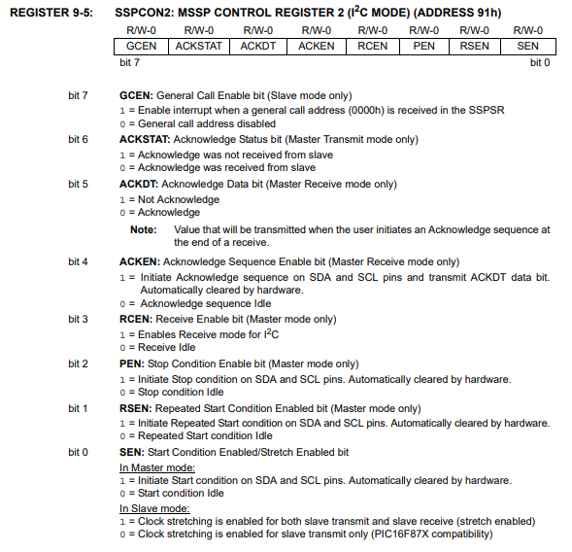
SSPCON2

Slide 14
I2c master clock calculation
Master clk= FOSC/(4*(SSPADD+1))
100khz =4mhz/(4*(SSPADD+1))
SSPADD=9;

Slide 15
I2c features
Clock stretch →slave hold master clock line by low ,on that stage master cant send data further
Arbitration→if two master send data at same time ,which master has more low bit in their data which will win arbitration .
Broadcast →all slave communicate with master at same time by general call bit which only applicable if slaves are controller and it should have general call bit on it register(SSPCON2)

Slide 16
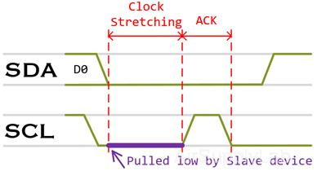
Clock stretch

Slide 17
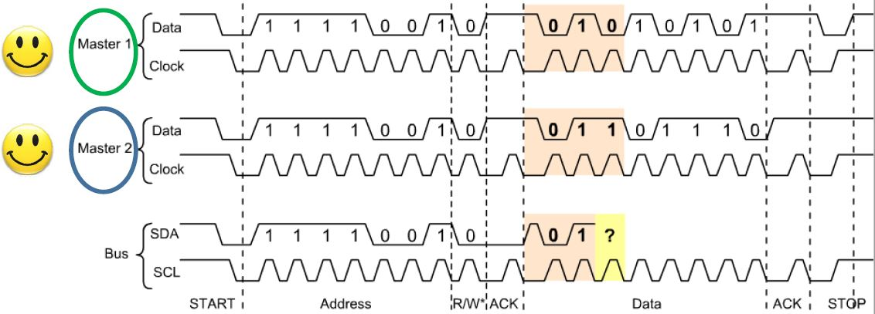
Arbitration

Slide 18
I2c program
Master
Master_init()
TRISC =sclk&sda input
SSPADD=9; //100khz
SSPCON=master mode
Master_read()
Master_write()
Slave
Slave_init()
TRISC = sclk&sda input
SSPADD=0x26; //pic mcu slave address
SSPCON=slave mode
Slave_read()
Slave_write()

Slide 19
I2c write and Read
Master_write()
I2c_start()
I2c_write(0x26) //slave address
I2c_write(‘a’)
I2c_write_string(“hello”)
I2c_stop()
Master_Read() from other device expect mcu
I2c_start()
I2c_write(0x26) //slave address
I2c_restart()
I2c_write(0x27) //slave address
data[index++]=I2c_read()
I2c_stop()
return data

Slide 20
Task
Pic to pic communication
Pic to eeprom 24c08
Pic to rtc ds1307
Pic to i2c display with pcf184

