Slide 1
7 segment

Slide 2
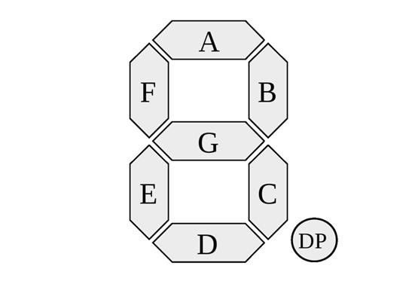
Pin discription

Slide 3
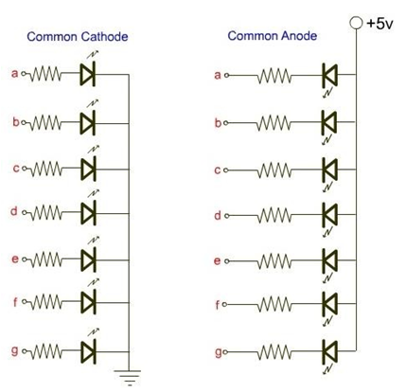
Types
Common cathode
Common anode

Slide 4
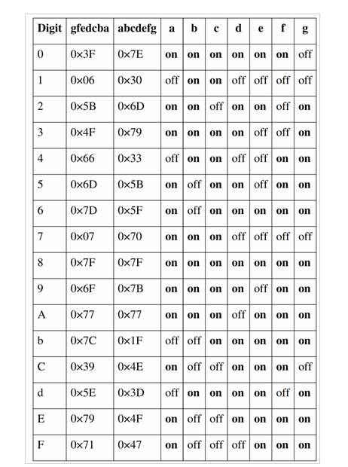
CC vs CA hex code

Slide 5
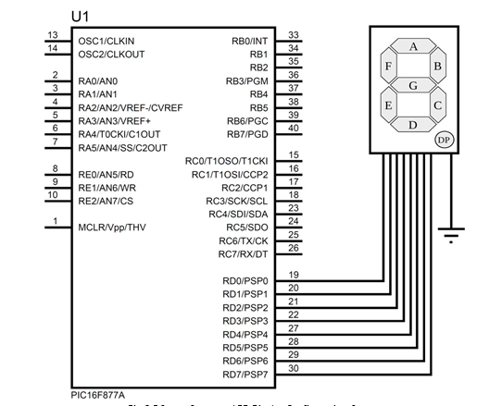
7 seg with MCU

Slide 6
Program
seven_seg_init()
Seven_seg_control()

Slide 7
tasks
Single seg – print 0 to 9
Double seg – print 0 to 99
Single seg with switch (inc and dec val )
Double seg with switch (inc val and dec val)
Mux control for double seg
Double seg with decoder ic 4511

