Slide 1
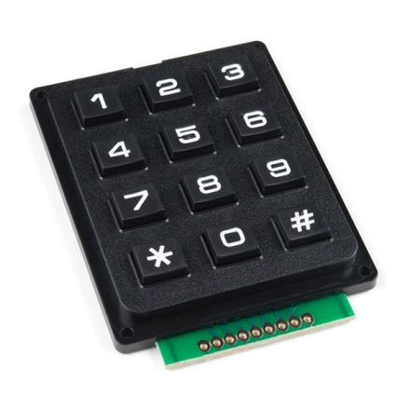
KEYPAD

Slide 2
Types & application
4*3
4*4
Keyboard
Atm
Elevators
mobiles

Slide 3
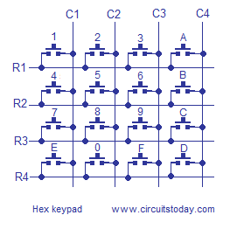
How works

Slide 4
Keypad with mcu

Slide 5
program
Init()
Keyscan()

Slide 6
tasks
Display numbers
Atm security

