Slide 1
timers

Slide 2
Timer vs delay

Slide 3
Timer vs cpu clock

Slide 4
Timer vs counter
Timer | Counter
Internal clock | External clock
Automatic counting to generate delay | Event generate counting from sensors or switches
Timer mode | Watchdog mode

Slide 5
Types
Timer0-8 bit (internal and external clk)
Timer1-16 bit (internal and external clk)
Timer2-8 bit (internal clk)

Slide 6
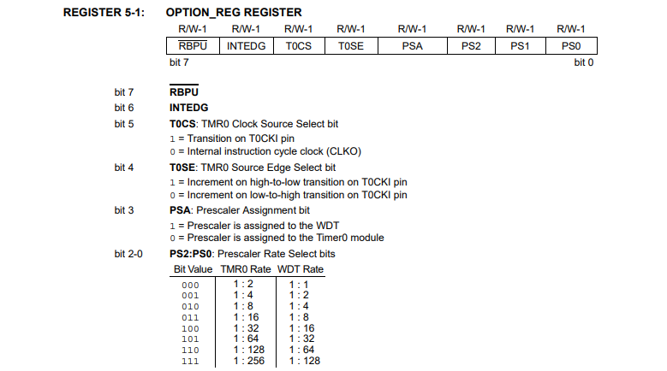
Registers
OPTION
TMR0

Slide 7
How Works

Slide 8
TIMER0 CALCULATION
COUNT = FOSC / (4 * PRE * (256 – TMR0 ) * FREQ )
FOSC = 4MHZ -20 MHZ
PRE = 2 TO 256 (TMR0 RATE)
1 TO 128 (WDT MODE)
TMR0 = 0 TO 255
FREQ = 1/T
1 SEC = 1HZ
1MS = 1000HZ

Slide 9
Program
Timer0_init(void)
Timer0_sec(unsigned int delay)
Timer0_ms(unsigned int delay)

Slide 10
Timer1
16BIT both timer and counter
More delay can generate than tmr0 and tmr1

Slide 11
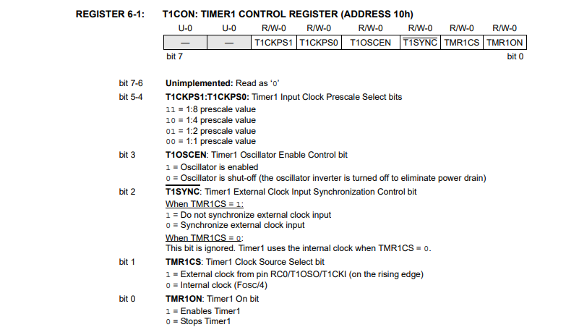
Timer1 registers
T1CON
TMR1L
TMR1H

Slide 12
HOW WORKS

Slide 13
TIMER1 CALCULATION
COUNT = FOSC / (4 * PRE * (65536 – TMR1 ) * FREQ )
FOSC = 4MHZ -20 MHZ
PRE = 1 TO 8
TMR1= 0 TO 65536
FREQ = 1/T
1 SEC = 1HZ
1MS = 1000HZ

Slide 14
Timer2
8BIT only timer
Used in PWM application
Compare to tmr1 and tmr0 accurate time

Slide 15
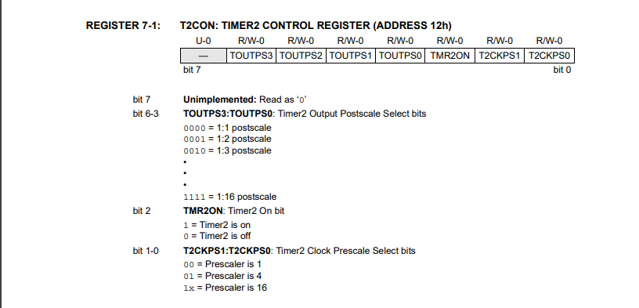
Timer2 registers
T2CON
TMR2
PR2

Slide 16
HOW WORKS

Slide 17
TIMER2 CALCULATION
COUNT = FOSC / (4 * PRE * (PR2 – TMR2 ) * FREQ )
FOSC = 4MHZ -20 MHZ
PRE = 1 TO 16
TMR0= 0 TO 255
PR2= 0 TO 255
FREQ = 1/T
1 SEC = 1HZ
1MS = 1000HZ

Slide 18
Tasks
1ms delay
1 sec delay
Dynamic time driver in ms and sec
1 min motor on and off using switch

