Slide 1
interrupts

Slide 2
Interrupts
Interrupt is signal to CPU which holds all tasks and execute interrupt tasks first then resume all others tasks
Interrupt used to do task automatically when event occurs into processor which saves processor monitoring time for task and reduces power consumption
It also used to implement schedulers in RTOS
Interrupt used in mobiles phones ->notifications,calls,volume keys,power keys

Slide 3
Interrupt vs polling
CPU has two types of process handlings methods using poling method and interrupt method
Interrupt -> CPU execute tasks when it occurs ->e.g notification,calls
Polling->CPU continuously monitor tasks to be executes which cause for power loss and cpu time ->e.g mobile data control,flash light control

Slide 4
Interrupt function vs normal function
Normal function | Interrupt function
Can call function | Cant call function
Can pass arguments to functions | Cant pass arguments to functions
Can return values from function | Cant return values from function
user can decide function name | user cant decide function name
No inbuild keywords for function | inbuild keywords for function -> interrupt
Normal function syntax: Return_type/data_type function_name(argument) | interrupt function syntax: void interrupt user_func_name(void)

Slide 5
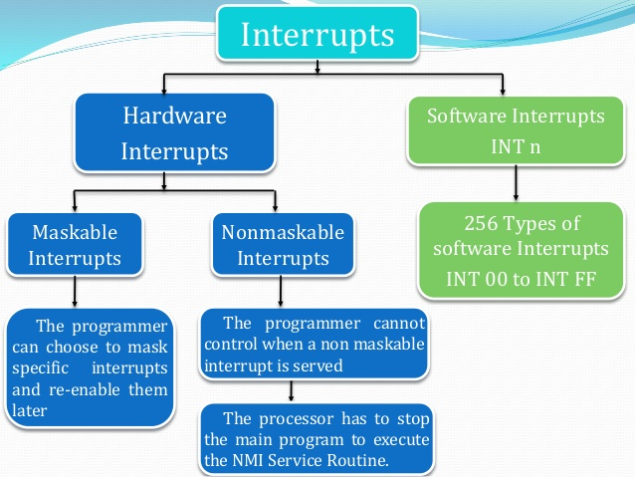
Types of interrupts

Slide 6
Types (continue ..)
Software interrupt / vector interrupt – CPU hold it address default to execute tasks e.g->notifications,calls
Hardware interrupt / non –vector interrupt ->CPU get address when event occurs to execute tasks ->volumn keys,power button
Maskable –> can change e.g volume keys
Non-maskable ->cant change ->e.g power shutdown key

Slide 7
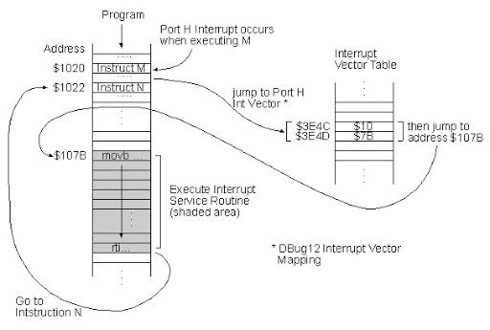
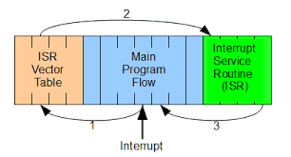
Interrupt works

Slide 8
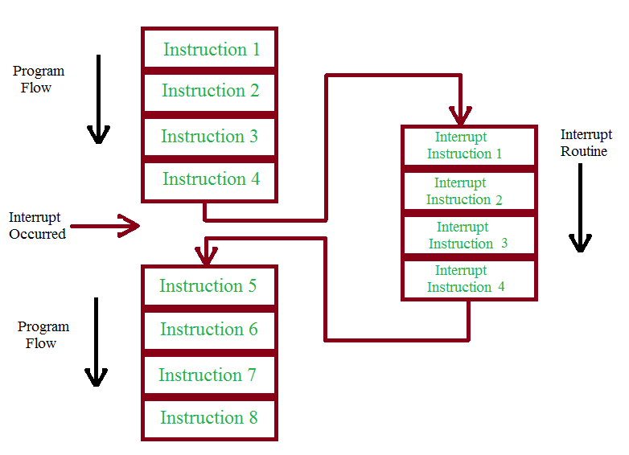
(continues...)

Slide 9
Interrupts in MCU
INT Pin Interrupt (external interrupt)
TMR0 Overflow Interrupt
PORTB Change Interrupt (pins RB7:RB4)
Comparator Change Interrupt
Parallel Slave Port Interrupt
USART Interrupts
Receive Interrupt
Transmit Interrupt
A/D Conversion Complete Interrupt
Data EEPROM Write Complete Interrupt
Timer1 Overflow Interrupt
Timer2 Overflow Interrupt
CCP Interrupt
SSP Interrupt

Slide 10
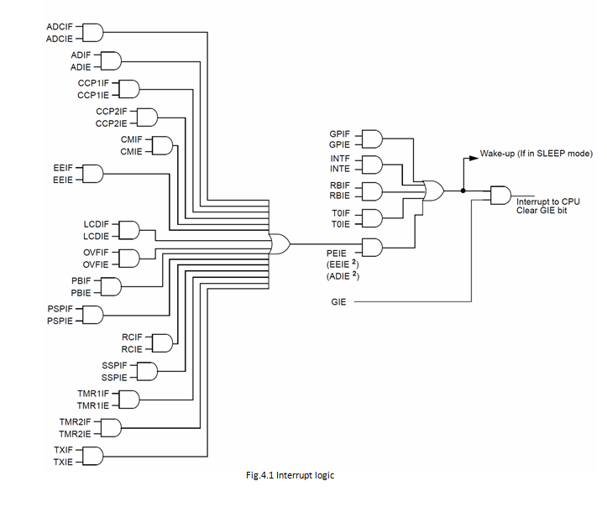
Interrupt tree

Slide 11
Registers
INTCON (byte access)
GIE
PEIE bit acess
TMR0IE

Slide 12
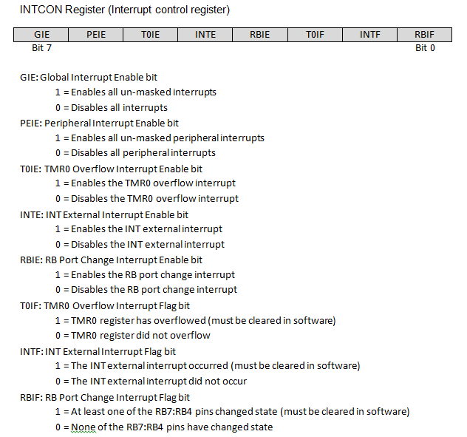
INTCON

Slide 13
Procedure for SW interrupt
Configure output register
TRIS
PORT
Configure timer0 register
OPTION
TMR0
Configure interrupt register
GIE
PEIE (IF ANY PERIPHERAL INTERRUPT)
TMR0IE/T0IE
Implement interrupt function with loop
Interrupt function syntax (void interrupt tmr(void)
Check and reset interrupt flag

Slide 14
Procedure for HW interrupt
Configure interrupt register
Implement interrupt function
Check and reset interrupt flag
Use external pull up switch to INT/RB0 pin (MCU connection)

Slide 15
Tasks
10ms timer interrupt(SW interrupt)
External interrupt using switch(HW interrupt)
10ms timer Interrupt with polling task
10ms and 100ms interrupt tasks(SW interrupt basic scheduling)

