Slide 1
CCP Module

Slide 2
CCP
It has 2 channels
C-capture -16bit, timer1 depend ,input
C-compare - 16bit, timer1 depend ,output
P-PWM - 10bit, timer2 depend ,output

Slide 3
Capture
Capture Registers
CCPxCON -control register
CCPRxL -storage register
CCPRxH -storage register
T1CON
TMR1L Dependent Registers
TMR1H
Each 8 bit registers
Input trigger
Applications –digital cameras, video recorder capture, stop watch

Slide 4
Capture Modes
Falling edge
Rising edge
4th rising edge
16th rising edge

Slide 5
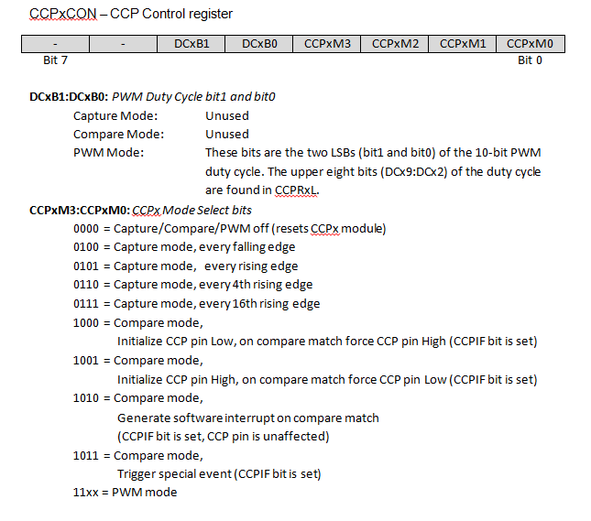
CCPxCON Register

Slide 6
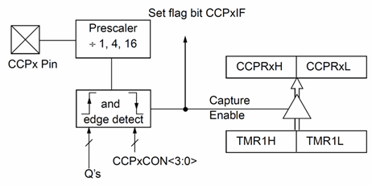
Capture functional diagram

Slide 7
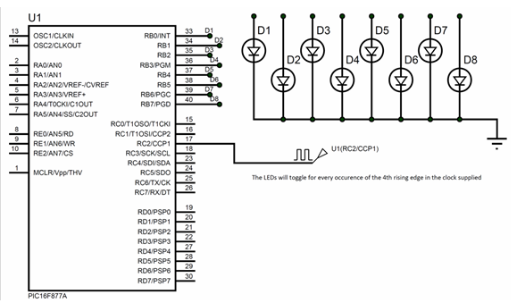
Capture MCU interface

Slide 8
Compare
Application –alarm clock
16bit Timer1 depend
Output trigger
Modes
Driven High
Driven Low
Unchanged effect
Special event trigger (ADC)

Slide 9
Registers
CCPxCON
CCPRxL
CCPRxH
T1CON
TMR1L Dependent Registers
TMR1H

Slide 10
CCPxCON Register

Slide 11
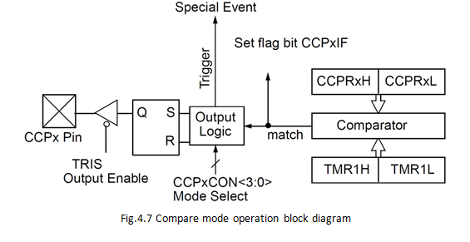
Compare functional diagram

Slide 12
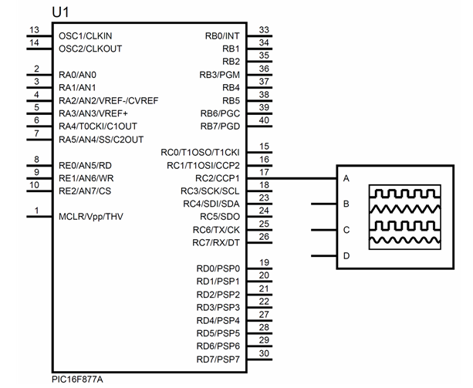
Compare interfacing with MCU

Slide 13
PWM
Application –brightness control, volume control, motor speed control ,acceleration
8bit Timer 2 depend
Duty cycle changes voltage effects using pulse width
Duty cycle % = ( duty on / ( duty on + duty off) ) * 100
Max frequency possibility is 19500hz (20khz) if FOSC=20Mhz

Slide 14
Registers
CCPxCON
CCPRxL
CCPRxH
T2CON
TMR2 dependent registers
PR2

Slide 15
CCPxCON Register

Slide 16
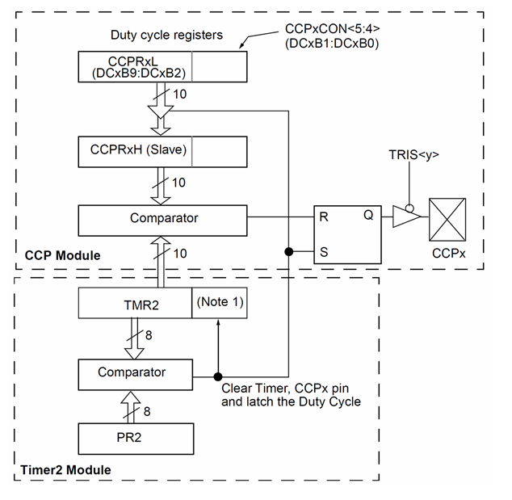
Functional diagram

Slide 17
calculation
PWM period = [(PR2) + 1] * 4 * TOSC * (TMR2 prescaler)
PWM frequency = 1/ PWM period
PWM frequency = FOSC / (4 * TMR2 pre * (PR2+1) ) (simplified form)
TOSC = 1/FOSC

Slide 18
PWM with MCU

Slide 19
Tasks
Capture value and display on lcd
Compare value and trigger led
Pwm for 25%,50%,75% duty cycles
Pwm for 1% to 100% using loops

