Slide 1
Communication protocols
SUMMARY

Slide 2
COMMUNICATION PROTOCOLS
wire
Serial(1bit)
Data transmission methods
Simplex-tx or rx
Half duplex-tx & rx
Full duplex –tx & rx simultaneous
Asynchronous
(no clk)
UART
CAN
Synchronous(clk)
USART
SPI
I2C

Slide 3
GENERAL TECH DIFFERENCE

Slide 4
UART
Universal asynchronous receiver and transmitter
2 wire Serial asynchronous protocol
Full duplex/half duplex
Max distance 15m(rs232)
Baud rate 9600bit/s
Application ->gsm/bt/wifi/rfid

Slide 5
SPI(serial pheripheral interface)
It is 4 wire serial synchronous protocol(SCL,MISO,MOSI,SS)
Single master multi slave
Max slave depend MCU I/O pins depend
Slave active by SS pin low ,hardware wiring slaves
Hardware address based
Full duplex / Hal duplex data transmission
4 types of communication clock configuration/modes
Max distance 15cm
Max speed 5mhz i.e fosc/4

Slide 6
I2c (inter integrate circuit)
2 wire serial synchronous protocol(SDA,SCL)
Multi master multi slave connection
Max distance 10cm
Max speed 100khz-or 400khz
Software Address based protocol
127 slaves can connect in 7bit slave address ,1023 slaves can connect in 10 bit slave address
Half duplex data transmission only
2 operating mode
Master (tx /rx )
Slave (tx /rx )

Slide 7
CAN(CONTROL AREA NETWORK
developed by bosch in 1980 for automotive industry
2 wire serial asynchronous protocol(CAN H,CAN L)
Multi master protocol
Max distance 40m if 1MBPS , 250m if 250kbps
Max speed -1mbps
Message based protocol
half duplex data transmission
Sent data in differential signal
Upto 127 nodes can connect on can bus
Can bus has hot-plugging feature (i.e) we can connect node while can bus in working

Slide 8
continue
high speed, high noise immunity,error detection
Auto retransmission,error confinement
No host and target communication (i.e) no source and destination address
Broadcast type communication
It reduce connection complicity

Slide 9
CONNECTIONS DIFFERENCES

Slide 10
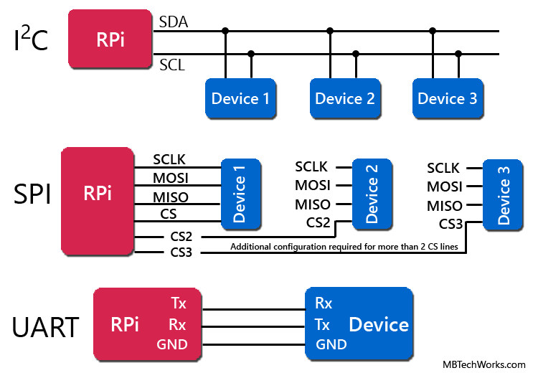
connections

Slide 11
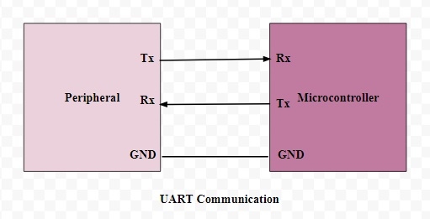
MCU to MCU/other UART Device interface
RC7
RC6
Pin details
RC6/TX -output
RC7/RX -input

Slide 12
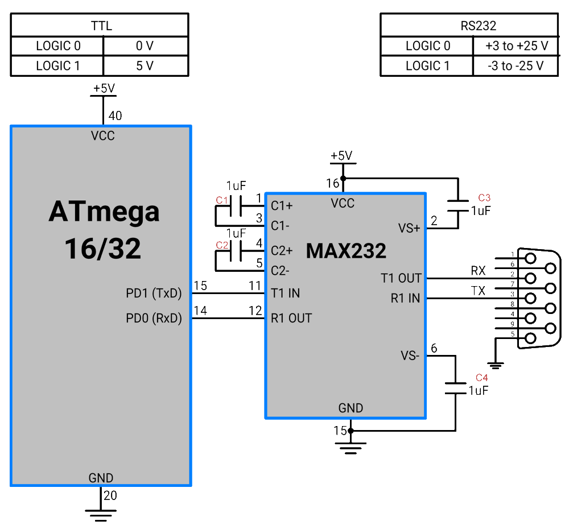
MCU with PC interface

Slide 13
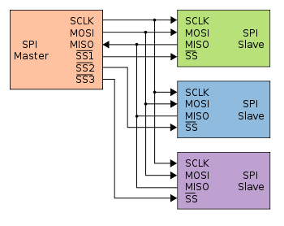
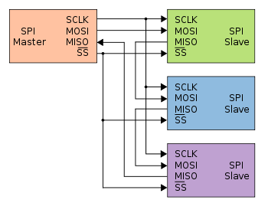
SPI connection
*Normal spi connection using separate SS pins
*Daisy chain connection by same SS pin

Slide 14
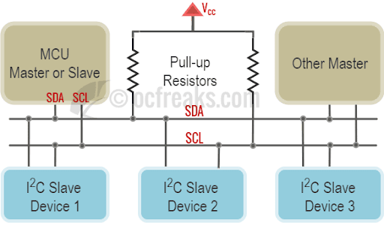
I2c bus
1k -400khz
2.2k (100-400khz)
4.7k -100khz

Slide 15
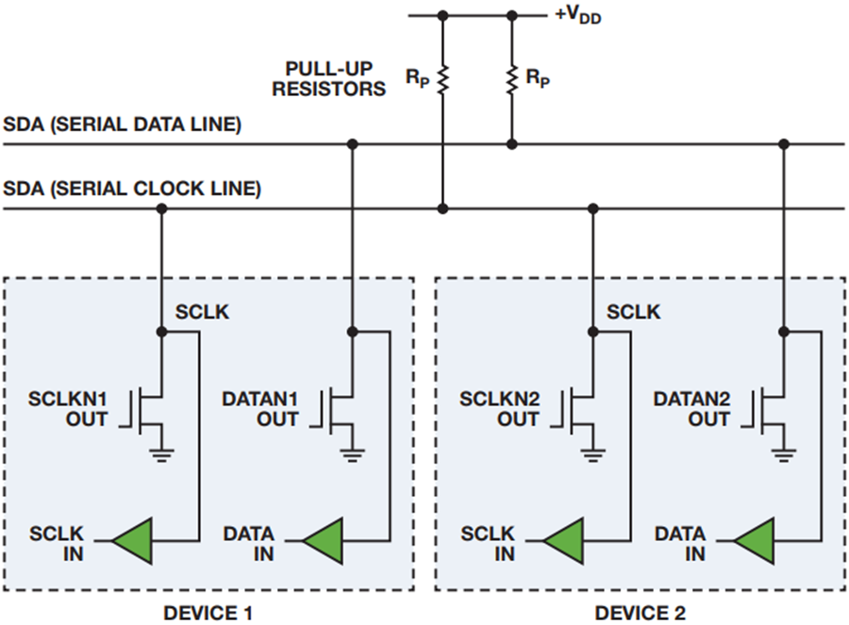
I2c bus circuit

Slide 16
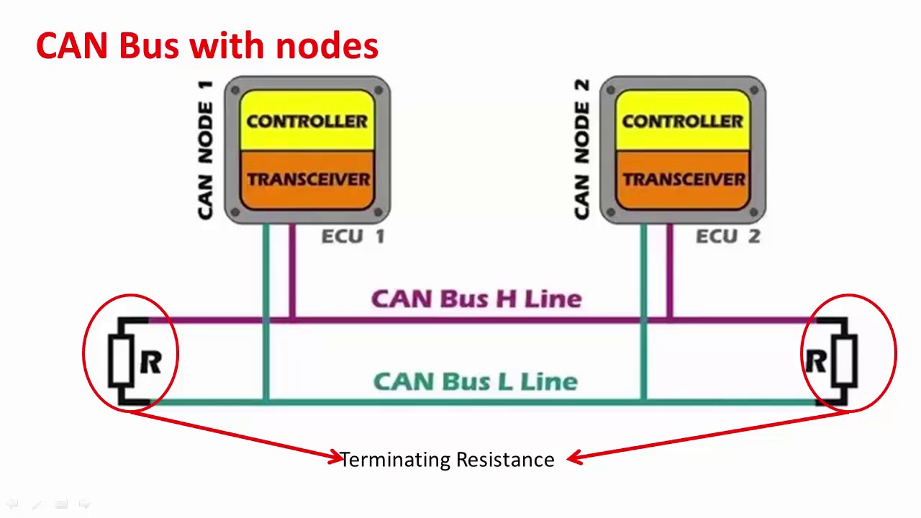
CAN BUS

Slide 17
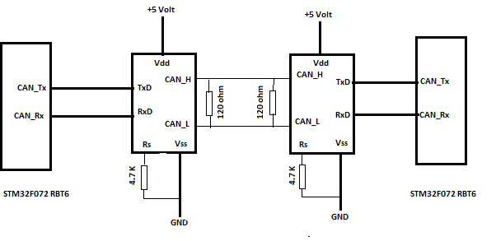

Slide 18
PROTOCOL FRAMAES

Slide 19
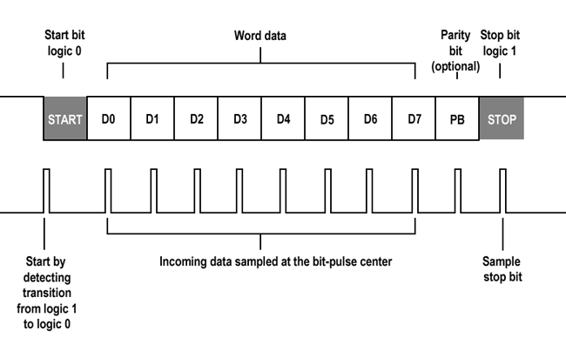
UART frame

Slide 20
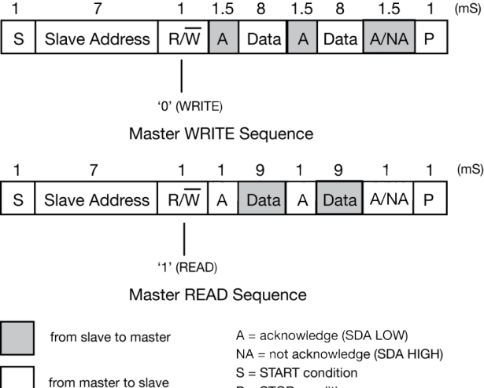
I2c frames format

Slide 21
I2c frames

Slide 22
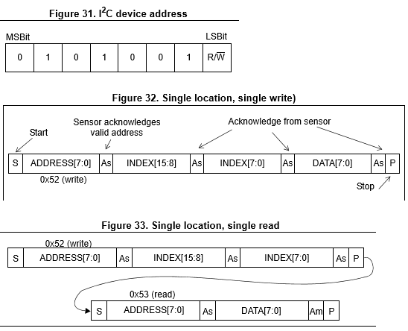
I2c frame

Slide 23
Can frames
Data frame
Remote frame
Error frame
Overload frame

Slide 24
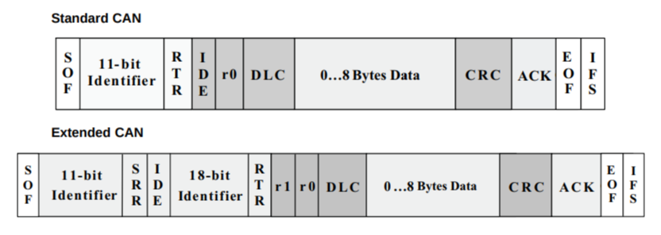
DATA FRAME-Standard can & Extended can

Slide 25
TIMING DIAGRAMS and CLOCKS

Slide 26
UART frame

Slide 27
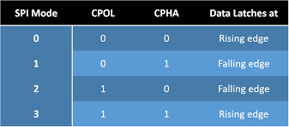
SPI clock modes

Slide 28
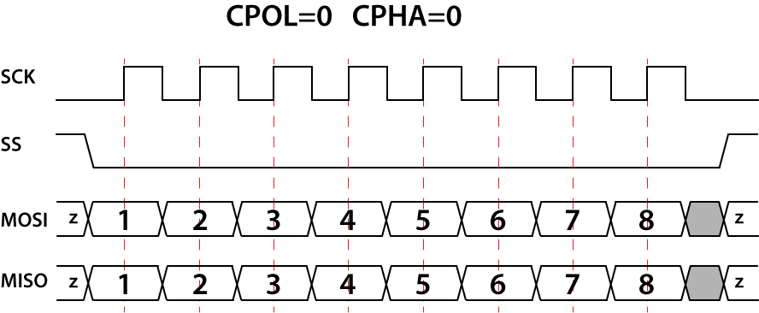
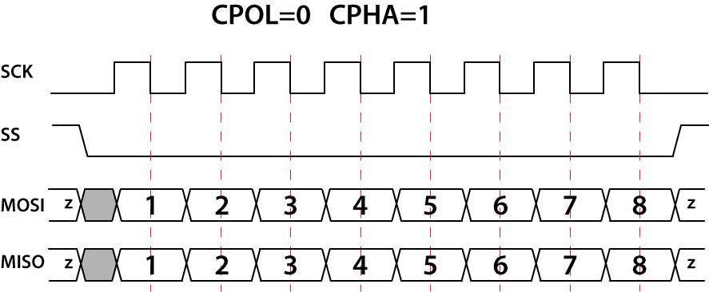
SPI timing or clock diagram

Slide 29


Continue..

Slide 30
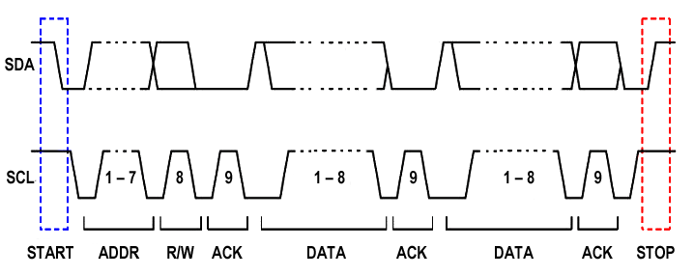
I2c frame clocks

Slide 31
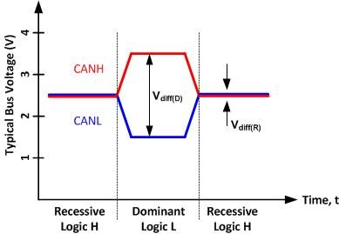
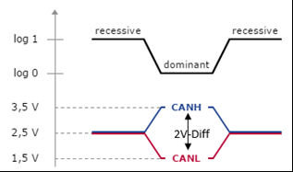
Can signalling

Slide 32
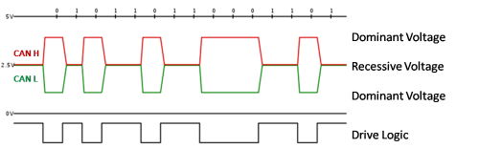
can-bus volt levels or timing diagram

Slide 33
 | UART | SPI | I2C | CAN
DEVELOPERS | NXP | MOTOROLA | NXP | BOSCH
TX TYPE | ASYN | SYN | SYN | ASYN
WIRE | TX,RX (2) | SCLK,MISO,MOSI,SS (4) | SCL,SDA(2) | CAN H ,CAN L(2)
TX SIGNAL | DIGITAL | DIGITAL | DIGITAL | DIFFERENTIAL
MODE | TX-RX | SINGLE MASTER MULTI SLAVE | MULTI MASTER MULTI SLAVE | MULTI MASTER
TRANSFER TYPE | FULL DUPLEX | FULL DUPLEX | HALF DUPLEX | HALF DUPLEX
DISTANCE | 15M(rs232) | 15CM | 10CM | 40M@1mbps
SPEED/TRANFER RATE | 9600BIT/SEC 115200bit/sec | MAX 10MBPS | 100KHZ/400KHZ | 1MBPS Can fd-2mbps
ARBITRATION | NO | NO | YES | YES
CLOCK STRETCH | - | - | YES | -
ADDRESS TYPE | - | HARDWARE | SOFTWARE | MESSSAGE

Slide 34
 | UART | SPI | I2C | CAN
RESISTOR TYPE | - | - | 4.7K@100KHZ | 120 OHM
NO.OF.DEVICE | 1 | DEPENDS MCU | 127@7BIT ADDR, 1023@ 10BIT ADDR | UPTO 127 nodes
HOT PLUG | - | - | - | YES
BROADCAST | - | - | YES | YES
APPLICATION | BT,WIFI,GSM AND CORE(cpu) | DISPLAY,SD module AND CORE(cpu) | MULT CORE(dual core,quad core) AND DEVICE(sensors,display) | VEHICLES ECU CONECTION,MULTI CORES(ECUs)

