Slide 1

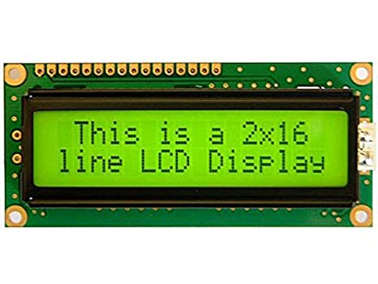
Lcd –Liquid crystal display
azetech.in

Slide 2
Lcd types
16*2
16*4
20*4
Graphical display
azetech.in

Slide 3
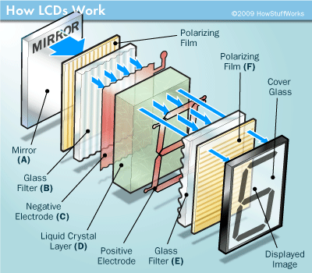
How lcd works
azetech.in

Slide 4
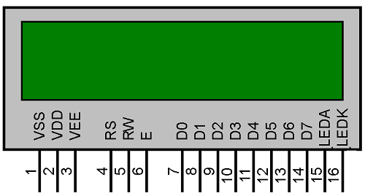
Lcd pin discriptions
azetech.in

Slide 5
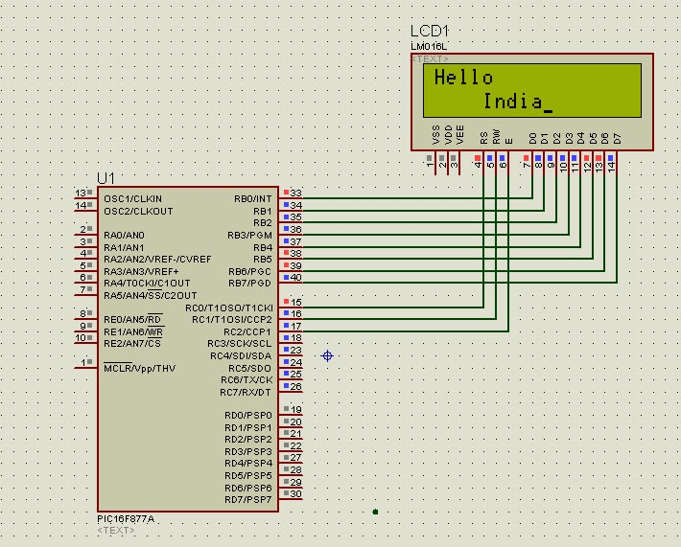
Lcd interface with pic16f877a
azetech.in

Slide 6
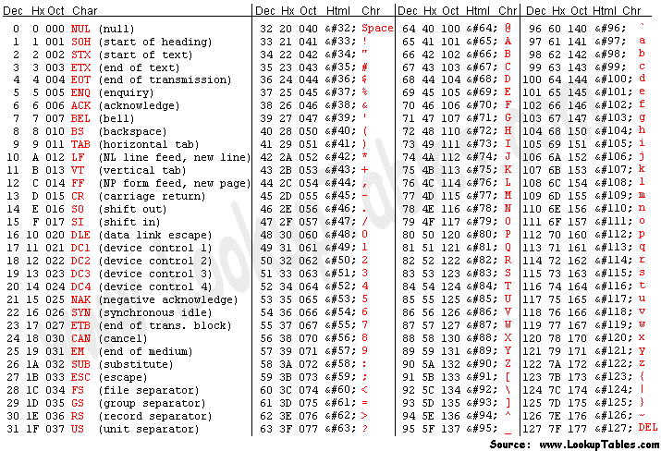
ASCII table
azetech.in

Slide 7
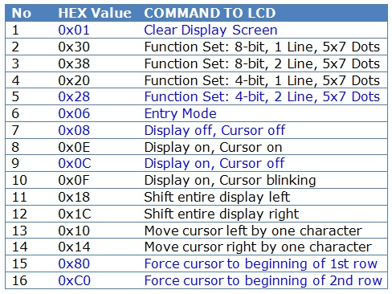
Lcd basic commands
azetech.in

Slide 8
Program
Main()
Lcd_init()
Lcd_cmd()
Lcd_write()
Lcd_write_string()
azetech.in

Slide 9
Tasks
Print ‘a’ and ‘1’
Print “hello world”
Print integer numbers 12345
Print room temperature 32.20c
azetech.in

