Slide 1
SPI

Slide 2
SPI(serial pheripheral interface)
It is 4 wire serial synchronous protocol(SCL,MISO,MOSI,SS)
Single master multi slave
Max slave depend MCU I/O pins depend
Slave active by SS pin low ,hardware wiring slaves
Hardware address based
Full duplex / Hal duplex data transmission
4 types of communication clock configuration/modes
Max distance 15cm
Max speed 5mhz i.e fosc/4

Slide 3
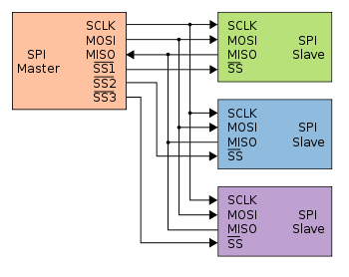
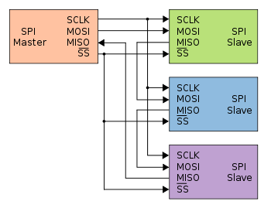
SPI connection
*Normal spi connection using separate SS pins
*Daisy chain connection by same SS pin

Slide 4
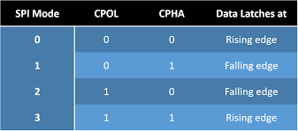
SPI clock modes

Slide 5
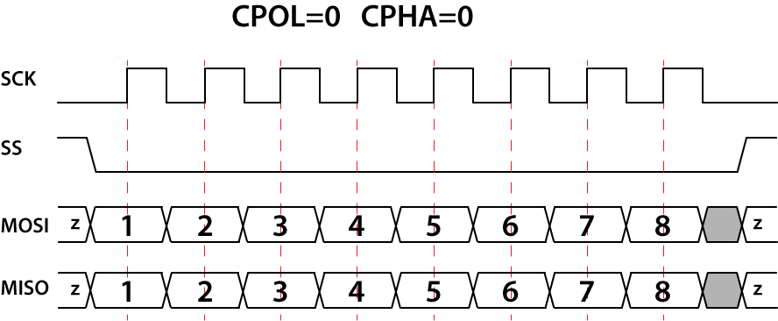
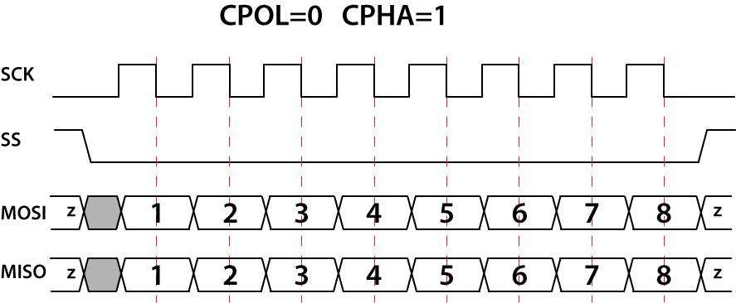
SPI timing or clock diagram

Slide 6


Continue..

Slide 7
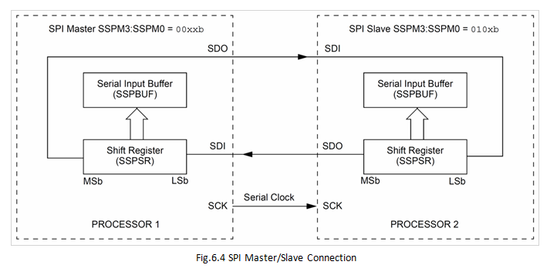
How works

Slide 8
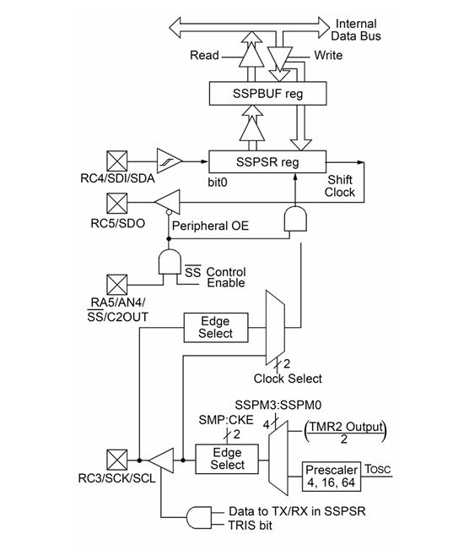
Block diagram

Slide 9
Registers
SSPCON -control reg
SSPSTAT -status reg
SSPBUF -storage reg

Slide 10
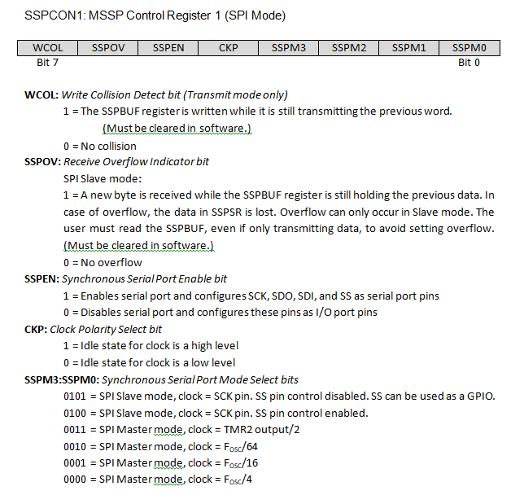
SSPCON1

Slide 11
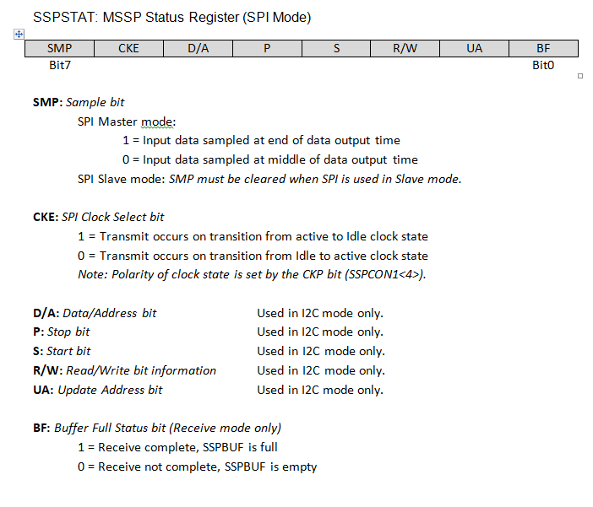
SSPSTAT

Slide 12
Program for master
Master_init()
Master_write()
Master_read()

Slide 13
Program for slave
slave_init()
slave_write()
slave_read()

Slide 14
Tasks
Mcu to mcu
Mcu to mcp4922
Mcu to mcp3008
Mcu to nrf24101

