Slide 1
OWNLY · INDEPENDENT PRODUCT CASE STUDY
“
…it showed that the order is delivered and gave me a random number.
Ownly customer · Play Store review · 1★
What 1,481 reviews of Ownly's three apps say, and what I'd do first
Mahesh Kontham · APM candidate
Notes:
SCRIPT (0:00–0:12)
A real Ownly review: “It showed that the order is delivered, and gave me a random number.” I read 1,481 reviews across Ownly’s three apps to find out why.
Delivery: Read the quote slowly. Pause after “random number”.

Slide 2
1 in 3 unhappy customers paid and got nothing
31.6%
Cancelled after payment
61 reviews · avg 1.00★
“deducted the amount. After 1hour… they are asking me to cancel”
of 493 negative (1–2★) customer reviews describe a paid order with no food
No captain came
‘rider’ theme in 23% of negatives
“no rider was assigned even after waiting”
Average rating when it happens: 1.05★
Marked ‘Delivered’, no food
104 reviews · avg 1.07★
“I didn't get my order. but it is showing delivered”
Source: 1,000 Google Play reviews of the Ownly customer app, 27 Sep–4 Oct 2026. Shares are of reviews, not of orders.
Notes:
SCRIPT (0:12–0:24)
One in three negative reviews says the same thing: I paid and got nothing. Cancelled after payment, no captain, or marked delivered without a handover. Those reviews average one star.
Delivery: Stress “paid and got nothing”.

Slide 3
Price is winning. One failed order undoes it
WHAT'S WORKING
WHAT BREAKS IT
43%
Thin margin
With zero commission*, a refund, support time and a wasted captain trip can wipe out the margin of many good orders
of 4–5★ reviews that give a reason praise the price, no platform fee or no hidden charges
First orders at stake
Since July 2026* Rapido's app sends new users to Ownly, so a failed first order wastes that distribution
Even 42 angry 1–2★ reviewers still praise the price
Public damage
74 negative reviews use ‘fraud’ or ‘scam’ words after losing money
*Press-reported, not verified by me. Review figures: Ownly customer app, 27 Sep–4 Oct 2026.
Notes:
SCRIPT (0:24–0:34)
Price isn’t the problem. Of happy reviews that give a reason, forty-three percent praise the price. But with zero commission, one failed order wipes out the margin of many good ones.
Delivery: Warm tone: this is a compliment first.

Slide 4
Three apps, one story: the handoffs break
CUSTOMER APP
RESTAURANT APP
CAPTAIN APP
1,000 reviews
105 reviews
376 reviews
“they accepted order first and deducted the amount… asking me to cancel the order”
“notification of order is not working… order getting cancelled without our knowledge”
“not getting order 12 hrs” — while customers wait for a captain
Nothing in the order flow has to prove a handoff happened,
and nothing refunds the customer automatically when one fails.
Notes:
SCRIPT (0:34–0:46)
Your restaurant and captain apps tell the same story: alerts that don’t ring, captains waiting for orders while customers wait for captains. Nothing has to prove a handoff happened.
Delivery: This is the line they won’t have heard. Slow down.

Slide 5
Measure first, then build the Ownly Promise
1
Measure
2
Build
3
Prove
2 weeks
Ownly Promise v1
4-week zone pilot
How many orders really fail? Do those customers come back? If it's small, stop here.
A 4-digit delivery code at handover, plus automatic refunds: cancelled after payment, no captain in 20 min, ‘not received’.
Scale only if ‘I never got my order’ claims fall and captains keep accepting food orders.
No feature is built before step 1. If failures are rare and customers still return, the team moves to a different problem.
Notes:
SCRIPT (0:46–0:58)
So first, I’d spend two weeks measuring the real failure rate. If it’s big enough: a four-digit delivery code at handover, plus automatic refunds when an order fails.
Delivery: “Measure first” signals judgement. Don’t rush it.

Slide 6
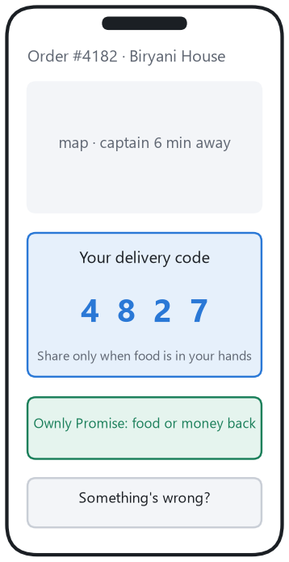
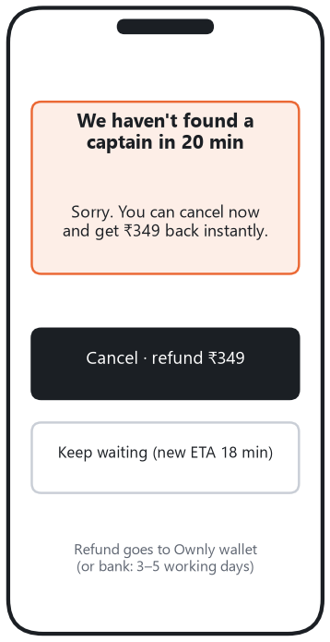
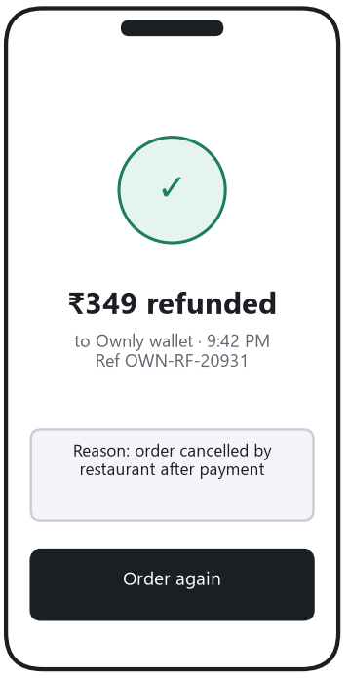
Food, or your money back in minutes
HOW WE'LL KNOW
−40%
‘not received’ claims per 1,000 orders: the bar to scale
North Star
weekly orders where the promise was kept
Guardrail
captains keep accepting food orders
Code at the door
No captain? Your choice
Refund as a fact
Targets, not results. Nothing has been built or tested.
Notes:
SCRIPT (0:58–1:06)
Then a four-week pilot, judged on one number: fewer “I never got my order” claims, without captains turning away food orders.
Delivery: Point at the −40% on screen.

Slide 7
I'd like to build this with you as an APM at Ownly
43-page case study
Evidence, root cause, competing explanations, MVP, PRD, experiment and risks
One-page summary
The whole argument in two minutes of reading
Honest boundary
Built only on public data. The first thing I'd do is measure what I couldn't see
Can we talk for 15 minutes?
Mahesh Kontham
Notes:
SCRIPT (1:06–1:19)
It’s built on public data only, and the full case study is attached. I’d love to build this with you as an APM at Ownly. Can we talk for fifteen minutes?
Delivery: Look into the camera for the ask. Smile.

