Slide 1
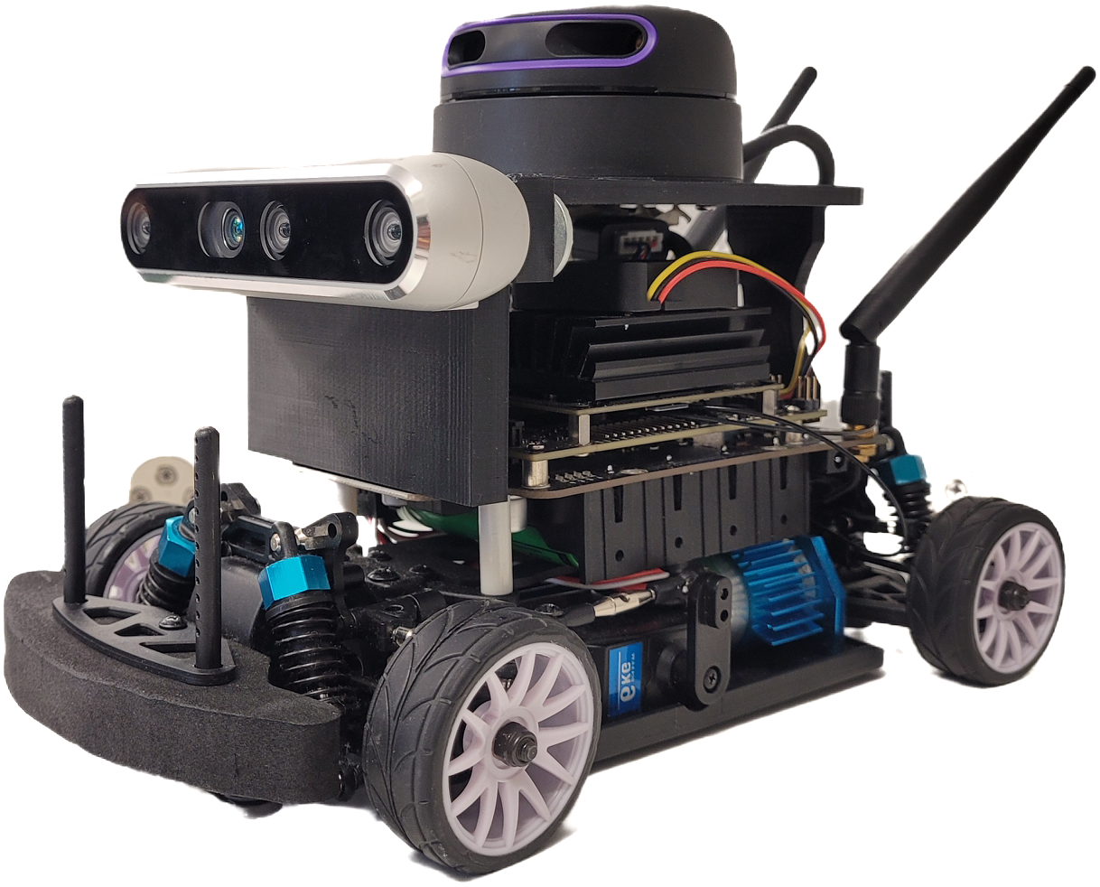
Autonomous indoor vehicles using
Deep Reinforcement Learning
Overview
This project focuses on developing a custom-built mobile bot capable of navigating within a building while avoiding obstacles. The bot's driving model is trained using Reinforcement Learning, specifically the Double Deep Q Network (DDQN), within a custom simulator built using Python.
Hardware Setup
The hardware setup leverages the Nvidia Jet Racer Pro as the foundation for the driving platform. A Rplidar A3 360-degree sensor from Slamtec is securely mounted on the bot using a 3D-printed mount. Additionally, obstacle detection is facilitated by the Intel D435i depth camera. The system is powered by a Linux operating system running the Robot Operating System (ROS) as middleware.
Simulator
A Python-based simulator has been developed using the Pygame library, featuring the floorplan of the university building. This simulator accurately represents the environment where the bot will operate. The bot's scaled geometry enables it to navigate within this simulated environment, with simulated Lidar sensor data generated based on the bot's position and orientation.
DDQN
The bot's driving policy is established through training within the custom-designed simulator using a Double Deep Q Learning setup (DDQN). Operating within the framework of a Markov Decision Process, the policy predicts the optimal action based on Lidar observations and executes it accordingly. Hardware calibration ensures smooth execution of these actions.
Skills Implemented and Acquired
1. Reinforcement Learning (Double Deep Q Network - DDQN)
2. Hardware (Nvidia Jet Racer Pro, Lidar, Depth camera)
3. Simulator Development (Python, Pygame library)
4. Policy Training (TensorFlow, Python, Linux OS, ROS)
5. Calibration procedures
Gallery

Slide 2
Simulation Environments &
AI-based Autonomous Driving Solutions
- a Comparative Evaluation
Overview
This project, presented as a master's thesis at THWS, delves into the evaluation and enhancement of autonomous vehicle simulators. Through meticulous research, it offers a comprehensive approach aimed at refining the simulation experience. The work comprises two primary components: the development of a prototype simulator propelled by a deep generative model and the introduction of a systematic method for comparing autonomous vehicle simulators.
Generative Model-Based Simulator
This segment of the project focuses on the creation of a prototype simulator driven by a Generative Adversarial Network (GAN). The objective is to simulate the transition of sensory data to subsequent states based on executed actions, generating a diverse range of scenarios. A conditional GAN is meticulously designed and trained to generate 2D Lidar data for each time step, given specific actions.
Comparative Study
The project conducts a comprehensive examination of various features that distinguish simulators, leading to the development of a systematic comparison system. A total of 73 parameters spanning six categories — Sensor, Actor, Environment, Ego vehicle, Algorithm, and Framework — are identified. Two sets of scores, one for simulators and another reflecting user preferences, are utilized to capture the simulator's capabilities and the user's interests, culminating in a final score.
Skills learned
Generative AI
Autonomous vehicle simulator
Comparative methods
Gallery

Slide 3
Buisness Simulation -
Mobility as a Service
Overview:
Our simulation software replicates the business model of "Vaegan," a Mobility as a Service (MaaS) startup located in Tamil Nadu, India. Vaegan specializes in providing rental electric scooters for public commutation, operating renting stations strategically positioned throughout the city. Our simulator accurately models the dynamics of Vaegan's business over a specified time period, allowing for insightful observations regarding its operational and financial performance.
Buisness Idea
The company operates a fleet of electric scooters stationed at multiple locations throughout Coimbatore, India. Customers have the flexibility to rent scooters from any station and drop them off at a station near their desired destination. To maintain uninterrupted service, a dedicated team of drivers, known as Wingmen, manages vehicle distribution between stations based on demand and vehicle availability.
Simulator
The simulator serves as a tool to monitor and optimize the vehicle shuffling process conducted by the Wingmen, aiming to minimize effort while maximizing service availability. It also tracks costs associated with the scooters and operational expenses, including scooter charging times, overall expenditure, and income for the entire business. To ensure accuracy, the simulation integrates real-time data from reliable sources such as distances and travel times between stations, service traffic power consumption by the vehicles, and station locations.
Purpose
The simulator is utilized to optimize the operations of the Wingman team, ensuring efficient reshuffling of scooters.
It identifies excess expenditures associated with the business, aiding in cost reduction strategies.
The simulator determines optimal station locations and the required number of vehicles for each station. This minimizes scooter idle time and ensures service availability.
Skills Learned
1. Business Intelligence (Data Analysis, Data Visualization, Business Acumen)
2. Python programming (OOPS, Matplotlib, Numpy)
3. Google Maps API (distance matrix, travel time)
4. Strategy (Location Planning, Traffic Regulation)

Slide 4
ROS2Mongo
ROS2MongoDB
Overview
The ROS2MongoDB package is designed for recording sensors and actuators data generated during scientific experiments with robots. It stores this data in a structured manner within a database, facilitating further analysis for research purposes.
Usage
The ROS2MongoDB package is used to log data from ROS topics published by sensors and actuators on a robot during its operation or experiments. It stores this data in a NoSQL database (MongoDB) and high-dimensional data (e.g., images) in hierarchical structured files (HDF5). Users can customize several functionalities based on their specific use case, including data compression and specifying the data of interest.
Database Information
This package is designed to work with MongoDB version 7.0.1. You can find installation instructions for MongoDB here. Each significant experiment is stored as a database, and each trial is stored as a collection. Local paths for high-dimensional data (HDF5 database name) and global paths (path to HDF5 files) are stored as separate features. Data from different sources is synchronized with a common reference time (time of generation). The latest data generated within the specified time window (default: 10 nanoseconds) is recorded, while the rest is ignored.
HDF5 Structure
HDF5 stores high-dimensional data in either compressed or non-compressed formats. Users can configure the different compression and pre processing technique tailored to their use case at heavy_data_call_back() method in datalogger.py .A new file is created for each type of experiment. Data from different trials of the same experiment is stored in different Level 1 groups, and different sensors/topics are distinguished by distinct Level 2 sub-groups.
Skills Learned
Bash Scripting
MongoDB
Query Language
ROS
HDF5 datatype

Slide 5
Autonomous shuttle service
Overview
This project, conducted as a bachelor's thesis at Anna University, establishes an ecosystem for an autonomous shuttle service within the university campus. The system comprises a retrofitted electric scooter equipped with sensors and actuators, alongside a software interface for service utilization. The vehicle's hardware setup enables autonomous navigation by following a white line laid on the road. This functionality allows the vehicle to autonomously transport users to their desired destinations upon activation.
Hardware Setup:
Drive System: The chassis of the TVS Scooty ES serves as the base frame, modified to accommodate the drive system. A Hub motor, powered by Lithium-Ion batteries, is integrated into the design. Custom hardware components are designed and installed to facilitate autonomous driving.
Autonomous System: The Line Following System is Guided primarily by data from the Pixy image sensor, the line following system directs the vehicle. The sensor data is processed by the onboard processor, which then controls the steering system via a gear mechanism. The steering shaft is driven by a stepper motor, while braking is achieved through servo motor actuation of the brake shoe. Speed control is managed by a potentiometer regulating power to the motor.
Software:
User login authentication is performed using barcode, with login data stored in an SQL database. A dedicated user interface webpage has been developed to streamline the login process and manage user data. The webpage is hosted locally within the university network. A Bluetooth cordless barcode scanner is employed for user barcode scanning, while a parking gate is installed to ensure proper vehicle parking.
Achievements
This project secured first place in the "Digital Bharat" category at the International Science Festival 2021, organized by the Ministry of Science and Technology.
Skills Acquired
Design (Solidworks, Ansys)
Embedded System (Servo and Stepper Motors, image sensor, processors)
Electrical System designing (Battery Management System)
Web page development (HTML, CSS, JavaScript)
Query Language (SQL Database)
Gallery

Slide 6
SAE BAJA 2020
Overview
The SAE BAJA is an international off-road racing event organized by the Society of Automotive Engineers. Our team, comprising 23 members, participated in this event, where we designed, constructed, and tested an off-road car to compete with over 200 teams from around the world. The competition included various racing formats such as maneuverability, suspension tests, brake tests, and endurance challenges.
Design and Development
The project unfolded over a year, from March 2019 to March 2020, encompassing two critical stages: Design Evaluation and Dynamic Testing. The team was structured into five major sub-teams: Chassis, Braking, Powertrain, Suspension, and Steering.
The entire car frame was meticulously crafted using Solidworks, undergoing thorough evaluation in both static and dynamic settings through Ansys software. The Steering and Suspension systems were meticulously designed using Lotus software, with evaluations conducted using Adam.
Upon successfully clearing the initial Design Evaluation stage, the constructed model was realized over a span of four months, followed by an intensive two-month testing phase adhering to Race standards.
Key Specifications:
Chassis:
The entire roll cage is constructed using AISI 4130 X alloy tube with a diameter of 29.2 mm. Welding is accomplished using TIG welding with GTAW ER70-S2 filler.
Braking System:
The vehicle employs a hydraulic brake system on all four wheels. A Tandem Master cylinder with F-R split is utilized. The caliper features 30mm dual pistons with DOT4 brake fluid. Front and rear discs are designed for maximal heat dissipation and fabricated using the water jet cutting method.
Transmission:
The vehicle is powered by a 305 CC Briggs & Stratton engine, capable of producing a maximum of 10 HP and 9 mKg-1 torque. Power transmission is achieved through CVT belt transmission with a tripod bearing axle shaft.
Steering and Suspension:
Both front and rear suspensions feature a double wishbone design. The vehicle employs Fox Float 3 suspension with 6-inch travel on all four wheels. Knuckles and wheel hubs are designed and manufactured using CNC machining.
Achievements:
Secured 12th position in Maneuverability.
Achieved 6th position in Suspension and Traction.
Successfully completed the 5-hour Endurance run, securing 8th position overall.
Skills Learned
Design (Solidworks, Lotus)
Analysis(Ansys, ADAM)
Team Management
Motorsport Driving
Testing Procedures
Welding (TIG, MIG)
Machining (CNC, basic machining)
Gallery

Slide 7
Human action Recogonition
Overview
This project was undertaken as part of a study assignment at THWS. Our team focused on developing diverse machine learning models for human action estimation utilizing the widely used OpenPose dataset. Additionally, the project involved thorough comparisons and justifications of the models' performances.
Dataset
The OpenPose dataset comprises key points of body parts such as the head, arms, and hips, extracted from humans performing 5 different activities. Each key point is represented by its x and y coordinates, accompanied by a confidence score. A total of 1500 such data points are utilized for training purposes.
ML Models
Here's a refined version of your description of different models used in your project:
---
**Machine Learning Models:**
1. **Convolutional Neural Network 1D (CNN 1D):**
- CNN 1D is commonly employed for processing one-dimensional sequential data such as time series or signals. Each key point is treated as a 1D sequence, allowing CNN 1D models to capture local patterns and hierarchies effectively, making them suitable for classification tasks.
2. **Convolutional Neural Network 2D (CNN 2D):**
-
3. **Recurrent Neural Network (LSTM):**
- LSTM (Long Short-Term Memory) is a type of recurrent neural network suitable for processing sequential data with long-range dependencies. It incorporates memory cells and gating mechanisms to retain and update information over time. LSTM is utilized to extract temporal features from the data, which is crucial in sequential problems.
4. **Random Forest:**
- Random Forest is an ensemble learning method comprising multiple decision trees trained on random subsets of dataset features. It aggregates predictions from individual trees through averaging or voting, resulting in robust and accurate predictions. In our approach, every 100 frames are flattened, and class prediction is made using Random Forest. The final class is determined based on maximum vote.
5. **Dynamic Time Warping (DTW):**
- DTW is a technique used to measure similarity between two time series sequences, even when they have different lengths or are temporally distorted. It dynamically aligns sequences by warping them in time to find the optimal matching. In our application, the movement of keypoints is treated as a sequence and compared for similarity against an ideal datapoint. Class prediction is made based on maximum similarity.
Skills
Data Preprocessing (Data cleaning, Outlier detection, statistical analysis)
Deep Learning (Convolutional Neural Network, Recurrent Neural Networks)
Machine learning (Random Forest, Principal Component analysis , Dynamic Time wraping
Python (PyTorch, TensorFlow, Sklearn)

Slide 8
Black Jack
Overview
This project was undertaken as part of the portfolio exam during Masters studies. The paper outlines the implementation of a self-learning blackjack player using Markov decision process principles. The game environment was developed in Python, with the basic strategy learning executed through the Q-learning method. The project involved experimentation with various rules and hyperparameters to observe the growth of win rate and changes in policy.
Environment:
The blackjack environment is implemented in Python, faithfully replicating the basic gameplay and strategies, including card counting techniques. The rules adhere closely to those outlined in the book "Beat the Dealer".
During each game, the agent has two possible actions: "Pick" or "Stick". The state of the game is represented by the sum of the player's cards and the dealer's initial card. Rewards are provided at the end of every game based on the outcome.
Q-Learning:
The learning policy is defined by the Q-table, which comprises state-action pairs storing the probabilities of all possible actions at each state. This table is formed by the states and actions of the environment.
For the basic strategy of Blackjack, the dimension of the Q-table is 310×10 (maximum states and actions). For the card counting strategy, the dimension is ((310 x 2) x 10) as each single state has 2 sub-states. The Q-table serves as the policy, guiding the agent to take actions at particular states.
The values of the Q-table are updated for each reward obtained using Bellman's equation. A total of 100,000 games are played, with exploration and exploitation managed by the epsilon-greedy approach.
A maximum win rate of 44% is achieved, which is comparable to human gameplay.
Skills
Reinforcement learning
Environment, Action, Reward, State, Agent
Markov decision process
Discount factor, policy and value iteration
Epsilon Greedy policy
Explore exploit trade off
Q learning
Q- table and values, Bellman equation
Results

Slide 9
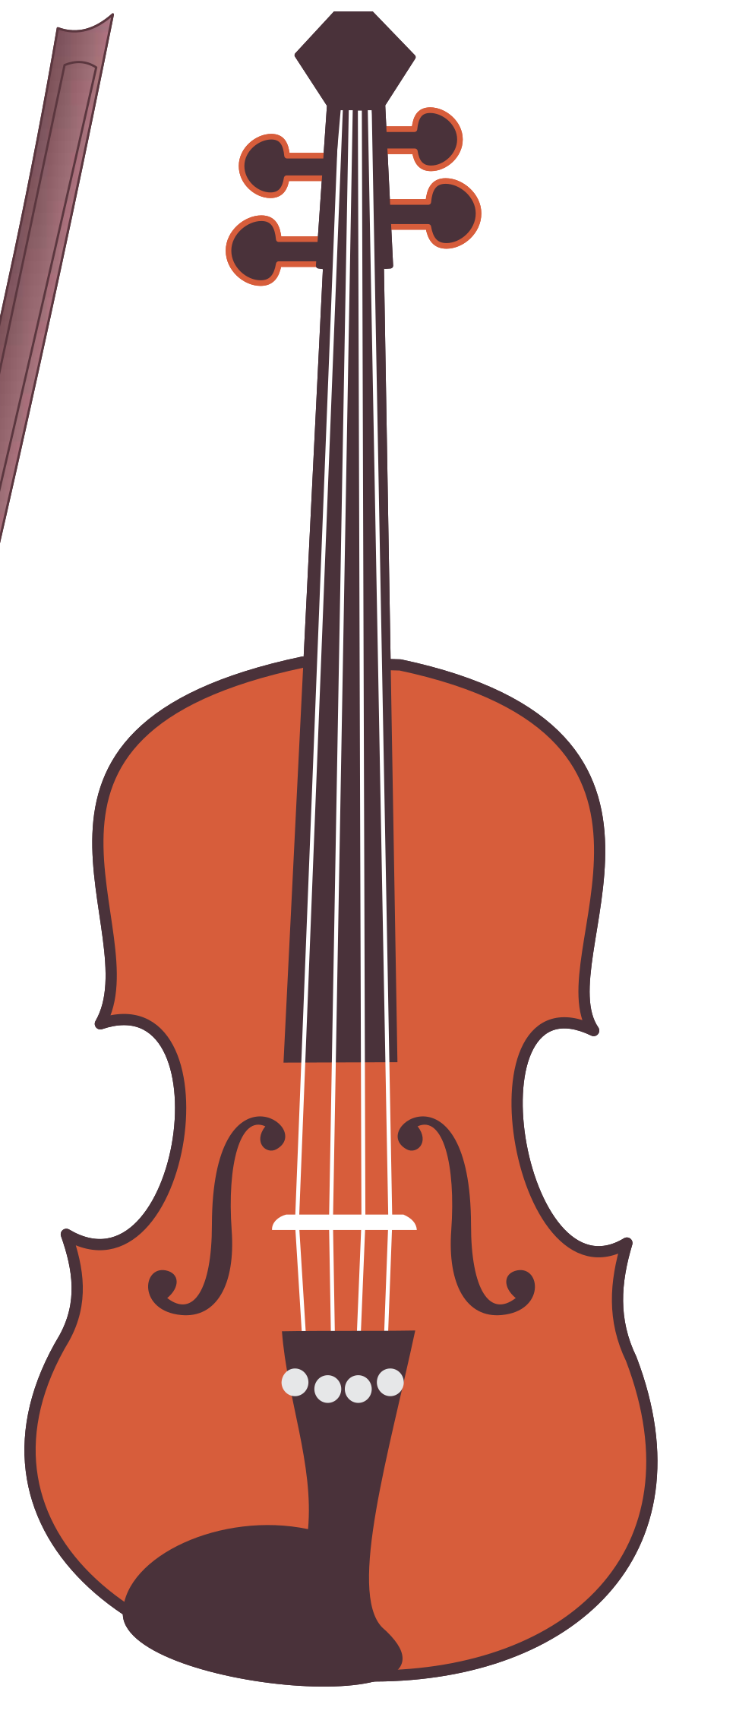

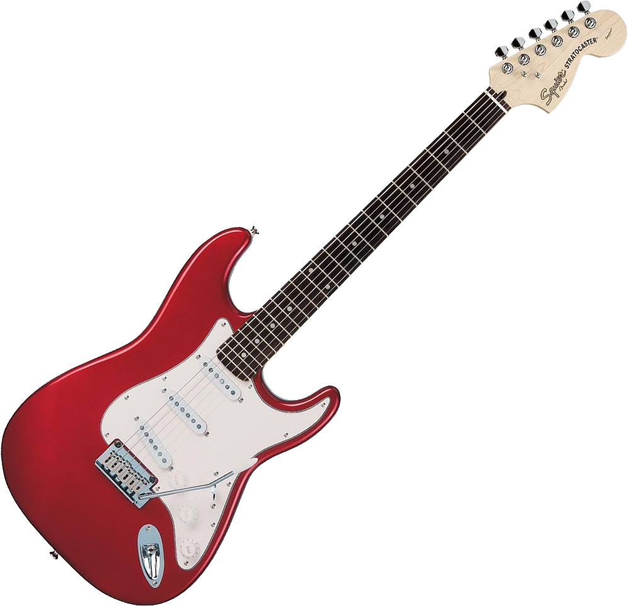



Slide 10
