Slide 1
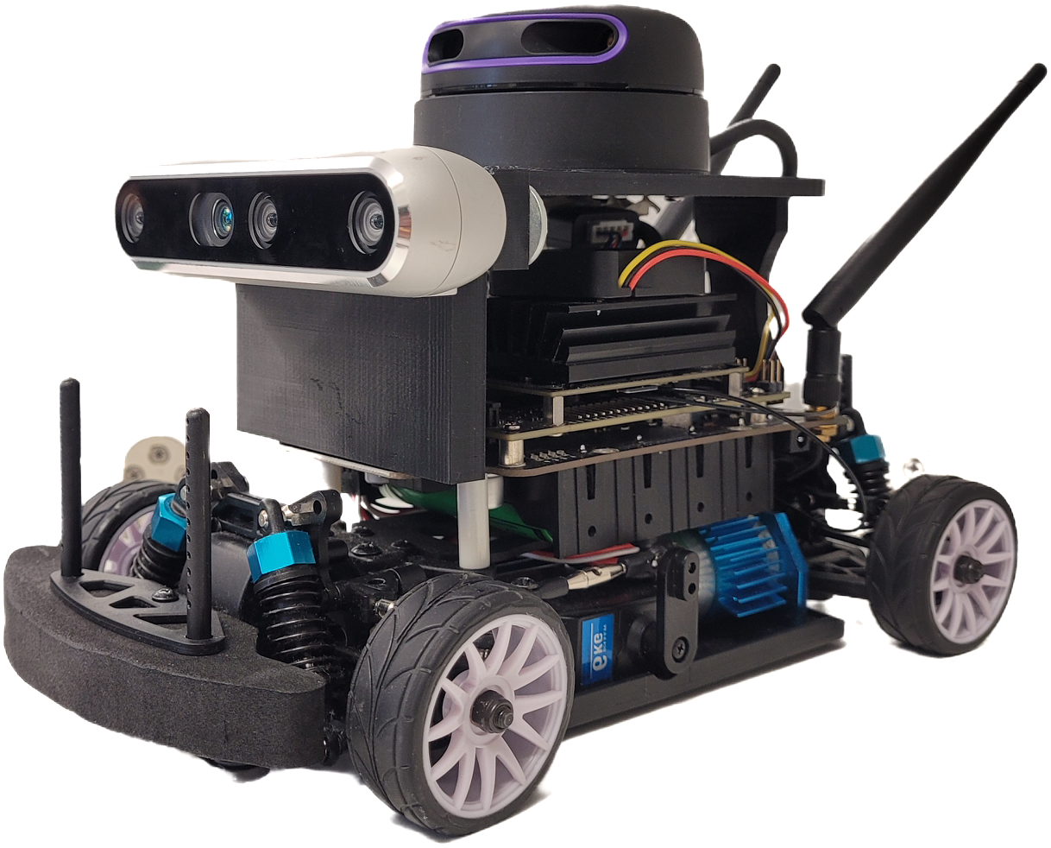
Autonomous indoor vehicles using
Deep Reinforcement Learning
Overview
This project focuses on developing a custom-built mobile bot capable of navigating within a building while avoiding obstacles. The bot's driving model is trained using Reinforcement Learning, specifically the Double Deep Q Network (DDQN), within a custom simulator built using Python.
Hardware Setup
The hardware setup leverages the Nvidia Jet Racer Pro as the foundation for the driving platform. A Rplidar A3 360-degree sensor from Slamtec is securely mounted on the bot using a 3D-printed mount. Additionally, obstacle detection is facilitated by the Intel D435i depth camera. The system is powered by a Linux operating system running the Robot Operating System (ROS) as middleware.
Simulator
A Python-based simulator has been developed using the Pygame library, featuring the floorplan of the university building. This simulator accurately represents the environment where the bot will operate. The bot's scaled geometry enables it to navigate within this simulated environment, with simulated Lidar sensor data generated based on the bot's position and orientation.
DDQN
The bot's driving policy is established through training within the custom-designed simulator using a Double Deep Q Learning setup (DDQN). Operating within the framework of a Markov Decision Process, the policy predicts the optimal action based on Lidar observations and executes it accordingly. Hardware calibration ensures smooth execution of these actions.
Skills Implemented and Acquired
1. Reinforcement Learning (Double Deep Q Network - DDQN)
2. Hardware (Nvidia Jet Racer Pro, Lidar, Depth camera)
3. Simulator Development (Python, Pygame library)
4. Policy Training (TensorFlow, Python, Linux OS, ROS)
5. Calibration procedures
Gallery

Slide 2
Simulation Environments &
AI-based Autonomous Driving Solutions
- a Comparative Evaluation
Overview
This project, presented as a master's thesis at THWS, delves into the evaluation and enhancement of autonomous vehicle simulators. Through meticulous research, it offers a comprehensive approach aimed at refining the simulation experience. The work comprises two primary components: the development of a prototype simulator propelled by a deep generative model and the introduction of a systematic method for comparing autonomous vehicle simulators.
Generative Model-Based Simulator
This segment of the project focuses on the creation of a prototype simulator driven by a Generative Adversarial Network (GAN). The objective is to simulate the transition of sensory data to subsequent states based on executed actions, generating a diverse range of scenarios. A conditional GAN is meticulously designed and trained to generate 2D Lidar data for each time step, given specific actions.
Comparative Study
The project conducts a comprehensive examination of various features that distinguish simulators, leading to the development of a systematic comparison system. A total of 73 parameters spanning six categories — Sensor, Actor, Environment, Ego vehicle, Algorithm, and Framework — are identified. Two sets of scores, one for simulators and another reflecting user preferences, are utilized to capture the simulator's capabilities and the user's interests, culminating in a final score.
Skills learned
Generative AI
Autonomous vehicle simulator
Comparative methods
Gallery

Slide 3
ROS2Mongo
ROS2MongoDB
Overview
The ROS2MongoDB package is designed for recording sensors and actuators data generated during scientific experiments with robots. It stores this data in a structured manner within a database, facilitating further analysis for research purposes.
Usage
The ROS2MongoDB package is used to log data from ROS topics published by sensors and actuators on a robot during its operation or experiments. It stores this data in a NoSQL database (MongoDB) and high-dimensional data (e.g., images) in hierarchical structured files (HDF5). Users can customize several functionalities based on their specific use case, including data compression and specifying the data of interest.
Database Information
This package is designed to work with MongoDB version 7.0.1. You can find installation instructions for MongoDB here. Each significant experiment is stored as a database, and each trial is stored as a collection. Local paths for high-dimensional data (HDF5 database name) and global paths (path to HDF5 files) are stored as separate features. Data from different sources is synchronized with a common reference time (time of generation). The latest data generated within the specified time window (default: 10 nanoseconds) is recorded, while the rest is ignored.
HDF5 Structure
HDF5 stores high-dimensional data in either compressed or non-compressed formats. Users can configure the different compression and pre processing technique tailored to their use case at heavy_data_call_back() method in datalogger.py .A new file is created for each type of experiment. Data from different trials of the same experiment is stored in different Level 1 groups, and different sensors/topics are distinguished by distinct Level 2 sub-groups.
Skills Learned
Bash Scripting
MongoDB
Query Language
ROS
HDF5 datatype

Slide 4
Buisness Simulation -
Mobility as a Service
Overview
The simulation software is been developed to replicate the business model of a Maas (Mobility as a service) startup “Vaegan” based in Tamilnadu, India. This Company provides rental electric scooters for public commutation with renting stations at various strategic locations scattered around the city. This simulator simulates the dynamics of the business for given time period of time and infere various observations regarding the working and financial aspects of the business
Buisness Idea
The company owns several electric scooters stationed at various locations of the city (in this case., Coimbatore, India). The customers can rent the scooters at any of the station and drop at any station near to the desired destination. Additionally, a dedicated team of drivers called wingman shuffles the vehicles between the stations depending upon the demand and surplus of vehicle to ensure uninterrupted service.
Simulator
The simulator is used to monitor and optimize the shuffling process done by the wingmen to minimize the wingmen effort and maximizing the service availability additionally, it monitors cost associated with the scoters and operational cost such as charging time of the scooters, expenditure and income of the entire business. To make it as accurate as possible, the simulation takes various real time data from reliable resources such as Distances and travel time between the stations, service traffic power consumed by the vehicle, location of stations…
Purpose
This simulate is used to optimize the functions of wingman team for efficient reshuffling of scooters.
It is used to identify the excess expenditure associated with the business
It is used to determine the locations of the stations and no of vehicles required for each stations to reduce the idle time of the scooters and ensuring the availability of service

Slide 5
Autonomous shuttle service
Overview
This project has been carried out as the bachelor thesis at Anna University. In this project a eco system of autonomous shuttle service within the university campus has been established. This system encompasses and retrofitted electric scooter and a software for using the service with a hardware setup. Moreover, the vehicle is installed with a sensors and actuaters to navigate and drive by following a white line laid on the road. This enables the vehicle to move autonomously to the any destination of choice when triggered.
Hardware setup
Drive system
The Chassis of TVS Scooty ES is modified and used as the base frame. The Drive system is designed and modified to house the Hub motor powered by Lithium Ion batterties. The custom hardware are designed and installed to achieve the autonomous driving.
Line following system
The Line following is mainly guided by the data from the image sensor Pixy, Which is fed into the processor which in turn guides the vehicle by controlling the steering system attached with a Gear system. The gear system coupled to the steering shaft if driven by the Stepper motor. The braking system is achieved by actuating the inter brake shoe with servo motor. The power to the moter is controlled by a potentiometer which can alter the speed of vehicle.
Software
To user login is authenticated by the bar code and the login data is stored in the SQL database. A dedicated webpage user interface has been developed to facilitate the user login and data login. The webpage is hosted locally in the university network. A Bluetooth cordless barcode scanner is used to scan the user barcode and a parking gate is installed to ensure the proper parking of the vehicle.
Achievements
This project has secured first place under the category of “Digital Bharat” at International Science festival 2021 by Ministry of Science and technology
Skills Acquired
Design (Solidworks, Ansys)
Embedded System
Electrical System designing
Web page development
Query Language (SQL Database)
Gallery

Slide 6
SAE BAJA 2020
Overview
SAE (Society of Automotive Engineers) BAJA is an international off road racing event where team around the world should design and develop and off road car and compete with each other. In this event I had led my team of 23 members as a captain and driver designed constructed and tested a car. Our Team had competed with 200+ teams in various formats of racing such as Manuverability, Suspension test, Brake test and Endurance.
Design and Development
The Entire project spans over the time period of 1 year during 03/2019 to 03/2020 with 2 stages (Design evaluation and Dynamic testing). The Team primarily cosist of 5 major sub teams (Chasis, Braking, Powertrain, Suspension and Steering). The Entire car frame is designed using Solidworks and the design evaluated in both static and dynamic setup using Ansys. The Steering and suspension system are designed using Lotus software and evaluated using Adam. After clearing the first round (Design evaluation) the Designed model is constructed in 4 months followed by 2 months of rigorous testing as per standards
Key Specs
Chassis
The entire Roll cage is constructed using AISI 4130 X alloy tube with diameter of 29.2 mm. The Roll cage was Welded in TIG welding with GTAW ER70-S2 filer.
2. Braking System
Hydrallic Brake system is used in all 4 wheels. A Tandem Master cylinder is been used woth F-R split. After the design consideration a calipar with 30mm dual piston is with DOT4 brake fluid. The Front and rear disc are designed from maximal heat dissipation with required structural strength and fabricated using water jet cutting method.
3. Transmission
A 305 CC Briggs & starton engine is used to power the vehicle producing maximum of 10 HP an 9 mKg-1 Torque the Power is transmitted using CVT belt transmission with tripod bearing axle shaft
4. Suspension
A Double Wishbone suspension is used in both front and rear suspension. The Fox Float 3 suspension woth 6 inch travel is employed in the all 4 wheels. The Knuckle and the wheel hub are designed and manufactured using CNC machining.
Achievements
12th position in Manuverability
6th position is Suspension and traction.
Successfully completed the 5 hours Endurance run with 8th position Overall
Skills Learned
Design (Solidworks, Lotus
Analysis(Ansys, ADAM)
Team Management
Motorsport Driving
Testing Procedures
TIG welding
Machining
Gallery

Slide 7
Human action Recogonition
Overview
This project is a done as the part of study (assignment) at THWS. In this project a team of 5 members has developed various Machine learning Models for Human action estimation from the popular Open pose dataset. Moreover the performance of the model compared and justified.
Dataset
The OpenPose dataset is a collection of keypoint of body parts such as head arm hip… of humans performing 5 different activities. The keypoints are denoted by x and y coordinates of the part with a confidence score 1500 such data points is used for training
ML Models
Convolutional Neural Network 1D (CNN 1D)
CNN 1D is a commonly used for processing one-dimensional sequential data like time series or signals. Each key points are assumed to be 1D sequence and CNN 1D is used CNN 1D models are adept at capturing local patterns and hierarchies in sequential data, making them effective classification.
2. **Convolutional Neural Network 2D (CNN 2D)**:
- CNN 2D is a architecture designed for processing two-dimensional structured data like images. The data is assumed to bed an Image with Keypoints of various body parts and time (15 frames) as axis. CNN 2D models leverage hierarchical feature representations to discern patterns and relationships within timesteps, making them effective in classification.
3. **Recurrent Neural Network (LSTM)**:
- LSTM (Long Short-Term Memory) is a type of recurrent neural network architecture suitable for processing sequential data with long-range dependencies. It incorporates memory cells and gating mechanisms to retain and selectively update information over time. As a typical sequential problem LSTM is used to extract the temporal features of the data
4. **Random Forest**:
- Random Forest is an ensemble learning method consisting of multiple decision trees trained on random subsets of the dataset features. It combines the predictions of individual trees through averaging or voting to produce robust and accurate predictions, particularly in classification and regression tasks. Every 100 frames are flattened and class is predicted using Random Forest and the final class is predicted using maximum vote
5. **Dynamic Time Warping (DTW)**:
- DTW is a technique used to measure the similarity between two time series sequences, even when they have different lengths or are temporally distorted. It dynamically aligns the sequences by warping them in time to find the optimal matching. The movement of the keypoins are assumed to be sequence and compared for similarity against an ideal datapoint and the class is predicted with maximum similarity
Results

Slide 8
Black Jack
Overview
This project has been done as the part of the studies (portfolio exam) during Masters. This paper describes the implementation of a self-learning black jack player using Markov decision process. The environment of the game is developed in python and learning of basic strategy is executed using Q-learning method. The growth of win rate and change in policy for different rules and hyper parameters are experimented.
Environment
The Black jack environment is developed in python. Which replicates the basic gameplay and strategies such as car counting . The rules as followed as described the book beat the dealer. The agent can take two possible action (Pick or stick) where the state is represented by the sum of players card and the dealers’ initial card. The reward are given at end of every game.
Q –learning
Q- learning policy is defined by q table, which is the table of state action pair. It stores the probabilities of all possible actions at each state. It is formed by states and actions of the environment. The dimension of Q-table for the basic strategy of Blackjack is 310×10 (Maximum states and action) and the dimension of Q- table for card counting strategy is ((310 x 2) x 10) as each single state have 2 sub states. This table is the termed as policy as the agent will follow the table to take action at particular state. The values of Q- table is updated for each reward obtained using Bellman’s equation.
A total of 100000 games are played and the exploration and exploitation is managed by epsilon greedy approach. A maximum of 44% win rate is achieved which is comparable t human gameplay.
Results

