Slide 1

A Project report on
Restaurant Billing System
By
Name Roll no
1.Mahesh Khairkar 21 545 2.Gaurav Khadke 21508
3.Ravindra Kamble 21515

Slide 2
ABSTRACT The project “Restaurant Billing System” is a basic program used in restaurants. The main aim is to process the ordering and billing of a “Restaurant”. This system is named as Restaurant Billing System. This is designed especially for a restaurant which wants to attend their customers in a very well manner. This system has the capability to give the receipt to the customers. The program is easily executable and can be easily accessed by a user. It is great software for saves time and decreases the work of the owner of the restaurants.

Slide 3
INTRODUCTION
This system is named as Restaurant billing system source code. This is designed especially for a restaurant which wants to attend to their customers in a very well manner. This system has the capability to take orders from the customers.It generates a unique transaction id for that according to the selection of the mode of payment. The icing on the cake is that it will be simply utilized by the staffs of various edifice departments and is hopped-up with extremely customizable strong options to fulfill each demand of your edifice, be it managing the stocks/inventory, increasing business potency, increasing table turnaround, managing totally different branches, aggregation client feedback, or managing any knowledge that’s necessary for your edifice, no matter the placement and time, we have got it all coated

Slide 4
OBJECTIVES
i) To provide a computer-based billing system for an accurate computation of bills. ii) To generate a receipt when performing a service. Iii) To provide a convenient solution of billing pattern.

Slide 5
FEASIBILITY STUDY This is the measure of how beneficial or practical the development of information system will be to the organization. The area introduces the system in terms of research into why it is more viable than the existing system.
Three main areas of feasibility study are: i)Operational feasibility ii)Technical feasibility iii)Economic feasibility

Slide 6
OPERATIONAL FEASIBILITY
The billing system will save time for the workers of restaurant. By use of their computer systems, workers of restaurant give bills to the customers. By the help of this software, paper work is reduced. This save both time and money.

Slide 7
TECHNICAL FEASIBILITY Technical feasibility centers to the existing computer system(Hardware, Software etc) and to what extent it can support the proposed system.
ECONOMIC FEASIBILITY The procedure is to determine the benefits and savings that are expected from a user system and compare it with the costs. If a benefit outweighs costs, then the decision is made to design and implement the system. Otherwise further alterations are made in the proposed system 1.Manpower cost 2.Hardware and Software cost

Slide 8
DATA FLOW DIAGRAM
CUSTOMER
CHEF
Customer order
FOOD
BILLING
SYSTEM
Ordered
Food
Cocked Food
Cooked
Food
Bill’s Receipt
CASHER

Slide 9
ER DIAGRAM
NAME
USER
ORDER
ITEM
PRICE
GENERATOR BILL
BILL_NO
CUST_NAME
CUSTOMERS
BILL
TOTAL

Slide 10
MODULES
Bills Management module: Used for managing the bill details.
Payment module: Used for managing the payment details.
Receipt module: Used for managing the receipt information.
Users: Used for managing the users of the system.

Slide 11
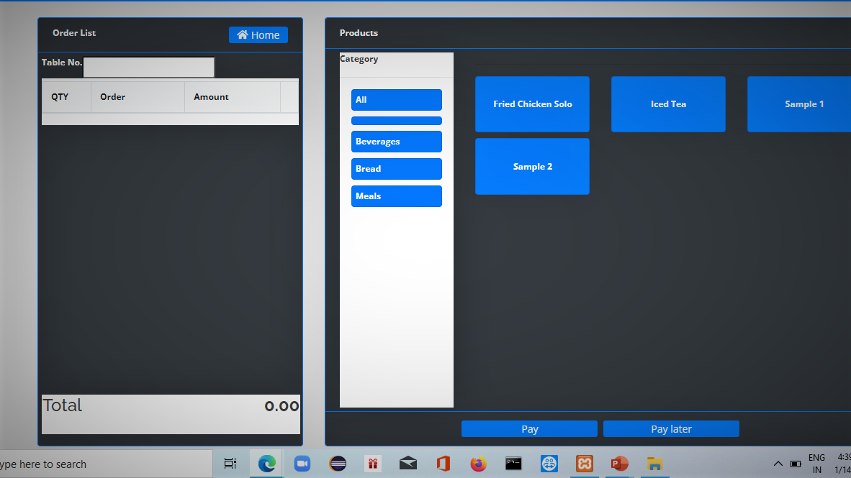

Slide 12
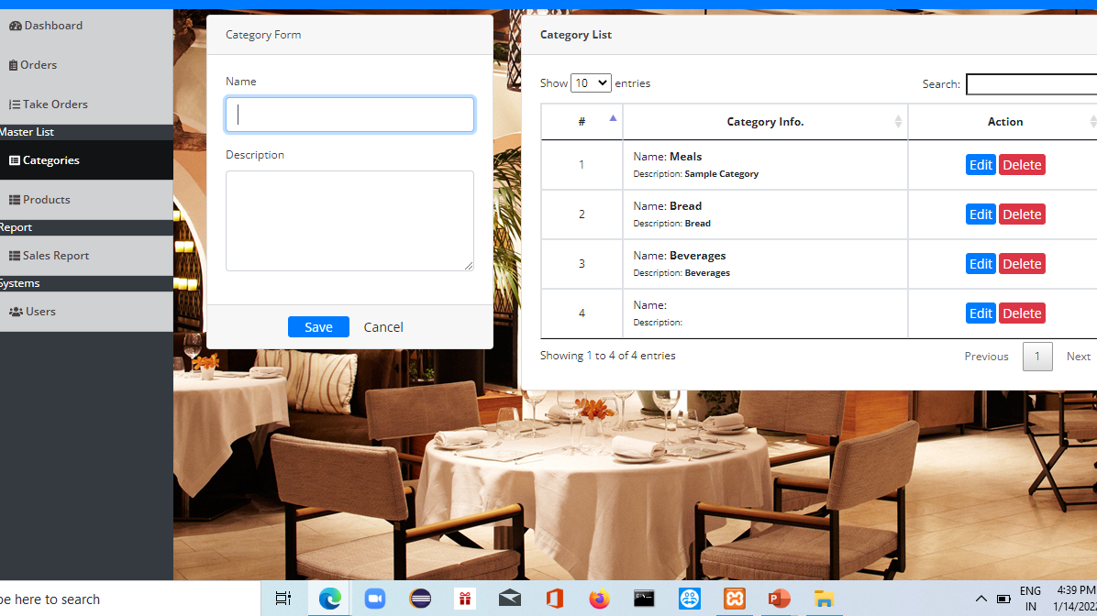

Slide 13
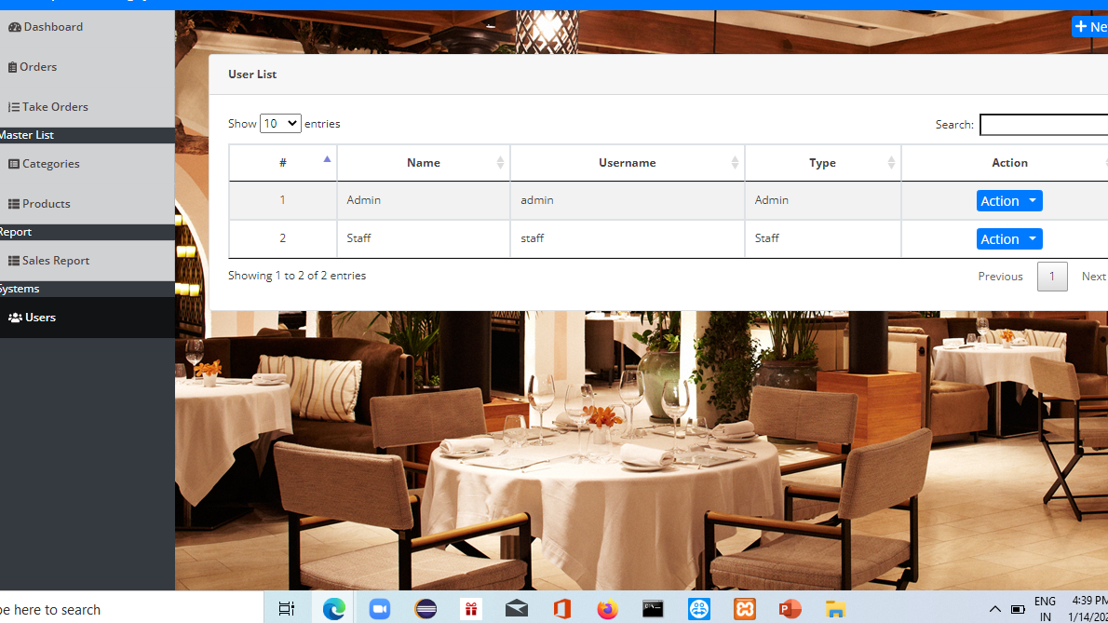

Slide 14
Functionalities used in the project
Login for Admin
Change password for Admin
Logout functionality
Dashboard for Admin user
Manage products
View details of the project
Listing of all the products

Slide 15
Manage Bills 1.Adding new bills 2.Edit the existing bills 3.View details of the bill 4.Listing of all bills
Manage product type
Adding new product type
Edit the existing product type
View details of the product type
Listing of all product type

Slide 16
Reports of project Restaurant Billing System *Report of all products *Report of all bills *Report of all product type

Slide 17
Conclusion of Restaurant Billing System
Finally, in the restaurant billing system source code, the outcome of all the time hard work is here. We have a system which takes the necessary choices of the customer according to the various filter like price, category of the food, and popularity. Then he is able to place the order accordingly and then the system calculates all the total of the order with taxes and then it can dispatch the bill that is handed over to the customer.Customer according to the choice pay bill via cash or debit card or credit card method. Hence all the process works perfect, full filling the demands.

Slide 18
Hardware and Software Requirement Hardware Requirement: • Intel Core Dual Processor • RAM: min 4 GB • Printer: Laser Printer Software Requirement: • Operating System: window • Front End: HTML, CSS, JavaScript • Back End:JavaScript

Slide 19
BIBLOGRAPHY
Google
Youtube
Books
Websites

Slide 20
THANK YOU!

