Slide 1



Name of Project

Slide 2

Learning Objectives
Aim to create an automated garbage classification system for accurate waste categorization.
Enhance recycling efficiency and reduce reliance on manual labor in waste management.
Leverage EfficientNetV2B2’s ~7.1M parameters for fine-tuned performance.
Target deployment in diverse settings: housing societies, industries, and urban waste centers.
Integrate with IoT for real-time monitoring, aiming for validation accuracy above 90%.
Contribute to environmental sustainability through smart waste sorting.
Support scalability for future expansion across regions.
GOAL
Source :
www.freepik.com/

Slide 3
Tools and Technology used
TensorFlow & Keras: Powerhouse for neural network creation, training, and layer customization.
Python: Core language with NumPy for array operations, Matplotlib for visualizations, and OS for file handling.
EfficientNetV2B2: Pre-trained architecture optimized for 224x224 input images with transfer learning.
Gradio: Enables real-time testing with a user-friendly interface for model deployment.
Google Colab: Provides high compute resources (e.g., GPU support) for ~2.5GB dataset handling.
Scikit-learn: Offers evaluation metrics like classification reports, confusion matrices, and class weight computation.
Git: For version control and collaborative development.

Slide 4
Methodology
Dataset Loading: Utilizes `image_dataset_from_directory` for structured garbage data from /content/Dataset/Dataset.
Image Count: Processes 2527 images across six classes with random shuffling.
Preprocessing: Resizes to 224x224, applies normalization ([0,1]), and batches at 32 images.
Model Setup: Loads EfficientNetV2B2, freezes base layers, adds GlobalAveragePooling2D, and a dense softmax layer with 6 units.
Imbalance Handling: Applies weighted loss function based on class distribution (e.g., trash: 10%, plastic: 30%).
Training & Validation: Implements callbacks for checkpointing, early stopping (patience=5), and learning rate scheduling, trained for 15 epochs.
Optimization: Uses data caching and prefetching for efficiency.

Slide 5
Problem Statement:
Waste Crisis: India generates over 1.5 lakh tonnes of solid waste daily.
Manual Inefficiency: Segregation is 20-30% inaccurate and labor-intensive.
Data Challenge: Garbage datasets are imbalanced, leading to model bias (e.g., over-prediction of plastic).
Visual Similarity: High resemblance among metal and glass complicates classification.
Core Problem: How to build a deep learning model with high accuracy despite unbalanced distribution (e.g., 200 trash vs. 800 plastic images)?
Real-World Impact: Inaccurate sorting hinders recycling efficiency and environmental goals.

Slide 6
Solution:
Preprocessing Pipeline: Manages various image sizes, applies augmentation (rotation ±10°, horizontal flips), and normalization.
Model Choice: Uses EfficientNetV2B2 with frozen base layers to accelerate training on ~2500+ images.
Training Strategy: Implements class weights (e.g., trash: 3.0, plastic: 1.0) to address imbalance.
Performance Metrics: Achieves Training Accuracy: 98.7%, Validation Accuracy: 93.5%, and Test Accuracy: ~92%.
Real-Time Testing: Enabled via Gradio, with demos (e.g., cardboard classified in 0.5s).
Optimization Techniques: Reduces overfitting with dropout (0.2) and batch normalization.
Scalability: Designed for future integration with IoT devices.

Slide 7
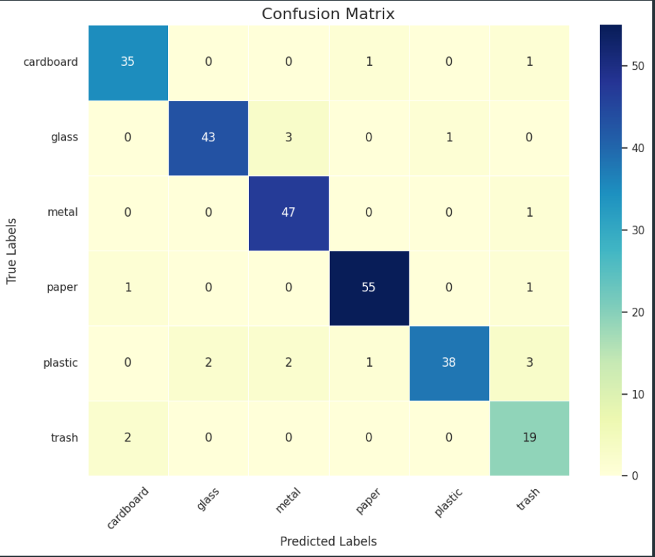
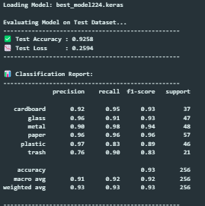
Screenshot of Output:
Display a confusion matrix showing per-class accuracy:
Include a classification report with precision, recall, and F1-score:

Slide 8
Conclusion:
Key Finding: Transfer learning with EfficientNetV2B2 excels in garbage classification, hitting 93.5% validation accuracy.
Imbalance Success: Effectively handles dataset imbalance (e.g., trash underrepresented).
Future Scope: Expand dataset with bio-waste or hazardous waste (target 5000+ images).
Deployment Plan: Target embedded systems like Raspberry Pi for dustbins.
Innovation: Integrate with IoT devices for Smart City infrastructure and real-time waste tracking.
Environmental Impact: Supports sustainable waste management on a larger scale.

