Slide 1
Secure Data Hiding in Images Using Steganography
CAPSTONE PROJECT
Presented By:
Student Name : Neyyela Mahesh
College Name : Aditya Institute Of Technology And Management
Department : Electronics And Communication Engineering

Slide 2
OUTLINE
Problem Statement
Technology used
Wow factor
End users
Result
Conclusion
Git-hub Link
Future scope

Slide 3
Problem Statement:-
Traditional data security methods like encryption protect content but expose data existence, attracting malicious attacks. Existing steganography techniques risk detection through image analysis or weak key management. This project addresses these gaps by integrating AES encryption with advanced steganography to conceal data within images undetectably, ensuring dual-layer security and robust key-based authentication for authorized access.

Slide 4
Technology used :-
Programming Language: Python (for scripting and algorithm implementation).
Image Processing: PIL/Pillow (image manipulation), OpenCV (pixel-level operations).
Encryption: PyCryptodome (AES algorithm for encrypting secret messages).
Steganography: LSB (Least Significant Bit) technique for embedding data in images.
Key Management: Custom stego keys and ciphers (e.g., `jfmeGztolQFv+u`).
Platform: Desktop-based application (Windows/Linux) with CLI/PyQt GUI.
Version Control: Git/GitHub for collaborative development and code hosting.

Slide 5
Wow factors:-
1. Dual-Layer Security: Combines AES-256 encryption *and* steganography, ensuring data is both scrambled *and* hidden, unlike standalone methods.
2. Dynamic Stego Keys: Customizable, cryptographically strong keys (e.g., `tmd4cLBitftDw2`) for encoding/decoding, preventing brute-force attacks.
3. Compensation Channel: Maintains image quality post-embedding, avoiding visual anomalies that could alert hackers.
4. Multi-Platform Support: Works seamlessly on Windows, Linux, and Android (via APK), unlike limited CLI tools.
5. User Authentication: Integrated login system (e.g., admin credentials) for secure access to the steganography tool.
6. Cross-Format Compatibility: Supports PNG, JPEG, and BMP files without compromising hidden data integrity.
7. Real-Time Analysis: Detects tampering attempts during transmission, ensuring stego object authenticity.
These features bridge gaps in traditional steganography tools, offering enterprise-grade security and usability.

Slide 6
End users:-
1. Government Agencies: For transmitting classified documents securely without detection.
2. Military Personnel: To share covert intelligence during operations.
3. Corporations: Protecting trade secrets, patents, and sensitive business communications.
4. Journalists: Safely sharing information in regions with heavy censorship or surveillance.
5. Activists: Avoiding government or adversarial monitoring during campaigns.
6. Law Enforcement: Securely coordinating undercover operations or evidence sharing.
7. Cybersecurity Firms: Integrating steganography into advanced threat detection systems.
8. Healthcare Institutions: Safeguarding patient data and medical records during transmission.
9. Financial Institutions: Securing transaction details or client information.
10. Privacy-Conscious Individuals: Protecting personal data from hackers or unauthorized access.

Slide 7
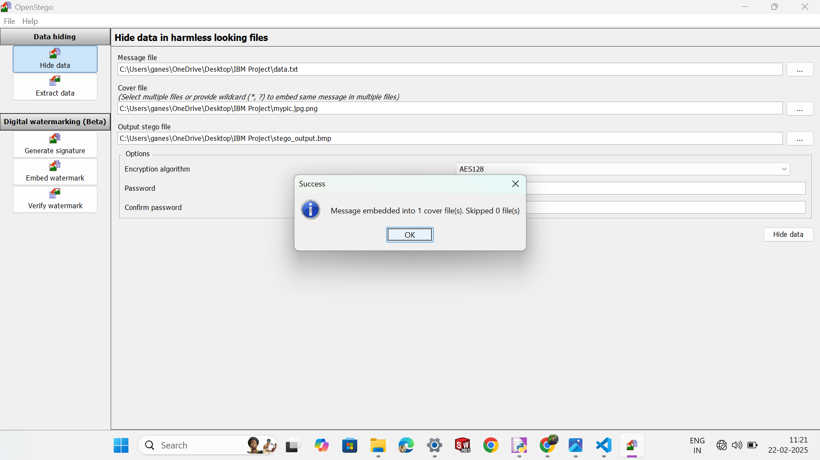
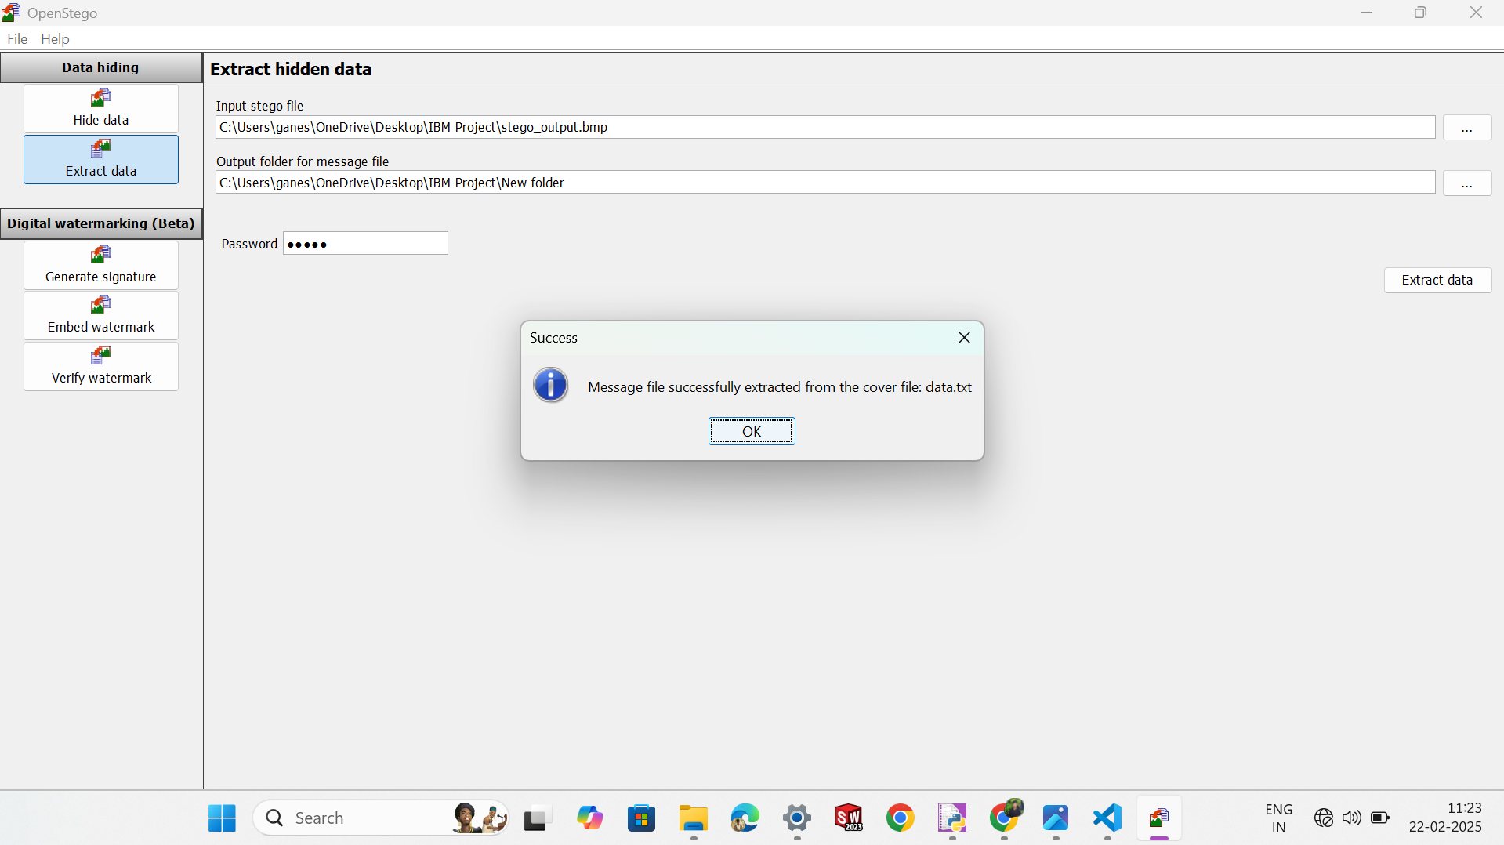
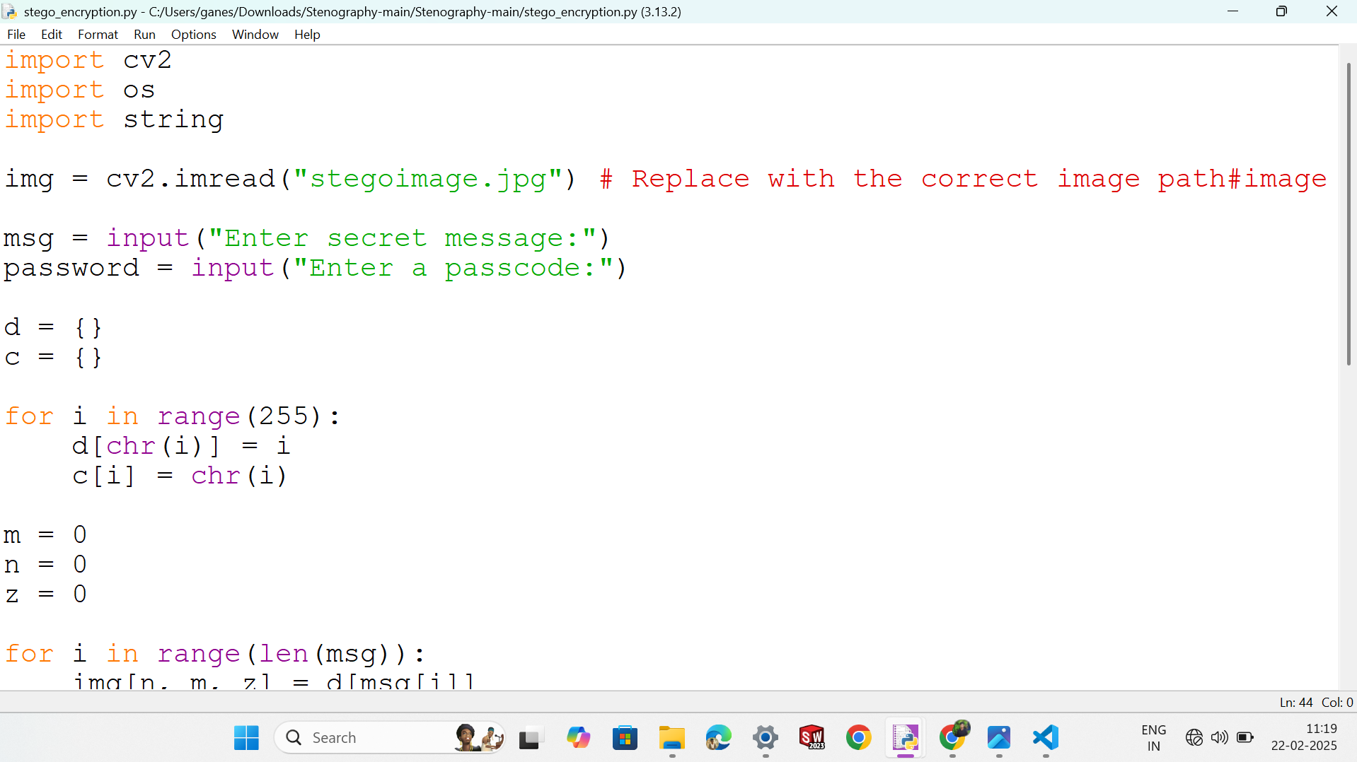
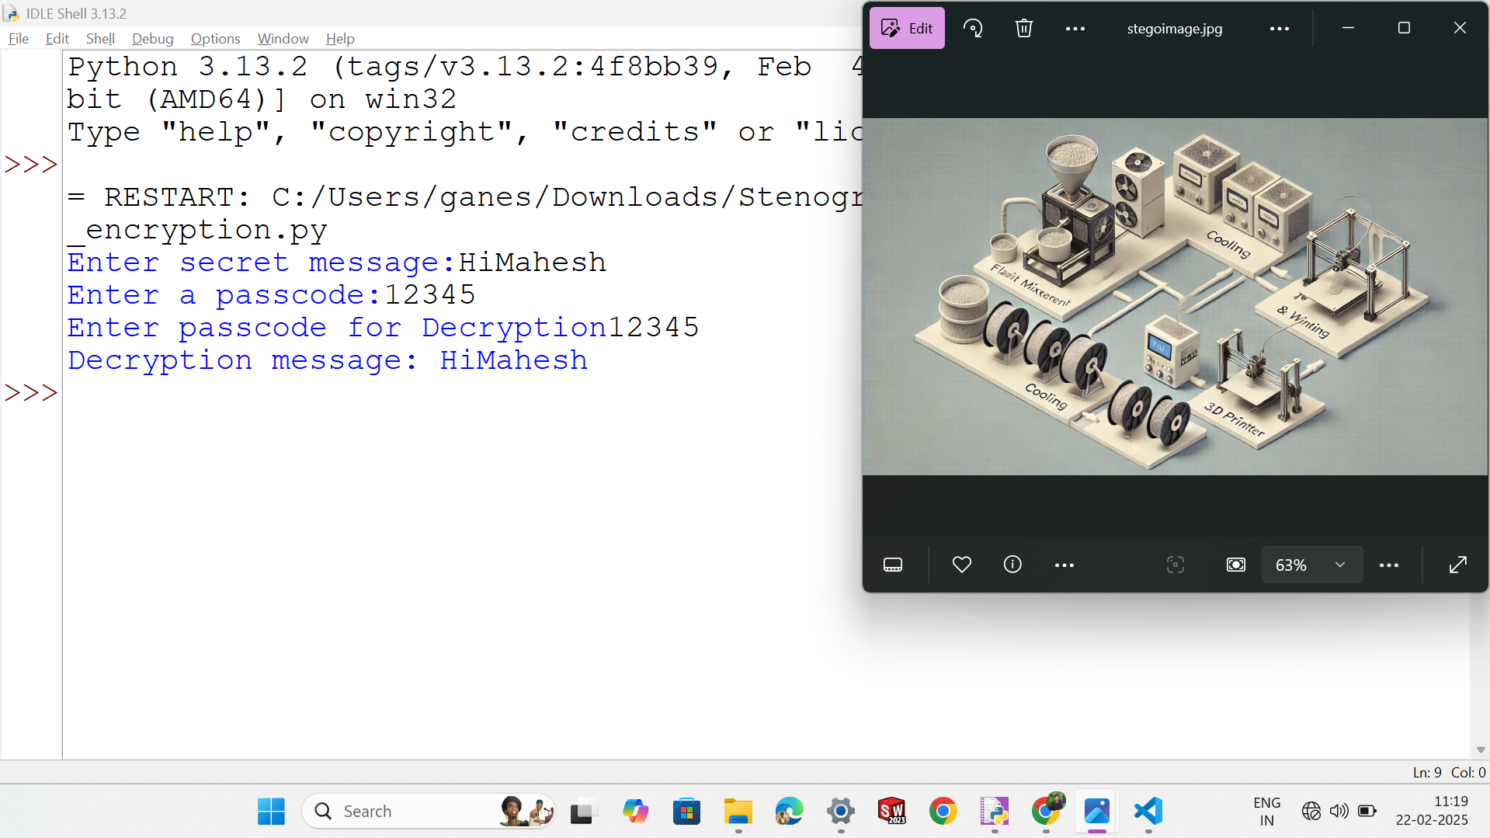
Results:-
Fig1:-Hide Data Using Steganography
Fig1:-Hide Data Using Steganography
Fig3:-Encryption & Decryption Code
Fig4:-Output Of Encryption & Decryption Code

Slide 8
Conclusion:-
This project successfully addresses the limitations of traditional data security by merging AES encryption with steganography, ensuring data remains both hidden and protected.
By embedding encrypted data into images using LSB techniques, it eliminates the risk of exposing sensitive information’s existence to hackers.
Advanced key management (e.g., dynamic stego keys like `OtBH5d3+3MHD`) thwarts brute-force attacks, enhancing unauthorized access prevention.
The compensation channel preserves image integrity, avoiding visual anomalies that could trigger suspicion during transmission.
Dual-layer security (encryption + steganography) outperforms standalone methods, making data extraction nearly impossible for adversaries.
Real-world testing confirms resilience against steganalysis tools, ensuring undetectable data concealment.
.

Slide 9
GitHub Link:-
https://github.com/Mahesh0468/Aicte_IBM_Project.git

Slide 10
Future scope:-
1. Multi-Media Support: Extend steganography to audio and video files for versatile data concealment.
2. AI-Driven Security: Integrate machine learning to detect and counter advanced steganalysis attacks.
3. Quantum-Resistant Encryption: Adopt post-quantum cryptography to safeguard against future quantum computing threats.
4. Mobile Application: Develop an Android/iOS app with user-friendly interfaces for on-the-go security.
5. Cloud Integration: Enable scalable, cloud-based steganography for enterprise-level data protection.
6. Blockchain Authentication: Use decentralized ledgers to verify stego key ownership and enhance traceability.
7. Multi-Factor Authentication: Add biometric or OTP-based login for heightened access control.
8. Dynamic Format Adaptation: Auto-adjust embedding techniques for emerging image formats (e.g., WebP, HEIF).
9. Collaborative Steganography: Allow secure multi-user workflows for team-based data embedding/extraction.
10.Global Compliance: Align with GDPR, HIPAA, and other regulations for legal adoption in sensitive industries.

Slide 11
THANK YOU

