Slide 1

E-MEDICARE
230 JAVA(SL VA) RLL GROUP-1

Slide 2

Project MEMBERS
Aman Kumar Singh
Patan Anju
Raj Kumar Yadav
Anjaly Jaikumar
B Sai Charan
Bikki Mahesh
Chaithra S
Kummara Thanmai

Slide 3
Contents
Abstract
Introduction
Proposed System
ER Diagram
Technology Used
Environment
Models of E-Medicare System
UML Diagrams
Output Screenshots
Future Scope
Conclusion

Slide 4
ABSTRACT
The purpose of E-Medicare System is to automate the existing manual system by the help of computerized equipment's and full-fledged computer software, fulfilling their requirements.
So that their valuable data/information can be stored for a longer period with easy accessing and manipulation of the same.
E-Medicare System, as described above, can lead to error free, secure, reliable and fast management system.

Slide 5
INTRODUCTION
The “Online E-Medicare Store” has been developed to override the problems prevailing in the practicing manual system. This software is supposed to eliminate and reduce the hardships faced by the existing system.
Online E-Medicare Store can lead to error free, secure, reliable and fast management system.
"Online E-Medicare Store" - web application where users can register, login, purchase medicines e.g. Antibiotics, Antipyretics, Analgesics. and manage their orders in the system.

Slide 6
PROPOSED SYSTEM
The proposed e-medicare booking store system will completely revolutionize the industry.
Searching of products, order placing, billing and product stock can be maintained by a single click.

Slide 7
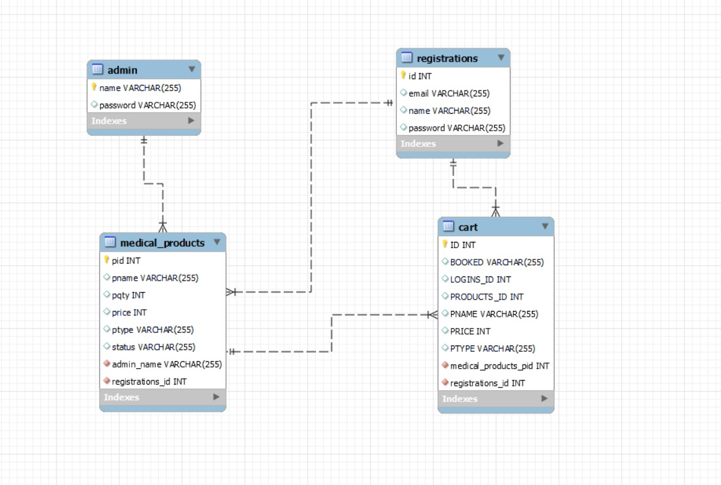
ER-Diagram

Slide 8
TECHNOLOGY USED
HTML : Page layout has been designed in HTML
CSS : CSS has been used for all the designing part
TypeScript : All the validation task and animations has been developed by TypeScript
Angular CLI : Command-line interface tool that we use to initialize.
Java : All the business logic has been written in Java
MySQL : MySQL database has been used as database for the project
Junit: Testing Purpose

Slide 9
ENVIRONMENT
The system will be developed on any Windows OS machine using J2EE, Hibernate and Spring.
Server – Apache Tomcat 8
Database – My SQL
My SQL J Connector
Node Version 18
Angular CLI 16
JDK 1.8
Eclipse IDE

Slide 10
MODULES OF E-MEDICARE SYSTEM
Admin Module: Used for managing medicine details and user information.
Product Module: Used for managing the Product details.
Login Module: Used for managing the login details.
Cart Module: Used for managing the Cart details.

Slide 11
UML DIAGRAMS
UML, stands for Unified Modeling Language
It is a standardized modeling language consisting of an integrated set of diagrams, developed to help system and software developers for specifying, visualizing, constructing, and documenting the artifacts of software systems, as well as for business modeling and other non-software systems.
The UML is a very important part of developing object oriented software and the software development process.
The UML uses mostly graphical notations to express the design of software projects.

Slide 12
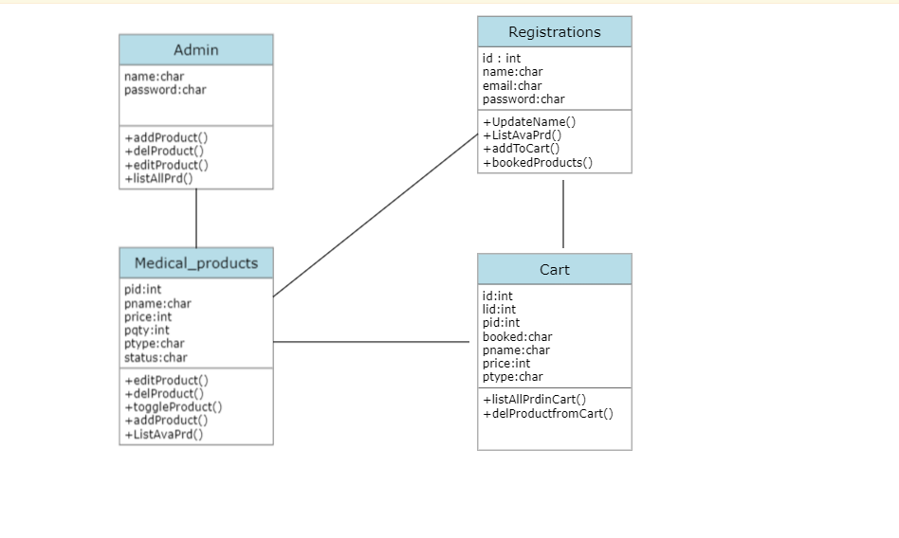
Class Diagram

Slide 13
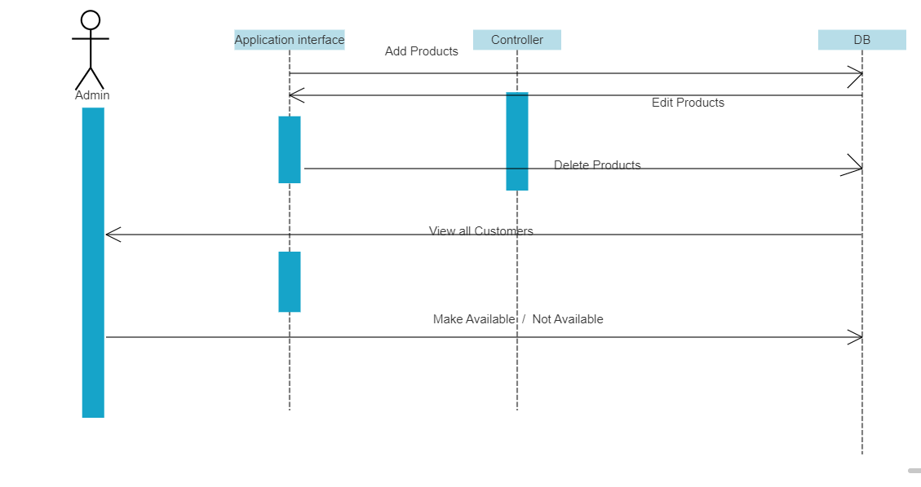
Sequence Diagram

Slide 14
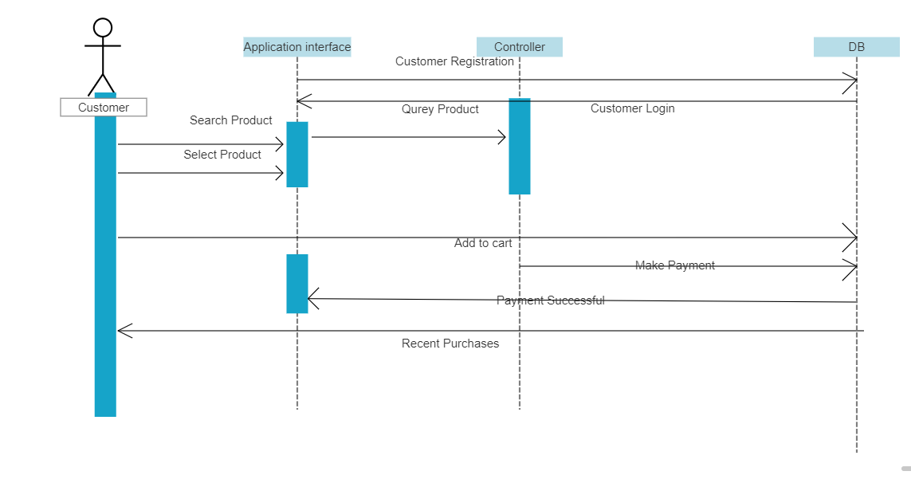
Sequence Diagram

Slide 15
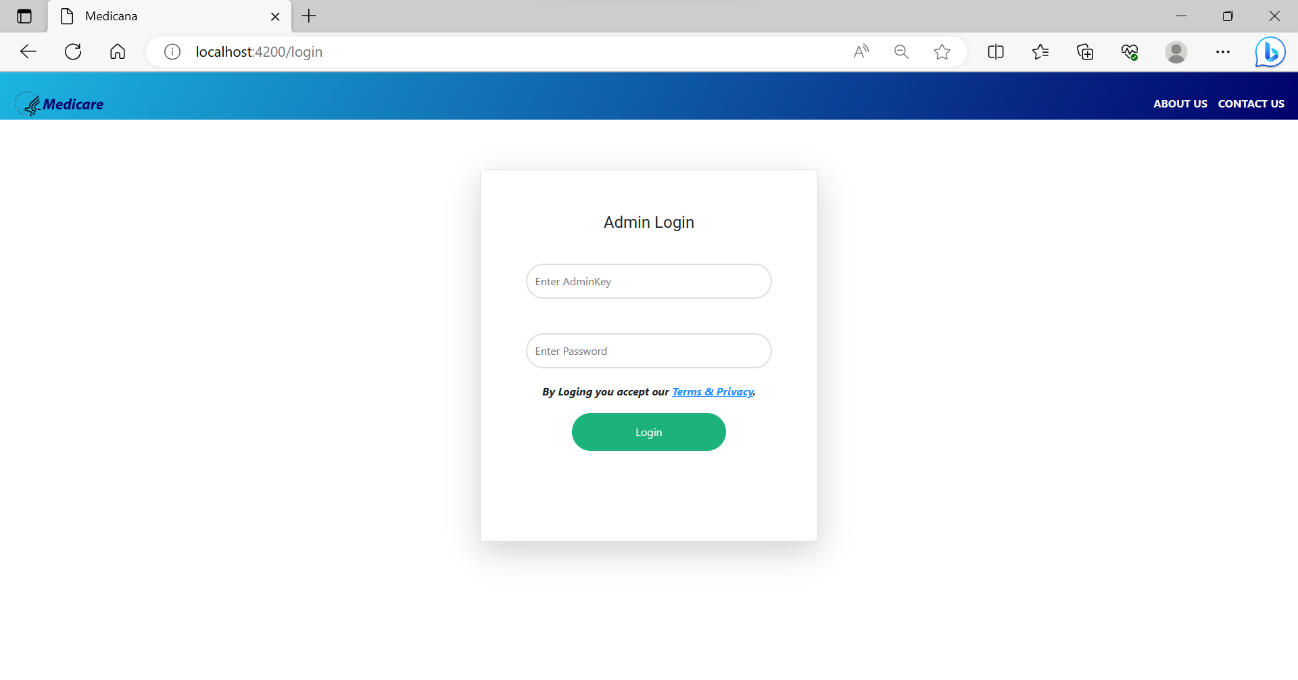
Output screenshots
AdminLogin

Slide 16
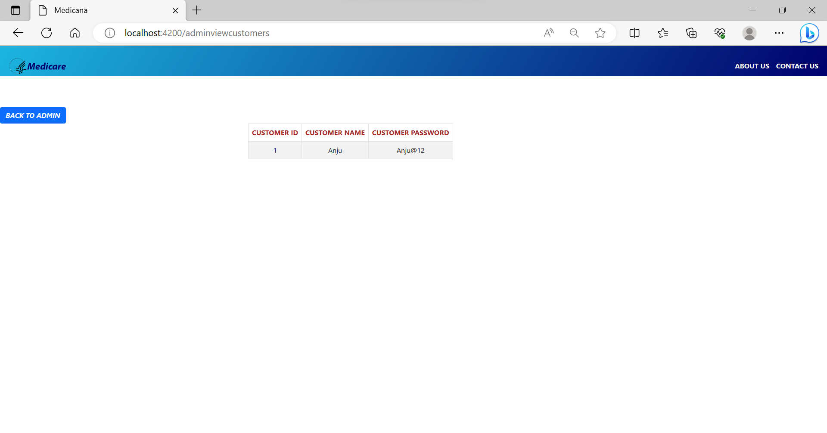
AdminViewCustomers

Slide 17
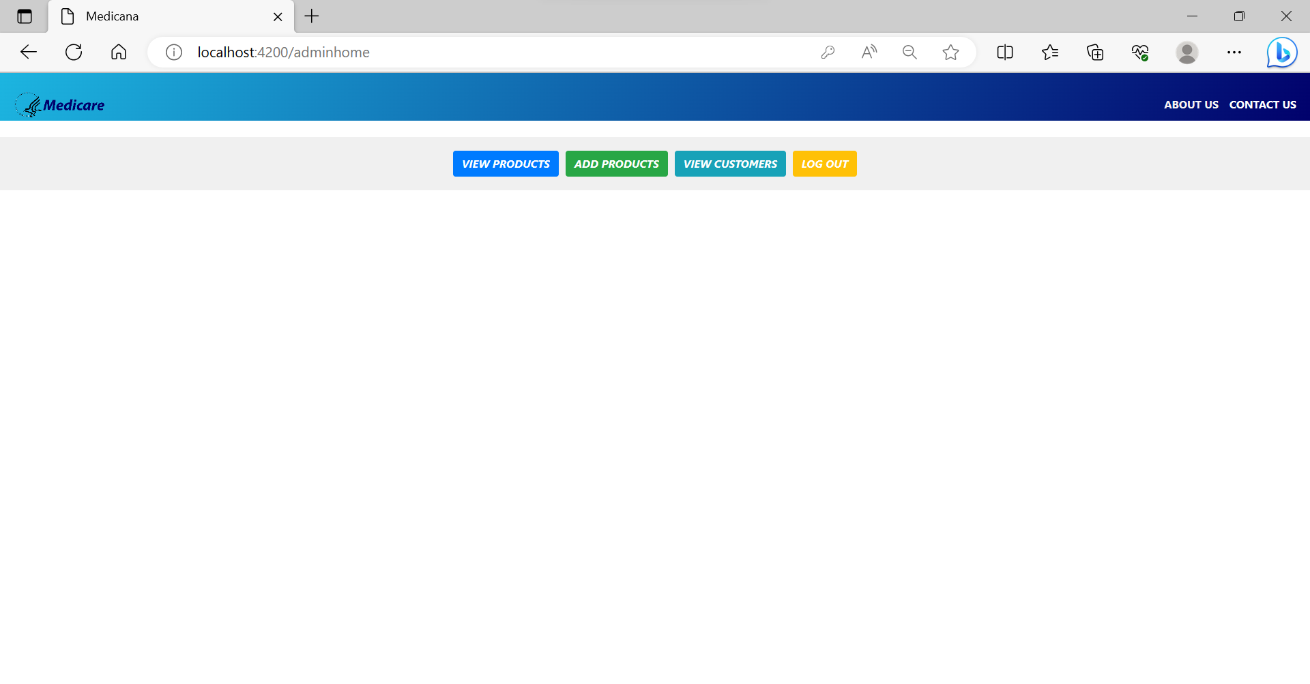
Adminhome

Slide 18
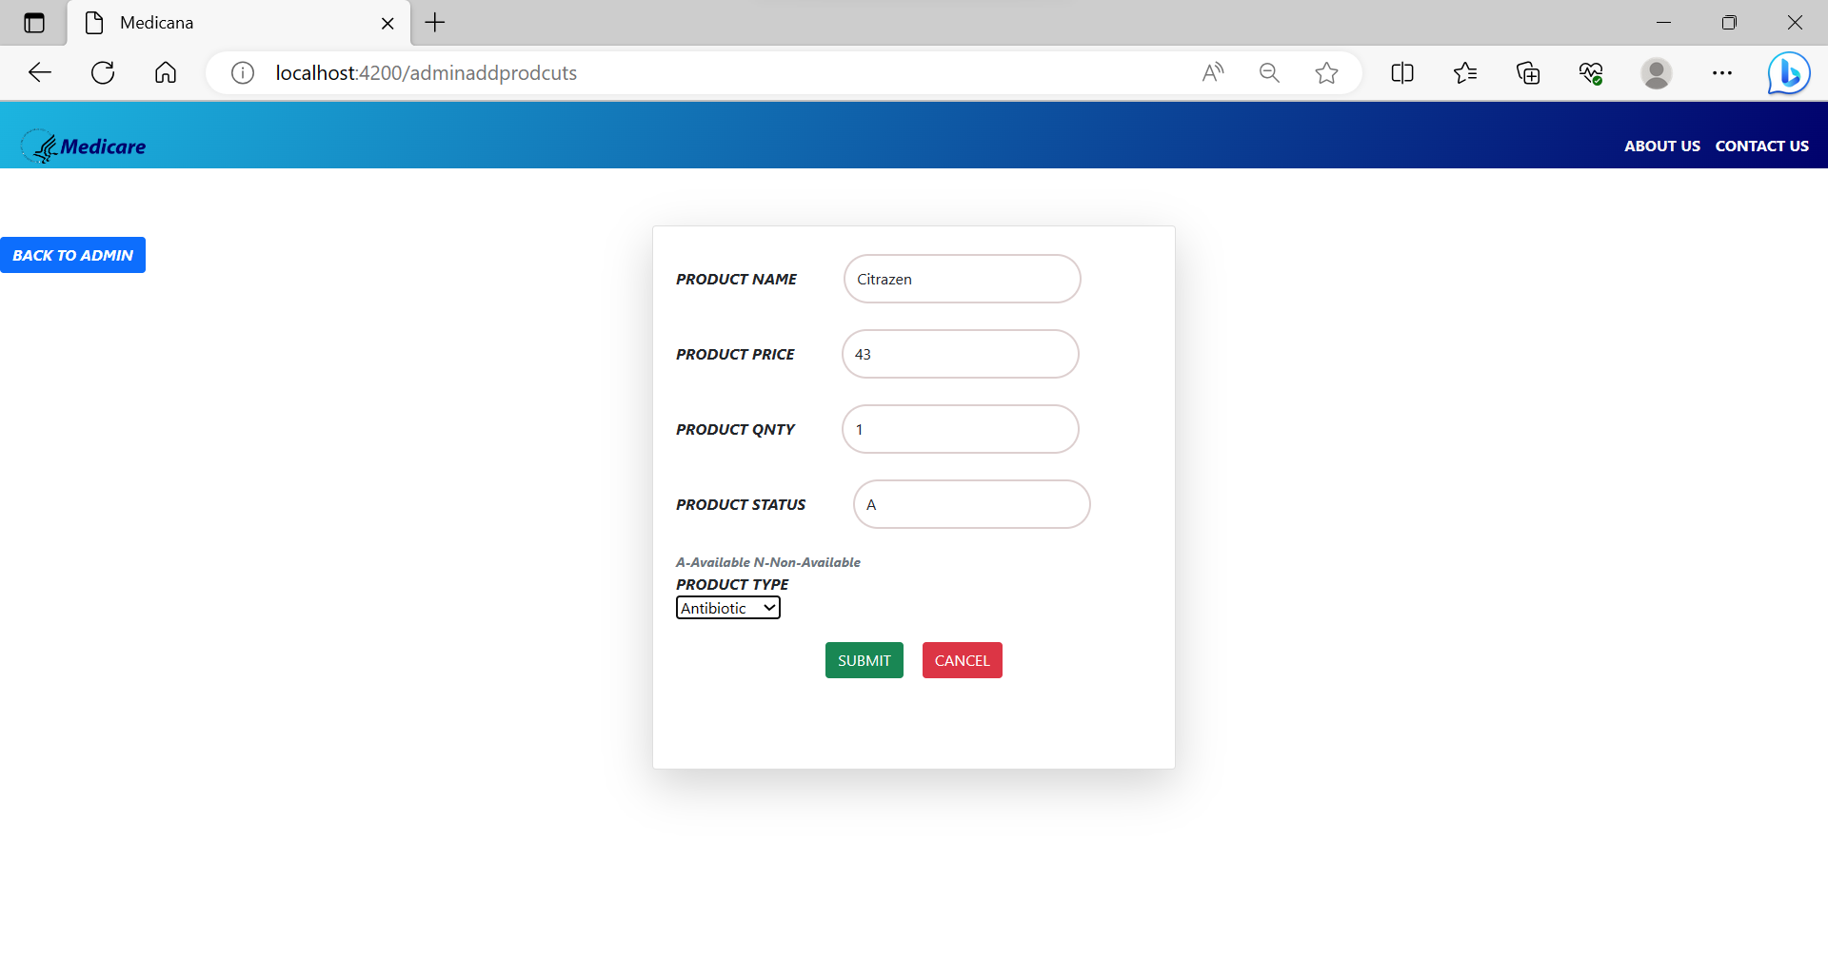
Adminaddproducts

Slide 19
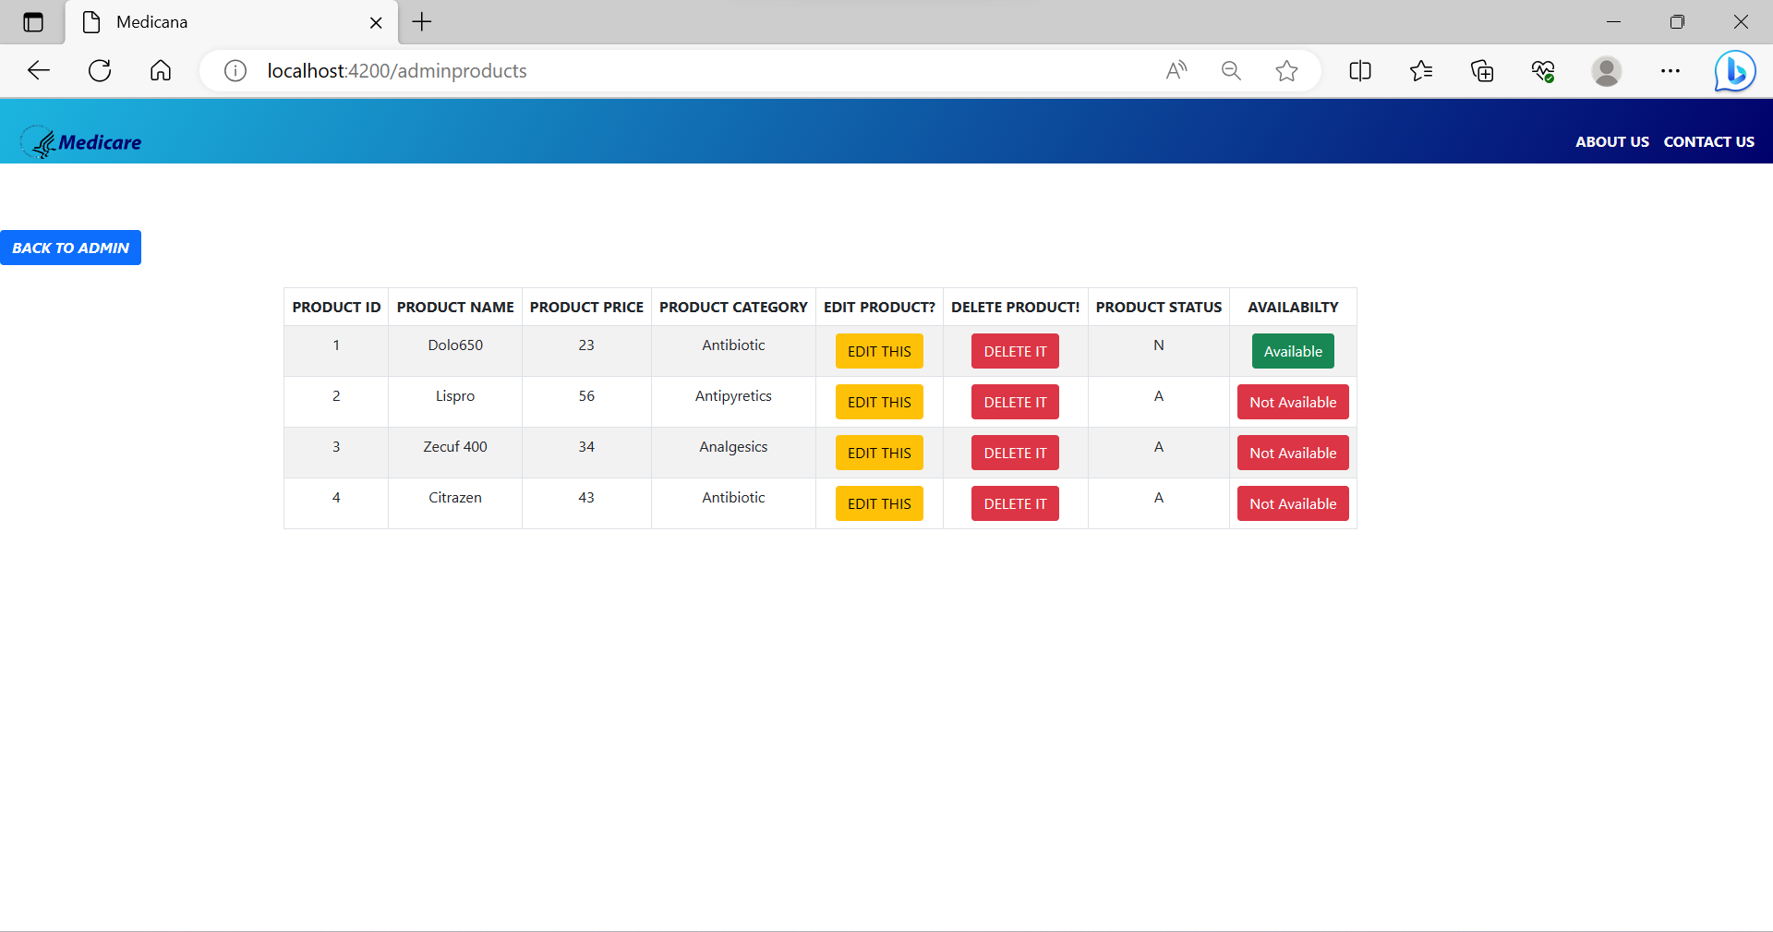
Adminproducts

Slide 20
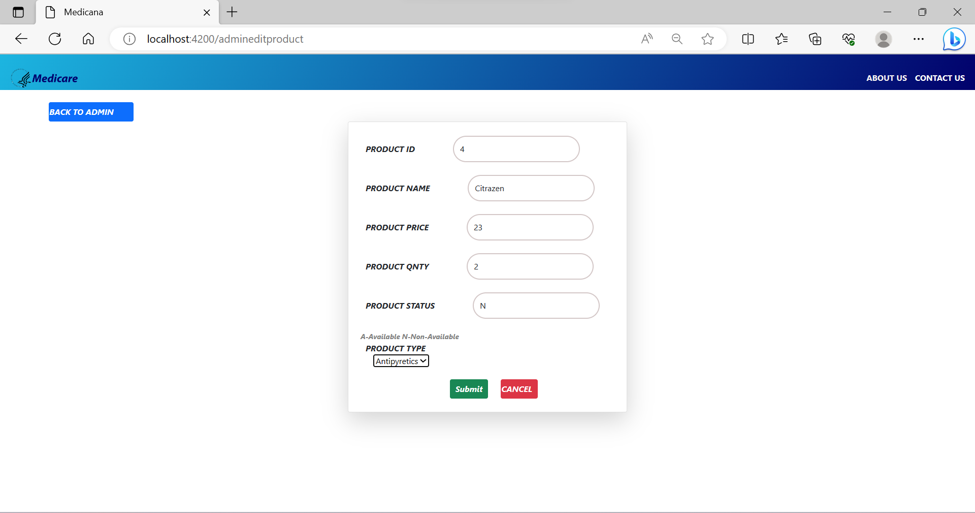
AdmineditProducts

Slide 21
Adminhome

Slide 22
Adminproducts

Slide 23
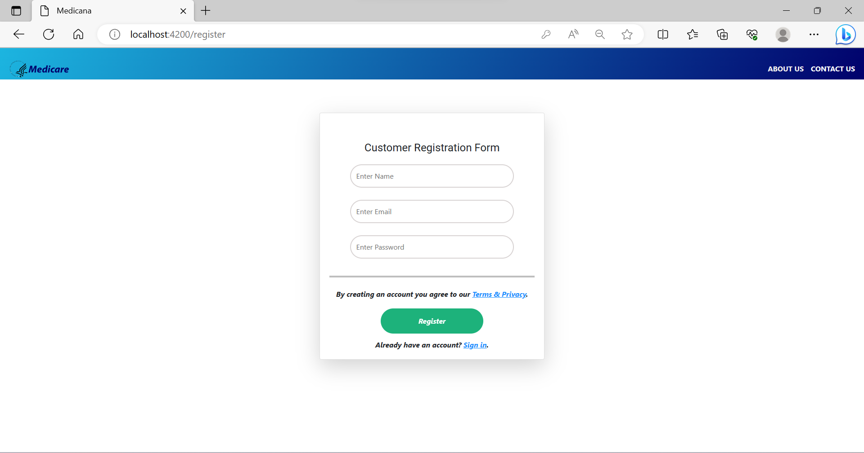
CustomerRegister

Slide 24
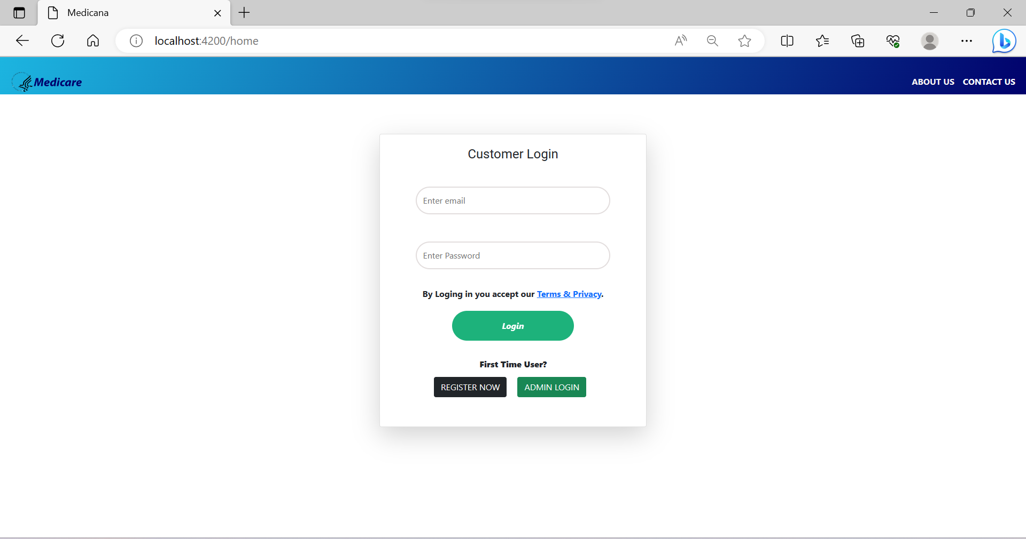
CustomerLogin

Slide 25
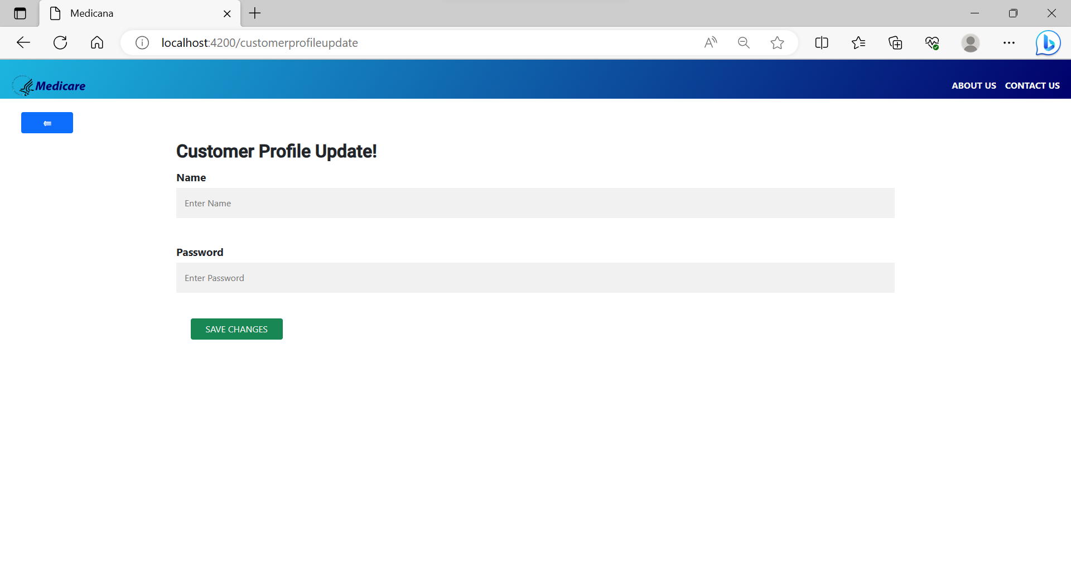
Customerprofileupdate

Slide 26
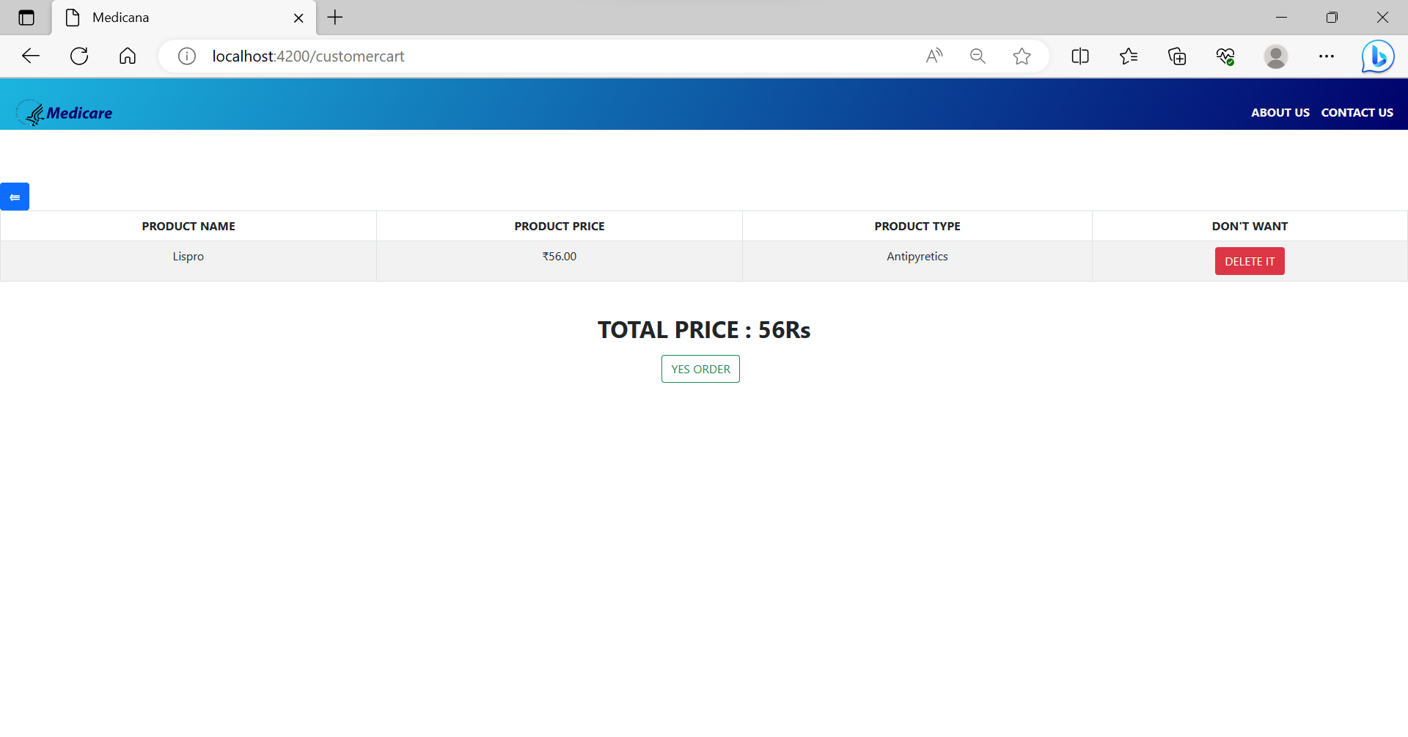
Customercart

Slide 27
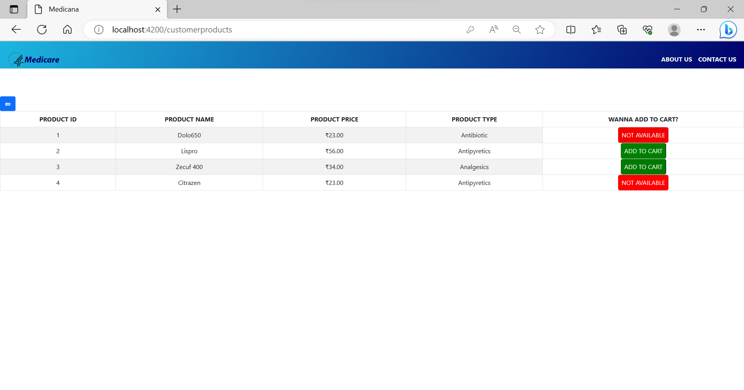
Customerproducts

Slide 28
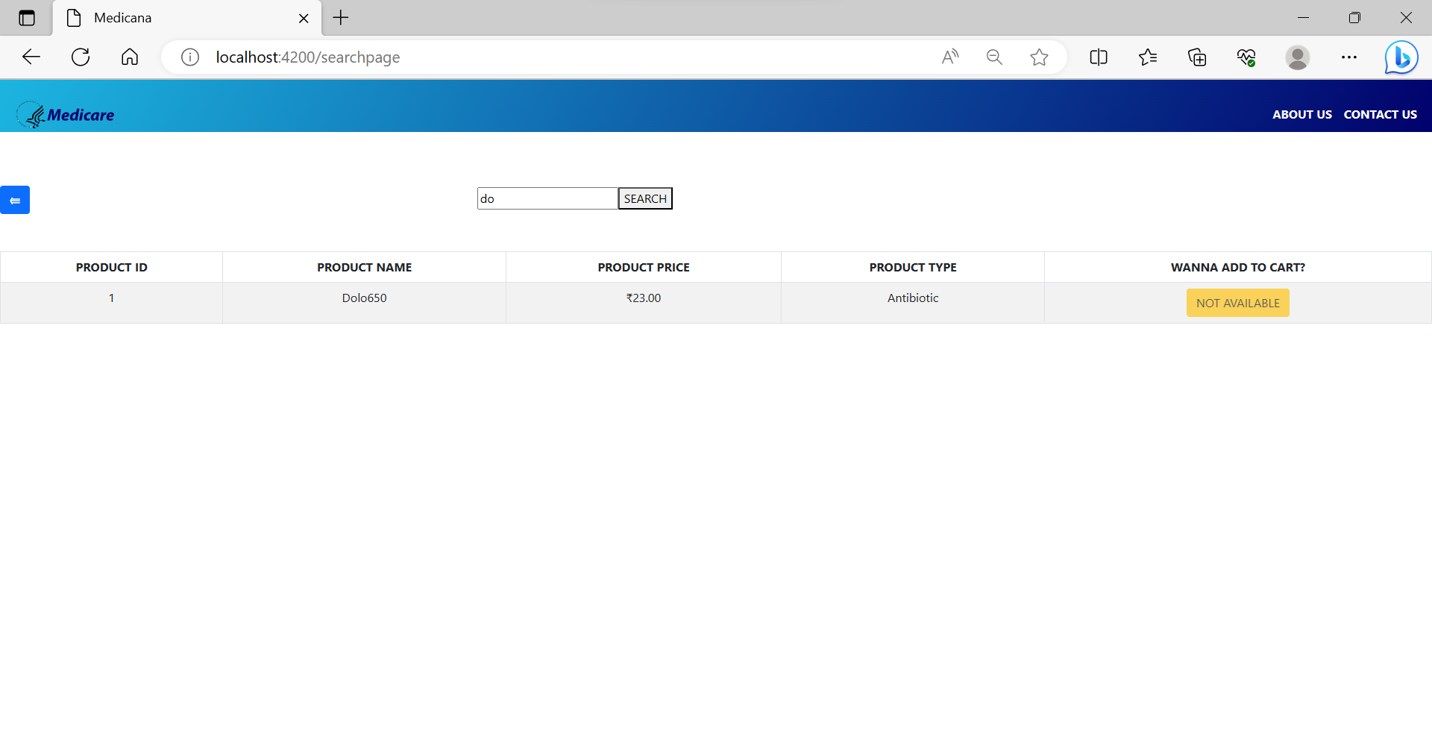
Search

Slide 29
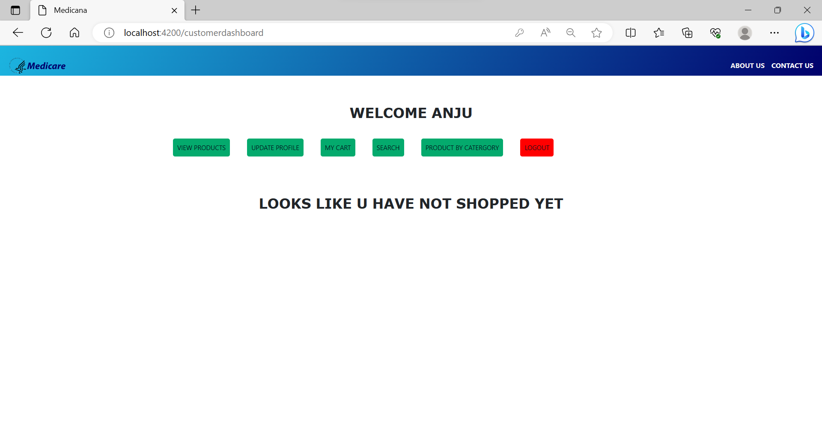
Customerdashboard

Slide 30
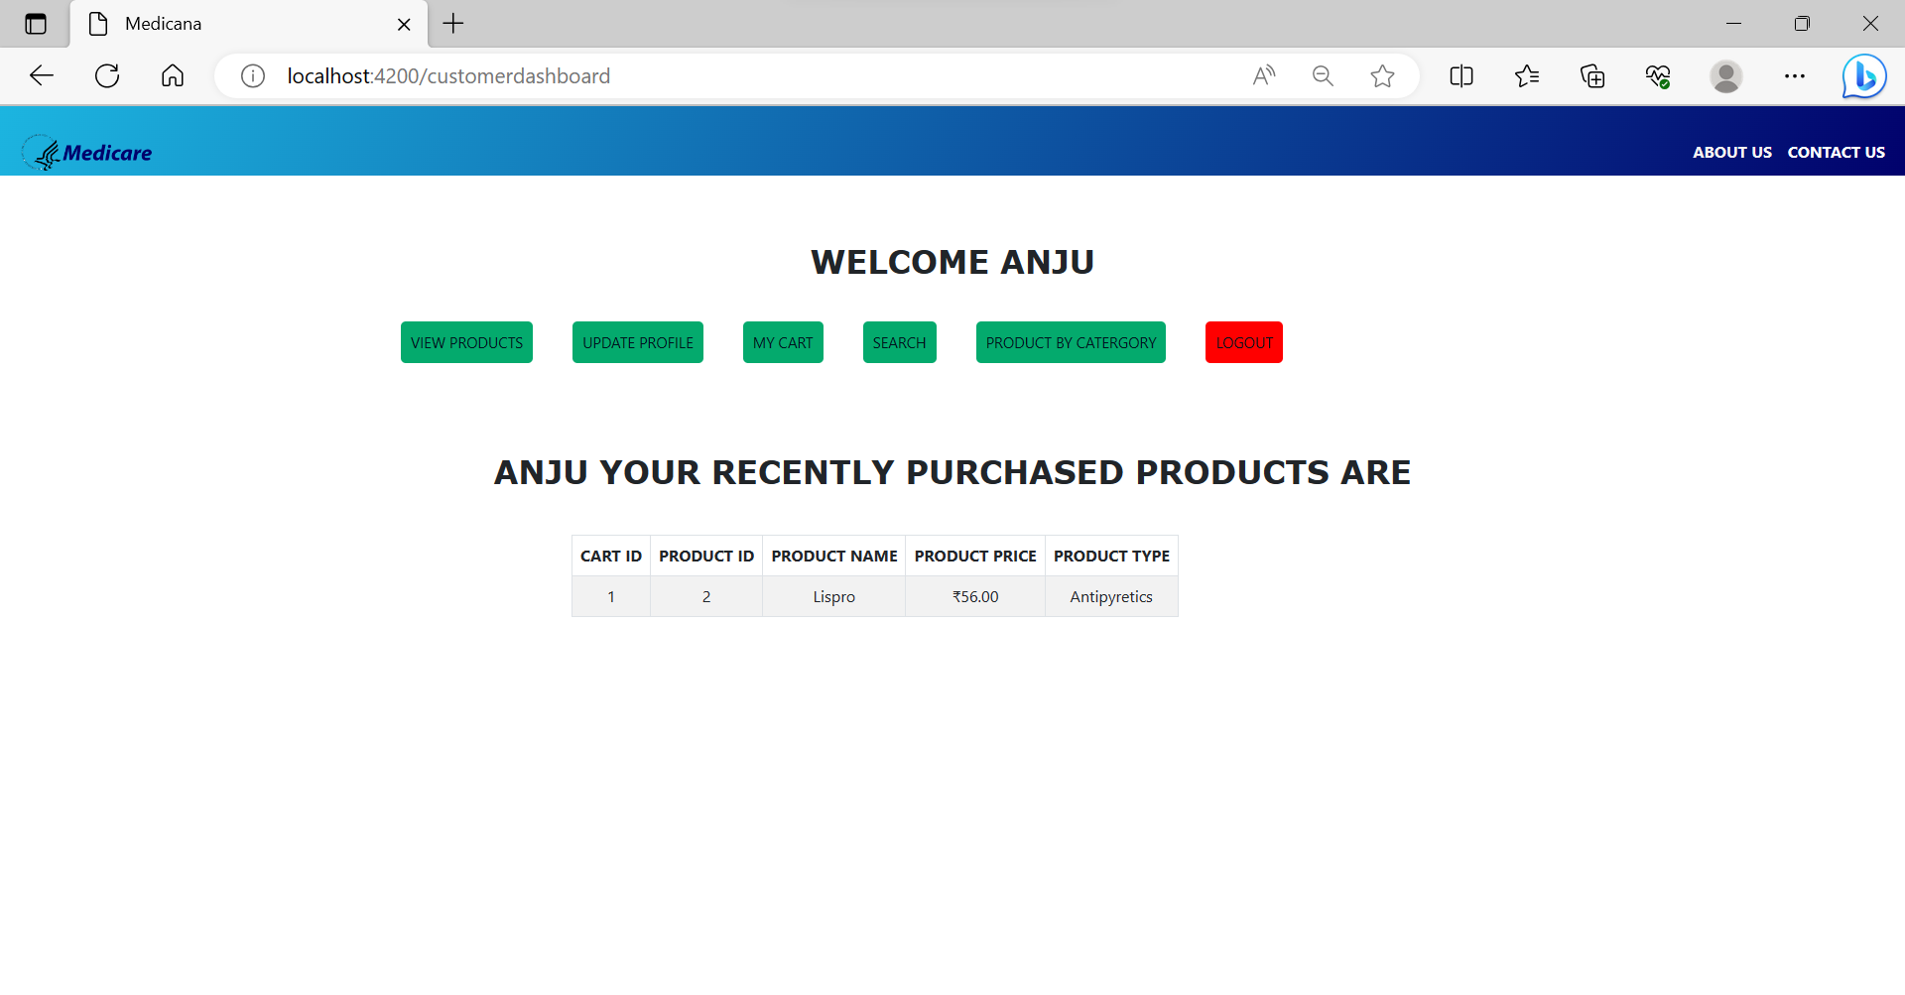
Customerdashboard

Slide 31
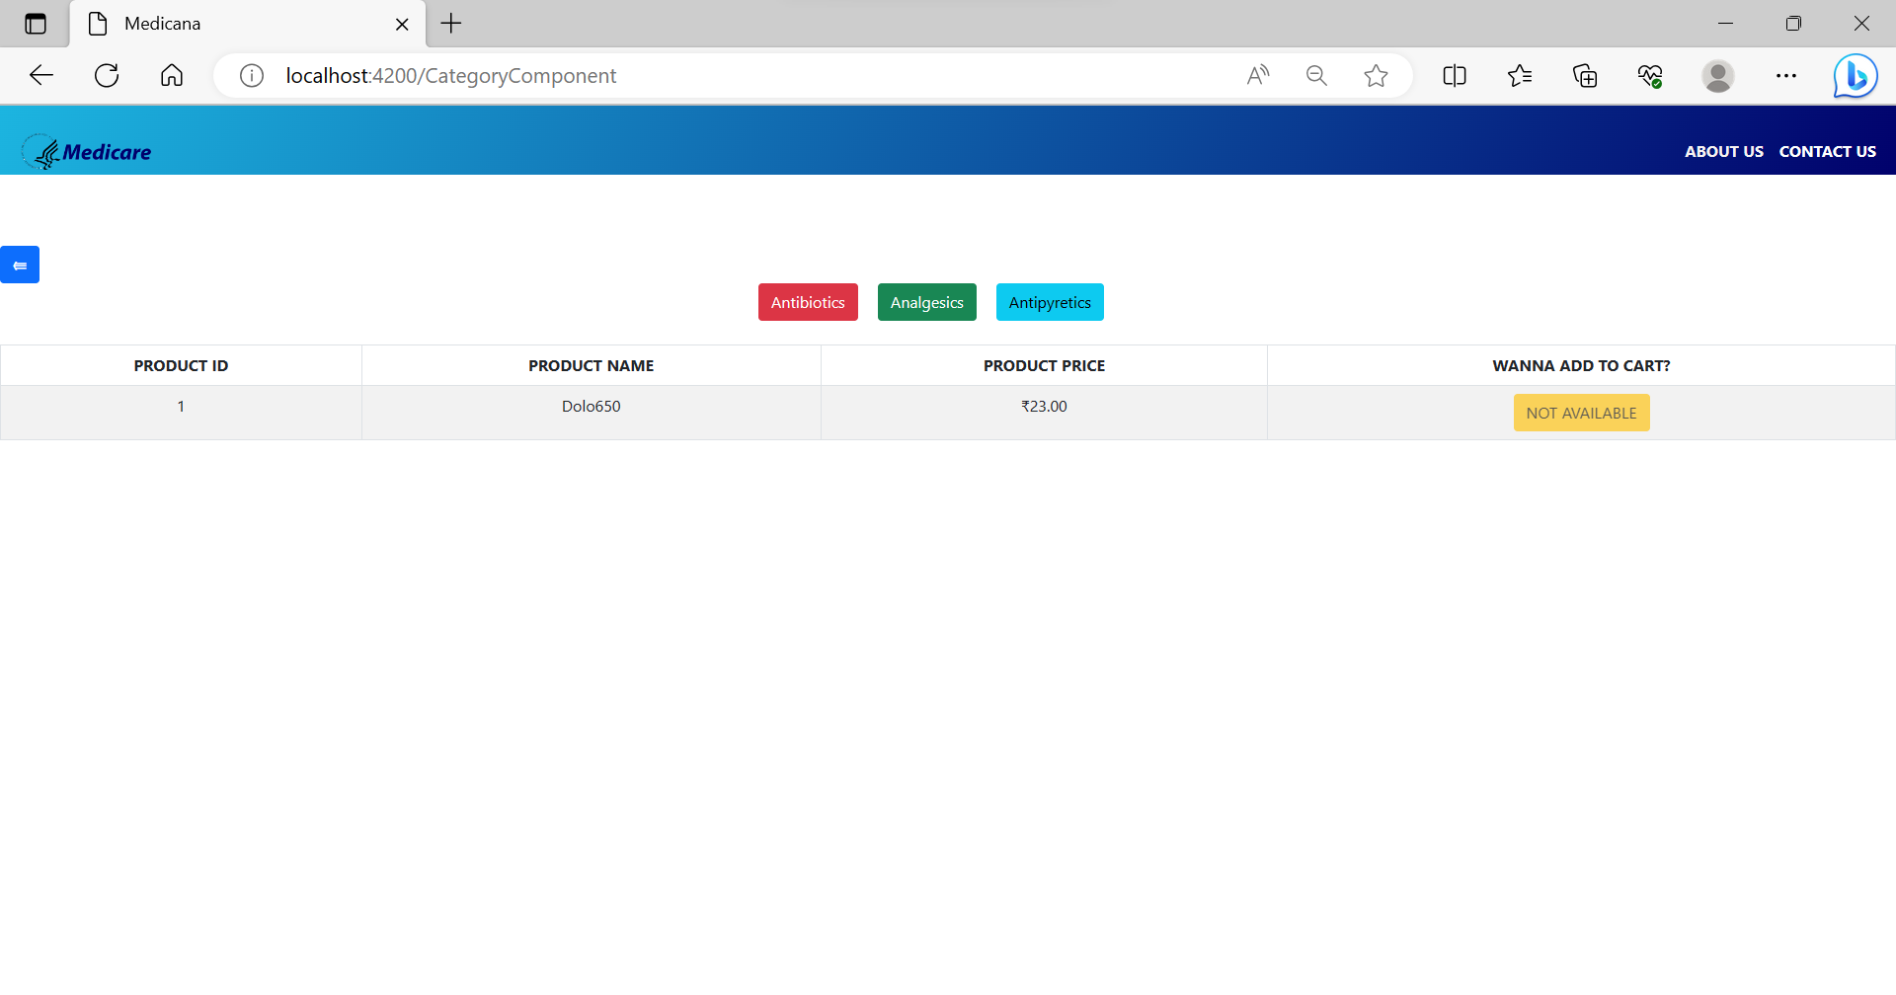
Category

Slide 32
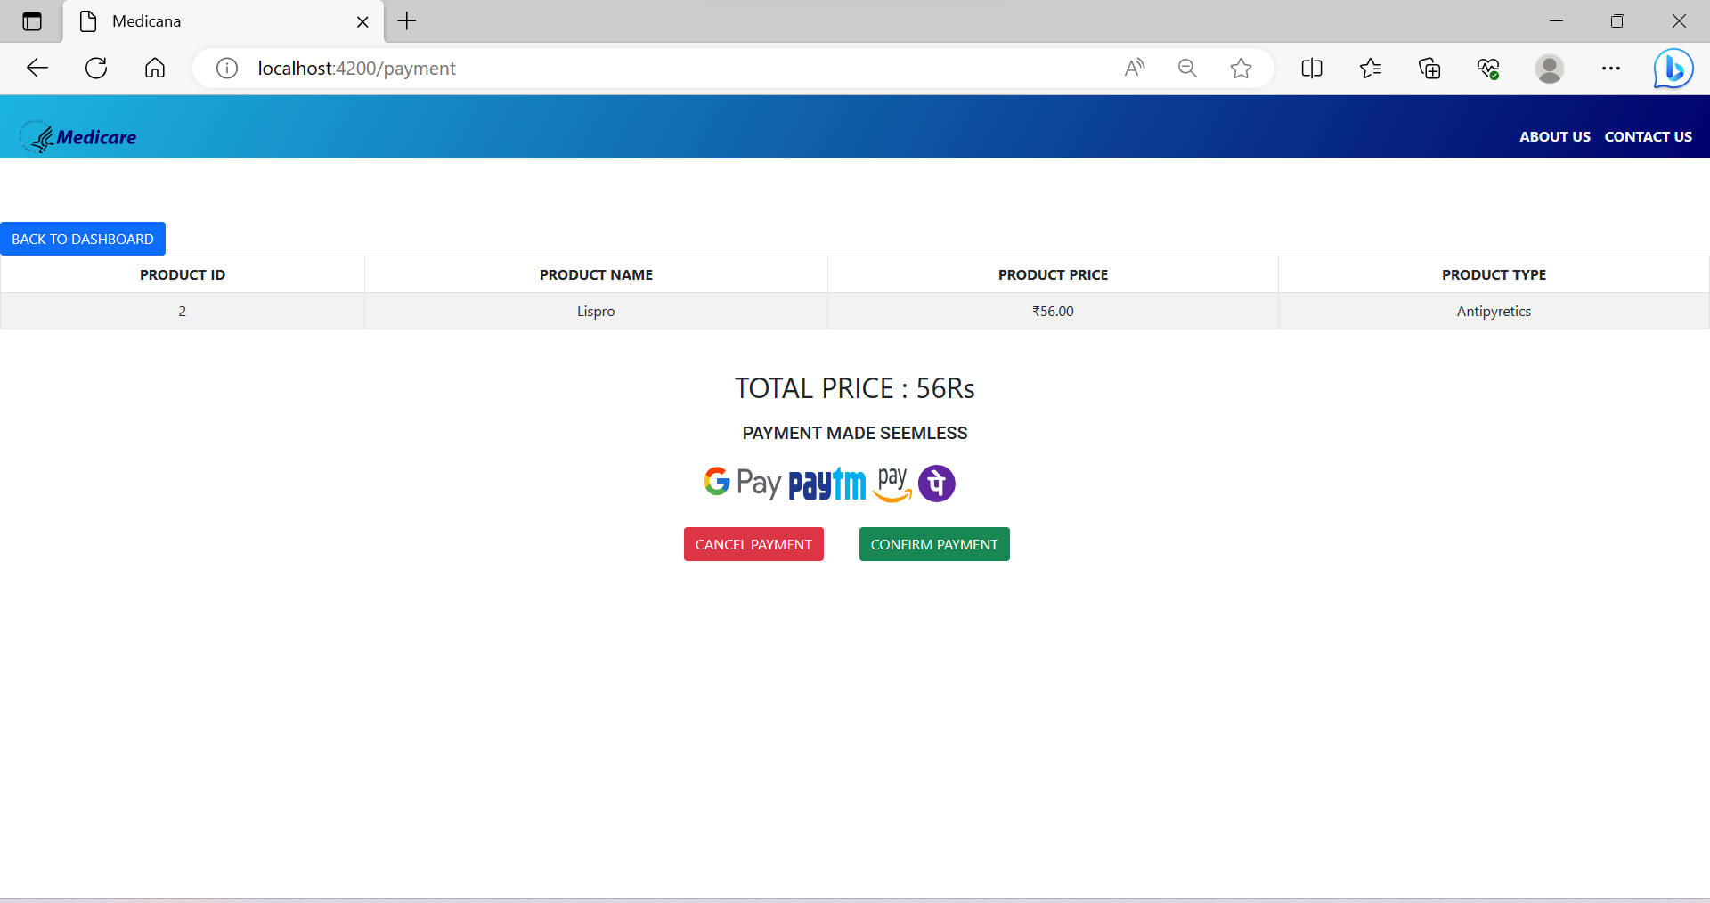
Payment

Slide 33
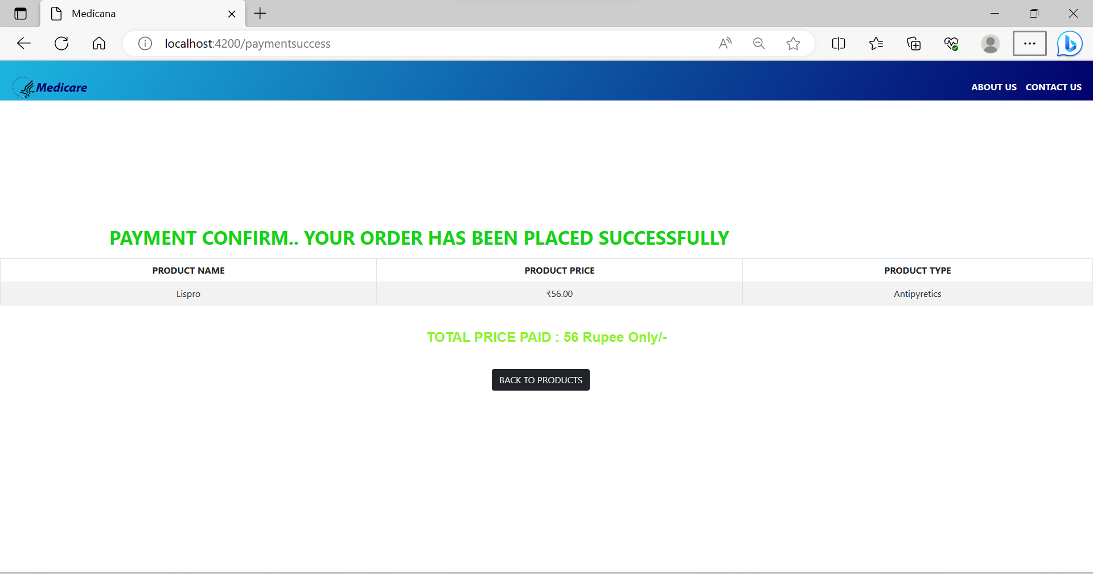
Paymentsuccess

Slide 34
PaymentSuccess Customerdashboard

Slide 35
Future Scope
The scope of this project is to make the medicine available to the user at cheaper price than the retail stores.
Making the medicine available to every small city and town with the help of
E-Medicare.

Slide 36
CONCLUSION
Our project is only a humble venture to satisfy the needs to manage their project work. At the end it is concluded that we have made effort on following points
We understand the problem domain and produce a model of the system, which describes operations that can be performed on the system.
We included features and operations in detail, including screen layouts.
We designed user interface related to system.
Finally, the system is implemented and tested according to test cases.

Slide 37


