Slide 1

CGL
MINI Project
with OpenGL
Our Team:
2110 - Sushant Behere 2113 - Atharva Bhosale 2121 - Nayan choudhary 2129 - Mahesh Dudhe
Mentor:
Prof. Mrinali Bhajibhakre
Space Invaders:
A Classic Atari Game

Slide 2
Table of Contents
Space Invaders: Classic Atari Game || CGL Mini Project
Part 1: Introduction to OpenGL and Libraries used
Part 2: Logic and Code Explaination
Part 3: Game Demonstration
Object Oriented Structure: C++ Object Collision Game Elements
Execution of program
OpenGL GLFW GLEW
02

Slide 3

Introduction to
OpenGL GLFW GLEW
OpenGL and
Libraries used

Slide 4
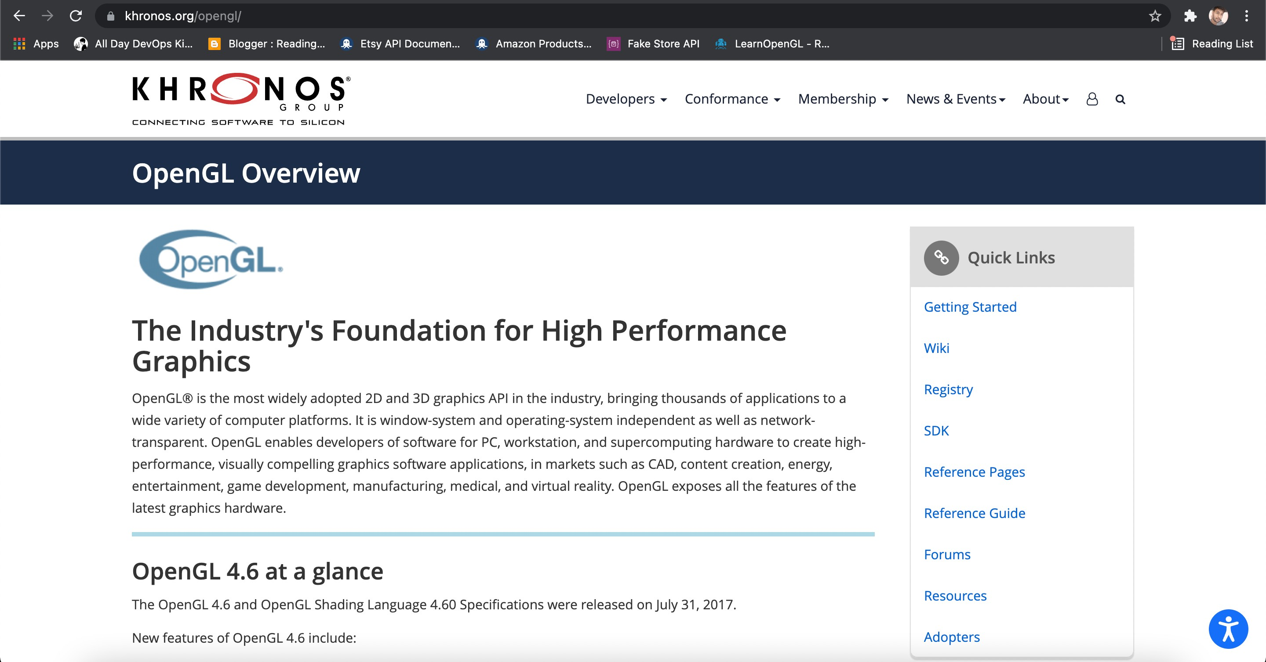

Slide 5
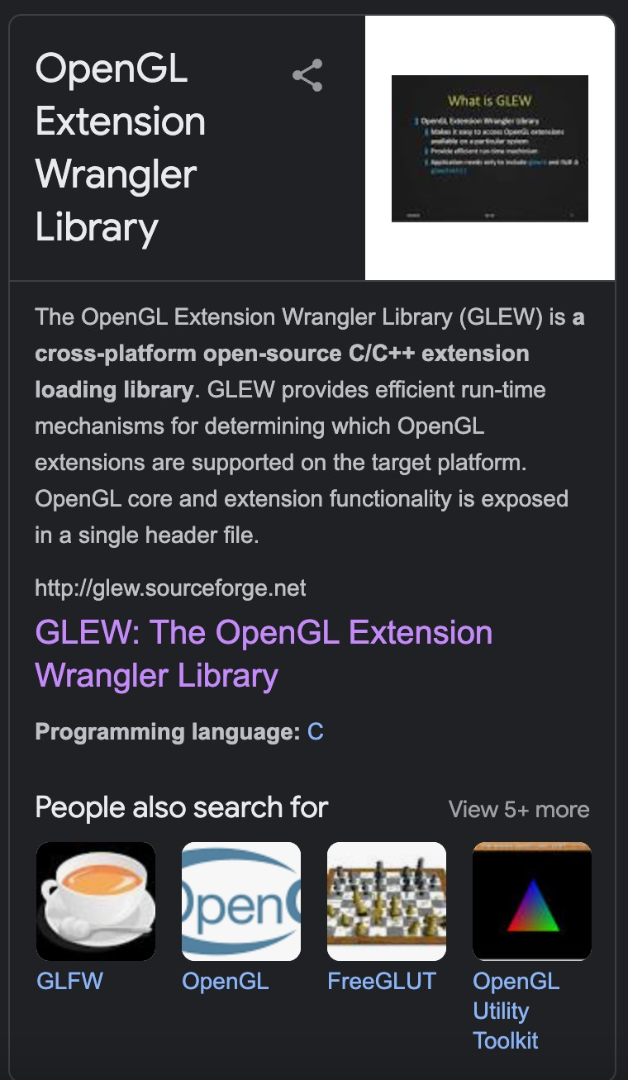
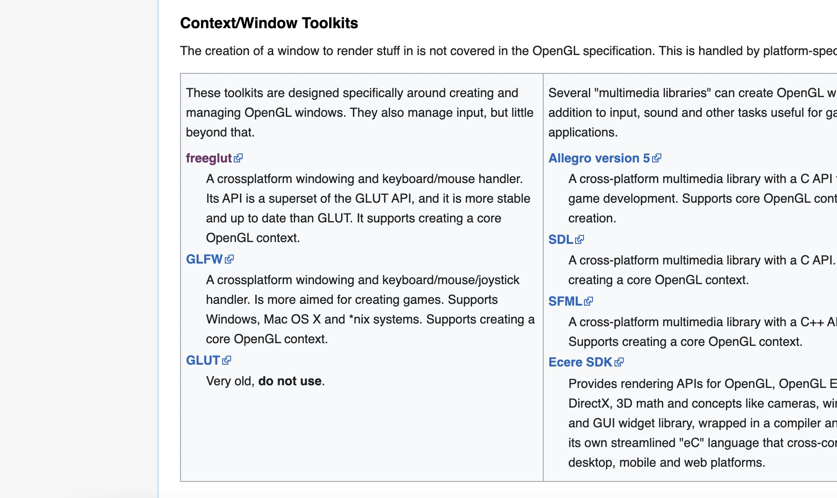
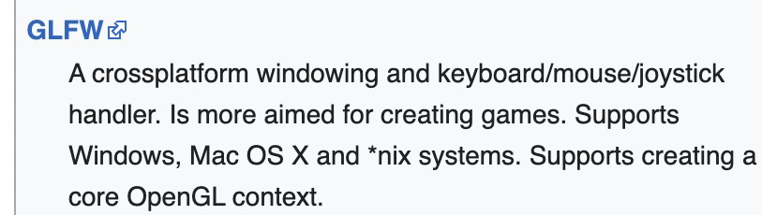
GLFW AND
GLEW LIABRARIES
We import these to enable most of the OpenGL functionalities

Slide 6


Part 2:
Logic and Code
Object Oriented Structure: C++ Object Collision Game Elements
Explaination

Slide 7
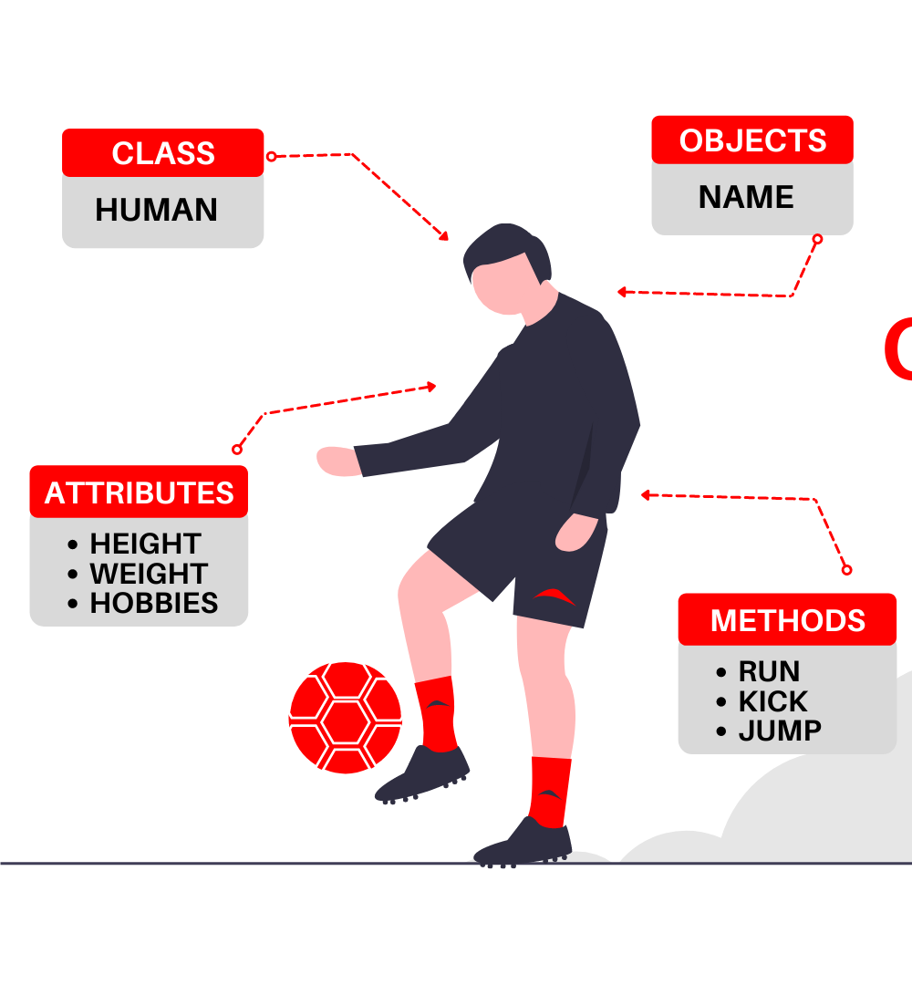
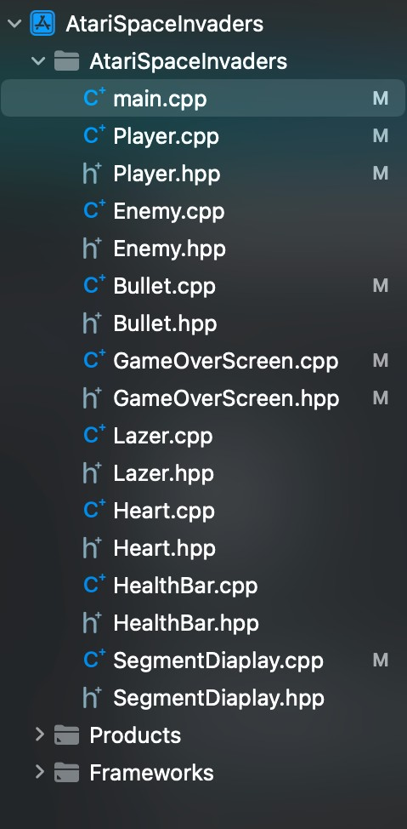
OOP:
OBJECT
ORIENTED
PROGRAMMING

Slide 8
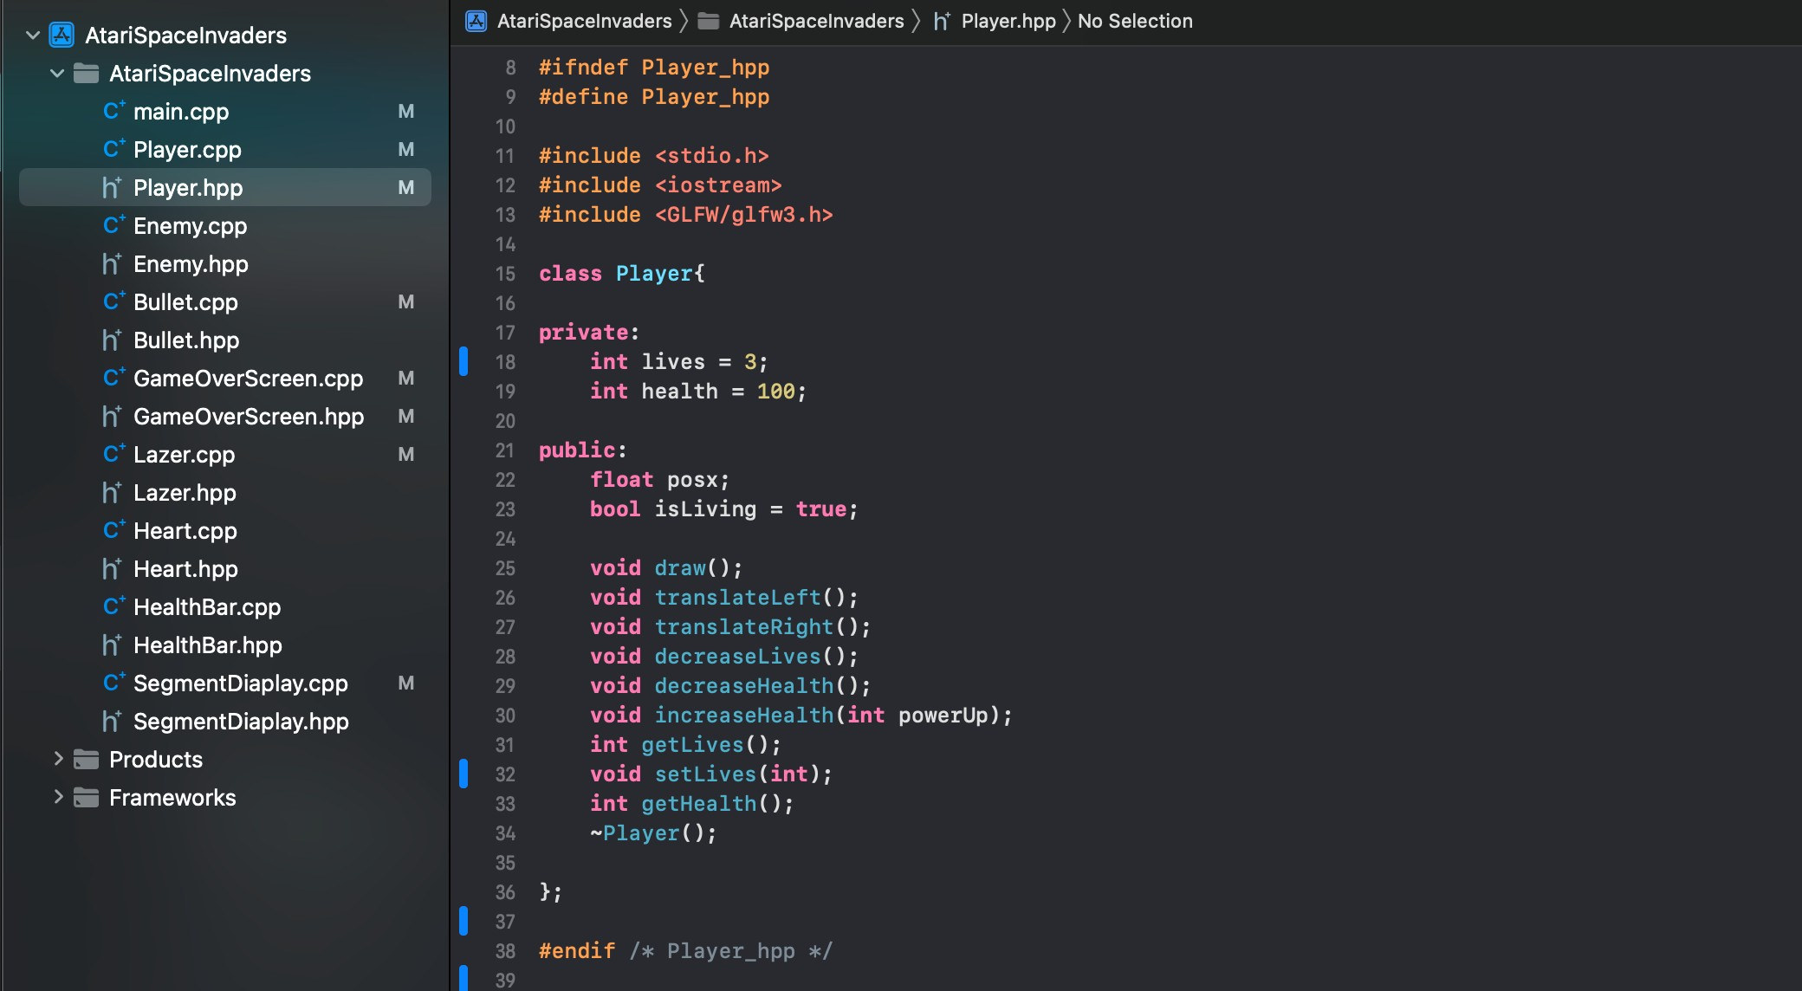
OOP
OBJECT
ORIENTED
PROGRAMMING
: IMPLEMENTATION

Slide 9
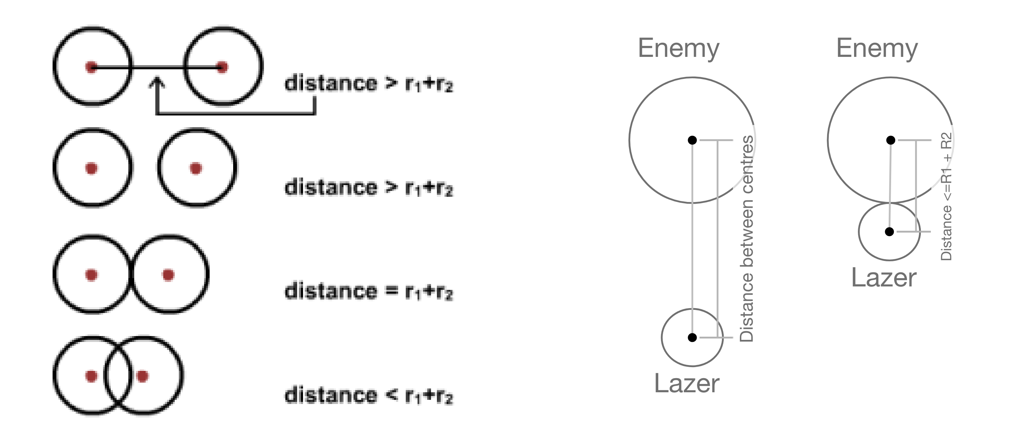
O B J E C T C O L L I S I O N
O b j e c t
d e t e c t i o n u s i n g d i s t a n c e t r a c i n g e v e r y
f r a m e

Slide 10
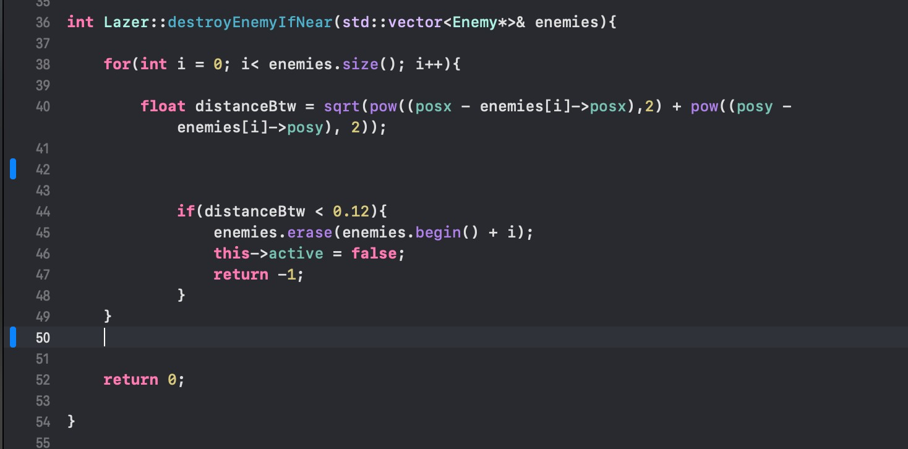

Slide 11

Part 2.3
Game Interface

Slide 12
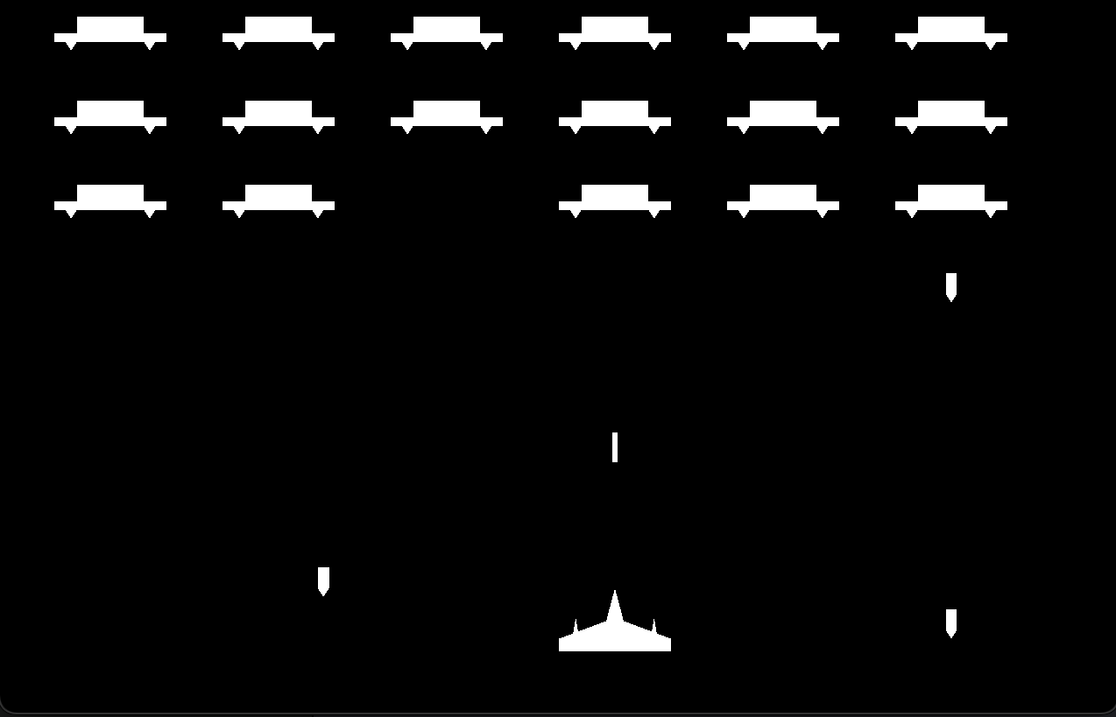




Enemy Ship
Player Ship
Lazer
Bullet

Slide 13





Player ship Health
Player Score
Player Lives
Lazer Reload bar

Slide 14
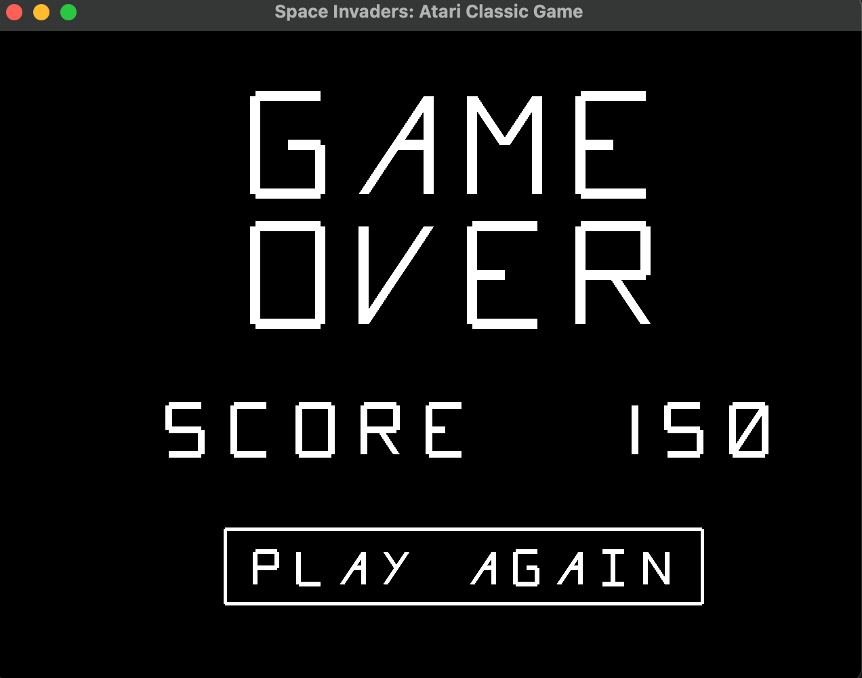


Slide 15

Part 3:
Demonstration

