Slide 1


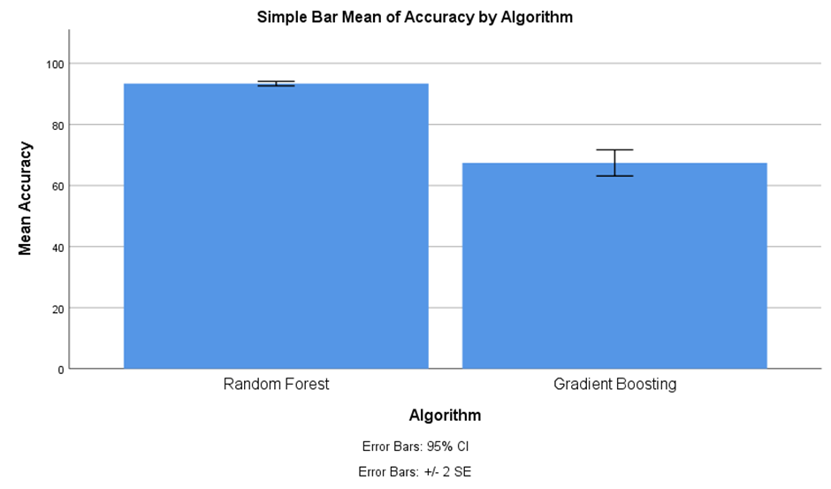
Students Name: N.Mahesh
Registration number:192111287
Guided By-Dr.Uma Priyadarsini
Analysing the Prioritization of Emergency Cases in Hospitals with Innovative Support Vector Machines Algorithm compared to Neural Network to improve the Accuracy.
INTRODUCTION
A medical emergency is an injury or illness that is acute and poses an immediate risk to a person's life or long-term health and it's extremely important to attend to these patients immediately.
Traditional methods rely heavily on clinical judgment, which can be subjective and prone to biases, Integrating advanced technologies like Support Vector Machine with Neural Networks offers a promising solution to enhance the accuracy and speed of prioritization processes.
As new data becomes available and patient populations evolve, the model can be retrained and fine-tuned to maintain optimal performance. Continuous learning ensures that the prioritization algorithm remains robust and aligned with the latest clinical insights and best practices.
By harnessing the strengths of both algorithms, healthcare institutions can enhance the accuracy, efficiency, and adaptability of their prioritization processes, ultimately leading to improved patient outcomes.
Hospital Emergency Case
MATERIALS AND METHODS
Input Data
Pre-processing
Training Data
SVM in ML
Output
Emergency Management
Neural Network diagnosis
Flow Diagram of Prioritizing Emergency Cases in Hospitals
RESULTS
Table-1:Independent Samples Test
 | Levene’s Test for Equality of Variances |  |  |  |  | T-test for Equality of Means |  | 95% Confidence Interval of the Difference
 | F | Sig. | t | df | Sig. (2-tailed) | Mean Difference | Std. Error Difference | Lower | Upper
Equal variances assumed | .737 | .394 | 57.103 | 58 | .000 | 29.267 | .513 | 28.241 | 30.293
Equal variance not assumed |  |  | 57.103 | 56.342 | .000 | 29.267 | .513 | 28.240 | 30.293
Comparison of Support Vector Machine & Neural Network
Table-2:Group Statistics
GROUP | N | Mean | Std. Deviation | Std.Error mean
Support Vector Machine | 30 | 93.33 | 1.807 | .330
Neural Network | 30 | 64.07 | 2.149 | .392
DISCUSSION AND CONCLUSION
According to an independent sample test, the algorithm obtains a significant accuracy difference of 0.001 (p<0.05). The Support Vector Machine approach performs better than other machine learning techniques in the area of hospital emergency cases.
SVM is a powerful supervised learning algorithm used for classification and regression tasks, It works well in high-dimensional spaces and is effective even when the number of features exceeds the number of samples.
The SVMs provide high accuracy and interpretable decision boundaries, making them suitable for scenarios where transparency and trust are essential. Meanwhile, NNs excel in capturing complex patterns but may lack interpretability and pose scalability challenges.
Ultimately, the choice between SVM and NN should be guided by the specific requirements and constraints of the healthcare setting, with careful consideration of factors such as data characteristics, computational resources, and the interpretability needs of healthcare professionals.
SVMs are preferred in scenarios with relatively small to moderate-sized datasets and high-dimensional feature spaces, where they can find optimal hyperplanes for classification tasks efficiently.
SVM is known for its effectiveness in high-dimensional spaces and its capability to handle non-linear data through the use of kernel
BIBLIOGRAPHY
“Extending the Framework for Mobile Health Information Systems Research: A Content Analysis.” 2017. Information Systems 69 (September): 1–24.
Ma, Yujun, Yulei Wang, Jun Yang, Yiming Miao, and Wei Li. 2024. “Big Health Application System Based on Health Internet of Things and Big Data.” Accessed March 6, 2024. https://ieeexplore.ieee.org/abstract/document/7782325/.
Alam, Muhammad Mahtab, Hassan Malik, Muhidul Islam Khan, Tamas Pardy, Alar Kuusik, and Yannick Le Moullec. 2024. “A Survey on the Roles of Communication Technologies in IoT-Based Personalized Healthcare Applications.” Accessed March 6, 2024.
“Medicine Reminder and Monitoring System for Secure Health Using IOT.” 2016. Procedia Computer Science 78 (January): 471–76.
Pavel, Misha, Holly Brugge Jimison, Howard D. Wactlar, Tamara L. Hayes, Will Barkis, Julia Skapik, and Jeffrey Kaye. 2024. “The Role of Technology and Engineering Models in Transforming Healthcare.” Accessed March 6, 2024. https://ieeexplore.ieee.org/abstract/document/6490450/.

