Slide 1


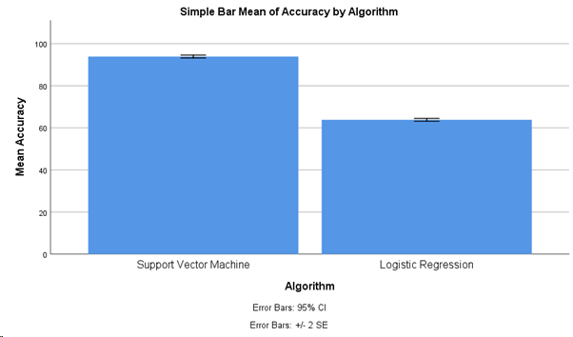
Name:N.Mahesh
Register Number: 192111287
Guided by Dr. Uma Priyadarsini
Ms. Poorani.S
Guided by Dr. Mary Valantina. G
Prioritization of Emergency Cases in Hospitals using Innovative Support Vector Machines Algorithm compared with Logistic Regression for improving Accuracy.
INTRODUCTION
In the dynamic landscape of healthcare, the accurate and efficient prioritization of emergency cases is pivotal for ensuring timely interventions and optimizing patient outcomes.
In recent years, machine learning techniques have emerged as valuable tools for enhancing the prioritization process. Among these techniques, Support Vector Machine and Logistic Regression stand out as popular choices due to their effectiveness in classification tasks.
In this context, this study aims to explore and compare the utilization of Support Vector Machine with Logistic Regression for prioritizing emergency cases in hospitals.
By evaluating the performance of these two algorithms, healthcare institutions can make informed decisions to improve emergency care delivery and patient outcomes.
Ultimately, this research endeavors to provide valuable insights that can inform healthcare practitioners and policymakers in adopting the most effective approach to emergency case prioritization, thereby optimizing patient care outcomes and resource utilization in hospitals.
Traditional methods often rely on heuristics or basic statistical models to determine the urgency of cases, but with the advent of machine learning, more sophisticated algorithms have emerged to enhance this process.
Handling Emergency Situations
MATERIALS AND METHODS
Input data
Pre-Treatment
Medical Treatment
Output
Reevaluation
Patient safety
Flow Diagram of Prioritizing Emergency Cases in Hospitals
Table-1:Independent Samples Test
RESULTS
 | Levene’s Test for Equality of Variances |  |  |  |  | T-test for Equality of Means |  | 95% Confidence Interval of the Difference
 | F | Sig. | t | df | Sig. (2-tailed) | Mean Difference | Std. Error Difference | Lower | Upper
Equal variances assumed | .207 | .651 | 62.683 | 58 | .000 | 30.067 | .477 | 29.111 | 31.022
Equal variance not assumed |  |  | 62.83 | 57.968 | .000 | 30.067 | .477 | 29.111 | 31.022
 |  |  | 62.83 | 57.968 | .000 | 30.067 | .477 | 29.111 | 31.022
Table-2:Group Statistics
Comparison of Support Vector Machine &
Logistic Regression
GROUP | N | Mean | Std. Deviation | Std.Error mean
Support Vector Machine | 30 | 93.87 | 1.871 | .342
Logistic Regression | 30 | 63.80 | 1.827 | .334
DISCUSSION AND CONCLUSION
The method showed a statistically significant accuracy difference of 0.001 (p < 0.05) during independent sample testing. Notably, Support Vector Machine Algorithm performs better than other machine learning techniques in the domain of emergency circumstances.
The Support Vector Machine Algorithm demonstrates an impressive accuracy of 93.87%, outperforming the Logistic Regression Algorithm accuracy of 63.80%.
Prioritizing emergency cases is essential for maximizing patient outcomes, optimizing resource utilization, and upholding ethical principles of fairness and beneficence.
By systematically assessing clinical severity, allocating resources efficiently, and addressing logistical challenges, healthcare systems can ensure that those in most urgent need receive timely and appropriate care.
Continued efforts to refine triage protocols, enhance resource management, and strengthen coordination among healthcare providers are necessary to meet the evolving demands of emergency care and uphold the principles of patient-centered healthcare delivery.
In this discussion, several factors come into play when determining how to prioritize cases, including the severity of the condition, the potential for deterioration without immediate intervention, and the availability of resources.
In conclusion, prioritizing emergency cases in a hospital requires a comprehensive approach that considers clinical urgency, resource availability, and ethical principles.
BIBLIOGRAPHY
“A Research Approach of Telemedicine for Managing Fetal Condition Based on Machine Learning Technology from IoT-Based Wearable Medical Device.” 2021. In Machine Learning and the Internet of Medical Things in Healthcare, 113–34. Academic Press.
Mathur, Neha, Greig Paul, James Irvine, Mohamed Abuhelala, Arjan Buis, and Ivan Glesk. 2024. “A Practical Design and Implementation of a Low Cost Platform for Remote Monitoring of Lower Limb Health of Amputees in the Developing World.” Accessed March 7, 2024. https://ieeexplore.ieee.org/abstract/document/7723857/.
Pavel, Misha, Holly B. Jimison, Ilkka Korhonen, Christine M. Gordon, and Niilo Saranummi. 2024. “Behavioral Informatics and Computational Modeling in Support of Proactive Health Management and Care.” Accessed March 7, 2024. https://ieeexplore.ieee.org/abstract/document/7283558/.
Shoaib, Mohammed, Niraj K. Jha, and Naveen Verma. 2024. “Algorithm-Driven Architectural Design Space Exploration of Domain-Specific Medical-Sensor Processors.” Accessed March 7, 2024.
“Safety Assessment of Drug Combinations Used in COVID-19 Treatment: In Silico Toxicogenomic Data-Mining Approach.” 2020. Toxicology and Applied Pharmacology 406 (November): 115237.
Song, Lei, Yongcai Wang, Ji-Jiang Yang, and Jianqiang Li. 2024. “Health Sensing by Wearable Sensors and Mobile Phones: A Survey.” Accessed March 7, 2024.
Stamford, Jonathan A., Peter N. Schmidt, and Karl E. Friedl. 2024. “What Engineering Technology Could Do for Quality of Life in Parkinson’s Disease: A Review of Current Needs and Opportunities.” Accessed March 7, 2024. https://ieeexplore.ieee.org/abstract/document/7177045/.

