Slide 1

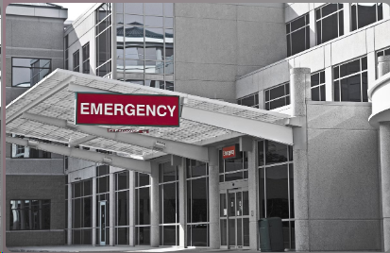
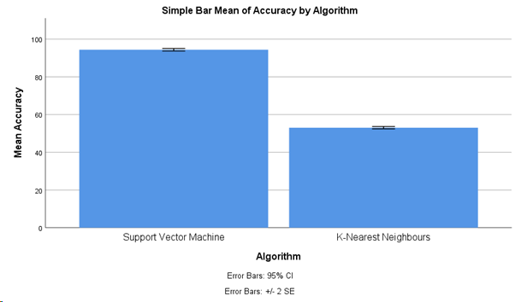
By identifying the most accurate and efficient algorithm for prioritizing emergency cases, hospitals can enhance their capacity to deliver timely and effective care, thereby saving lives and mitigating adverse health outcomes.
Students Name: N.Mahesh
Registration number:192111287
Guided By-Dr.Uma Priyadarsini
Improving accuracy of Prioritizing Emergency Cases in Hospitals using Innovative Support Vector Machines (SVMs) Algorithm in comparison with K-Nearest Neighbours.
INTRODUCTION
In today's fast-paced healthcare environment, the accurate prioritization of emergency cases is paramount to ensure timely and effective care delivery.
Hospitals are often inundated with a myriad of emergency cases, ranging from critical conditions requiring immediate attention to less urgent cases that can afford some delay.
In this study, we explore the application of Support Vector Machines, a powerful machine learning technique, to improve the accuracy of prioritizing emergency cases in hospitals.
The urgency and severity of patients' conditions demand swift and accurate decision-making to allocate resources efficiently and provide timely care.
Ultimately, our goal is to enhance patient outcomes and resource allocation in healthcare settings, thereby advancing the quality and efficiency of emergency care delivery.
Traditional methods of prioritization often rely on clinical judgment and subjective assessment, which can sometimes lead to suboptimal outcomes due to human error or bias.
Emergency Department
MATERIALS AND METHODS
Input Data
Pre-processing
Triage Future
Applications Triage
Output
Significant Improvements
Algorithm Implementation
Flow Diagram of Prioritizing Emergency Cases in Hospitals
RESULTS
Table-1:Independent Samples Test
 | Levene’s Test for Equality of Variances |  |  |  |  | T-test for Equality of Means |  | 95% Confidence Interval of the Difference
 | F | Sig. | t | df | Sig. (2-tailed) | Mean Difference | Std. Error Difference | Lower | Upper
Equal variances assumed | .848 | .361 | 91.386 | 57 | .000 | 41.332 | .452 | 40.427 | 42.238
Equal variance not assumed |  |  | 91.598 | 56.438 | .000 | 41.332 | .451 | 40.428 | 42.236
Table-2:Group Statistics
Comparison of Support Vector Machine &
K-Nearest Neighbour
GROUP | N | Mean | Std. Deviation | Std.Error mean
Support Vector Machine | 30 | 94.37 | 1.847 | .337
K-Nearest Neighbour | 30 | 53.03 | 1.614 | .300
DISCUSSION AND CONCLUSION
The method was found to achieve a noteworthy accuracy difference of 0.001 (p<0.05) in an independent sample test. Comparing the Support Vector Machine approach to other machine learning techniques, it performs better in the area of hospital emergency cases.
The Support Vector Machine Algorithm achieves an accuracy of 94.37%, surpassing the K-Nearest Neighbour Algorithm's 67.40%.
The SVM-based triage algorithm has demonstrated significant improvements in the accuracy and consistency of prioritizing emergency cases, with the potential to transform hospital operations.
Ongoing exploration of advanced machine learning techniques, integration with electronic health records, and interdisciplinary collaborations can further enhance the triage process.
Successful implementation of the SVM-based triage system in hospitals can lead to its widespread adoption, improving patient outcomes and healthcare efficiency.
Moving forward, further research and implementation efforts are warranted to validate the findings of this study in real-world healthcare settings and to explore additional avenues for enhancing emergency case prioritization.
In the context of prioritizing emergency cases in hospitals, the choice between SVM and KNN depends on various factors such as the size and complexity of the dataset, computational resources, and the desired level of accuracy.
BIBLIOGRAPHY
“Accuracy and Reliability of Emergency Department Triage Using the Emergency Severity Index: An International Multicenter Assessment.” 2018. Annals of Emergency Medicine 71 (5): 581–87.e3.
Alipour Vaezi, Mohammad, and Reza Tavakkoli-Moghaddam. 2020. “A New Methodology for COVID-19 Preparedness Centers Based on a Location-Allocation Platform.” International Journal of Industrial and Systems Engineering 13 (1): 35–41.
“An Electronic Emergency Triage System to Improve Patient Distribution by Critical Outcomes.” 2016. The Journal of Emergency Medicine 50 (6): 910–18.
Desautels, Thomas, Ritankar Das, Jacob Calvert, Monica Trivedi, Charlotte Summers, David J. Wales, and Ari Ercole. 2017. “Prediction of Early Unplanned Intensive Care Unit Readmission in a UK Tertiary Care Hospital: A Cross-Sectional Machine Learning Approach.” BMJ Open 7 (9): e017199.
“Machine-Learning-Based Electronic Triage More Accurately Differentiates Patients With Respect to Clinical Outcomes Compared With the Emergency Severity Index.” 2018. Annals of Emergency Medicine 71 (5): 565–74.e2.
Hong, Woo Suk, Adrian Daniel Haimovich, and R. Andrew Taylor. 2018. “Predicting Hospital Admission at Emergency Department Triage Using Machine Learning.” PloS One 13 (7): e0201016.

