Slide 1


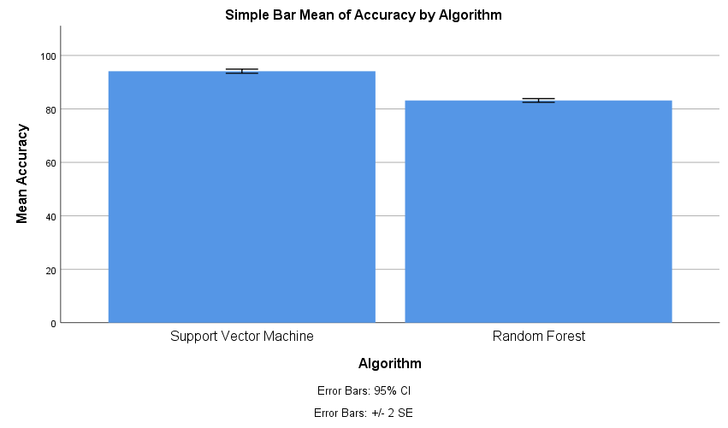
.
.
Name: N.Mahesh
Register Number: 192111287
Guided by Dr. Uma Priyadarsini.
Ms. Poorani.S
Guided by Dr. Mary Valantina. G
Prioritizing Emergency Cases in Hospitals using Innovative Support Vector Machines Algorithm comparing with Random Forest Algorithm for better Accuracy.
.
INTRODUCTION
Efficiently managing emergency cases in hospitals is essential for providing timely and effective care, This entails employing established triage protocols to evaluate the severity of each patient's condition.
By swiftly identifying critical cases, medical personnel can allocate resources and attention appropriately.
In the dynamic landscape of hospital emergency care, the swift and accurate prioritization of cases stands as a critical determinant of patient outcomes.
Recognizing the complexities inherent in this process, this study embarks on a quest for enhanced efficiency and precision, Central to our investigation is the exploration of two distinct yet powerful machine learning algorithms.
Through this comparative analysis, we seek to not only optimize the prioritization process but also offer insights that can potentially revolutionize emergency care protocols, ultimately translating into improved patient outcomes and resource allocation within hospital settings.
In any hospital setting, prioritizing emergency cases efficiently is crucial to ensure timely and effective care delivery.
Prompt and accurate prioritization of emergency cases is vital for allocating resources, optimizing patient outcomes, and enhancing overall healthcare efficiency.
Examining the patients
MATERIALS AND METHODS
Input Data
Pre-processing
Model Training Process
Output
Hyperparameter
Model Testing and Evaluation
Flow Diagram of Prioritizing Emergency Cases in Hospitals
RESULTS
Table-1:Independent Samples Test
 | Levene’s Test for Equality of Variances |  |  |  |  | T-test for Equality of Means |  | 95% Confidence Interval of the Difference
 | F | Sig. | t | df | Sig. (2-tailed) | Mean Difference | Std. Error Difference | Lower | Upper
Equal variances assumed | 0.239 | 0.627 | 21.436 | 58 | .000 | 10.946 | .511 | 9.924 | 11.968
Equal variance not assumed |  |  | 21.438 | 21.438 | .000 | 10.946 | .511 | 9.923 | 11.968
Table-2:Group Statistics
Comparison Accuracy of Support Vector
Machine &
Random Forest
GROUP | N | Mean | Std. Deviation | Std.Error mean
Support Vector Machine | 30 | 94.10 | 2.084 | .380
Random Forest | 30 | 83.16 | 1.8625 | .341
DISCUSSION AND CONCLUSION
According to an independent sample test, the algorithm's accuracy exhibits a noteworthy difference at a significance level of 0.001 (p<0.05). Among various machine learning algorithms evaluated for prioritizing emergency cases in hospitals, the Support Vector Machine consistently demonstrates superior performance.
The Support Vector Machine Algorithm achieves an accuracy of 94.10%, surpassing the Random Forest Algorithm 83.16%.
The superiority of one algorithm over another depends on various factors, including the nature of the dataset, the complexity of the problem, computational resources, and the specific requirements of the application
Despite its promising performance, it's important to acknowledge that the effectiveness of SVM may vary depending on the specific characteristics of the dataset and the nature of emergency cases encountered.
Therefore, it is essential to carefully evaluate and compare different algorithms based on empirical performance metrics and considerations of interpretability and computational efficiency before determining the most suitable approach for a given task.
In essence, the utilization of Support Vector Machine algorithms represents a significant step towards revolutionizing emergency care practices, empowering healthcare professionals with the tools needed to navigate complex scenarios and ultimately save lives.
Ultimately, the choice should be guided by the specific requirements and constraints of the healthcare system, with experimentation and validation playing a key role in determining the most effective algorithm for the task.
BIBLIOGRAPHY
Kalid, Naser, A. A. Zaidan, B. B. Zaidan, Omar H. Salman, M. Hashim, and H. Muzammil. 2017. “Based Real Time Remote Health Monitoring Systems: A Review on Patients Prioritization and Related ‘Big Data’ Using Body Sensors Information and Communication Technology.” Journal of Medical Systems 42 (2): 1–30.
Reducing Waiting Time for Remote Patients in Telemedicine with Considering Treated Patients in Emergency Department Based on Body Sensors Technologies and Hybrid Computational Algorithms: Toward Scalable and Efficient Real Time Healthcare Monitoring System.” 2020. Journal of Biomedical Informatics 112 (December): 103592Bouarara, Hadj Ahmed. 2019. “A Computer-Assisted Diagnostic (CAD) of Screening Mammography to Detect Breast Cancer Without a Surgical Biopsy.” International Journal of Software Science and Computational Intelligence (IJSSCI) 11 (4): 31–49.
Johnston CL, Coulthard MG, Schluter PJ, Dick ML. Medical emergencies in general practice in south-east Queensland: Prevalence and practice preparedness. Med J Aust. 2001;175:99–103.
Zhang, Xingyu, Joyce Kim, Rachel E. Patzer, Stephen R. Pitts, Aaron Patzer, and Justin D. Schrager. 2017. “Prediction of Emergency Department Hospital Admission Based on Natural Language Processing and Neural Networks.” Methods of Information in Medicine 56 (05): 377–89.
Shin, Kyohong, and Taesik Lee. 2020. “Emergency Medical Service Resource Allocation in a Mass Casualty Incident by Integrating Patient Prioritization and Hospital Selection Problems.” IISE Transactions, October. Pandey, Subhash Chandra. 2024. “Data Mining Techniques for Medical Data: A Review.” Accessed March 6, 2024.
“Survey-Based Calibration of a Parking Entry as a Single-Server Mathematical Queuing Model: A Case Study.” 2020. Alexandria Engineering Journal 59 (2)

