Slide 1
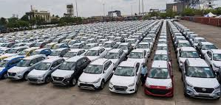
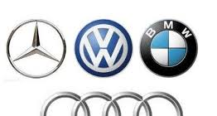
EDA – Car Sales Data
By Mahesh Rajah

Slide 2
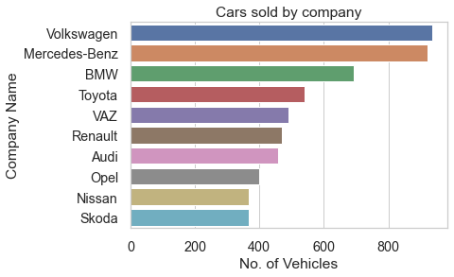
1. Which company sold most number of cars?
Volkswagen company sold most number of cars followed by Mercedes-Benz.

Slide 3
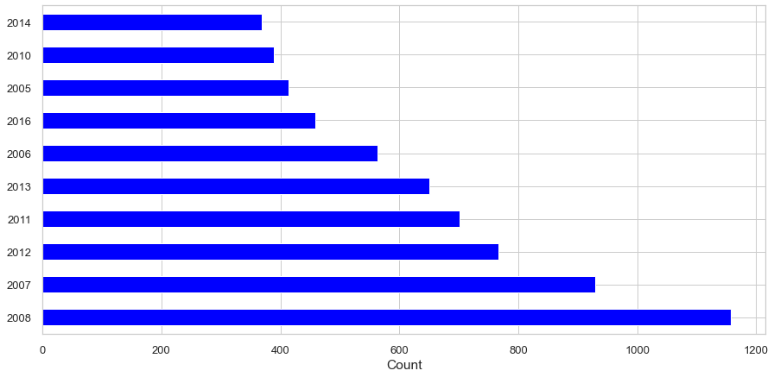
2. Which year was maximum number of cars sold?
Maximum number of cars were sold in year 2008.

Slide 4
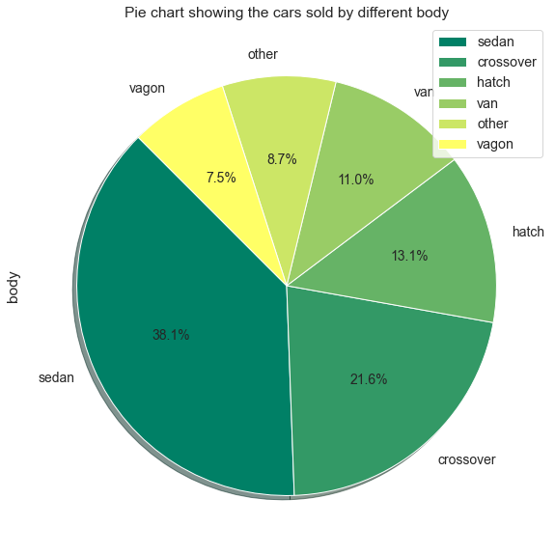
3. Which body segment of cars sold the most?
Sedan body car types are the most sold. Its around 38.1%
Crossover body car types are the next with 21.6% and Hatch body type with 13.1%

Slide 5
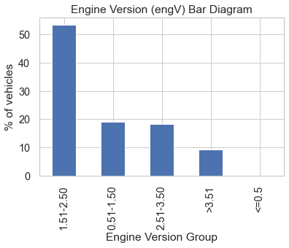
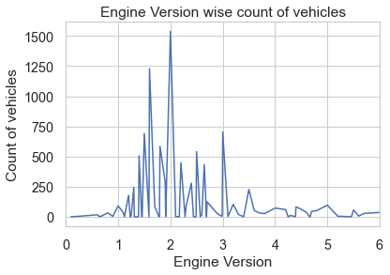
4. Which engine version of car is the most sold?
Approximately 92% of cars sold are of 1.5 to 3.5 engine version.
Engine Verison 2.0 is the most sold and 1.5 is the next best.

Slide 6
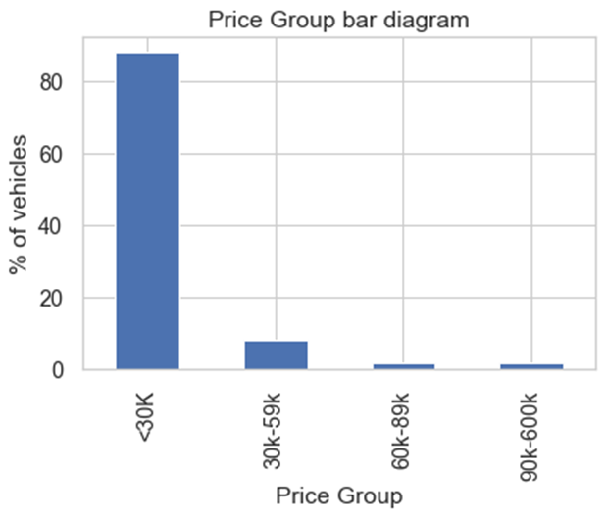
5. Which price segment of cars is the most sold?
85% of cars sold are in price range of less than 30K.

Slide 7
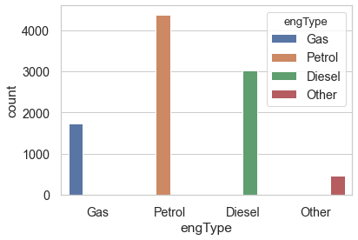
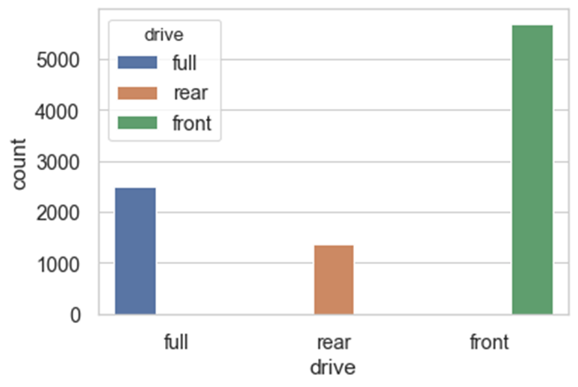
6. Which engine version and drive type of the car is the most sold?
Petrol engine type car is the most sold, followed by Diesel engine type car.
Front drive type car is the most sold, followed by full drive type car.

Slide 8
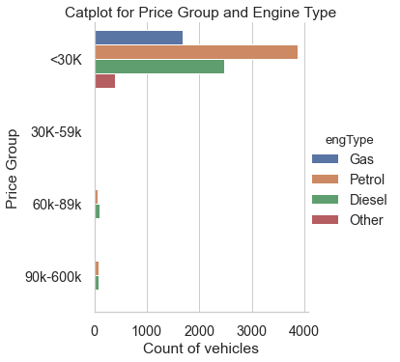
7. Does price of the car varies based on engine type?
Majority of cars sold in price range of less than 30k are Petrol cars.

Slide 9
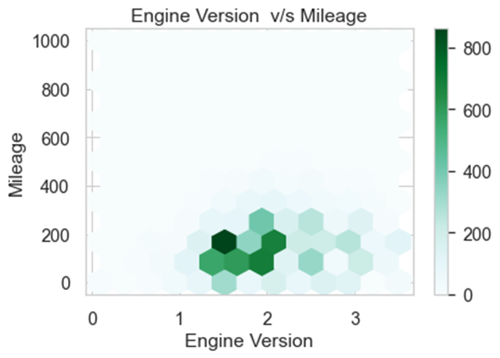
8. How does engine version relate to mileage of the car?
Most cars sold is of engine version 1.5 and its mileage is around 200.

Slide 10
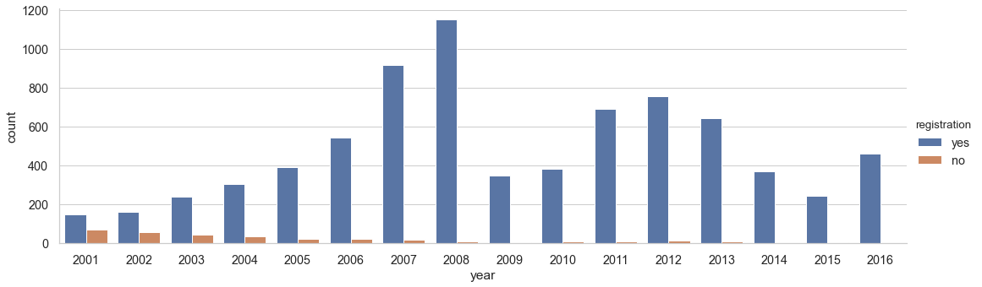
9. Relation between purchasing year and registration?
Majority of the cars purchased from year 2008 and later are registered.

Slide 11
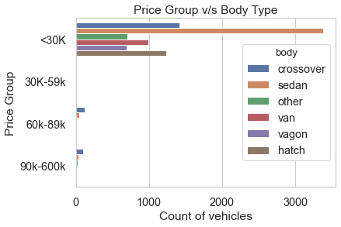
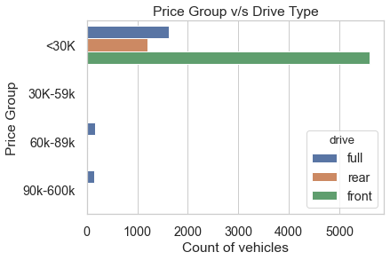
10. Relationship of price with body and drive type of car?
Majority of cars sold in price range of less than 30k are sedan
Majority of cars sold in price range of less than 30k are front drive type.

Slide 12
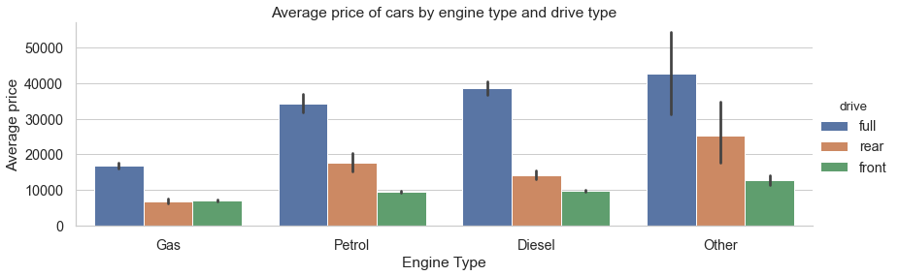
11. How does price relate to engine type (engType) and drive type of the car?
we can infer that for cars sold of all Engine Type, average price is more for full drive type cars

Slide 13
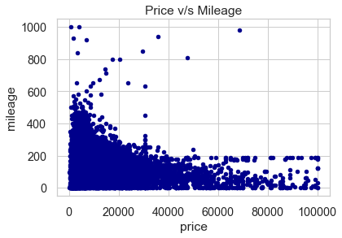
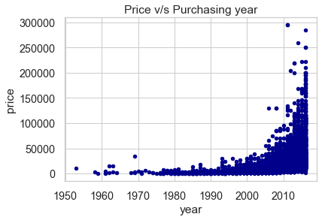
12. Relationship of price with mileage and purchasing year of the car?
Price and mileage has strongly negative correlation in sold car dataset i.e, lower price segment has higher mileage and higher price segment has lower mileage.
Majority of cards sold with purchasing year 2008 or later is of price 50k or lower.

Slide 14
THANK YOU

