Slide 1
Mahesh Selvalakshmi M
Bitcoin Price Prediction
3/21/2024 Annual Review

Slide 2
PROJECT TITLE
Bitcoin Price Prediction
3/21/2024 Annual Review

Slide 3


3/21/2024 Annual Review
AGENDA
Problem Statement
Objective
Project Overview
Who is the end user
Model Used
Dataset
Conclusion

Slide 4

PROBLEM STATEMENT
Develop a robust predictive model capable of accurately forecasting the price of Bitcoin over a given time horizon. This involves analyzing historical price data, identifying relevant features, and applying suitable machine learning or statistical techniques to make future price predictions. The objective of this proposed system is to develop an application which will predict the bitcoin prices in future with decent accuracy. This allows the investors to invest wisely in bitcoin trading as the prices of bitcoin have gone up to an exaggerating amount in the last ten years.
3/21/2024 Annual Review

Slide 5
Objective
The objectives of the “Bitcoin Price Prediction” can be stated as follows:
1. Develop an application which will predict the bitcoin prices in future with decent accuracy.
2. Allow the investors to invest wisely in bitcoin trading as the prices of bitcoin have gone up to an exaggerating amount in the last ten years.
3. Make use of machine learning algorithms to increase the accuracy of Bitcoin price prediction

Slide 6
PROJECT
OVERVIEW
The aim of this project is to develop a robust predictive model capable of forecasting the price of Bitcoin over a given time horizon. Bitcoin, as the leading cryptocurrency, exhibits high volatility and attracts considerable attention from investors, traders, and researchers. Accurate price prediction can offer valuable insights for decision-making in the cryptocurrency market.
Data Collection: Historical Bitcoin price data will be collected from reliable sources such as cryptocurrency exchanges, financial APIs, and databases. Additional data sources may include market sentiment indicators, trading volume, macroeconomic factors, and technical analysis metrics.
Feature Engineering: Relevant features influencing Bitcoin prices will be identified and extracted from the collected data. This involves preprocessing, normalization, and transformation of the data to enhance its suitability for predictive modeling.
Model Selection: Various machine learning algorithms and time series forecasting techniques will be explored to determine the most effective approach for Bitcoin price prediction. Candidate models may include regression models, autoregressive integrated moving average (ARIMA), long short-term memory (LSTM) networks, and ensemble methods.
3/21/2024 Annual Review

Slide 7

PROJECT
OVERVIEW
Model Training and Evaluation: The selected models will be trained using historical data and evaluated based on performance metrics such as Mean Absolute Error (MAE), Root Mean Squared Error (RMSE), and R-squared (R2) on a test dataset. Cross-validation techniques may be employed to ensure robustness and generalization.
Hyper parameter Tuning: The hyper parameters of the chosen models will be optimized to enhance predictive accuracy and minimize overfitting. Grid search, random search, or Bayesian optimization methods may be utilized for hyper parameter tuning.
Prediction and Visualization: Deployed models will generate future price predictions for Bitcoin, which will be visualized using interactive charts or dashboards. This allows stakeholders to interpret the forecasts effectively and gain insights into potential price trends.
Model Monitoring and Updating: A framework will be established for monitoring model performance over time, retraining the models periodically with updated data, and adapting to changing market conditions. Continuous evaluation and refinement ensure the relevance and accuracy of the predictive model.
3/21/2024 Annual Review

Slide 8

WHO ARE THE END USERS?
End-Users are:
Investors: Individual and institutional investors interested in Bitcoin as an investment asset can use the price predictions to make informed decisions regarding buying, selling, or holding Bitcoin positions. The predictions can help investors optimize their portfolio allocation and manage risk effectively.
Traders: Cryptocurrency traders engaged in short-term or intraday trading may utilize the price forecasts to identify potential trading opportunities and execute profitable trades. The predictions can assist traders in devising trading strategies, setting entry and exit points, and managing trading positions.
Financial Analysts: Professionals in the financial industry, including analysts, economists, and researchers, can leverage the predictive model to gain insights into Bitcoin market trends, evaluate market dynamics, and conduct scenario analysis. The predictions can inform investment research reports, market analysis, and strategic decision-making processes.
Cryptocurrency Exchanges: Exchange platforms that facilitate trading of Bitcoin and other cryptocurrencies can integrate the price prediction model into their trading platforms or analytical tools. This can enhance the user experience for traders by providing them with accurate price forecasts and market insights.
3/21/2024 Annual Review

Slide 9
Model Used
Linear Regression:
Linear regression is one of the easiest and most popular Machine Learning algorithms. It is a statistical method that is used for predictive analysis. Linear regression makes predictions for continuous/real or numeric variables such as sales, salary, age, product price, etc.
Linear regression algorithm shows a linear relationship between a dependent (y) and one or more independent (y) variables, hence called as linear regression. Since linear regression shows the linear relationship, which means it finds how the value of the dependent variable is changing according to the value of the independent variance
Linear regression assumes the linear relationship between the dependent and independent variables.
n
3/21/2024 A nual Review

Slide 10
Dataset
The dataset we will use here to perform the analysis and build a predictive model is Bitcoin Price data.
We will use (‘Open’, ‘High’, ‘Low’, ‘Close’) data from 1st Jan 2013 to 29th December 2017
which is for 5 years for the Bitcoin price.
Link: https://www.kaggle.com/datasets/imsid777/bitcoin-dataset
3/21/2024 Annual Review

Slide 11
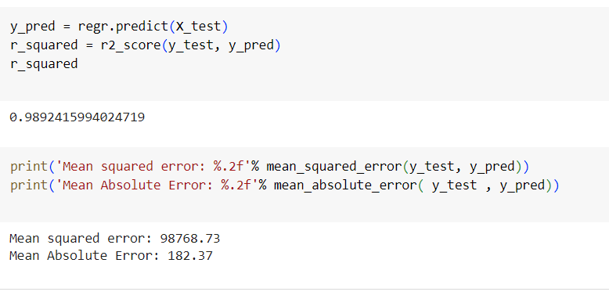
Conclusion
We introduced Bitcoin cryptocurrency prices in this study. We evaluated the network under different parameters for tuning the model. It has been found that using the activation function and appropriate dropout value, using gradient descent, a proper and experimented hidden node along with an effective learning rate value, and using the Adam learning algorithm considerably improved the overall result of prediction process, as well as it affected the performance of training time. The prediction is performed on Bitcoin real time dataset and after training we gained the accuracy of 95.7% with error loss of 0.00065 and 0.05 of RMSE which is quite satisfying for a time series data prediction.
Result:
n

