Slide 1
The Basic Concepts of OOPS
Objects
Classes
Inheritance
Encapsulation
Polymorphism
Abstraction

Slide 2

Object-oriented programming (OOP) is a computer programming model that organizes software in the form of objects.
Everything is represented in the form of objects.
The four pillars of OOPS
Inheritance
Polymorphism
Encapsulation
Abstraction

Slide 3
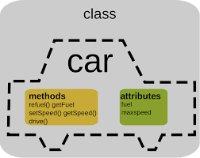
Classes
In object-oriented programming, a class is a template for an object which definition of the variables and methods.
Class is a logical representation
Inside Class we can write multiple Objects

Slide 4
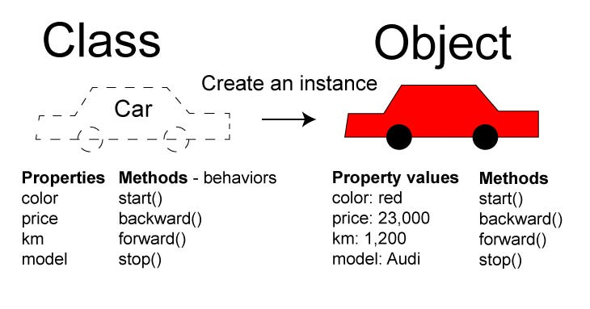
Objects
An object is an instance of a class which has its own states and behaviour. States variables or Properties Behavior methods or functionals
Object is a real time entity or physical representation of class and memory is allocated. to it.

Slide 5
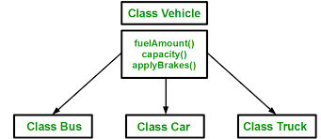
Inheritance
Inheritance is a mechanism in which one object acquires all the properties and behaviors of a parent object.
The class which shares their properties is know as Super class.
The class which acquires the properties is know a Sub class.

Slide 6
Types of Inheritance
Single Inheritance.
Multiple Inheritance.
Multilevel Inheritance.
Hierarchical Inheritance.
Hybrid Inheritance.

Slide 7
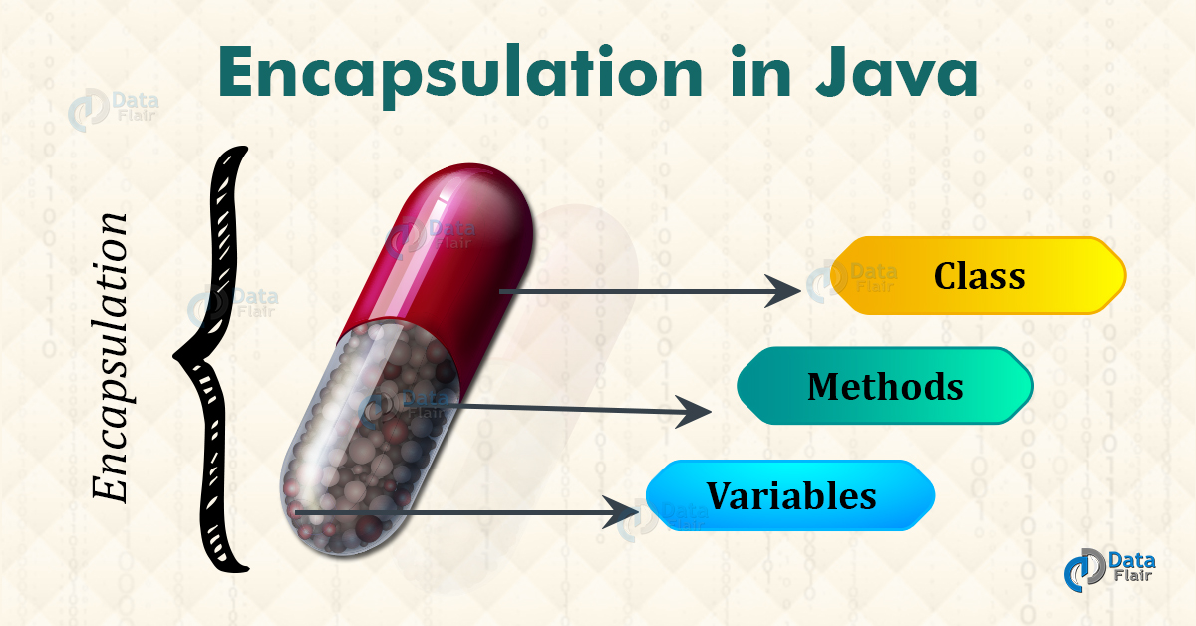
Encapsulation
Encapsulation is defined as the wrapping up of data under a single unit.
We can achieve encapsulation through class
Example:

Slide 8
Advantages of Encapsulation:
Data Hiding
Increased Flexibility
Reusability

Slide 9
Polymorphism
“poly” means many and “morphs” means forms.
Polymorphism means one object is showing different behavior in different stages of life cycle.
Types of Java Polymorphism
Compile-time Polymorphism
Runtime Polymorphism

Slide 10
Compile-time Polymorphism:
Method declaration is going to binds with method definition by the compile during compile time.
Compile-time polymorphism is also known as static polymorphism or early binding.
We can achieve Compile-time Polymorphism through the –
Method Overloading
Method shadowing

Slide 11
Runtime Polymorphism:
Method declaration is going to binds with method definition by the JVM during run time.
Runtime Polymorphism is also known as dynamic polymorphism or late binding.
We can achieve Runtime Polymorphism through the –
Inheritance
Method overriding
Upcasting

Slide 12
Abstraction
Abstraction in Java refers to hiding the implementation details of a code and exposing only the necessary information to the user.
We can achieve Abstraction through the abstract class and interface.
Example for abstraction is facebook application.
Advantages of abstraction is
Increase security
Code duplication

