Slide 1

AICTE INTERNSHIP PROJECT BOOK_RECOMMENDER
Presented By- Mahesh Ayushkanta barik
Student Name: Mahesh Ayushkanta barik
College Name: Nit Rourkela
Department: computer science and engineering
Email ID: maheshbarik2006@gmail.com
AICTE Student ID: AINSI_127288
MS USERNAME- MaheshAyushkantaBarik-7599

Slide 2
OUTLINE
Problem Statement
Proposed System/Solution
System Development Approach
Algorithm & Deployment
Result
Conclusion
Future Scope
References

Slide 3

Problem Statement
Sometimes We face the problem of searching things that we want but sometimes it is hard to search in a large database. If any solution is there which can help us to find our liking things or the things we actually look for or similar to what we want,then it would be a great help in reducing the time to search or completeion of task- be it watching movie or similar shopping items or liked genre books.

Slide 4
PROPOSED SOLUTION
The proposed system aims to address the challenge of searching books according to their name or similar type recommendation.The solution will consist of the following components(contd)

Slide 5
1.DATA COLLECTION
• Gathered book data from Kaggle datasets containing:
Book titles, authors, ISBNs , User ratings and reviews, Book metadata (genres, publication year, etc.)
• For this project, we used the Book-Crossing dataset containing:
271,379 books, 1,149,780 ratings and 278,858 users data from Kaggle official website
2.DATA PREPROCESSING
• Cleaned and preprocessed the collected data &
Handled missing values in author/publisher fields, Removed duplicate entries, Standardized ISBN formats
Feture engineering:
Created average rating fetures, Calculated rating counts per book,
Merged user, book, and rating datasets

Slide 6
3.ML ALGORITHMS USED
Popularity-Based Filtering
Ranks books based on two metrics:
Uses pandas operations for sorting, num_ratings (total number of ratings),avg_rating (average rating score)
K-Nearest Neighbors (KNN) Implicitly
(When finding similar books, the system effectively performs a KNN search (with K=4) in the similarity space)
Core Algorithm: Cosine Similarity
Measures angle between vectors in user-item rating space
Implemented via sklearn.metrics.pairwise.cosine_similarity()

Slide 7
4.DEPLOYMENT
• Developed multiple deployment options,Jupyter Notebook interface,Python script with command-line interface,Google Colabs and Github
5.EVALUATION
• Assessed system performance through:Qualitative inspection of recommendations,Coverage of recommendation catalog,Diversity of recommended items
• Results::System provides logically similar book recommendations & Popularity recommendations with matching known bestsellers

Slide 8
System Approach
System requirements: Not too much necessity of system architecture as it is based on online datasets and platform like Google colab so no load on System
Library required to build the model
pandas,
numpy,
sklearn

Slide 9
Algorithm & Deployment
Uses pandas operations for sorting, num_ratings (total number of ratings),avg_rating (average rating score), K-Nearest Neighbors (KNN) Implicitly
), Core Algorithm: Cosine Similarity
(already mentioned in prev. pages)

Slide 10
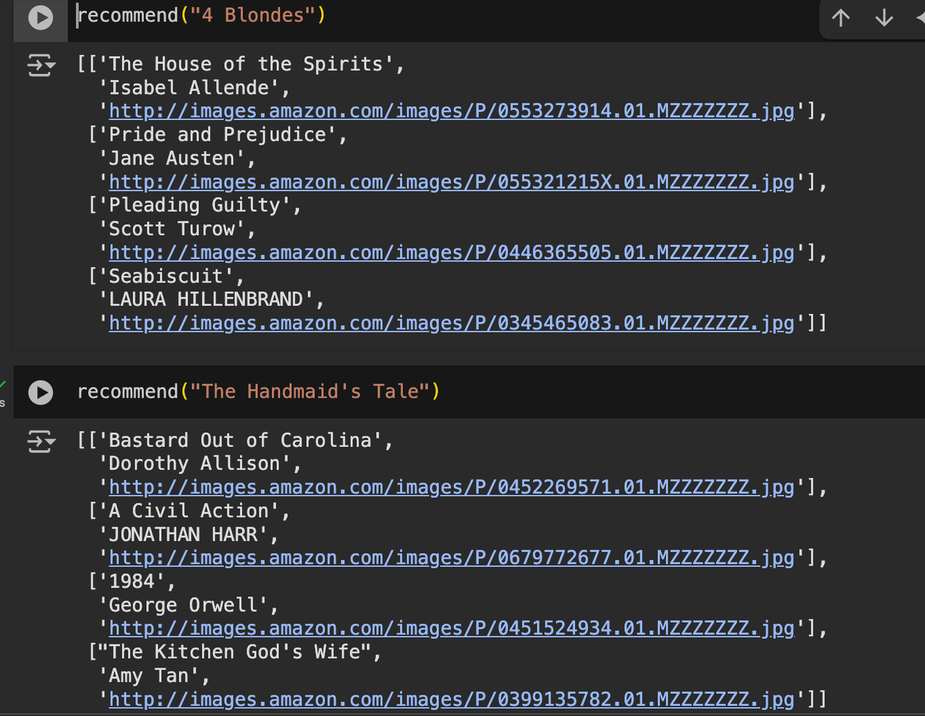
Result

Slide 11
Conclusion
In this manner we learnt some of the basic libraries in python and how to implement them in Real world projects including this predictor.We were introduced to various ML algorithms that help us manipulate data and predict output . This project helps us to understand the basic structure of a recommending ML prototype and the same cane be done to predict and analyse different other things as well.

Slide 12
Future scope
We can deploy this project as web app or mobile app and integrate different algorithms and libraries to do this thing in other apps like recommending videos,movies,webseries,songs,study topics,relevant skills etc.

Slide 13
References
Book dataset link Kaggle: https://www.kaggle.com/datasets/arashnic/book-recommendation-dataset
GitHub Link:https://github.com/Mahesh29032006/my_Book_Recommendation.git

Slide 14
Thank you

