Slide 1

Intelligent Traffic Management / Control System
Problem Code: #GTS2
Notes:
To change the image on this slide, select the picture and delete it. Then click the Pictures icon in the placeholder to insert your own image.

Slide 2
INFORMATION
Problem Statement: Intelligent Traffic Management/Control System
Problem Code: #GTS2
Team Lead Name: Harsha Vardhan Pendyala
Ministry Category: Government of Telangana

Slide 3
ABSTRACT
Using computer vision technology we can classify and count the vehicles on a particular road and based on the count we can compare with other roads on the same junction using the cc cameras mounted at traffic signals. With this system we can dynamically control the priority and time duration of signals at real time automatically.
Authorized personal can also monitor the current traffic on any junction at real time we can also have flexibility to manually operate any traffic junction from remote location.
Best thing about this system is we can not only control the traffic but also record the traffic patterns on every junction and take necessary measures or actions to eliminate the causes for the traffic. The number of accidents which happen during rights can be greatly reduced ensuring better road safety and we can have the flexibility of diverting the incoming traffic of a junction through any media or updates in any abnormal conditions like sewage problems, road accidents, road repairs etc.

Slide 4
PROBLEMS OF TRADITIONAL TRAFFIC LIGHTS
Rules for allocating traffic light colours to measures are inconsistently defined and used.
Interpretation of traffic lights is rarely consistent with performance improvement.
Traffic light rules are statistically invalid assessments of current performance.
Traffic light does not implement emergency protocols.

Slide 5
BASIC COMPONENTS
Python based Automobile classifier and controller.
CC Cameras. (To capture real time traffic)
Database. ( For storing and transmitting real time data)
Web Portal/Android App. (To interface admins and traffic personnel logins)

Slide 6
APPROACH
Taking snaps of the real time traffic, the classifier classifies the types and number of vehicles on each lane. Based on the weightage of each lane, the classifier assigns priority to each by comparing one another.
Based on this priority, the system defines which lane to be signaled green and for what duration and controls the lanes. This data is transmitted to the Traffic Light controller where the actual triggering of lights takes place.
Authorized personal can also monitor the current traffic on any junction at real time. We can also have flexibility to manually operate any traffic junction from remote location.
After every classification the classifier stores the weightage or traffic density of each lanes to its distributed server. Which can be used to predict future traffic based on the historic pattern’s.

Slide 7
DIAGRAMS

Slide 8
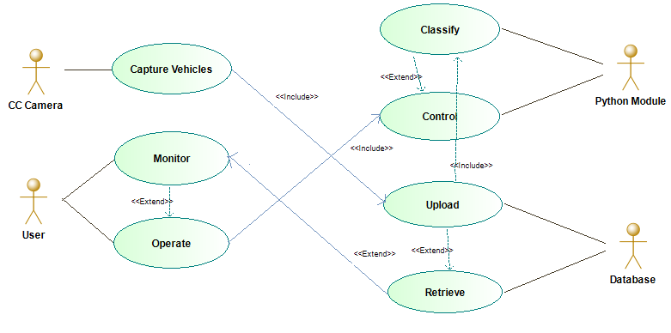
USECASE DIAGRAM

Slide 9
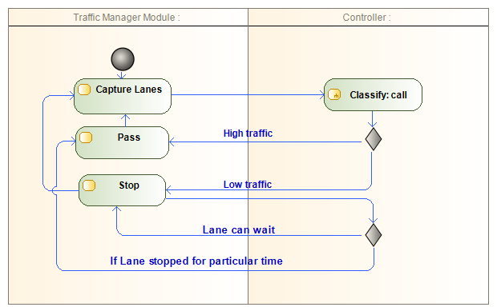
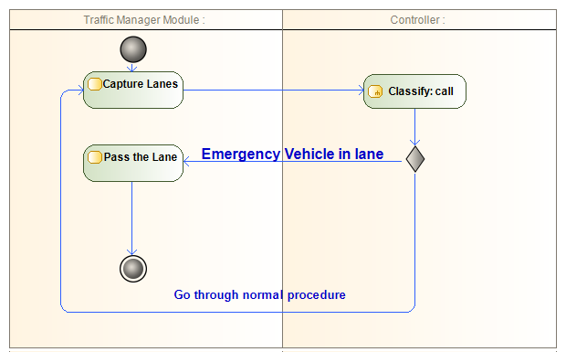
ACTIVITY DIAGRAM
In Normal Conditions
In Emergency Conditions

Slide 10
WORK FLOW
Capture
Classify
Evaluate
Control

Slide 11
END PRODUCT
Intelligent traffic management system which provides
Better control and load balancing at critical signals during VIP movements.
Better co-ordination between health and traffic during organ transplant process.
Help for developing strong historical database for future traffic planning.
Information to civic society.

Slide 12
TRAFICOLUS
New Way To Hit The Roads

