Slide 1
ARCHITECTURE REVIEW BOARD · FIRST SITTING
Insurance Distribution Platform
Assisted Life · intended design for Dev and UAT
35 min
Walkthrough
25 min
Discussion
Not today
Production
1 / 16
Notes:
TIMEBOX: 1 min
SAY:
Good morning. This is the first architecture review of the Insurance Distribution Platform.
Today we walk the intended design: the problem, one sale as it will actually run, the runtime, and the stack — so Dev and UAT can be stood up.
We are not claiming production evidence. Working logs, security operations, compliance proofs and a proven day-one estate are what we bring after UAT, to a later sitting. A longer copy of this deck is not that sitting.
I will take about thirty-five minutes. The rest of the hour is yours.
IF ASKED:
If someone asks whether this is production approval — no. Say it once, park it, keep walking.
DO NOT:
Do not say the architecture was designed by AI. Do not claim logs, VA/PT or DR drills as done.

Slide 2
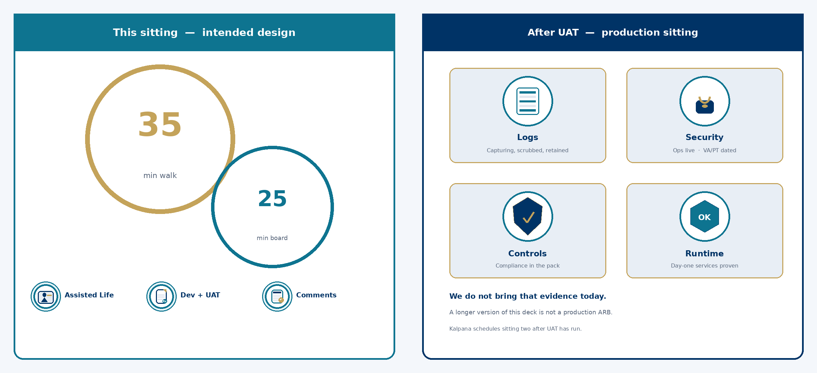
First review · Dev & UAT · not production · not DR-ready · not VA/PT
2 / 16
Notes:
TIMEBOX: 2 min
SAY:
Left is today: intended design, Dev and UAT, your comments. Right is after UAT: a production sitting with evidence that logging is capturing, security ops are running, compliance is in the pack, and the day-one services actually work. We will not pretend those proofs exist this morning.
IF ASKED:
If they want one ARB for everything — we still cannot evidence a pentest of an unvended estate. Staged review matches how landing zones are vended.
DO NOT:
Do not promise a production date. Kalpana schedules sitting two after UAT.

Slide 3
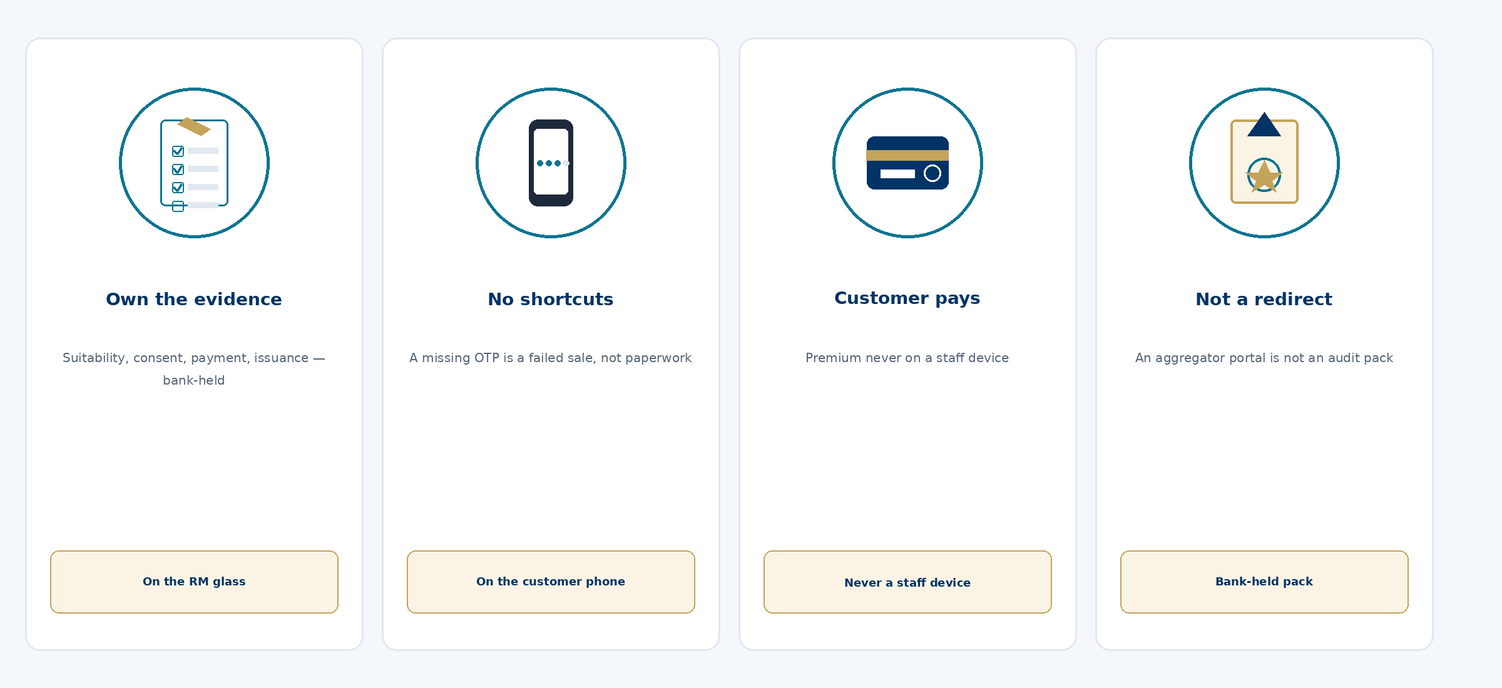
First review · Dev & UAT · not production · not DR-ready · not VA/PT
3 / 16
Notes:
TIMEBOX: 2 min
SAY:
Four pictures, one point: a licensed corporate agent must own the evidence of a Life sale. Suitability on the RM glass, OTP and premium on the customer phone, a policy only when money and issuance agree. Redirecting the customer to an aggregator site does not produce that pack.
IF ASKED:
Health, Motor and DIY are later horizons. Do not design them here.
DO NOT:
Do not invent a Product signature.

Slide 4
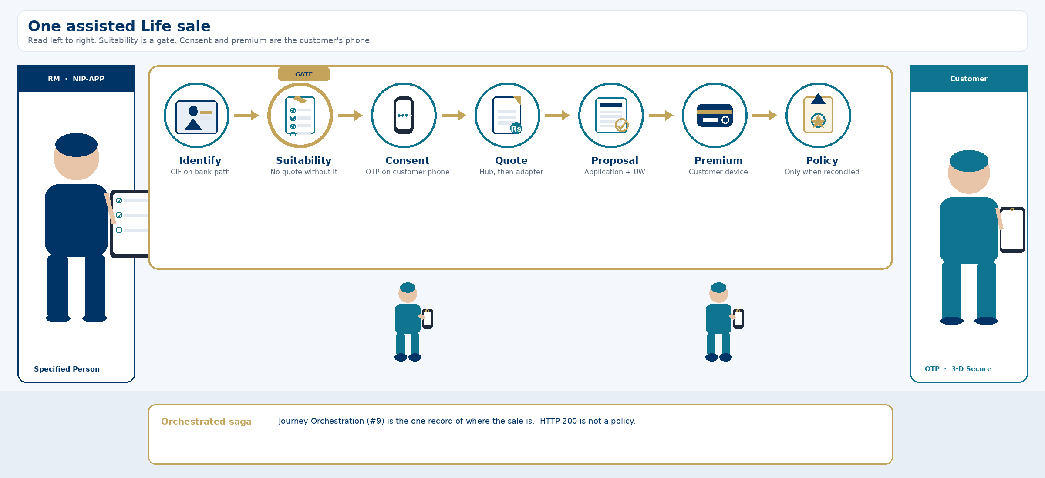
First review · Dev & UAT · not production · not DR-ready · not VA/PT
4 / 16
Notes:
TIMEBOX: 5 min
SAY:
Walk the ribbon left to right. The RM stands with NIP-APP. Suitability is a gate on that device — no quote without it. Consent and premium are the customer's phone, not the iPad. Quote and proposal go Hub then adapter. Policy is last, and only after reconciled. The gold line is an orchestrated saga: Journey Orchestration is the one record of where the sale is. Flutter never calls the aggregator, the database, or Apigee.
IF ASKED:
Why not one InsuranceService? Health later must not rewrite Life. Quote and suitability are different systems of record.
DO NOT:
Do not accept RM-pays-for-the-customer as a UAT exception. Do not call Kafka the audit log.

Slide 5
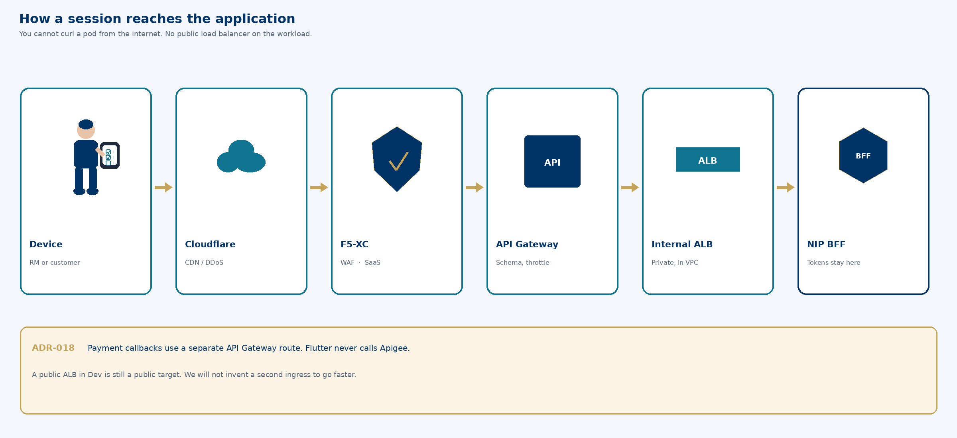
First review · Dev & UAT · not production · not DR-ready · not VA/PT
5 / 16
Notes:
TIMEBOX: 3 min
SAY:
You cannot curl a pod from the internet. If asked why not a public ALB — it would put a public target in front of a front door we already have. ADR-018. That is a Security exposure decision, not a Dev convenience.
IF ASKED:
FAQ on public ALB. Play 2 if they insist.
DO NOT:
Do not agree to a public ALB just for Dev.

Slide 6
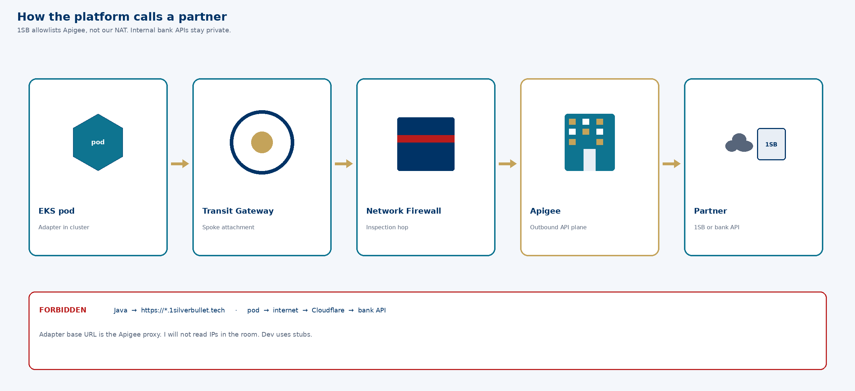
First review · Dev & UAT · not production · not DR-ready · not VA/PT
6 / 16
Notes:
TIMEBOX: 2 min
SAY:
The adapter base URL is the Apigee proxy, never the aggregator host. I will not read IPs. That action does not block vpc-dev.
IF ASKED:
Play 3, DEP-20260914-apg. Dev uses stubs.
DO NOT:
Do not invent IPs.

Slide 7
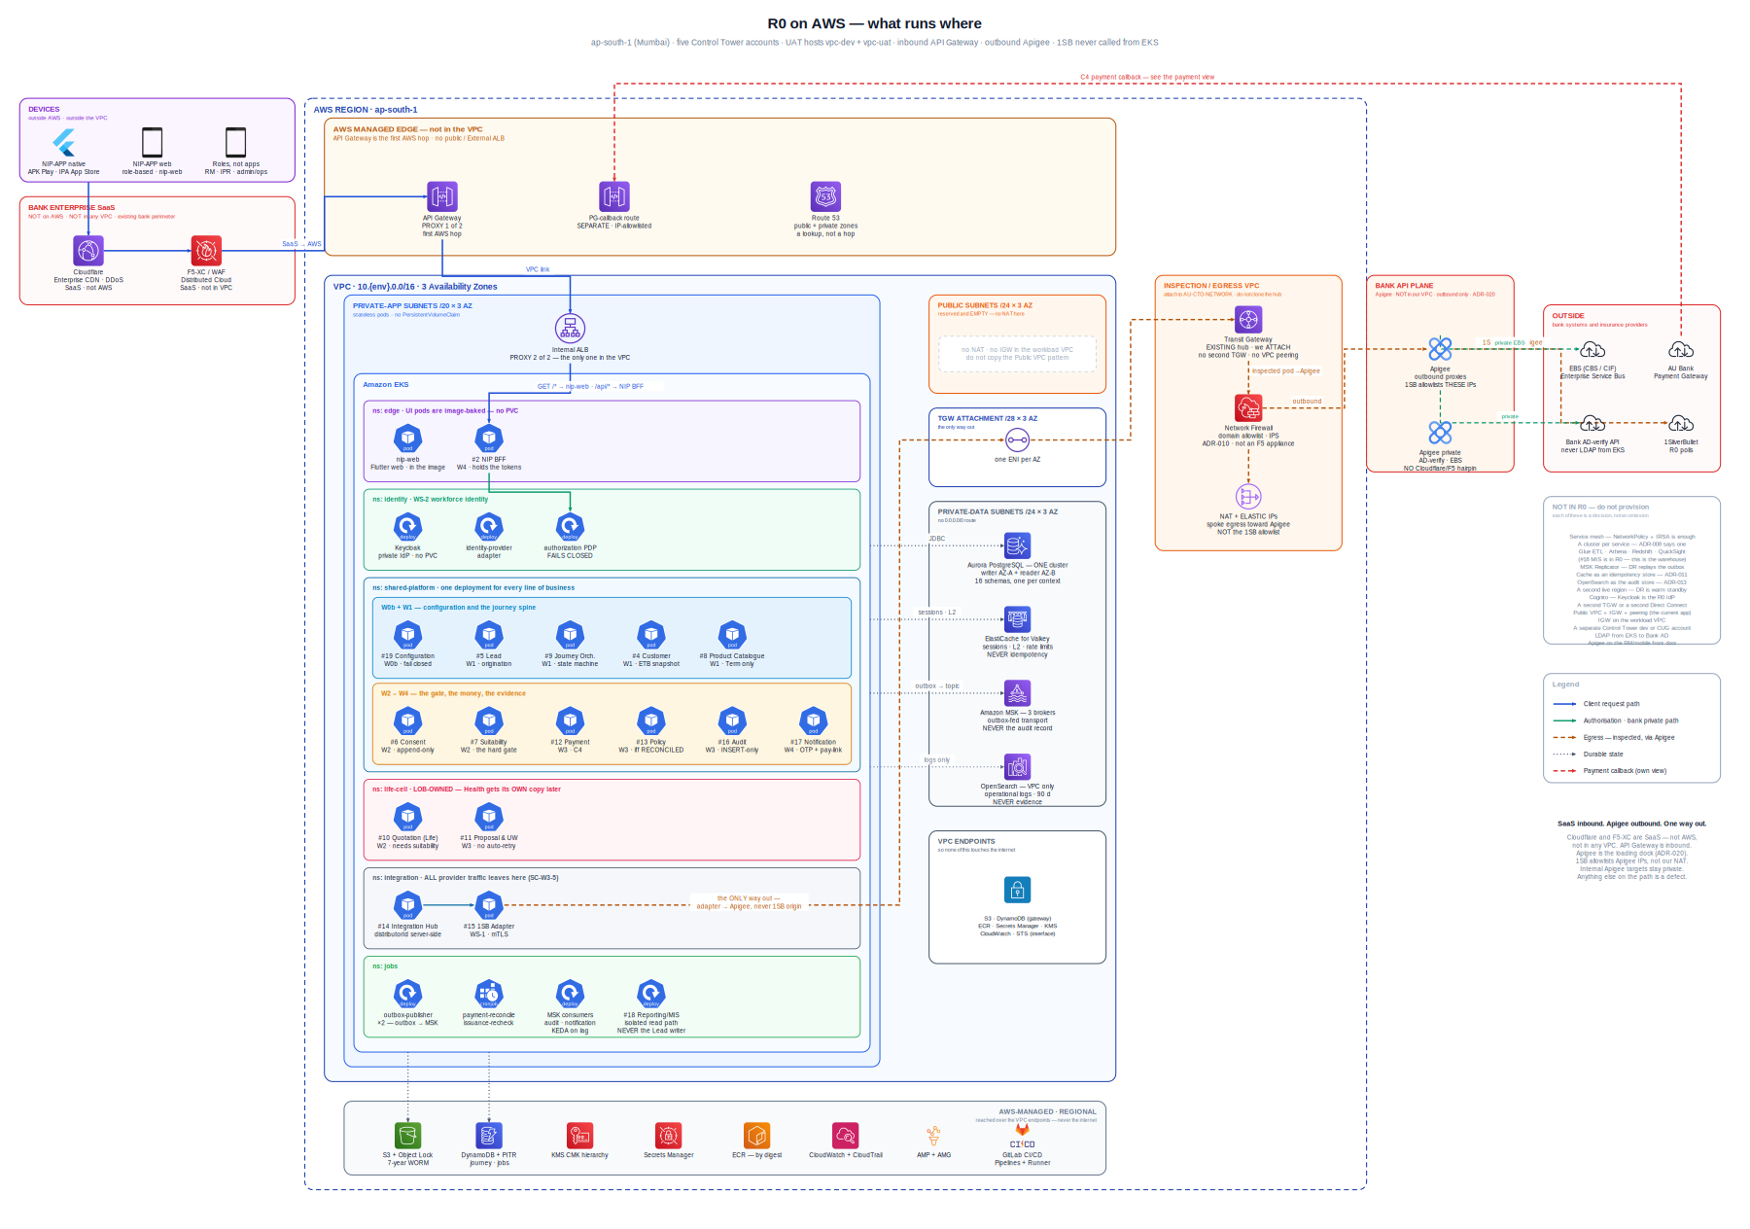
First review · Dev & UAT · not production · not DR-ready · not VA/PT
7 / 16
Notes:
TIMEBOX: 2 min
SAY:
Attach as a spoke. Inbound as you saw. Outbound through Apigee. I will pause here if you want the drawing; otherwise I protect discussion time. If this picture disagrees with an ADR, the ADR wins.
IF ASKED:
Previous two slides are the same facts in sequence.
DO NOT:
Do not walk every box.

Slide 8
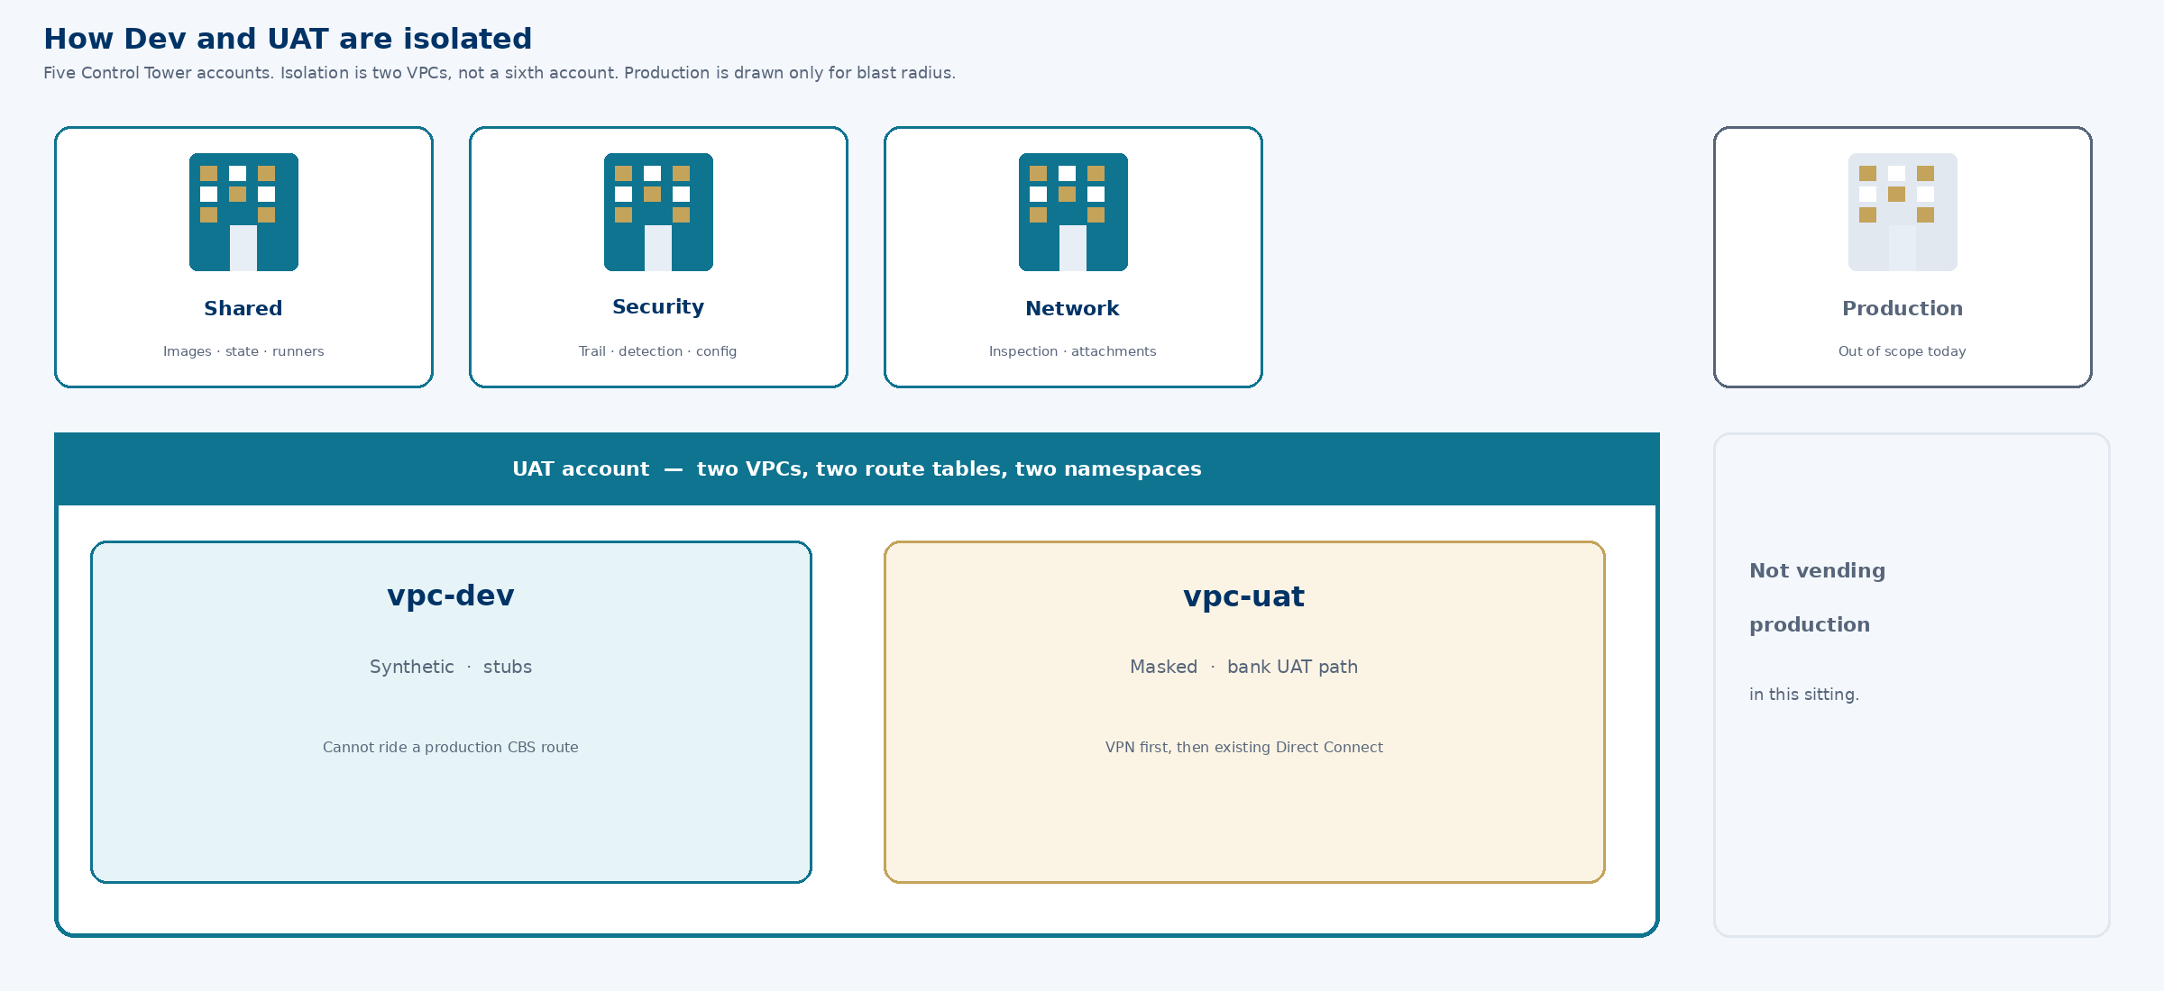
First review · Dev & UAT · not production · not DR-ready · not VA/PT
8 / 16
Notes:
TIMEBOX: 1 min
SAY:
Five accounts. Dev is a VPC inside UAT, not a sixth account. Stubs cannot ride a production CBS route. Production is drawn so you see blast radius — we are not vending it today.
IF ASKED:
Split Dev account is a Cloud exception we are not requesting.
DO NOT:
Do not offer to vendor production while we are here.

Slide 9
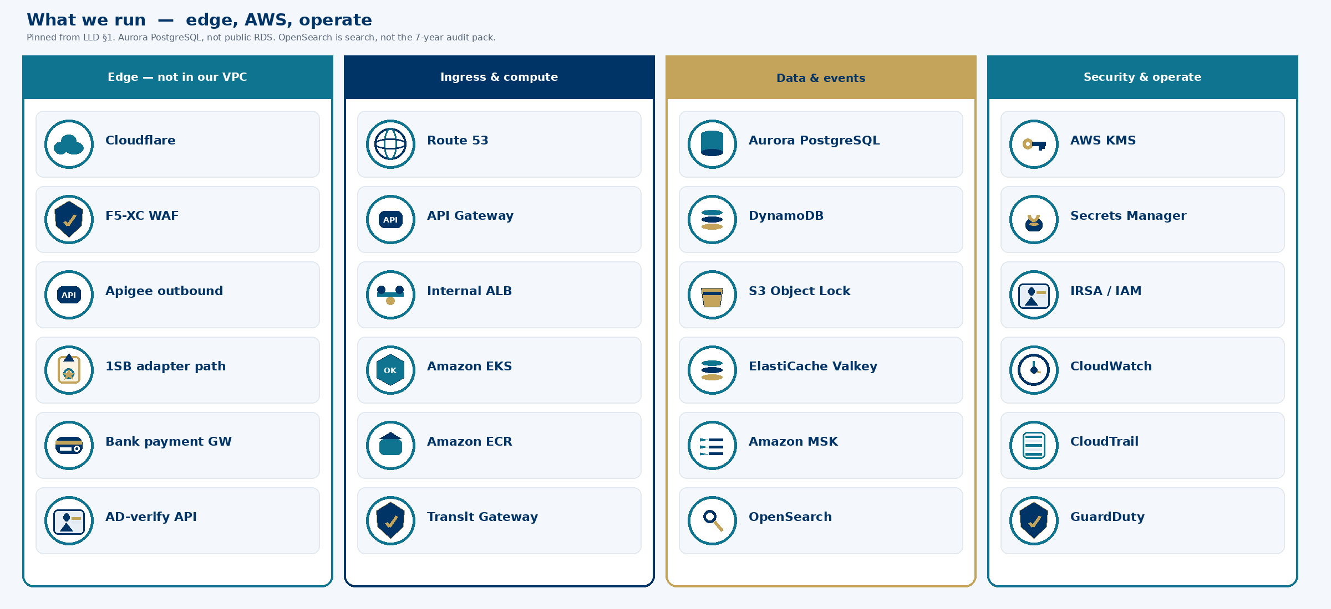
First review · Dev & UAT · not production · not DR-ready · not VA/PT
9 / 16
Notes:
TIMEBOX: 3 min
SAY:
Four clusters, not a shopping list. Edge is Cloudflare, F5-XC, Apigee — they do not sit in our VPC. Compute is EKS behind API Gateway and an internal ALB. Data is Aurora PostgreSQL — one cluster, schema per context — not a public RDS. Events on MSK, fed by an outbox. Keys in KMS, secrets in Secrets Manager, telemetry in CloudWatch and CloudTrail. OpenSearch is operational search, not the audit pack.
IF ASKED:
Why not RDS? Aurora PostgreSQL is the recorded pin (ADR-008). Why not self-managed Kafka on EKS? MSK is the managed backbone; the outbox remains source of truth.
DO NOT:
Do not add Istio, Cognito, or a warehouse to look more complete. They are not R0.

Slide 10
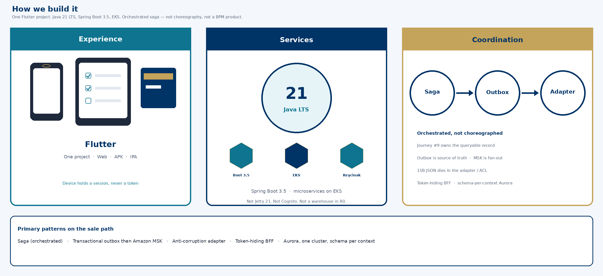
First review · Dev & UAT · not production · not DR-ready · not VA/PT
10 / 16
Notes:
TIMEBOX: 3 min
SAY:
Experience is Flutter — one project, web, APK, IPA. Services are Java 21 and Spring Boot 3.5 on EKS. Coordination is an orchestrated saga, not a choreography: Journey Orchestration is queryable when a sale stops. Outbox then MSK. 1SB JSON dies in the adapter. Tokens never reach the glass.
IF ASKED:
They said Jetty — we run Java 21 LTS. Spring Boot 3.5 is the BOM in repo. Saga is recorded in the domain model §5, not a slide invention.
DO NOT:
Do not start a language war. Do not claim a saga framework product — it is the Journey service plus state, not a third-party BPM.

Slide 11
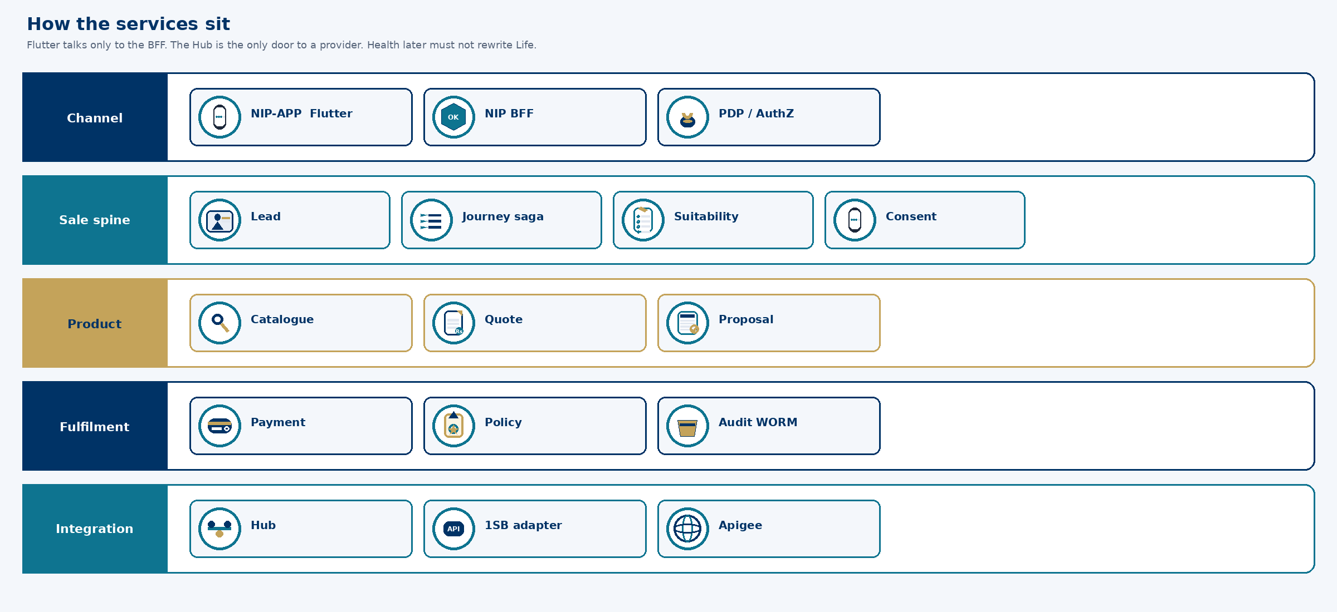
First review · Dev & UAT · not production · not DR-ready · not VA/PT
11 / 16
Notes:
TIMEBOX: 2 min
SAY:
Five lanes. Flutter talks only to the BFF. The sale spine owns lead, saga, suitability, consent. Product owns catalogue, quote, proposal. Fulfilment owns payment, policy, WORM audit. Integration is Hub, 1SB adapter, Apigee. That is why Health later does not rewrite Life.
IF ASKED:
Not every name is a pod today. R0 is the assisted Life cut of these lanes.
DO NOT:
Do not list twenty class names. Stay on the lanes.

Slide 12
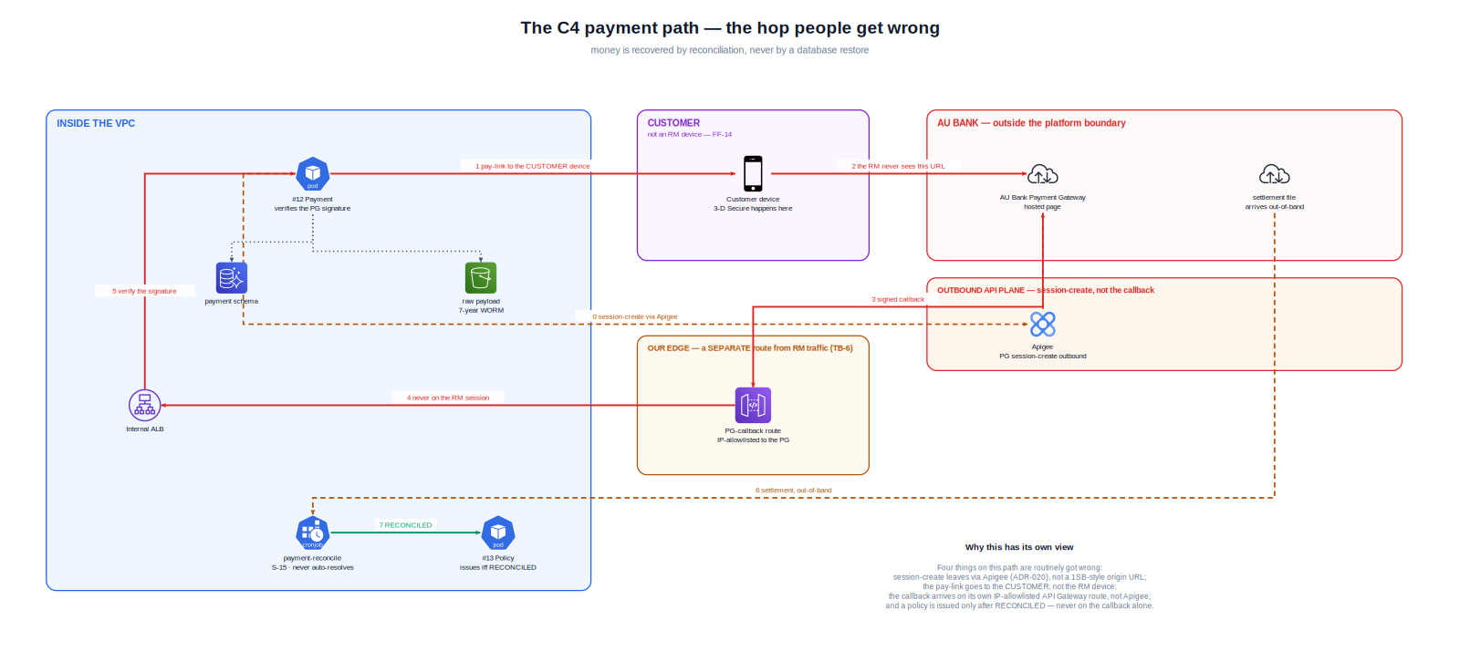
First review · Dev & UAT · not production · not DR-ready · not VA/PT
12 / 16
Notes:
TIMEBOX: 2 min
SAY:
Session-create through Apigee. Customer completes 3-D Secure on their phone. Callback on a separate API Gateway route. Sold waits for reconciled. Uncertain blocks a second attempt. Timeouts do not mint money.
IF ASKED:
PAN never on the RM device, never in logs.
DO NOT:
Do not accept RM pays on behalf for a demo.

Slide 13
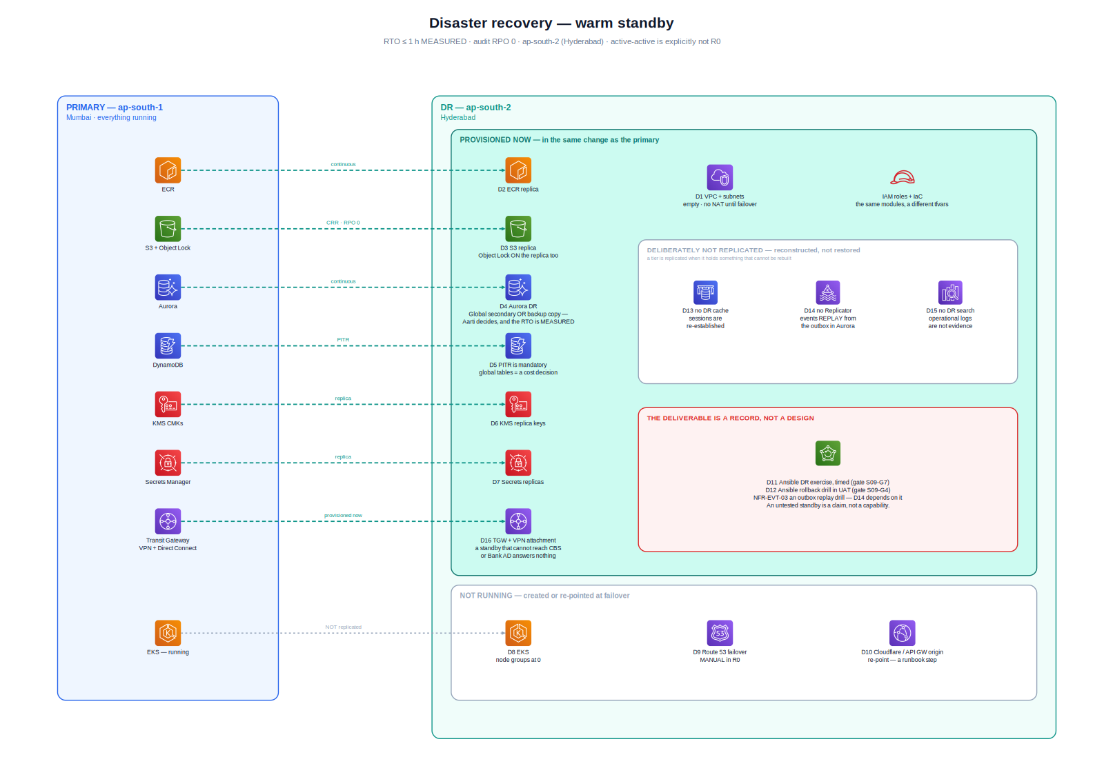
Continuity — designed, not yet drilled
≤ 1 h
Recovery time
≤ 5 min
Transactional RPO
0
Audit RPO
First review · Dev & UAT · not production · not DR-ready · not VA/PT
13 / 16
Notes:
TIMEBOX: 1 min
SAY:
Designed, not measured. That is why this is not the production ARB.
IF ASKED:
Play 4. NFR-DR-04.
DO NOT:
Do not claim DR is proven.

Slide 14
Decision requested
Review
Proceed
Return
Record this as the intended R0 design.
Allow Dev and UAT on this shape — two VPCs in the UAT account.
Production sitting after UAT, with evidence, not with a thicker deck.
After UAT — logs, security ops, compliance pack, VA/PT, timed restore, day-one services
First review · Dev & UAT · not production · not DR-ready · not VA/PT
14 / 16
Notes:
TIMEBOX: 2 min
SAY:
Please record this as the intended R0 design and allow Dev and UAT on this shape. When UAT has run, we return with evidence — logging, security ops, compliance, services on the path — not with a thicker version of these pictures. I will stop here so we can discuss.
IF ASKED:
If they write only 'approved', qualify: first review, Dev/UAT vending, production ARB still required.
DO NOT:
Do not leave without a written observation.

Slide 15
Appendix — network terms
Transit Gateway
The estate roundabout. We attach a spoke.
Internet gateway
Public door of a VPC. Not on the workload.
NAT gateway
Lets private pods start outbound. Not the 1SB allowlist.
Network Firewall
Inspection on the outbound hop. Security accepts remainder.
Internal ALB
The only load balancer inside the VPC.
API Gateway
Inbound AWS front door. Not Apigee.
Apigee
Outbound API plane for 1SB and bank APIs.
First review · Dev & UAT · not production · not DR-ready · not VA/PT
15 / 16
Notes:
APPENDIX — open only if asked
SAY:
Open only if a network SME quizzes terms. You do not need BGP in this sitting.
IF ASKED:
Below this table — Play 3, with SRE and bank network.
DO NOT:
Do not draw BGP on a whiteboard unless SRE is speaking.

Slide 16
Appendix — if you do not have the number
1 — Cite and stop
That decision is recorded in ADR-0XX. I will not re-litigate it from memory. Happy to walk the clause after the sitting if needed.
2 — Name the owner
The structure is Architecture's. The remaining acceptance sits with [Deepali / Shivanshi / bank network / Apigee team]. I will not speak for their residual.
3 — Action, dated, non-blocking
Fair question. I do not have a measured answer in the room and I will not invent one. Action: we return by [date] with [owner]. That item does not change the Dev/UAT VPC shape we are asking you to review today.
4 — Later sitting
That is a production, DR-readiness or VA-PT question. We will bring evidence to the second ARB. Today is the intended design, so Dev and UAT can be stood up.
5 — Never guess
I will not guess an IP, a pentest result, a restore-drill time, or a CIS register class. Guessing those in this room would be the actual control failure.
First review · Dev & UAT · not production · not DR-ready · not VA/PT
16 / 16
Notes:
APPENDIX — open only if asked
SAY:
Memorise Play 3 and Play 5. Put them on a card in your pocket.
DO NOT:
Do not present this slide in the main walk.

