Slide 1
Architecture Review Board
AU Bank Insurance Distribution Platform (NIP)
R0 assisted Life — 19-item prerequisite walk-in
Horizon H0 / R0 only. H1–H3 are direction, not this submission.
AI-DRAFTED evidence. Not ARB approval, not T4 Architecture, not Board 4, not Board 6 CIS registration, not a VA/PT pass. HA-02: ADR / LLD / NFR win.
Draft: Mahesh (Board 1 / R2) · Work item ARB-PRE-2026-09-14 · SUG-20260914-xpt
1 / 24

Slide 2
What to put in front of the reviewer
In the room: this PowerPoint (walk-in). Do not open Markdown.
To circulate / print: AU-NIP-R0-ARB-Prerequisite-Pack PDF (or the Word file if they want comments).
When they ask for matrices: AU-NIP-R0-ARB-Matrices.xlsx — integration, RACI, CIS, SBOM, lifecycle, exit.
Ask of this sitting: review the design. Not production authority. Not a CIS register entry.
Fair holds we already name: CIS class, Product volumes, Deepali Board 4, VA/PT date, Apigee IPs, human T4.
AU Bank NIP R0 · ARB pack 2026-09-14 · AI-DRAFTED evidence. Not ARB approval, not T4 Architecture, not Board 4, not Board 6 CIS registration
2 / 24

Slide 3
Business ask (row 1) — PARTIAL until Rajal signs
One RM, certified Specified Person, sells a complete Life policy (Term or Savings/ULIP) to one ETB customer of one Group A insurer, end to end.
Suitability, customer-device OTP consent, customer-device payment, reconciled issuance, immutable audit.
Licence: IRDAI Composite Corporate Agency CA0515.
Written: BOOT.md scope, CR-010, CR-015 (CANDIDATE transcribed; HUMAN T4 outstanding).
Architecture will not invent a BRD signature, budget memo, or GOV-004 Product counter-sign.
AU Bank NIP R0 · ARB pack 2026-09-14 · AI-DRAFTED evidence. Not ARB approval, not T4 Architecture, not Board 4, not Board 6 CIS registration
3 / 24

Slide 4
Readiness dashboard — rows 1 to 10
# | Bank ARB prerequisite | Readiness | Named gap / owner
1 | Business ask and sign-off for new technical or application requirement | PARTIAL | Rajal Product sign-off of CAP-A volumes and CR-015 T4. PO counter-signature on GOV-004 still outstanding. This pack does not invent a business BRD signature.
2 | Critical Information System classification | HUMAN-REQUIRED | Shailja + bank InfoSec / CISO. Architecture proposes Critical. The bank CIS register is the SoT.
3 | Solution Architecture Document | READY (unsigned) | Human T4 Architecture.
4 | Current-state and target-state architecture | READY (unsigned) | Do not read H1–H3 as admitted scope.
5 | Data-flow and trust-boundary diagrams | READY (unsigned) | Split plane ADR-020 is now on topology/payment. Security mermaid in §2 of this change aligns TB-5/TB-7 to Apigee. Deepali still owns the threat-model signature.
6 | Integration and dependency matrix | READY (compiled) | External rows OPEN: Apigee onboard (DEP-20260914-apg), VPN/DX (DEP-20260824-dx1), bank UAT slot (DEP-002).
7 | Infrastructure sizing and capacity assessment | PARTIAL | CAP-A1…A7 are assumptions, not an approved business baseline (NFR-OPEN-1, owner Rajal). R0 is correctness-constrained, not throughput-constrained.
8 | Availability, RTO and RPO of base product | READY (unsigned) | Sale-path 99.9%. RTO ≤ 1 h, RPO ≤ 5 min transactional, RPO 0 audit. Unproven until S09 drills (NFR-DR-04).
9 | DR architecture and failover mechanism | READY (unsigned) | Warm standby ap-south-2. Cache/MSK/OpenSearch not replicated (D13–D15). Proof is a timed Ansible drill, not the picture.
10 | Security architecture (as per Security NFR) | PARTIAL | Deepali Board 4 human. ADR-010 remainder (pod→Apigee inspection) is her acceptance, not Architecture's.
AU Bank NIP R0 · ARB pack 2026-09-14 · AI-DRAFTED evidence. Not ARB approval, not T4 Architecture, not Board 4, not Board 6 CIS registration
4 / 24

Slide 5
Readiness dashboard — rows 11 to 19
# | Bank ARB prerequisite | Readiness | Named gap / owner
11 | VA/PT and secure-code-review | NOT-YET | No VA/PT report exists. Swapnali + Deepali: SAST in pipeline now; DAST/VA/PT before UAT exit / S11–S12. Do not tell ARB a pentest passed.
12 | SBOM / software dependency inventory | PARTIAL | CycloneDX/SPDX CI artefact still to be wired (S09). Flutter pubspec.lock is a second inventory.
13 | Data classification and data residency | READY (unsigned) | Shailja S02-G5/G6. GAP-016 residual on attribute-level BA ratification.
14 | IAM / PAM design | PARTIAL | Application IAM is designed. Privileged Access Management for AWS console / break-glass is bank PAM + Deepali; not a second IdP we invent.
15 | Logging and monitoring design | READY (unsigned) | Operational logs RET-OPERATIONAL 90 d. Audit is not logging (TI-07).
16 | Third-party and subcontractor details | READY (compiled) | 1SB is a provider route, not a domain dependency (TI-04). Insurers underwrite (TI-03).
17 | Cloud architecture and shared-responsibility matrix | READY (compiled) | Attach to AU-CTO-NETWORK; five Control Tower accounts; no CUG.
18 | Technology lifecycle and end-of-support assessment | READY (compiled) | Java 21 and Spring Boot 3.5 are in support. Keycloak / Flutter / EKS pin to be confirmed by Amit + Shivanshi at S09.
19 | Exit, portability and decommissioning strategy | READY (compiled) | 1SB replaceable at the adapter. Data exits as Aurora + S3 WORM in India. Kubernetes PVC is not a SoR.
AU Bank NIP R0 · ARB pack 2026-09-14 · AI-DRAFTED evidence. Not ARB approval, not T4 Architecture, not Board 4, not Board 6 CIS registration
5 / 24

Slide 6
Honest posture — review, not production authority
The design is internally consistent enough to REVIEW.
It is not internally consistent enough to approve as production authority.
HUMAN-REQUIRED: CIS register (Shailja + CISO). Architecture proposes Critical; the bank register is SoT.
PARTIAL: business volumes (Rajal CAP-A*), security signature (Deepali), IAM vs bank PAM, CycloneDX CI.
NOT-YET: VA/PT report. CI has Checkstyle, Spotless, ArchUnit, JaCoCo, lockfile SCA only.
OPEN outside the room: DEP-20260914-apg (Apigee IPs), DEP-20260824-dx1 (VPN/DX), DEP-002 (UAT slot).
AU Bank NIP R0 · ARB pack 2026-09-14 · AI-DRAFTED evidence. Not ARB approval, not T4 Architecture, not Board 4, not Board 6 CIS registration
6 / 24

Slide 7
Current state vs target state (rows 3–4)
Current = H0 / R0 as designed. Nothing is running in a bank prod account yet.
SAD: 03-solution-architecture-r0.md · HLD · LLD · narrative dossier. Unsigned T4.
Target = North Star capability model, horizons H1–H3 + hdl.svg. Do not read H1–H3 as admitted scope.
Release strategy follows business maturity, not architecture completeness (HR-01…HR-05).
Attach to the existing AU cloud estate (BE-01). Do not clone Control Tower, TGW, DX, or FortiGate.
AU Bank NIP R0 · ARB pack 2026-09-14 · AI-DRAFTED evidence. Not ARB approval, not T4 Architecture, not Board 4, not Board 6 CIS registration
7 / 24

Slide 8
Split API plane — ADR-020
INBOUND: device → Cloudflare → F5-XC → Amazon API Gateway → Internal ALB → nip-web / NIP BFF.
OUTBOUND: pod → TGW → NFW → Apigee → 1SB or private bank API.
FORBIDDEN: Java → https://*.1silverbullet.tech
FORBIDDEN: internal API → internet → Cloudflare → F5
FORBIDDEN: publish spoke NAT EIPs to 1SB. 1SB allowlists Apigee IPs.
Payment: session-create OUT via Apigee; 3-DS on the customer device; callback IN on a separate API Gateway route (TB-6).
AU Bank NIP R0 · ARB pack 2026-09-14 · AI-DRAFTED evidence. Not ARB approval, not T4 Architecture, not Board 4, not Board 6 CIS registration
8 / 24

Slide 9
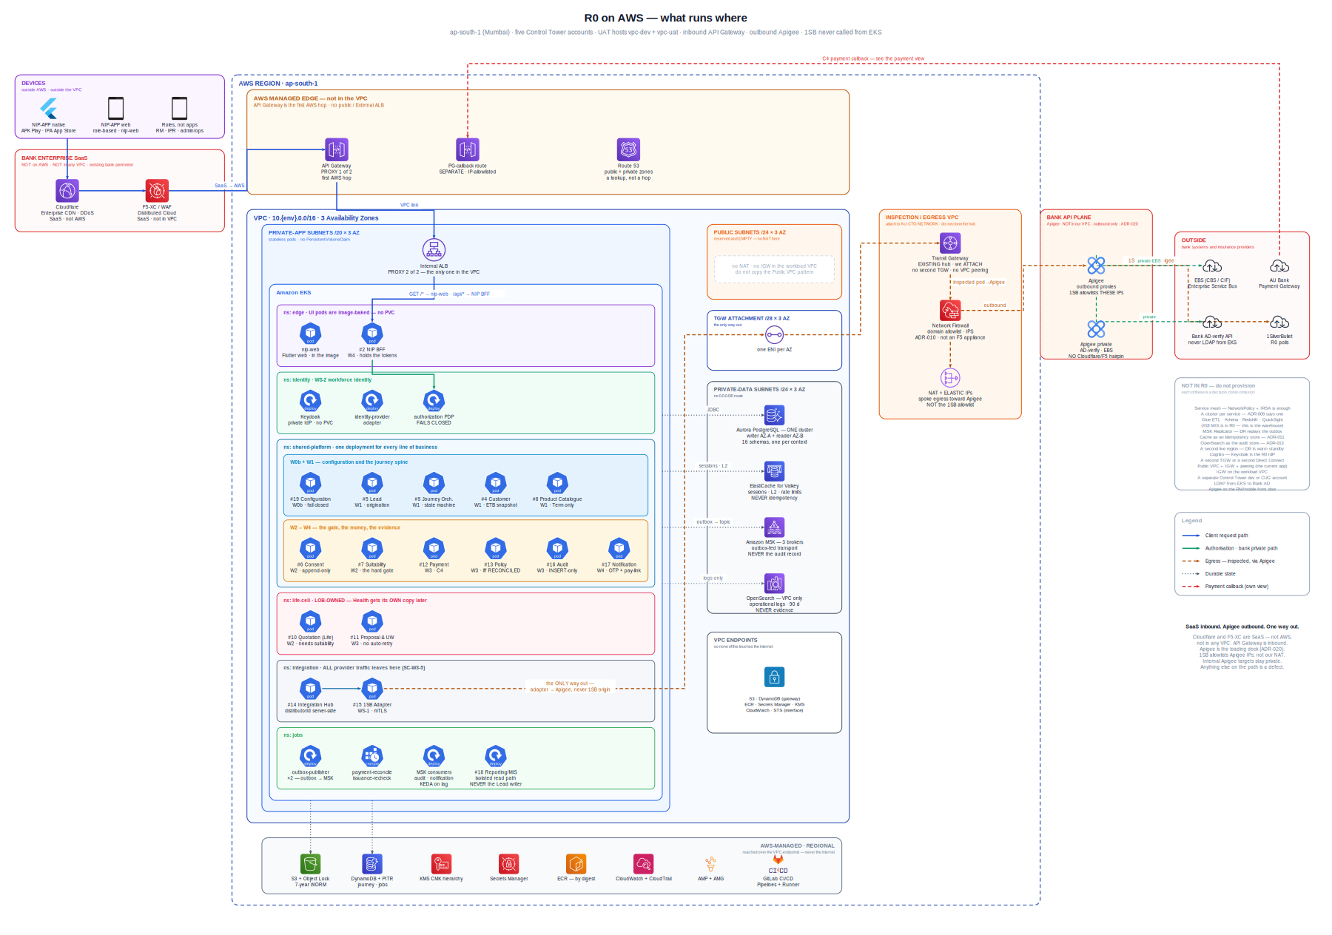
Data-flow — R0 platform topology (row 5)
AU Bank NIP R0 · ARB pack 2026-09-14 · AI-DRAFTED evidence. Not ARB approval, not T4 Architecture, not Board 4, not Board 6 CIS registration
9 / 24

Slide 10
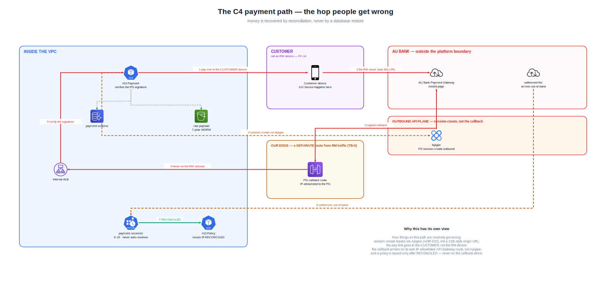
Payment trust boundary TB-6
AU Bank NIP R0 · ARB pack 2026-09-14 · AI-DRAFTED evidence. Not ARB approval, not T4 Architecture, not Board 4, not Board 6 CIS registration
10 / 24

Slide 11
Integration matrix I-01 … I-06 (row 6) — full sheet in Excel
# | Counterpart | Direction | Path (R0) | R0 status
I-01 | NIP-APP (Flutter web/APK/IPA) | Inbound | Device → Cloudflare → F5-XC → Amazon API Gateway → Internal ALB → nip-web / #2 NIP BFF | Designed. App not in this repo.
I-02 | Amazon API Gateway (inbound) | Inbound | First AWS hop. Separate PG-callback route, IP-allowlisted (TB-6) | ADR-018. Not provisioned.
I-03 | 1SilverBullet | Outbound | #14 Hub → #15 adapter → Apigee → 1SB. Adapter base URL = Apigee proxy. Never .1silverbullet.tech from EKS | Code exists. Path ADR-020. IPs DEP-20260914-apg OPEN.
I-04 | AU Bank Payment Gateway | Outbound session-create | #12 Payment → Apigee → PG | Designed.
I-05 | AU Bank Payment Gateway | Inbound callback | PG → API Gateway callback route (not Apigee, not RM session) | Designed (TB-6).
I-06 | AU Bank PG settlement | Inbound / file | Out-of-band from the API path | Designed.
AU Bank NIP R0 · ARB pack 2026-09-14 · AI-DRAFTED evidence. Not ARB approval, not T4 Architecture, not Board 4, not Board 6 CIS registration
11 / 24

Slide 12
Integration matrix I-07 … I-12
# | Counterpart | Direction | Path (R0) | R0 status
I-07 | EBS / CBS / CIF | Outbound | #4 Customer → Apigee private → EBS. Stubs in dev only | Path designed. VPN/DX DEP-20260824-dx1 OPEN.
I-08 | Bank AD-verify API | Outbound | Identity adapter → Apigee private → existing AD-verify. Never LDAP from EKS | ADR-020. DEP-010 AD technology confirmation OPEN (overdue).
I-09 | SMS / email gateway | Outbound | #17 Notification → Apigee / inspected egress | Designed. Beyond OTP/pay-link is out of R0.
I-10 | Insurers (Group A) | Via I-03 | Platform never calls an insurer origin in R0 | Direct insurer APIs are R1+ (#15 sibling adapter exists as a seam, unused).
I-11 | GitLab CI/CD | Delivery | Build, ArchUnit, JaCoCo, Terraform apply | Bank standard (ADR-016).
I-12 | AWS (ap-south-1 / ap-south-2) | Platform | See LLD BOM | Not vended.
AU Bank NIP R0 · ARB pack 2026-09-14 · AI-DRAFTED evidence. Not ARB approval, not T4 Architecture, not Board 4, not Board 6 CIS registration
12 / 24

Slide 13
Forbidden paths and open dependencies
Defect if drawn: Java → 1SB origin · internal API hairpin via Cloudflare/F5 · spoke NAT EIPs to 1SB · Flutter → Keycloak/Apigee/domain · cross-schema DB grants.
DEP-20260914-apg OPEN — 1SB allowlist + AD-verify/EBS private proxies (Apigee team).
DEP-20260824-eip — must NOT send spoke NAT EIPs to 1SB.
DEP-20260824-dx1 OPEN — uat/prod CBS and AD-verify without stubs.
DEP-002 OPEN — bank caller UAT. DEP-010 OPEN (overdue) — AD technology named; R0 uses AD-verify API, never LDAP.
AU Bank NIP R0 · ARB pack 2026-09-14 · AI-DRAFTED evidence. Not ARB approval, not T4 Architecture, not Board 4, not Board 6 CIS registration
13 / 24

Slide 14
Capacity, availability, RTO / RPO (rows 7–8)
CAP-A* assumption (not Product-signed): ~100 journey starts/hour BAU, ~7/minute at Q4 peak.
R0 is correctness-constrained, not throughput-constrained. Do not scale from CPU. Aurora connection budget is the one that bites.
Sale-path availability 99.9% (NFR-AVL-01).
RTO ≤ 1 hour. Transactional RPO ≤ 5 minutes. Audit RPO 0.
Unproven until S09 timed restore drill (NFR-DR-04).
AU Bank NIP R0 · ARB pack 2026-09-14 · AI-DRAFTED evidence. Not ARB approval, not T4 Architecture, not Board 4, not Board 6 CIS registration
14 / 24

Slide 15
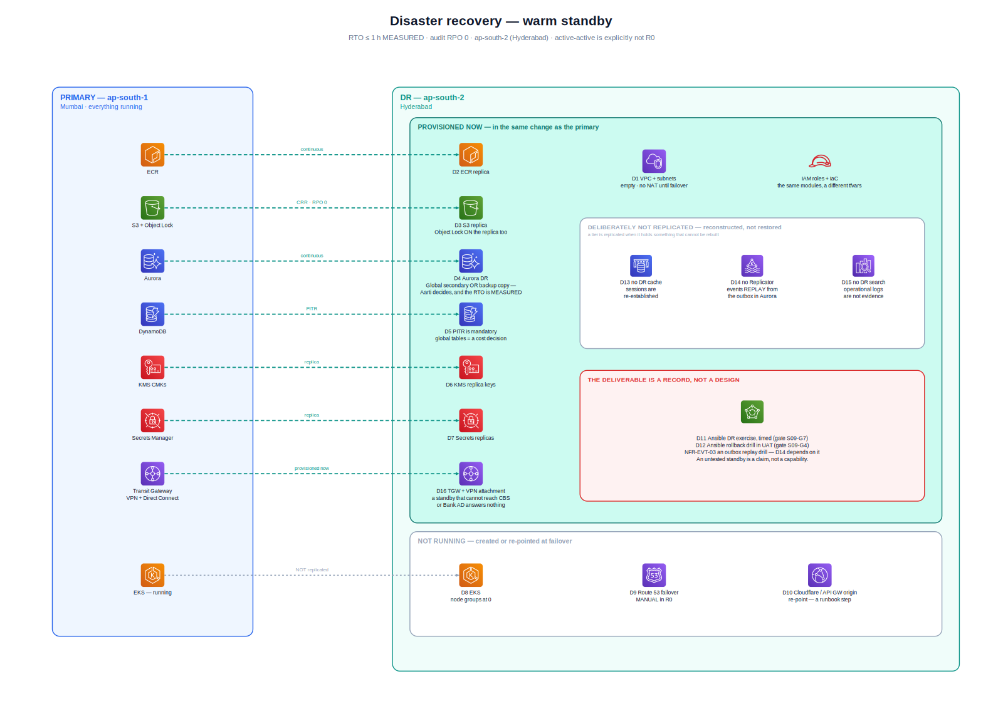
DR architecture — warm standby ap-south-2 (row 9)
AU Bank NIP R0 · ARB pack 2026-09-14 · AI-DRAFTED evidence. Not ARB approval, not T4 Architecture, not Board 4, not Board 6 CIS registration
15 / 24

Slide 16
Security, VA/PT, SBOM (rows 10–12)
Security architecture is an INPUT to Board 4, not a Board 4 verdict. Deepali signs.
ADR-010 remainder (pod → Apigee inspection) is Deepali’s acceptance, not Architecture’s.
VA/PT: NOT-YET. Do not tell ARB a pentest passed. SAST/ArchUnit/JaCoCo/lockfiles are in CI now. DAST/VA/PT before UAT exit.
SBOM today: 14 Gradle lockfiles, 137 unique runtimeClasspath coordinates. Java 21, Spring Boot 3.5.16.
CycloneDX/SPDX CI artefact is S09. Flutter pubspec.lock is a second inventory, not merged.
AU Bank NIP R0 · ARB pack 2026-09-14 · AI-DRAFTED evidence. Not ARB approval, not T4 Architecture, not Board 4, not Board 6 CIS registration
16 / 24

Slide 17
CIS classification — proposal only (row 2)
Field | Proposed value
System name | AU Bank Insurance Distribution Platform (NIP) — R0 assisted Life
Proposed class | Critical Information System (CIS)
Why not “High” or below | The platform stores and processes CIF-derived customer identity, PAN and other KYC identifiers, health/suitability attributes, payment orchestration state, and 7-year immutable audit. A confidentiality, integrity or availability failure is a regulatory and customer-harm event, not only an operational inconvenience.
R0 processing location | AWS ap-south-1 (Mumbai). DR replicas ap-south-2 (Hyderabad) only. No regulated data outside India (TI-08, FF-08).
Internet exposure | Inbound: Cloudflare → F5-XC → Amazon API Gateway only (ADR-018). No public ALB, no public datastore. Outbound: Apigee (ADR-020).
Privileged access | IRSA per deployable; bank IAM Identity Center / PAM for humans; Keycloak admin console is not a bank-user UI.
Mahesh does not classify the system into the bank CIS register. Shailja + CISO do.
A lower class would be a written risk acceptance, not a design simplification.
AU Bank NIP R0 · ARB pack 2026-09-14 · AI-DRAFTED evidence. Not ARB approval, not T4 Architecture, not Board 4, not Board 6 CIS registration
17 / 24

Slide 18
Data, IAM/PAM, logging (rows 13–15)
Classes: PUBLIC / INTERNAL / CONFIDENTIAL / RESTRICTED + [P][F][H][K]. India only (TI-08, FF-08).
Primary ap-south-1, DR ap-south-2. No regulated data outside India.
Workforce identity stays Bank AD (TI-01). R0 reaches it via AD-verify API through Apigee private. Never LDAP from EKS.
AWS human privilege is bank PAM / IAM Identity Center. We consume it. We do not clone an IdP (BE-01).
CloudTrail (who changed AWS) and CloudWatch (how the pod behaves) are both mandatory.
OpenSearch = operational logs, never evidence (ADR-013). Audit is INSERT-only + S3 Object Lock (TI-07).
AU Bank NIP R0 · ARB pack 2026-09-14 · AI-DRAFTED evidence. Not ARB approval, not T4 Architecture, not Board 4, not Board 6 CIS registration
18 / 24

Slide 19
Third parties (row 16) — no new subcontractor
Party | Role | Contract posture | Exit
1SilverBullet | Insurance aggregator (provider route) | Bank–1SB commercial + IP allowlist of Apigee | Replace adapter; Hub contract unchanged (TI-04)
Group A insurers | Underwriters | Insurer terms; bank does not underwrite | Catalogue row + adapter route
Cloudflare, Inc. | Edge CDN / DDoS (SaaS) | Bank enterprise already in use | ADR-018 hop 1; not in our VPC
F5 (Distributed Cloud / XC) | Edge WAF (SaaS) | Bank enterprise already in use | Not an in-VPC BIG-IP
Google (Apigee) or bank-operated Apigee | Outbound API plane | Bank API platform product (DEP-20260914-apg) | Adapter base URL change
Amazon Web Services | IaaS/PaaS India | Bank Control Tower already exists (BE-01) | See exit paper
GitLab | SCM + CI | Bank standard | —
AU Bank NIP R0 · ARB pack 2026-09-14 · AI-DRAFTED evidence. Not ARB approval, not T4 Architecture, not Board 4, not Board 6 CIS registration
19 / 24

Slide 20
Five Control Tower accounts — attach, don’t clone (row 17)
Account | Holds | If it is compromised
shared-services | Terraform state pattern, ECR, shared runners | Build supply chain — not customer data at rest
security | CloudTrail, GuardDuty, Security Hub, Config | Detection failure; not the sale-path datastore
network | Inspection VPCs, attachments | Egress / routing; production data does not live here
uat | vpc-dev (synthetic) + vpc-uat (masked) | Two route tables so stubs cannot reach prod CBS
prod | Real ETB, real AD-verify, real 1SB | The CIS blast radius
shared-services, security, network, uat, prod. No separate dev account. No CUG.
UAT hosts vpc-dev + vpc-uat with two route tables so stubs cannot reach prod CBS.
No workload VPC Internet Gateway. Shared-responsibility matrix is the Excel RACI sheet.
AU Bank NIP R0 · ARB pack 2026-09-14 · AI-DRAFTED evidence. Not ARB approval, not T4 Architecture, not Board 4, not Board 6 CIS registration
20 / 24

Slide 21
Technology lifecycle (row 18) — pins as of 2026-09-14
Component | Pin in repo / LLD | Owner
Java | 21 (LTS) | Amit
Spring Boot | 3.5.16 BOM | Amit
Gradle | Wrapper in repo | Amit
Amazon EKS | Kubernetes 1.30+ (LLD; “platform current”) | Shivanshi
Amazon Aurora PostgreSQL | Engine chosen by Aarti at S09 | Aarti
Amazon ElastiCache for Valkey | R0 session / L2 / rate-limit | Shivanshi
Amazon MSK | 3 brokers, KRaft, SASL/IAM | Shivanshi
OpenSearch | VPC-only, ISM 30 d hot | Shivanshi
AU Bank NIP R0 · ARB pack 2026-09-14 · AI-DRAFTED evidence. Not ARB approval, not T4 Architecture, not Board 4, not Board 6 CIS registration
21 / 24

Slide 22
Exit, portability, decommission (row 19)
Exit | What we keep | What we turn off | Timebox (draft)
Replace 1SB | Hub contract, canonical model, audit, policies already issued | #15 adapter module + Apigee 1SB product | Adapter-swap; no domain migration (TI-04)
Leave AWS (extreme) | Logical model, WORM export, Terraform as documentation of intent | Accounts, KMS, network | Multi-quarter; India residency still binds the destination
Decommission NIP | 7-year evidence (audit, consent, suitability, policy documents) | Compute, sessions, operational logs, IdP for this programme | Retention clock starts from event time / policy termination per information model §2.2
One-line exit: turn off the adapter, keep the evidence. 1SB JSON never enters a domain schema.
Canonical model is bank-owned. PVC is not a system of record. Workforce identities stay in AD.
S3 Object Lock retention cannot be shortened by decommission enthusiasm (Shailja).
ARB is not being asked to approve a decommission. Exit is a designed property of R0.
AU Bank NIP R0 · ARB pack 2026-09-14 · AI-DRAFTED evidence. Not ARB approval, not T4 Architecture, not Board 4, not Board 6 CIS registration
22 / 24

Slide 23
Who must still walk into the room
Seat | What they sign | What they must not be asked to sign for Architecture
Rajal (R1) | Business ask, CAP-A baseline, CR-015 product acceptance | Technology choice
Mahesh (R2) human T4 | SAD / HLD / LLD / this pack as architecture evidence | Deepali’s security residual, Shailja’s CIS class
Deepali (R8) human | Board 4, ADR-010 remainder, VA/PT scope, PAM pattern | Product behaviour
Shailja (R9) human | CIS class, classification/retention, residency attestation | A pentest result
Shivanshi (R10) | S09 vending, Apigee onboard, DR drill records | Architecture structure
Aarti | Physical model / PITR / WORM restore | Service boundaries
Swapnali (R7) | Evidence sufficiency of VA/PT and SAST | Waiving a non-waivable control
Kalpana (R12) | Whether ARB is on the critical path this increment | The content of a specialist verdict
AU Bank NIP R0 · ARB pack 2026-09-14 · AI-DRAFTED evidence. Not ARB approval, not T4 Architecture, not Board 4, not Board 6 CIS registration
23 / 24

Slide 24
Close — what we are asking ARB to do
Review the R0 architecture against the 19 bank prerequisites.
Record named holds. Do not treat silence as approval.
Do not convert this pack into production authority, a CIS register row, or a VA/PT pass.
Next humans: Rajal (volumes), Shailja+CISO (CIS), Deepali (Board 4), Mahesh human T4, Shivanshi (Apigee IPs + DR drill record).
AU Bank NIP R0 · ARB pack 2026-09-14 · AI-DRAFTED evidence. Not ARB approval, not T4 Architecture, not Board 4, not Board 6 CIS registration
24 / 24

