Slide 1
CAPSTONE PROJECT REPORT
Impact of Inventory Management system on the sales of E-Commerce
Submitted
by
MAHESH M (192224092)
Guided
by
Saranya S

Slide 2
ABSTRACT
Inventory control management systems (IMS) are essential for businesses across industries.
IMS plays a crucial role in optimizing inventory levels and reducing costs.
Leveraging automation and data analytics, IMS enables real-time tracking of inventory.
IMS minimizes stockouts and overstock situations, enhancing operational efficiency.
Improved order fulfillment accuracy through IMS enhances customer satisfaction and loyalty.

Slide 3

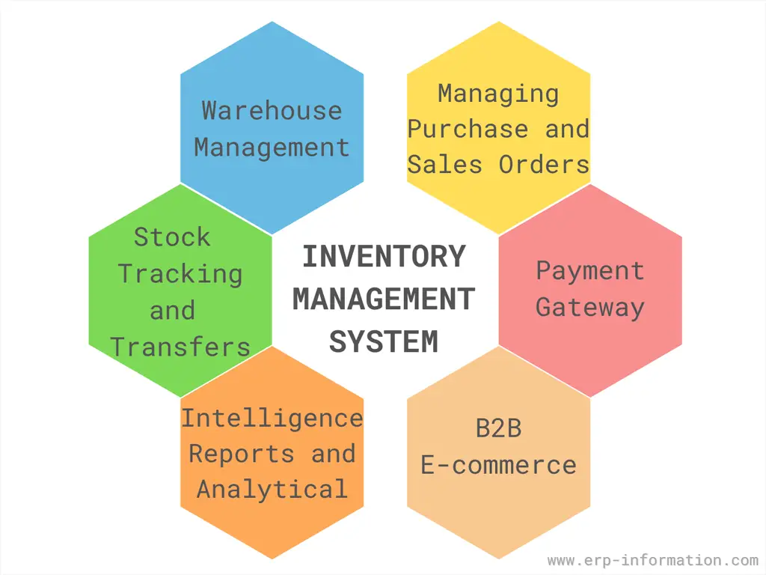
Introduction
Inventory management refers to the process of ordering, storing, using, and selling a company's inventory.
This includes the management of raw materials, components, and finished products, as well as warehousing and processing of such items.
An Inventory Management System (IMS) is a software application that helps businesses track, manage, and organize their inventory levels, orders, sales, and deliveries.
It enables companies to efficiently manage their stock, reducing the risk of overstocking or stockouts, thus optimizing operations and improving customer satisfaction.
Inventory management is the entire process of managing inventories from raw materials to finished products.
Inventory management tries to efficiently streamline inventories to avoid both gluts and shortages.

Slide 4
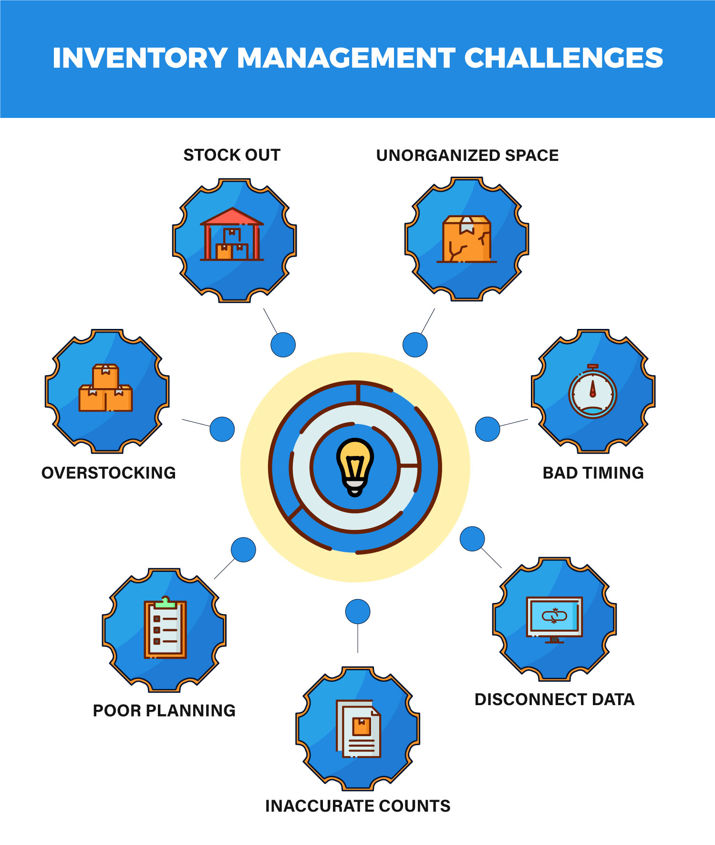
CHALLENGES
Demand Forecasting and Inventory Optimization
Seasonal Demand and Inventory Management
Warehouse Efficiency and Fulfilment
Stockouts and Overstocking
Order Tracking and Inventory Visibility
Returns and Reverse Logistics
Inaccurate Counts
Bad Timing

Slide 5
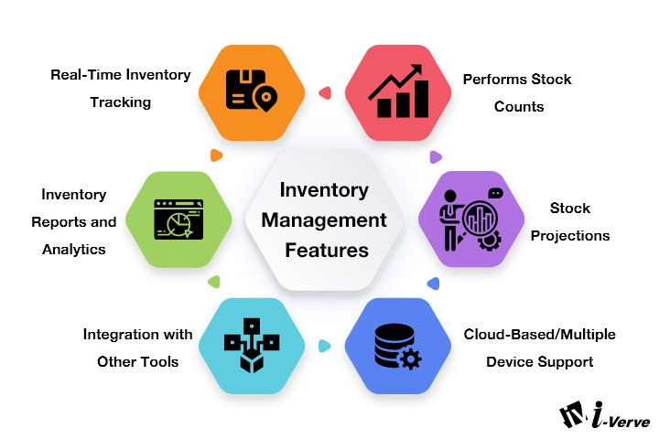
METHODOLOGY
Real-Time Inventory Tracking:
Continuously updates inventory levels instantly as transactions occur, ensuring that inventory data is always accurate and up-to-date for efficient inventory management and decision-making.
Performs Stock Counts:
Conducts accurate and periodic physical counts of inventory to verify and reconcile system data with actual stock levels, helping to identify discrepancies and maintain inventory accuracy.

Slide 6
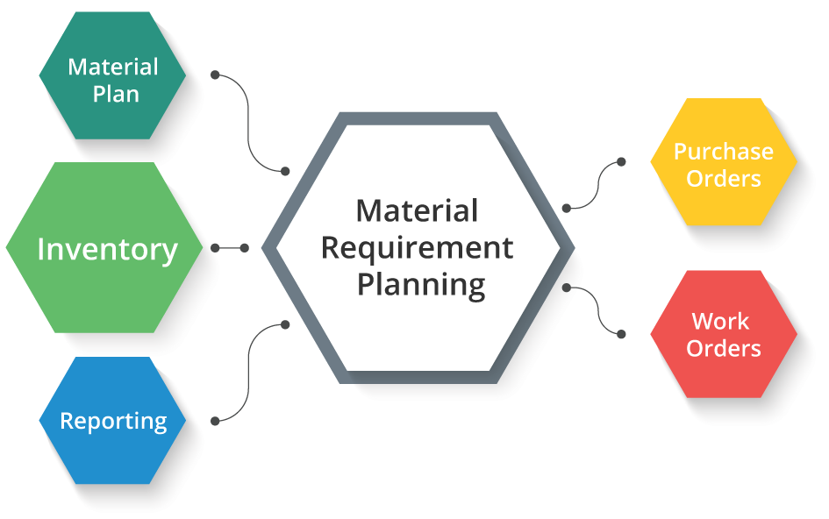
Stock Projections:
Predicts future inventory needs based on historical data, trends, and demand forecasting, enabling businesses to plan inventory purchases and avoid stockouts or overstock situations.
Inventory Reports and Analytics:
Generates detailed reports and insights on inventory performance, turnover rates, and trends, providing valuable information for strategic planning, cost control, and optimizing inventory levels.
Integration with Other Tools:
Seamlessly connects with other business applications like ERP, CRM, and e-commerce platforms, ensuring smooth data flow across systems, improving efficiency, and reducing manual data entry errors.

Slide 7
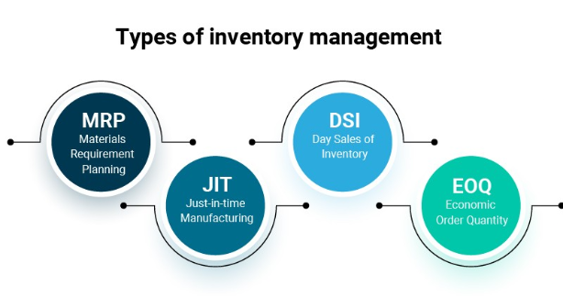
INVENTORY MANAGEMENT TECHNIQUES
Just-in-Time Management (JIT):Minimizing inventory levels by receiving goods only as they are needed.
Materials Requirement Planning (MRP):This inventory management method is sales-forecast dependent, meaning that manufacturers must have accurate sales records to enable accurate planning of inventory needs and to communicate those needs with materials suppliers in a timely manner.
Economic Order Quantity (EOQ):Calculating the optimal order quantity to minimize total inventory costs
Days Sales of Inventory (DSI):Indicating the liquidity of the inventory, how many days a company’s current stock of inventory will last

Slide 8
LITERATURE REVIEW:
Title | Year | Objective | Advantages | Limitations
Impact of Stockout Compensation in E-Commerce Drop-Shipping Supply Chain Author: Raj Kamalapur | 2020 | ● Investigate impact of stockout compensation strategies on supplier and retailer profits Analyze profit differences between E-SC, S-SC, and N-SC strategies . | E-SC and S-SC strategies increase profits in the e-commerce supply chain. S-SC strategy can offset stockout compensation cost with slight price increase. | High demand variability, low production capacity, and service level affect profits. E-SC has less than 4.0% profit difference compared to N-SC.
An Optimal Pricing and Inventory Control Policy for Online Sale Author: Wedad Elmaghraby | 2022 | Maximize average profit through optimal pricing and inventory control policy. Develop an iterative algorithm to determine optimal price and order quantity. | Maximize average profit Improve sale profit through optimal pricing and inventory control | ● The study's theoretical emphasis may neglect real-world complexities ●It overlooks sudden changes in consumer behavior and supply chain disruptions, affecting practical relevance
Analysis of Behavioural Data of Customer for the E-Commerce Platform by using Machine Learning Approach Author: Ayushi Maurya | 2023 | Analyze customer purchase tendencies and improve product discoverability. Use machine learning to classify customers and anticipate product sales. | ● Improves customer behavior, product discoverability, warehouse maintenance Anticipates e-commerce sales using machine learning techniques . | The collection and analysis of detailed behavioral data raise significant privacy and security concerns. Machine learning models may suffer from overfitting and bias, leading to poor generalization and potentially unfair predictions.

Slide 9
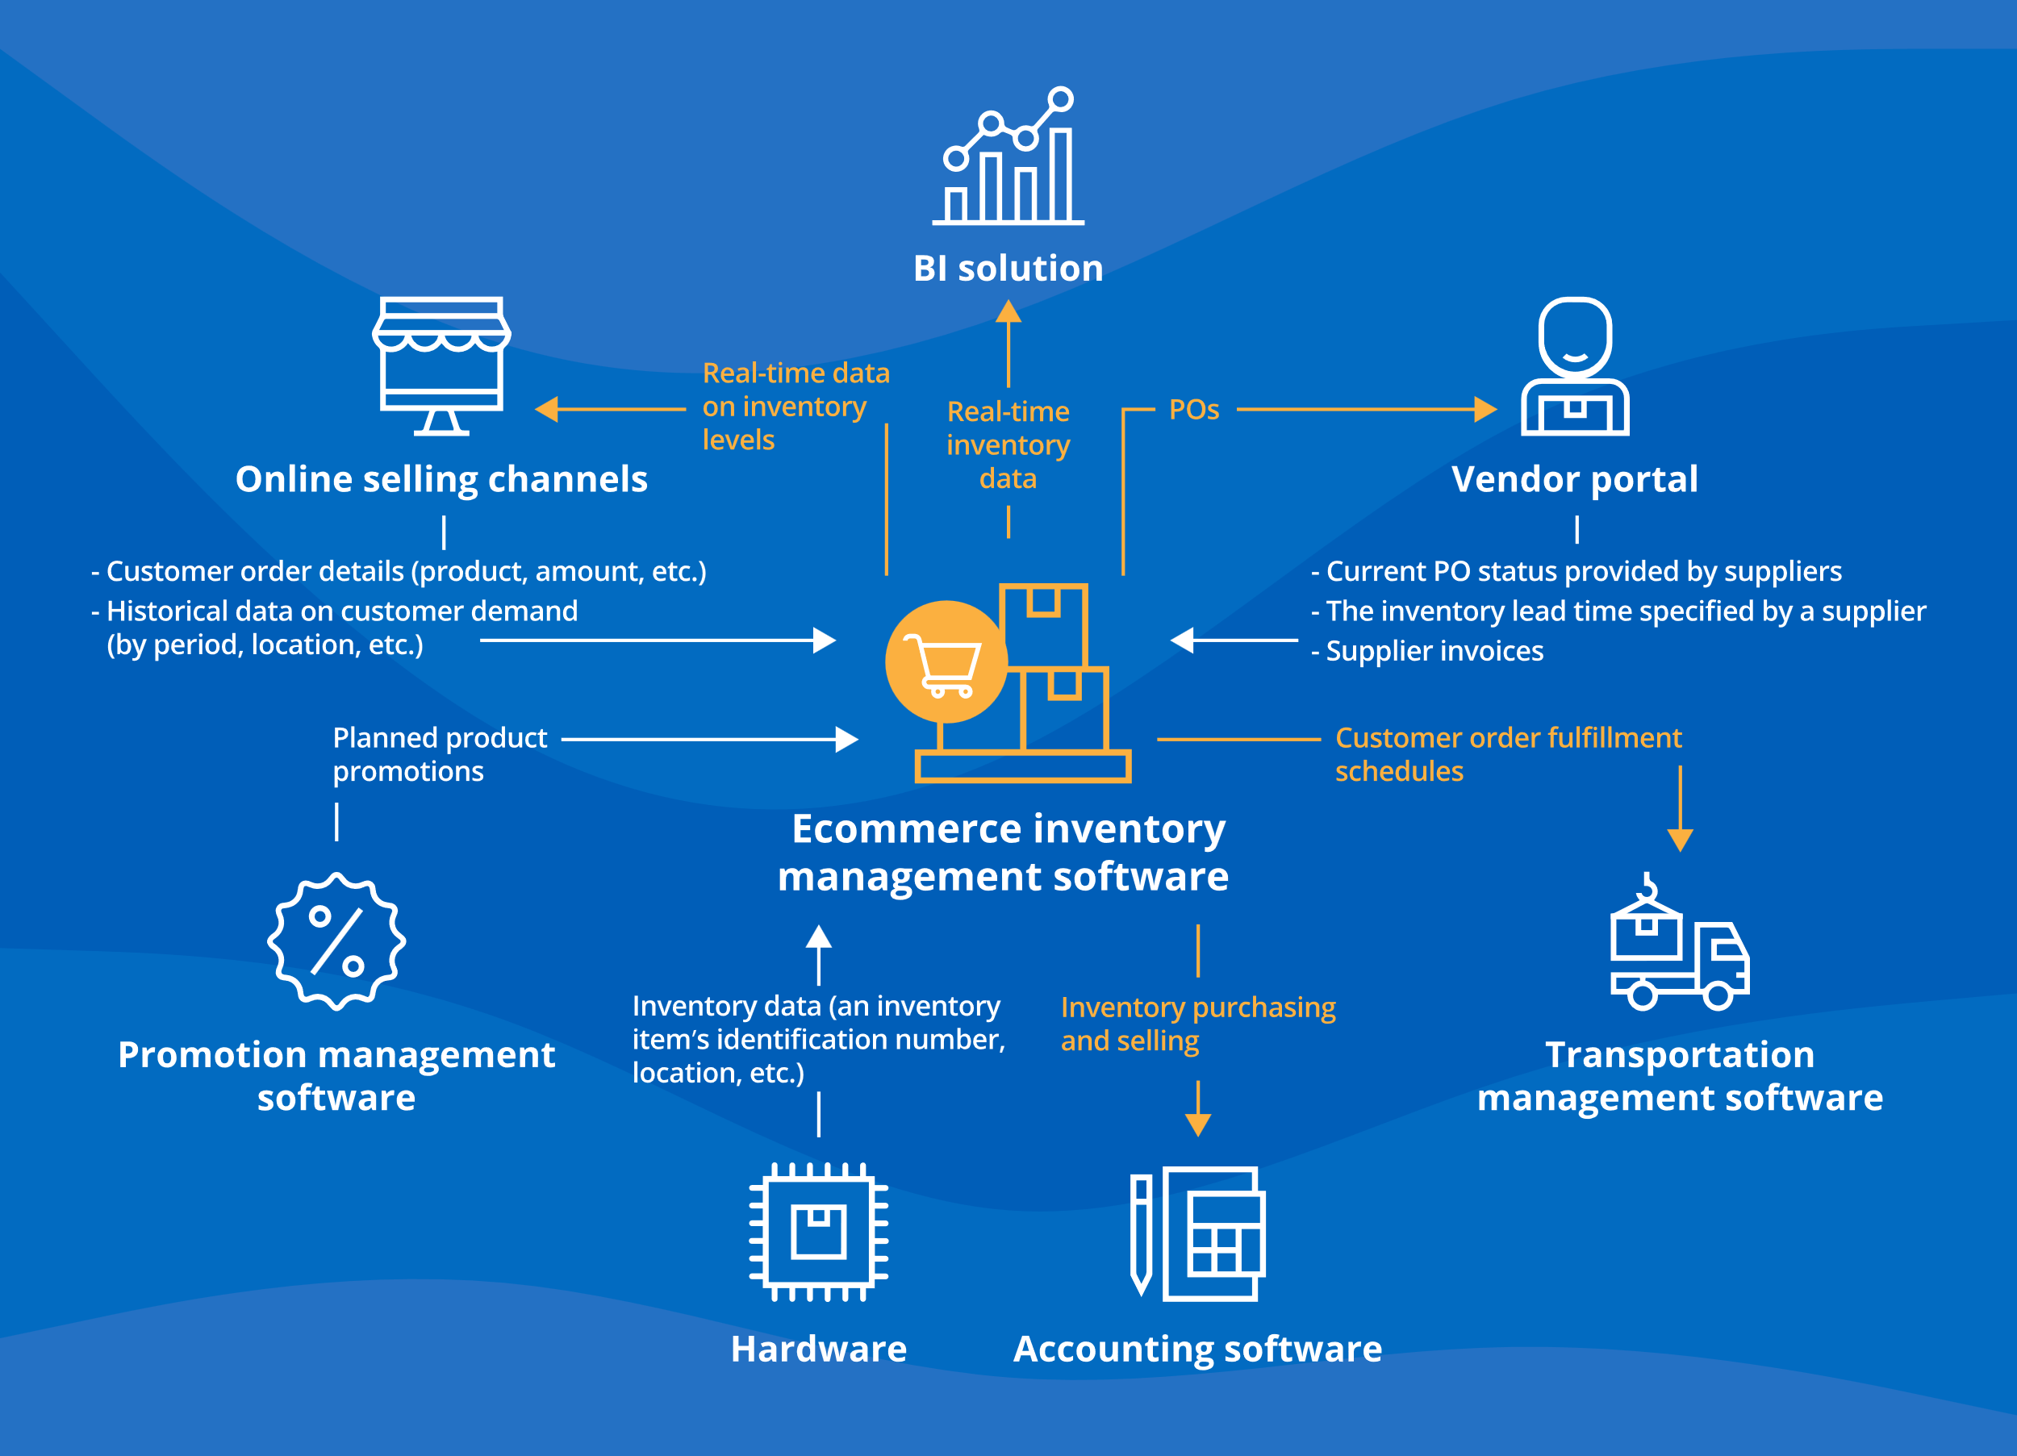
Code Implementation
import pandas as pd
import matplotlib.pyplot as plt
import numpy as np
data_past = {
'Month': ['Jan', 'Feb', 'Mar', 'Apr', 'May'],
'Stock_Sold': [100, 150, 120, 130, 140],
'Stock_Ordered': [120, 170, 130, 140, 160],
'Stock_Wasted': [20, 25, 15, 10, 20],
'Delivered_On_Time': [80, 85, 90, 88, 82],
'Customer_Need_Met': [70, 75, 80, 78, 72]
}

Slide 10
data_after = {
'Month': ['Jan', 'Feb', 'Mar', 'Apr', 'May'],
'Stock_Sold': [110, 160, 130, 140, 150],
'Stock_Ordered': [115, 165, 125, 135, 150],
'Stock_Wasted': [5, 8, 3, 2, 5],
'Delivered_On_Time': [90, 92, 95, 93, 90],
'Customer_Need_Met': [85, 88, 90, 92, 88]
}
df_past = pd.DataFrame(data_past)
df_after = pd.DataFrame(data_after)
colors = ['blue', 'green']
plt.figure(figsize=(12, 8))
stock_metrics = ['Stock_Sold', 'Stock_Ordered', 'Stock_Wasted']
for i, metric in enumerate(stock_metrics):
plt.subplot(2, 2, i+1)
plt.bar(df_past['Month'], df_past[metric], color=colors[0], width=0.4, align='center', label='Past')
plt.bar(df_after['Month'], df_after[metric], color=colors[1], width=0.4, align='edge', label='After')
plt.title(f'Comparison of {metric} Before and After Implementing Inventory Control')
plt.xlabel('Month')
plt.ylabel(metric)
plt.legend()
plt.tight_layout(rect=[0, 0, 1, 0.96])
plt.suptitle('Stock-Related Metrics Comparison', fontsize=16)
plt.show()

Slide 11
plt.figure(figsize=(12, 8))
service_metrics = ['Delivered_On_Time', 'Customer_Need_Met']
for i, metric in enumerate(service_metrics):
plt.subplot(2, 1, i+1)
plt.bar(df_past['Month'], df_past[metric], color=colors[0], width=0.4, align='center', label='Past')
plt.bar(df_after['Month'], df_after[metric], color=colors[1], width=0.4, align='edge', label='After')
plt.title(f'Comparison of {metric} Before and After Implementing Inventory Control')
plt.xlabel('Month')
plt.ylabel(metric)
plt.legend()
plt.grid(axis='y', linestyle='--', linewidth=0.7)
plt.tight_layout(rect=[0, 0, 1, 0.96])
plt.suptitle('Service-Related Metrics Comparison', fontsize=16)
plt.show()

Slide 12
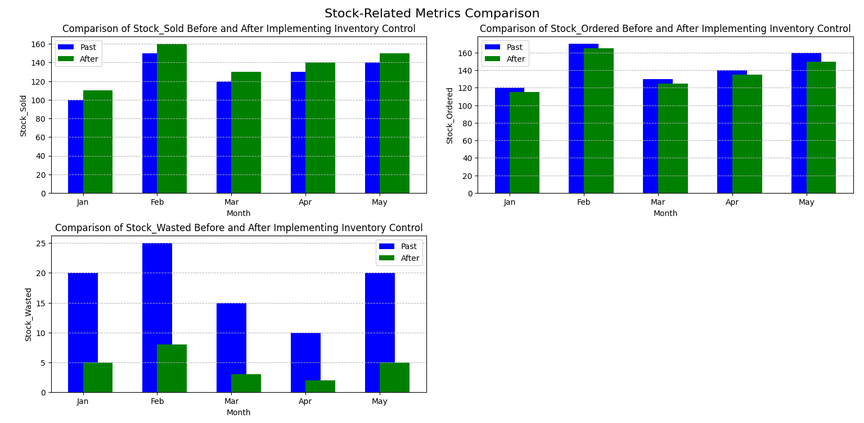
OUTPUT

Slide 13
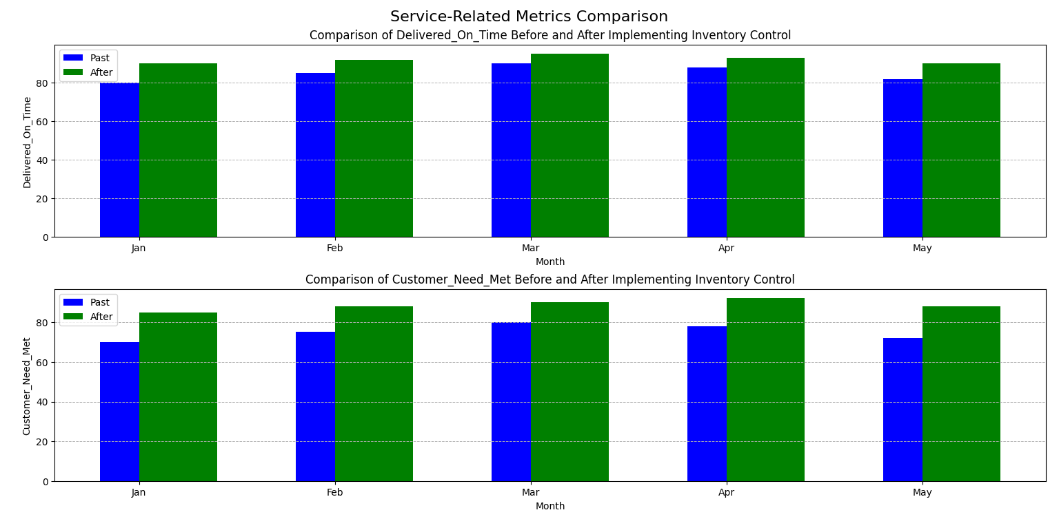

Slide 14
RESULTS AND DISCUSSION
The Inventory Control Management System was successfully implemented, including modules for inventory tracking, order management, supplier management, and reporting. Key functionalities such as real-time inventory updates, automated reorder alerts, and detailed analytics were tested and validated.
Having accurate inventory data and better forecasting capabilities, the company could negotiate better terms with suppliers and take advantage of bulk purchasing discounts without overstocking.
Improved order accuracy and a significant reduction in customer complaints underscore the positive impact of the ICMS on customer satisfaction.
The increase in the inventory turnover ratio indicates more efficient inventory management.
The significant reduction in waste is a notable achievement, reflecting better demand forecasting and more efficient inventory management.
This contributes positively to sustainability goals and reduces disposal costs.

Slide 15
Conclusion
An e-commerce store’s inventory is its lifeblood. Backorders are avoided, consumers are satisfied, and your firm is lucrative when you have the right products in stock. By streamlining and automating inventory control operations, optimizing your logistic cycle, and providing you with a real-time picture of stock levels, a robust inventory management system may help you save time and money.

