Slide 1


Saveetha school of engineering
ONLINE GROCERY PRODUCTS APPLICATION
Project By : K . Mahesh
Reg NO : 191911472
Dept : CSE

Slide 2
Abstract
1.Verify that the user is able to view the list of grocery products.
2. Verify that the user is able to add, view the details and search the grocery products to the cart.
3.Give desired capabilitie in Appium server
4.Give the java code for testing
5.Paste the code in intelliJ IDE and run

Slide 3
Introduction ----> APPIUM
Open source Automation tool.
Automation Framework.
Automates different types of mobile applications testing.
It can test web , Native and Hybrid application.
It supports multiple programming languages.
(Java , python , ruby and many more )
6. It works on Emulator as well as Real Devices.

Slide 4
introduction ----> Android studio
It is Integrated development Environment.
It has fast Emulator for App Testing.
Used to Develop applications for Android devices.
It is an open source software.

Slide 5
OBJECTIVES
The objective of testing an online grocery products Android application using Appium is to ensure that the application is functioning properly and that all features are working as expected.
This includes verifying that the user interface is easy to use.
That the checkout process is secure and efficient, and that the application is compatible with all Android devices.
Additionally, the testing should also ensure that the application is free of any bugs or glitches that could cause it to crash or malfunction.

Slide 6
Proposed work
Develope a test plan for the online grocery application.
Setup the Appium envvironment for testing the aaplication
Install the application on the device and launch it.
Run the application using Android Studio Emulator
Appium intercats with the application and finds the positive and negative outcomes.
Different strategies will be tested using appium

Slide 7
TEST CASES
App Launch
User Name
Login
Adding items to the cart
Chechout
buttons
Labels
images

Slide 8


APP TOOLS AND INSTALLATION

Slide 9

ANDROID STUDIO

Slide 10
FLOWCHART
Install Andriod Studio
Install Intellij
Install Appium
Develop App in Android studio
App Launch
Login
(Testing)
Online grocey Products
Open Appium Software
Open App in Emulator
Buttons
Imagesg
(Testing)
Automate the Testing
Positive and Negative Outcomes
Testing Completed

Slide 11
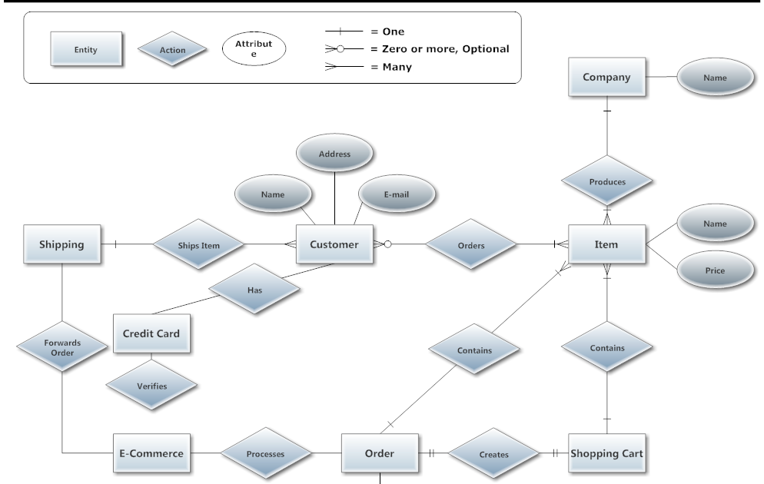
CONCEPT MAP

Slide 12
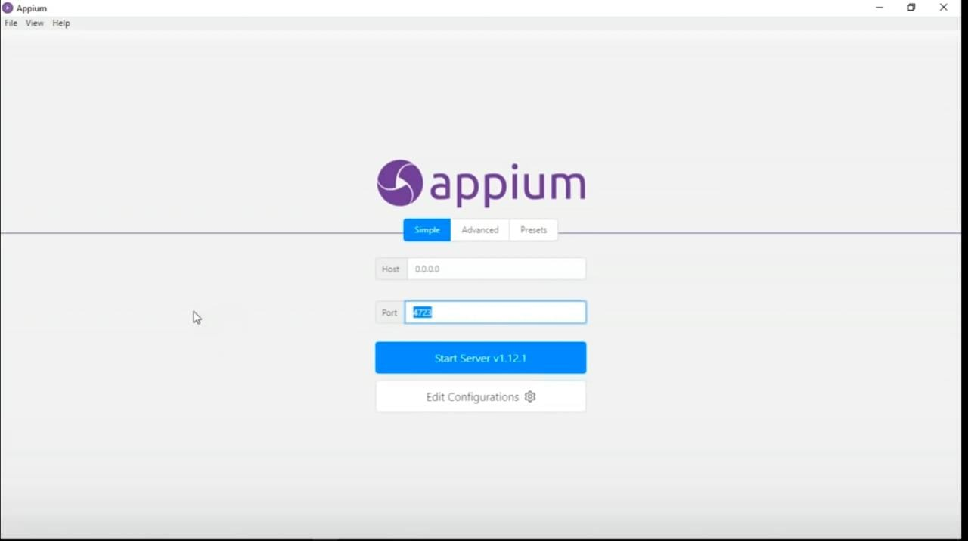
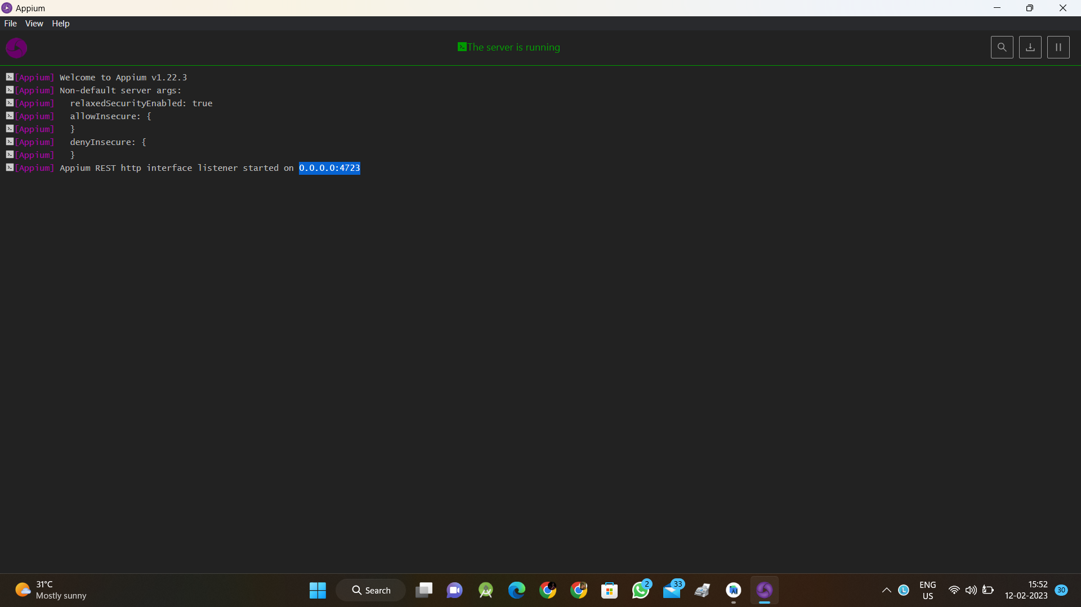

Slide 13
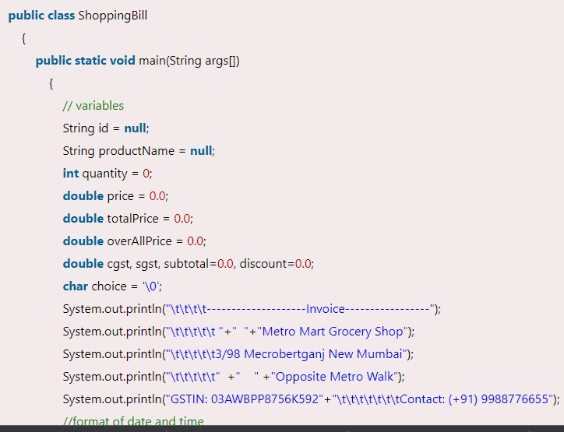
implementation

Slide 14
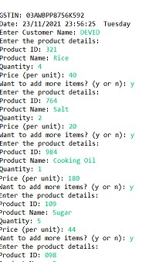
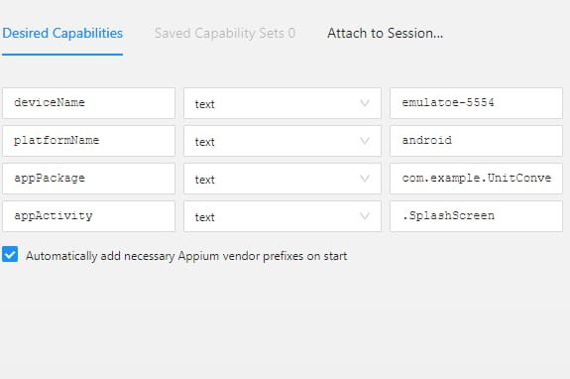
OUTPUT

Slide 15
TEST CASE OUTCOMES
App Launch (Positive)
User Name (Positive)
Login (Positive)
Adding items to the cart (Negative)
Checkout (Positive)
Buttons (Positive)
Labels (Negative)
Images (Positive)

Slide 16
THANK YOU

