Slide 1



Git, Github AND Jenkins

Slide 2
Agenda
What is Git and GitHub?
Github Structure
Github Vocabulary
Git Workflow
Creating Organizations
Creating Repository in Github
Clone,Pull and Push Projects from GIT
Versioning in Github
Rollback to previous version
Notes:
You don’t have to go ask someone to create a branch for you, or create a repo for you or request a branch merge.. you do as you please with YOUR copy.

Slide 3
Git and Github
Git - Git is a version control system. Version control is a system that records changes to a file or set of files and helps us recall specific versions later if needed.
It allows you to:
Revert files or the whole project to an earlier state
Compare change overtime
See who modified what?
Merge ﬁles rather than a “lock and checkout” model
Control modifications by collaborators with permissions of admin/owners
GitHub - GitHub is a hosting service for Git repositories.
It is a web-page on which you can publish your Git repositories
and collaborate with other people

Slide 4
GITHUB Vocabulary
Organisation
Repository
Fork
Push/Pull
Collection of Repositories
Collection of stored Code
Copy repository, Copy of repository
Check-out or Check-in mechanism
Branch
Commit
Pull Request
Indicator of divergence from base
Point in time snapshot of repository with changes
Comparison of edits to see if team wants to accept changes
Notes:
(almost) everything is local... branching, merging etc

Slide 5
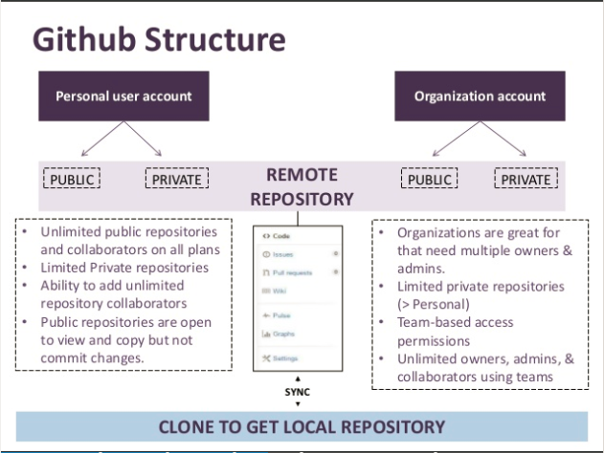
Github Structure
Notes:
initially created by Linus Torvalds, now supported by a huge open source community ... field tested with Linux Kernel

Slide 6
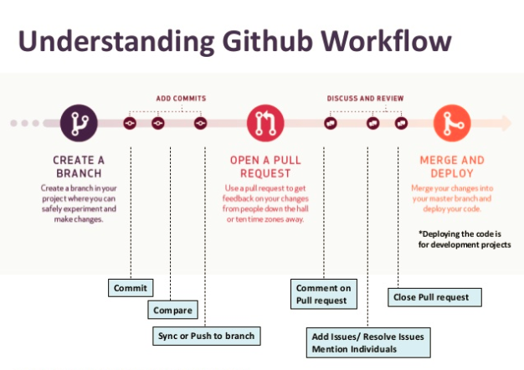
Github Workflow
Notes:
We’ll be using the git command line interface, but feel free to choose your preferred solution GUIs, Editor Extension etc

Slide 7
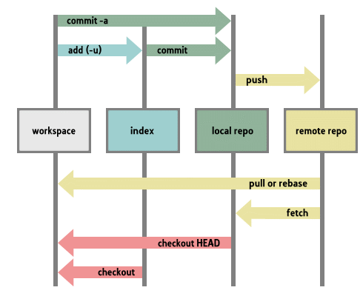
Github Workflow

Slide 8
Creating Organisation
In the upper-right corner of any page, click your profile photo, then click Settings.
In your user settings sidebar, click Organizations.
In the "Organizations" section, click New organization.
Under "Organization name", type a name for your organization.
Provide the contact email and click on create Organisation.
Add the members to the repository.

Slide 9
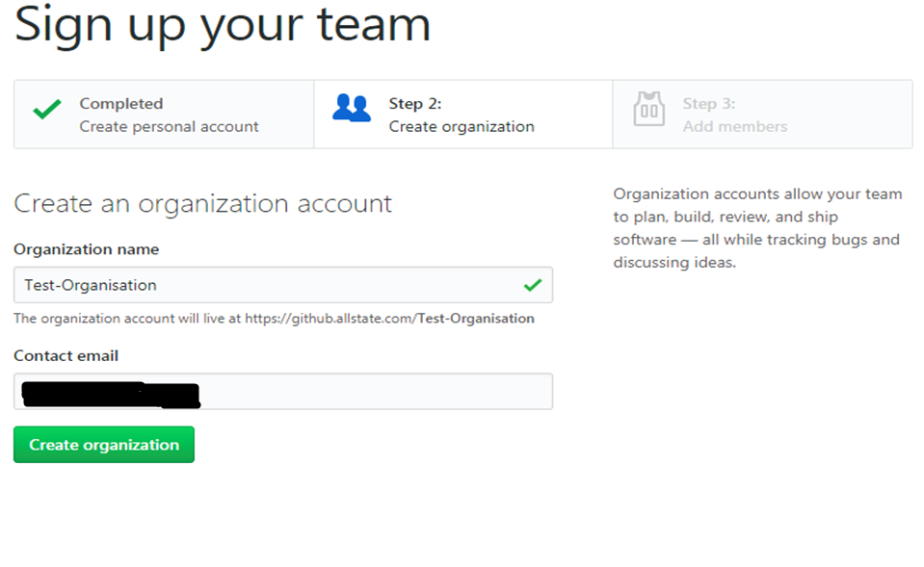

Slide 10
Create Repository in Github
In the upper-right corner of Organisation page, click on New tab.
Under the “Repository name”, type a name for your project.
Provide the description of the project under “Description”. It is optional.
Click on Public or Private .
Check the Initialize this repository with a README.
Click on the Create repository.

Slide 11
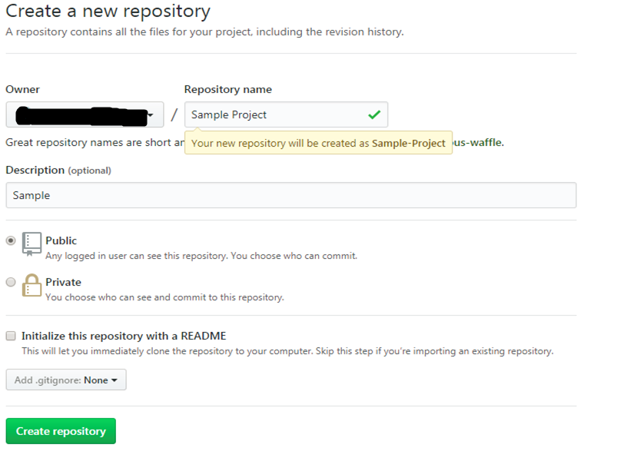

Slide 12
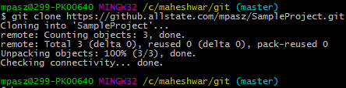

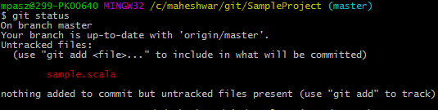
Git Clone,Pull and Push

Slide 13
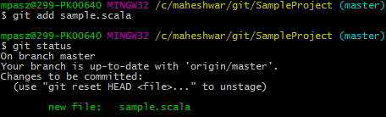

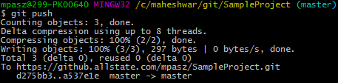
Notes:
show the students

Slide 14
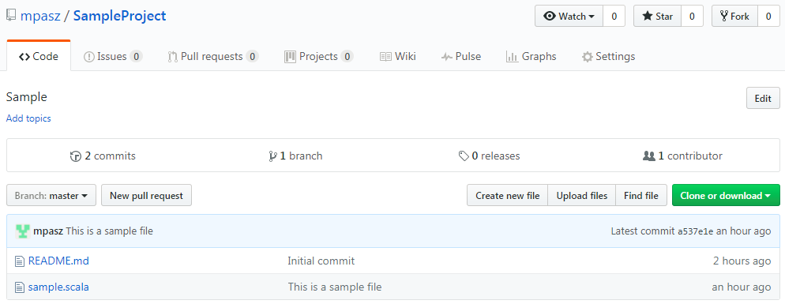
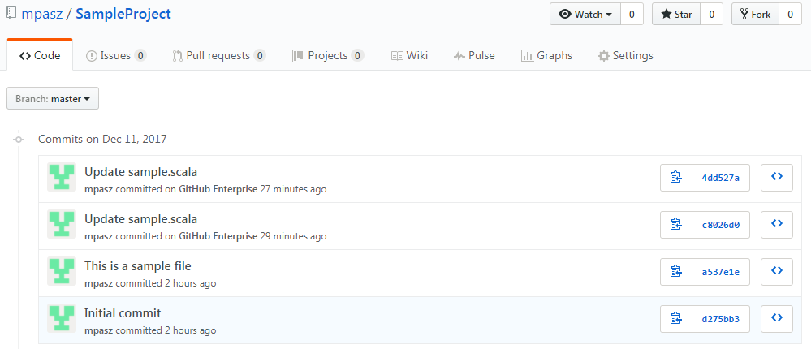
Versioning in Github

Slide 15
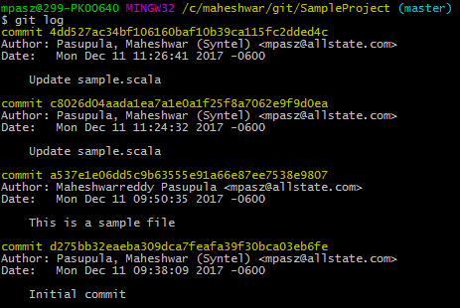
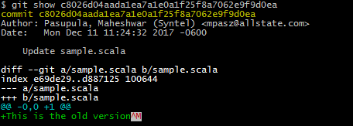
Rollback to Previous version

Slide 16
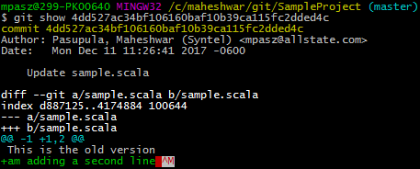




Slide 17
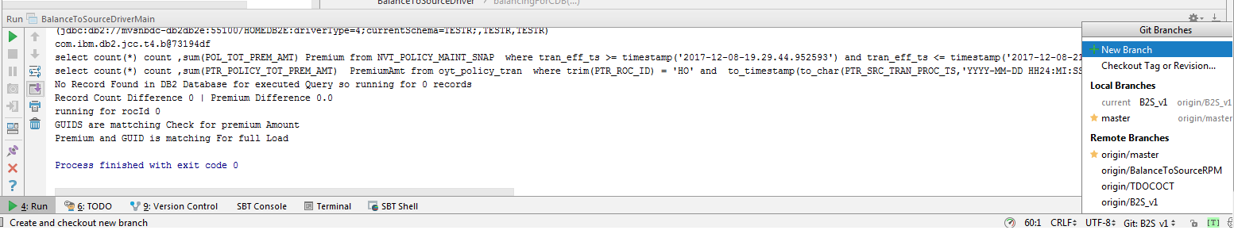
Creating Branches from Intellij

Slide 18

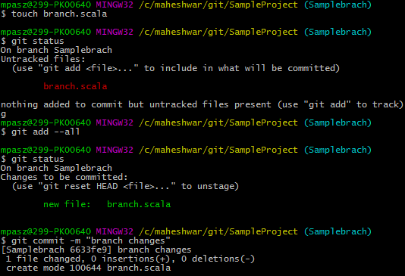
Creating Branch and Merging

Slide 19
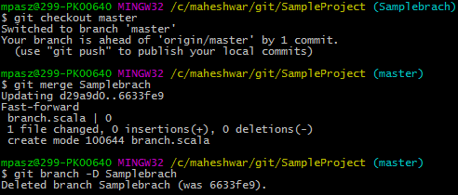
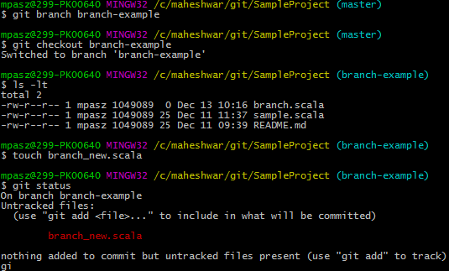
Creating and Merging branch

Slide 20
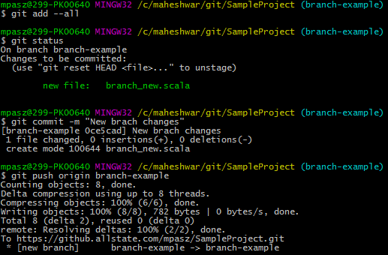
Creating branch and Push to Github

Slide 21
Jenkins
Jenkins is an open source automation tool written in Java with plugins built for Continuous Integration purpose.
Jenkins is used to build and test your software projects continuously making it easier for developers to integrate changes to the project, and making it easier for users to obtain a fresh build.
Advantages are it is an open source, Easy to install, 1000+ Plug-ins, Free of cost, Built in Java and hence portable to all major platforms.

Slide 22
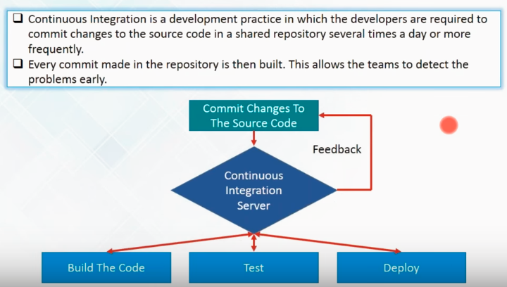
What is Continuous Integration

Slide 23
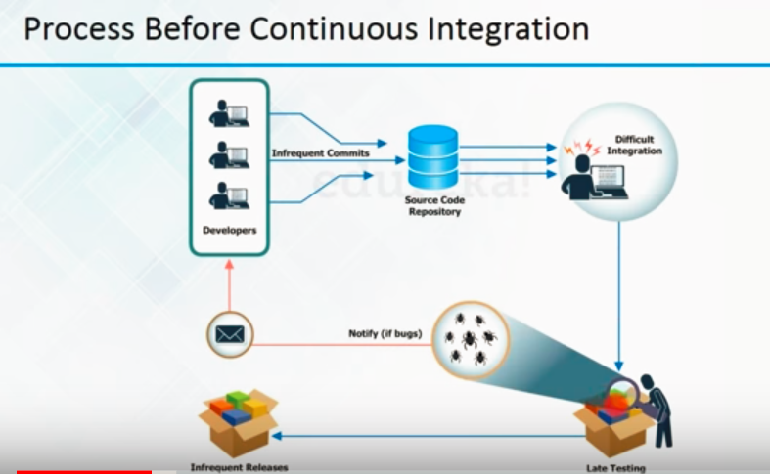
Why Continuous Integration

Slide 24
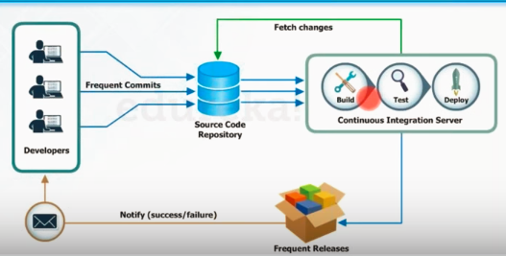
Continuous Integration

Slide 25
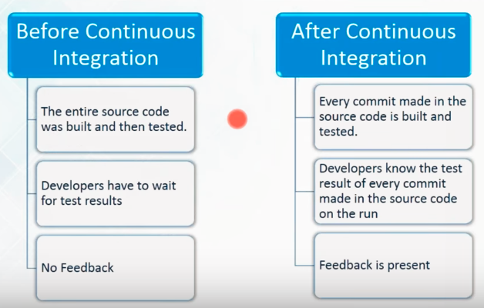
Before and After

Slide 26
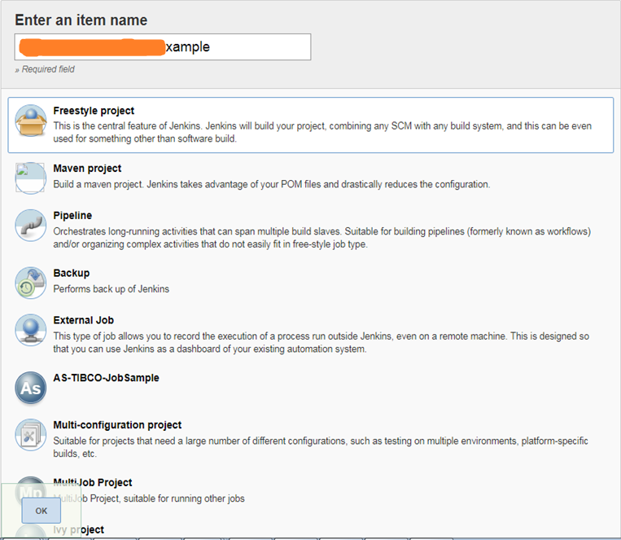
Jenkins Setup
Step 1: Go to Jenkins.com. Click on new item on left top corner of the page.

Slide 27

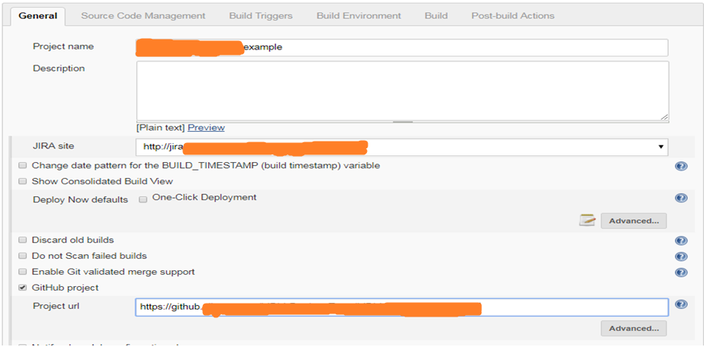

Slide 28
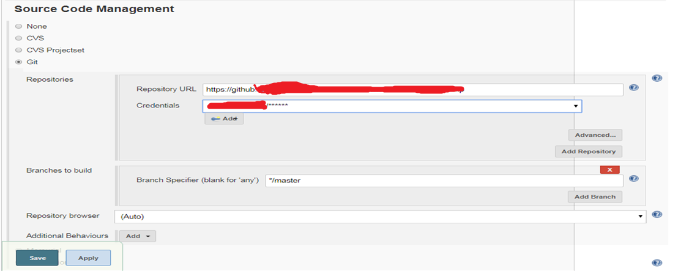

Slide 29
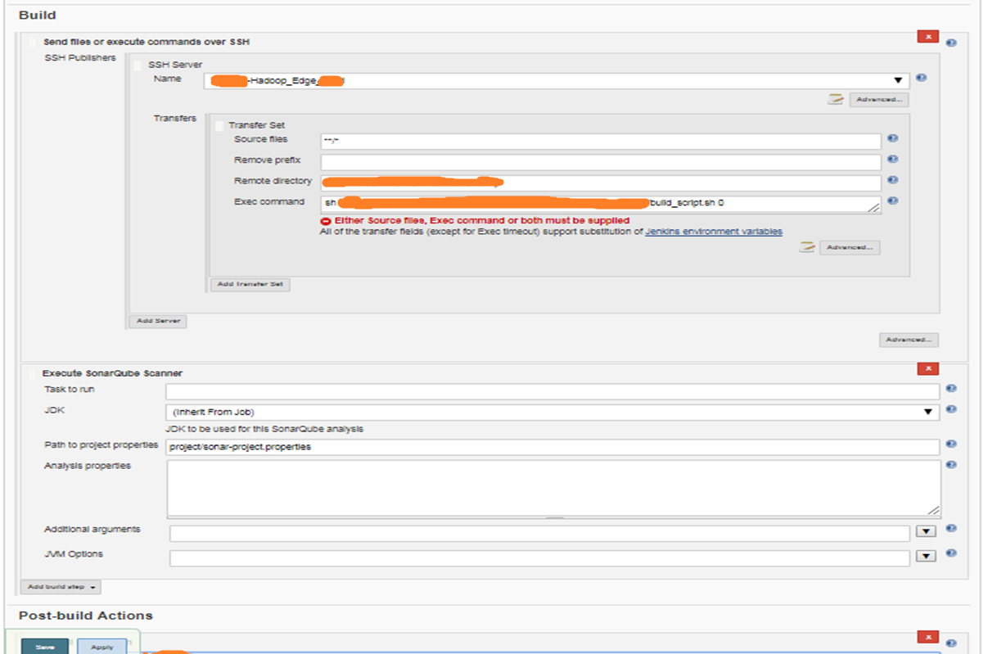

Slide 30
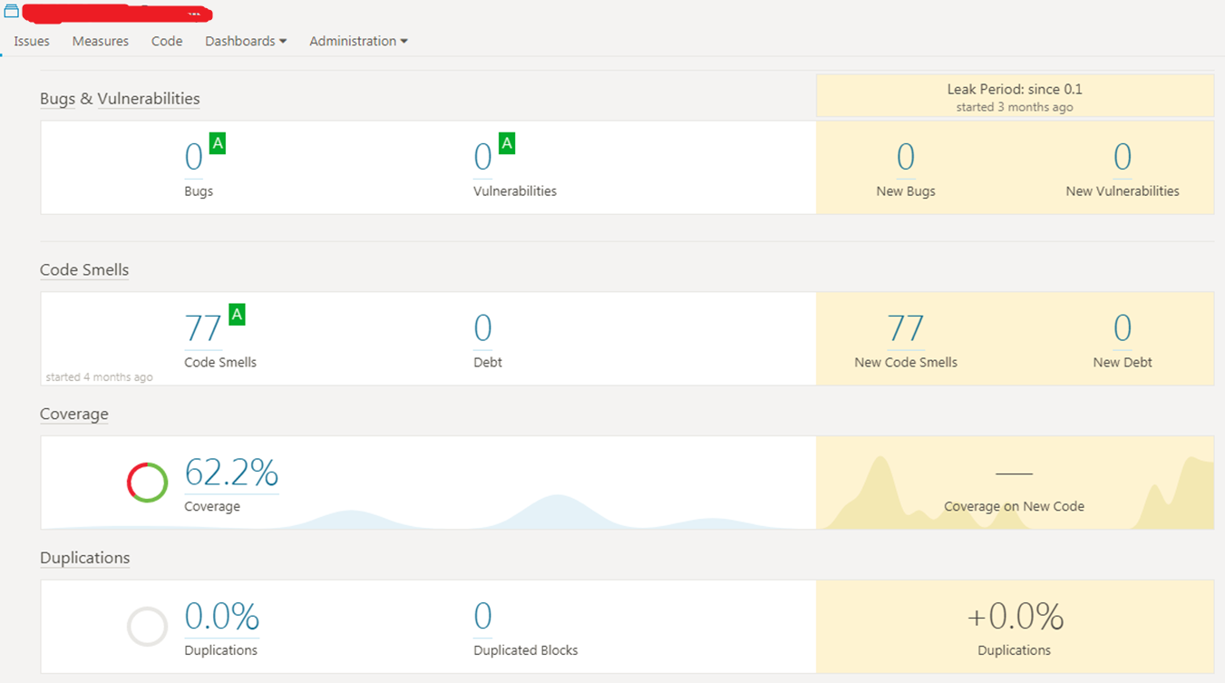
Sonarcube

Slide 31

Thank You

