Slide 1
Bengaluru House Price Prediction
DataVerse Housing Track | Regression | RMSLE

Slide 2
Contest Requirement
Build a regression model for Bengaluru residential property prices.
Optimize for RMSLE because the target price range is wide and skewed.
Show strong EDA, cleaning decisions, feature engineering, model rigor, and interpretability.
Be ready for the 3 PM technical pivot by merging new helper data and proving metric improvement.

Slide 3
Dataset And Cleaning
Raw rows: 1000; cleaned rows: 917; removed outlier/noisy rows: 83.
Cleaned location strings and converted area into numeric sqft.
Removed impossible or unrealistic BHK, bathroom, price, and sqft-per-BHK records.
Preserved categorical features for one-hot encoding in the model pipeline.

Slide 4
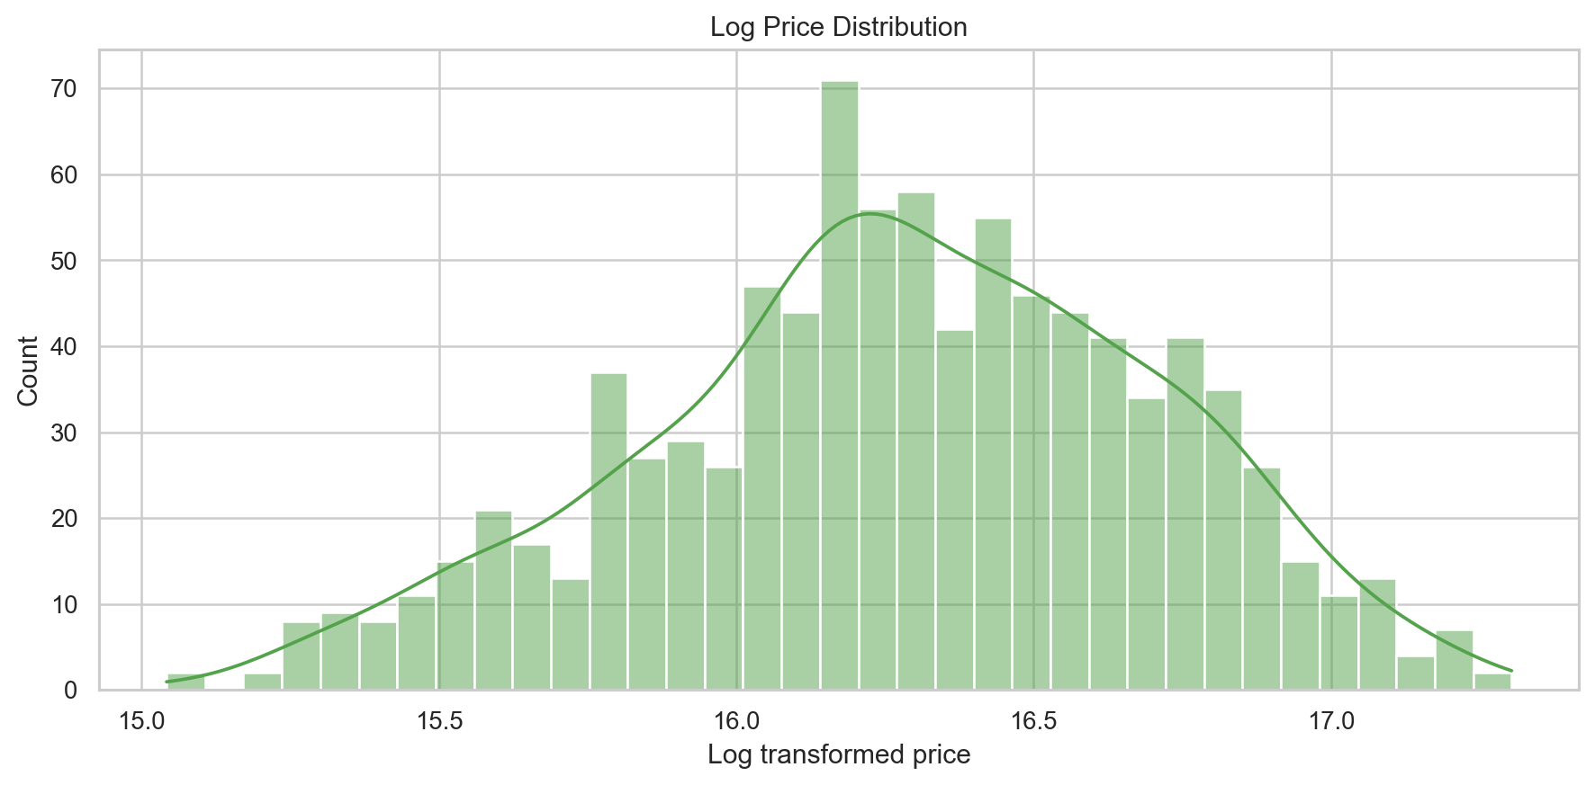
Target Distribution
House prices are skewed. Log transformation makes model training and RMSLE evaluation more stable.

Slide 5
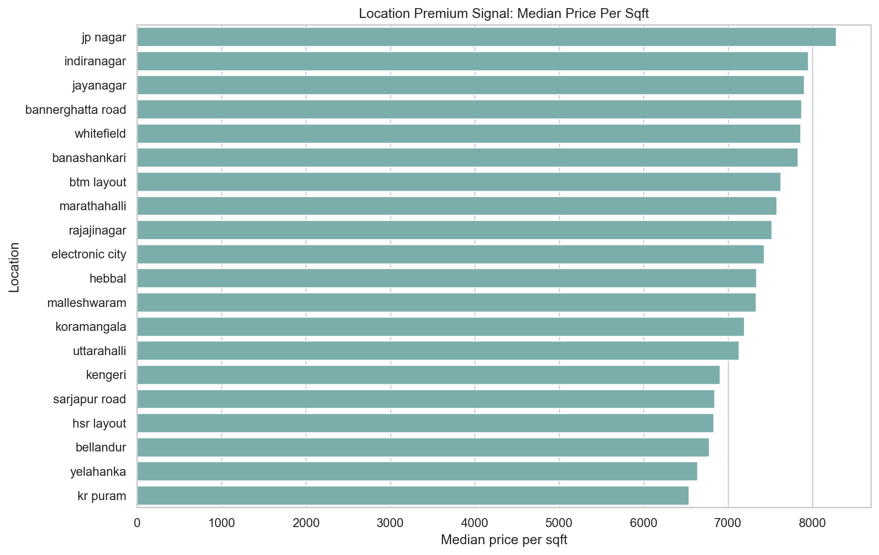
Location Is The Strongest Signal
Median price per sqft by location captures locality premium better than raw area alone.

Slide 6
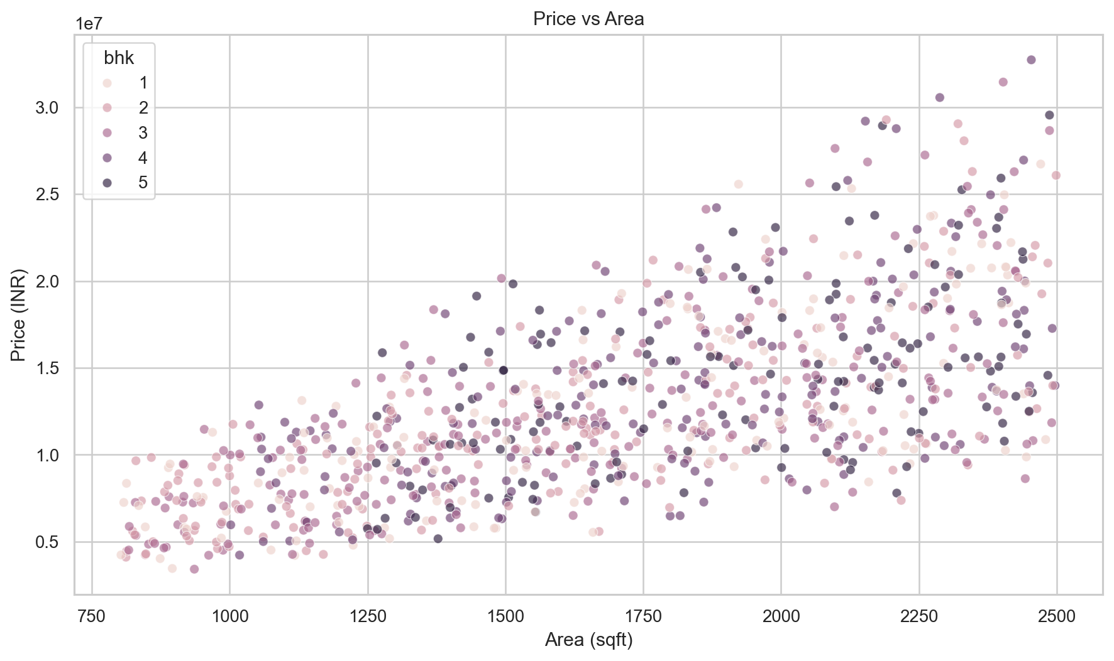
Area Matters, But Not Alone
Area and BHK explain part of price, but similar-sized homes can vary strongly by location and property profile.

Slide 7
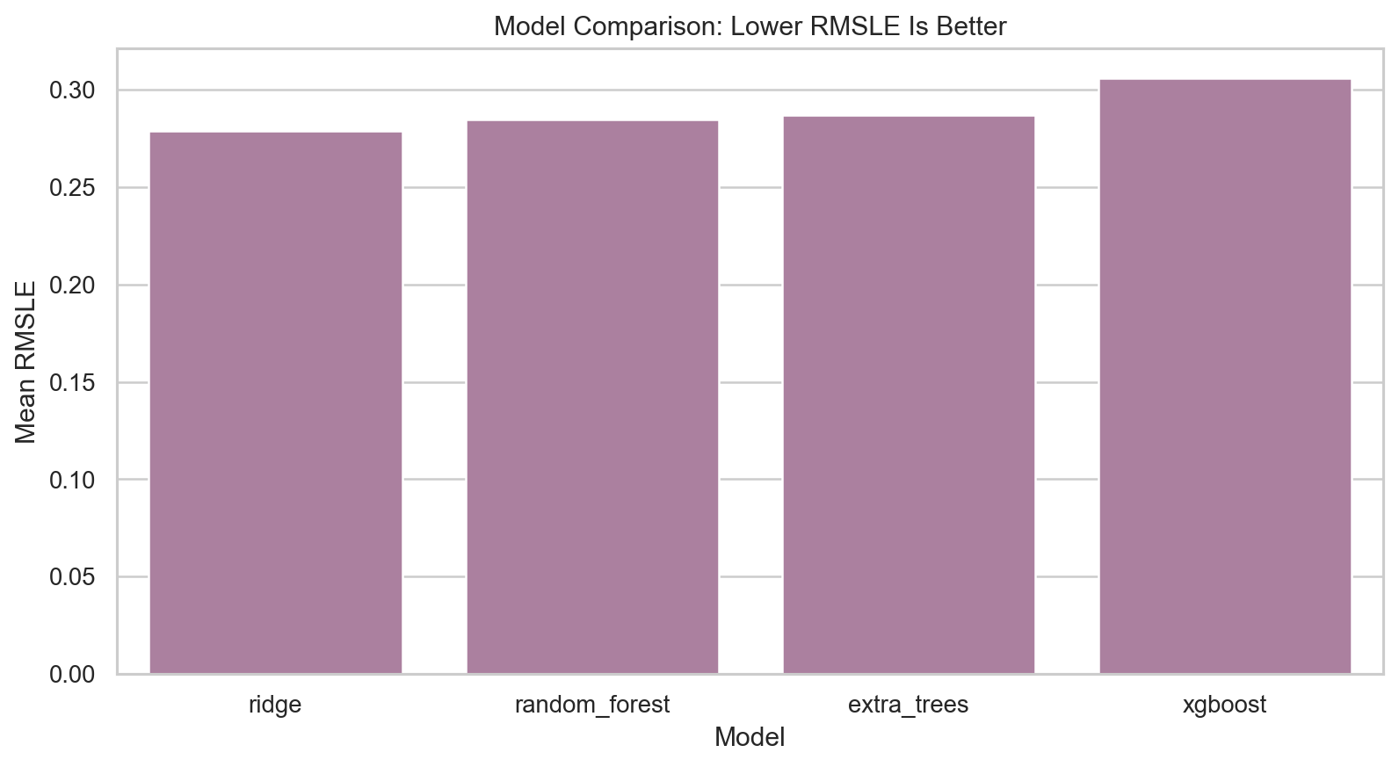
Model Comparison
The best cross-validated model is ridge. Lower RMSLE means better price prediction stability.

Slide 8
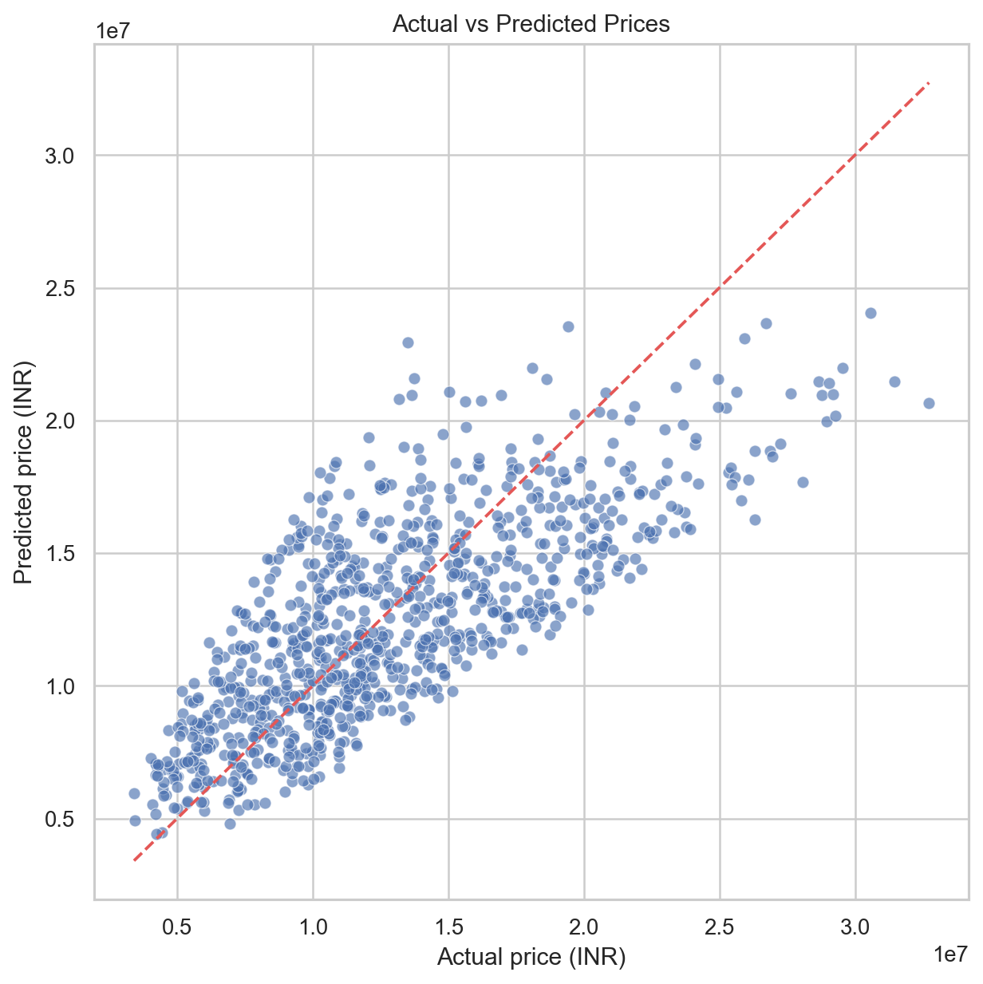
Prediction Diagnostics
Actual vs predicted values show whether the model follows the correct pricing trend across the data.

Slide 9
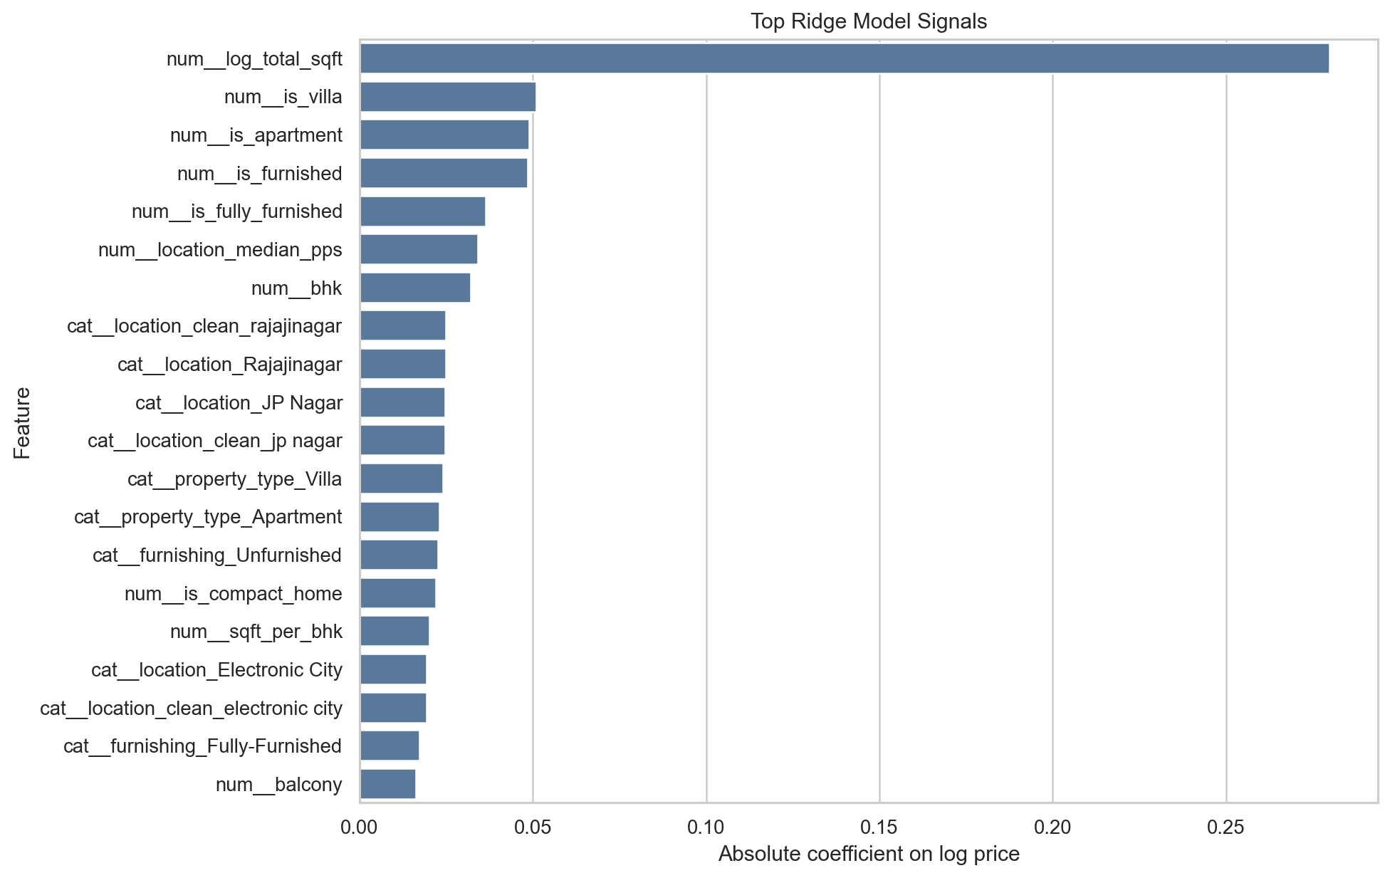
Interpretability
Ridge coefficients show which engineered and encoded features most influence log-price prediction.

Slide 10
3 PM Pivot Readiness
If helper data is released, merge it by location or property identifier.
Possible helper features: metro distance, IT park proximity, school ratings, road access, zoning, or guidance value.
Create a before/after metric table to prove the delta after adding pivot features.
Explain whether the provided hypothesis was supported or disproved by plots and validation score.

Slide 11
Final Pitch
This project covers the full ML workflow: EDA, cleaning, feature engineering, validation, saved model, and app.
Main insight: location premium plus space-quality ratios explain price better than area alone.
Main limitation: exact coordinates, infrastructure proximity, and market trend data are not present.
Impact: quick market screening and negotiation baseline for Bengaluru properties.

