Slide 1
KT on Appium
Presented By:

Slide 2
Agenda
Introduction to Appium – Overview, purpose, and key features
Appium Architecture – How Appium works, key components, and interaction flow
Prerequisite Software – Required tools and dependencies
Installation and Setup – Step-by-step guide for installing Appium
Appium Inspectors – Tools for identifying UI elements
Desired Capabilities – Configuring Appium for automation

Slide 3
Introduction to Appium
What is Appium?
Appium is an open-source mobile automation testing tool for native, hybrid, and web applications.
It supports Android, iOS, and Windows platforms.
Works with multiple programming languages like Java, Python, JavaScript, and C#.
Uses the WebDriver protocol for automation 2.0 Json protocol for 1.0 , similar to Selenium.
Purpose of Appium
To automate mobile applications across different platforms.
To provide a cross-platform testing solution (write tests once and execute on both Android & iOS).
To support automation of native, hybrid, and mobile web applications.
To allow testing using real devices, emulators, and simulators.
To integrate with popular CI/CD tools for continuous testing.
Key Features: ✔ Supports cross-platform testing (Write Once, Run Anywhere). ✔ No need to modify the app’s source code for automation. ✔ Uses standard automation frameworks like UIAutomator (Android) & XCUITest (iOS).

Slide 4
Why Use Appium Instead of ADB?
Feature | ADB | Appium
Cross-platform (Android + iOS) | ❌ No (Android only) | ✅ Yes
Test Automation Framework | ❌ No | ✅ Yes (JUnit, TestNG, etc.)
Find Elements (ID, XPath, ClassName) | ❌ No | ✅ Yes
Assertions & Validations | ❌ No | ✅ Yes
Synchronization (Waits) | ❌ No | ✅ Yes (Implicit/Explicit Waits)
Gestures (Swipe, Pinch, Multi-touch) | ❌ Limited | ✅ Yes
Parallel Execution on Multiple Devices | ❌ Difficult | ✅ Yes
Example for adb :- adb shell input tap 500 1200
Example for Appium with selenium :- driver.findElement(By.id("com.example:id/login_button")).click();
To launch App:- adb shell am start -n com.android.car.settings/com.android.car.settings.Settings_Launcher_Homepage adb shell dumpsys window | find "mCurrentFocus"

Slide 5
Examples of Native, Hybrid, and Web Applications
1. Native Applications (Built specifically for Android or iOS)
✅ Examples:
Android: WhatsApp, Google Maps, Spotify (built using Kotlin/Java)
iOS: Apple Music, Safari, iMessage (built using Swift/Objective-C)
Uses platform-specific APIs for best performance
Installed via Google Play Store or Apple App Store
2. Hybrid Applications (Uses Web + Native components)
✅ Examples:
Instagram (UI is web-based but uses native camera features)
Uber (Web-based UI but uses native GPS & notifications)
Gmail (Mobile app loads web content but has offline storage)
Built using frameworks like React Native, Flutter, Ionic

Slide 6
3. Web Applications (Runs on a browser, no installation needed)
✅ Examples:
Facebook (m.facebook.com)
Twitter (mobile.twitter.com)
Amazon (www.amazon.com)
Fully web-based, accessed via Chrome, Safari, etc.
Does not require app store downloads
Key Difference:
Native apps are fastest but platform-dependent.
Hybrid apps work cross-platform but may have performance issues.
Web apps run in browsers and don’t require installation.
performance issues
• Web apps: Browser-based, no installation needed

Slide 7
Appium Architecture
Appium follows a client-server architecture and consists of:
Components:
Appium Client – Test scripts written in Java, Python, etc.
Appium Server – Built using Node.js, it listens to test commands and sends them to mobile devices.
Mobile Device (or Emulator/Simulator) – The actual environment where the app runs.
Automation Frameworks –
Android: Uiautomator, Espresso
iOS: XCUITest
How It Works:
The client sends a request (test command) to the Appium Server.
The Appium Server forwards it to the respective automation framework.
The automation framework interacts with the app and performs actions.
The response (success/failure) is sent back to the client.

Slide 8
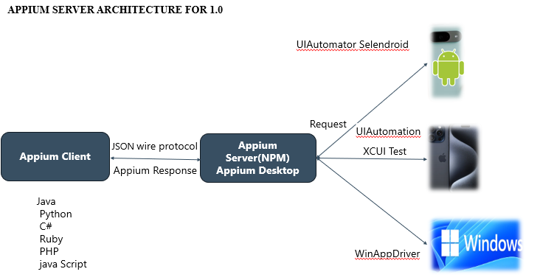
APPIUM SERVER ARCHITECTURE FOR 1.0

Slide 9
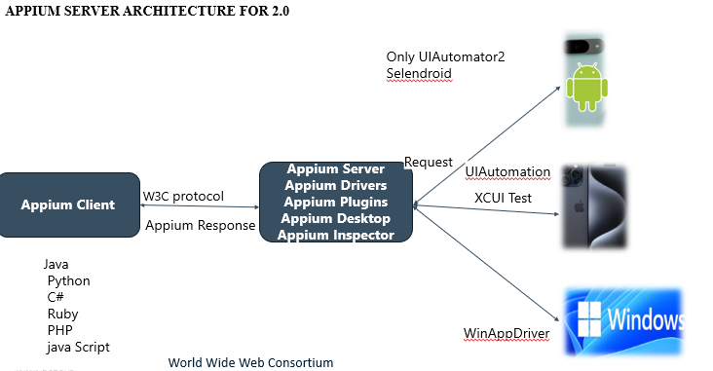

Slide 10
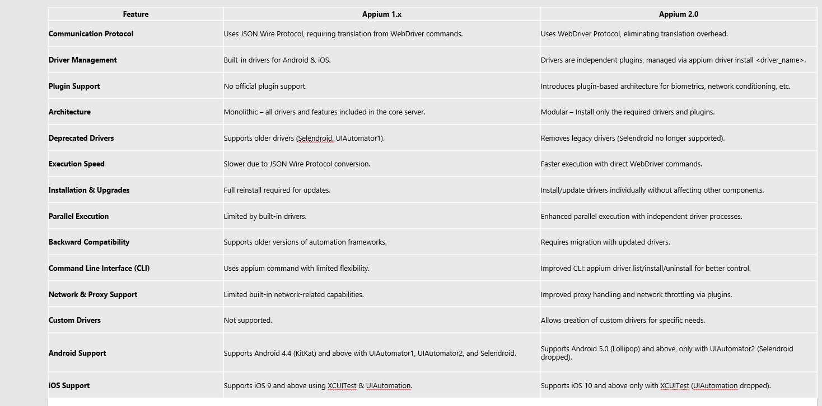

Slide 11
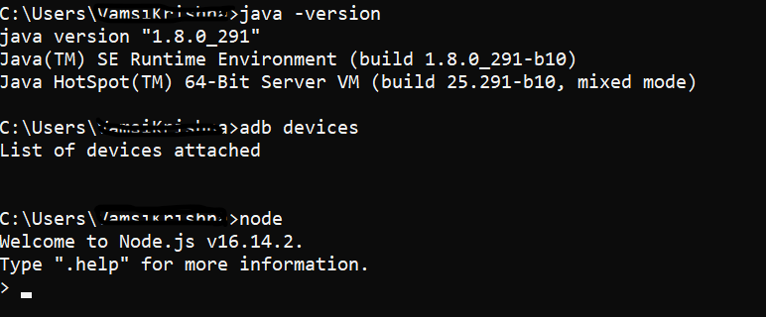
Required Software
Before installing Appium, ensure the following are installed:
✅ Java Development Kit (JDK) + Java Environment Variables ✅ Android SDK + Platform Tools (for Android automation) ✅ Node.js (for Appium server) ✅ Appium Desktop (GUI-based Appium Server - optional) ✅ Eclipse, PyCharm & VS code (for writing scripts)

Slide 12
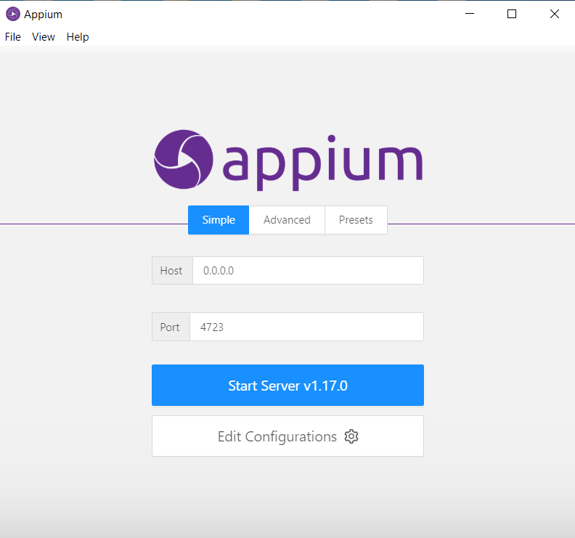
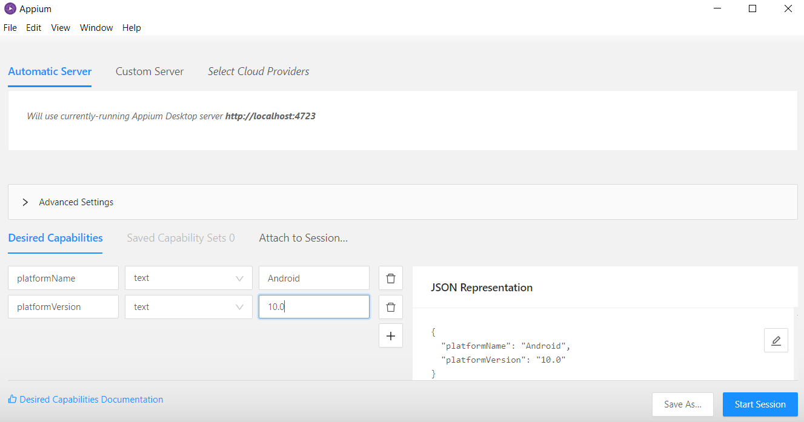
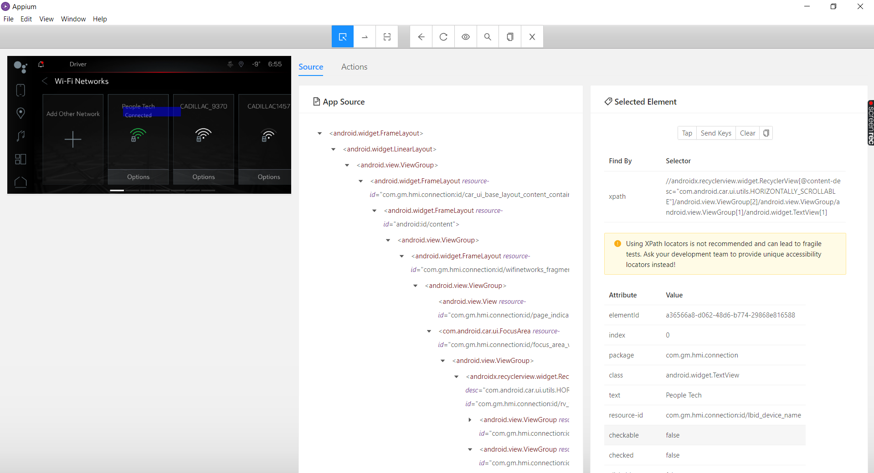
Desired Capabilities (Android)
What is an Appium Inspector?
A tool to inspect UI elements of an app for automation.
Helps find element locators (ID, XPath, Class Name, etc.).
Popular Inspectors:
Appium Desktop Inspector – Bundled with Appium Desktop.
UIAutomator Viewer & monitor (Android) – Comes with Android SDK.
Xcode Accessibility Inspector (iOS) – Part of Xcode tools.

Slide 13
Desired Capabilities (iOS)
What are Desired Capabilities?
A set of key-value pairs used to configure Appium sessions.
Defines the target platform, device, and app properties.
Common Desired Capabilities for Android:
{
"platformName": "Android",
"platformVersion": "12",
"deviceName": "Pixel_4",
"app": "/path/to/app.apk",
"automationName": "UiAutomator2"
}
Common Desired Capabilities for iOS:
{
"platformName": "iOS",
"platformVersion": "16",
"deviceName": "iPhone 14",
"app": "/path/to/app.app",
"automationName": "XCUITest"
}
Common Desired Capabilities for iOS:

Slide 14
Thank You
End of Presentation

