Slide 1
FLIGHT PRICE PRDICTION

Slide 2
ACKNOWLEDGMENT
I take great pleasure to thank and acknowledgement the allowance by Data Trained Education and permission by Flip Robo. I extend whole hearted thanks to them I worked and learned a lot and sharing me the knowledge and experience.
Data Trained Education and Flip Robo provided training is the very important to completion of project.

Slide 3
INTRODUCTION
Business Problem Framing
The tourism industry is changing fast and this is attracting a lot more travelers each year. The airline industry is considered as one of the most sophisticated industry in using complex pricing strategies. Now-a-days flight prices are quite unpredictable.
Conceptual Background of the Domain Problem
The ticket prices change frequently. Customers are seeking to get the lowest price for their ticket, while airline companies are trying to keep their overall revenue as high as possible.
Review of Literature
Anyone who has booked a flight ticket knows how unexpectedly the prices vary. The cheapest available ticket on a given flight gets more and less expensive over time. This usually happens as an attempt to maximize revenue based on - 1. Time of purchase patterns (making sure last-minute purchases are expensive) 2. Keeping the flight as full as they want it (raising prices on a flight which is filling up in order to reduce sales and hold back inventory for those expensive last-minute expensive purchases).
Motivation for the Problem Undertaken
Using technology it is actually possible to reduce the uncertainty of flight prices. So here we will be predicting the flight prices using efficient machine learning techniques.

Slide 4
Analytical Problem Framing
Mathematical/ Analytical Modeling of the Problem
This dataset contains information about Flight listed on https://www.makemytrip.com. This data can be used for a lot of purposes such as price prediction to exemplify the use of Random Forest regression in Machine Learning.
Data Sources and their formats
I have used the data from Flight Price with the aim of building and comparing several Flight Price prediction models.

Slide 5
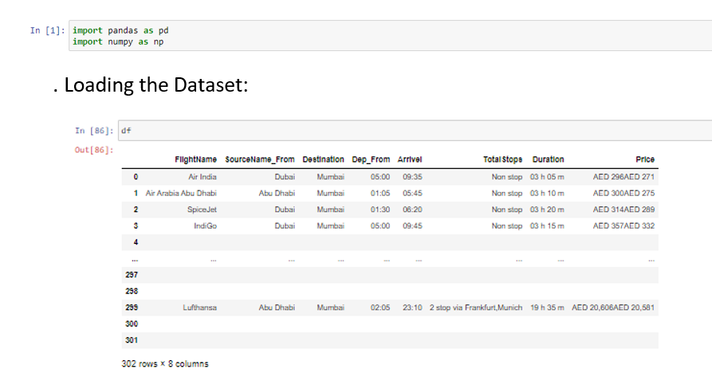
Data Sources & Formats
Collected dataset using scrapping the data as below:

Slide 6
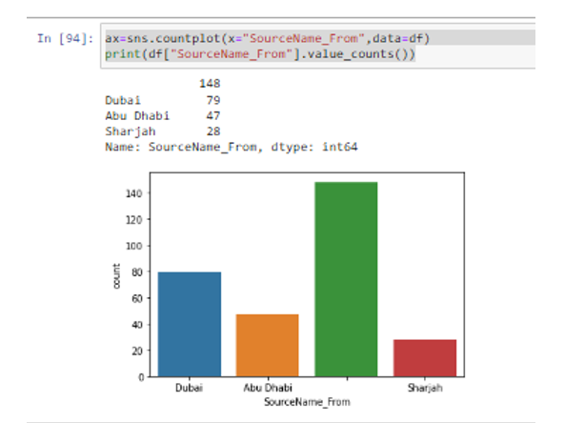
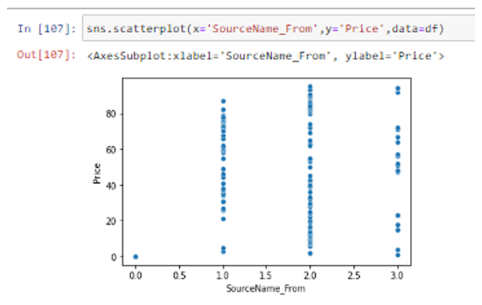
EDA steps and visualizations
After null values and encoding the data moving to the EDA steps and visualization.
In visualization it visualize the data in easy format.
In visualization, comparing the feature and target value in a plot.
For plotting the data in this project used Count plot & scatter plot.

Slide 7
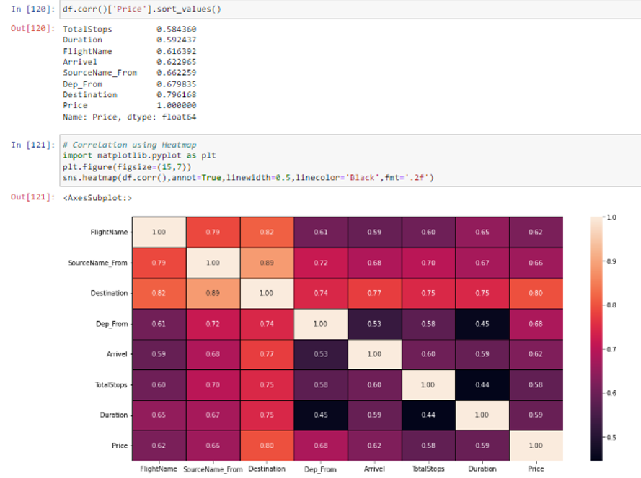
Steps
After visualizing the data checking correlation between the feature and target variable data.
In this some of the variables are highly correlated target variable.
For correlation checking using heatmap correlation method
FlightName and Price features are highly correlated with each other.
SourceName_From and Price features are highly correlated with each other.
Destinatiojn and Price columns are highly correlated with each other.
Dep_From is also highly correlated with Price column.
Arrivel and Price is highly correlated with each other
TotalStops and Price is highly correlated with each other
Duration and Price is highly correlated with each other

Slide 8
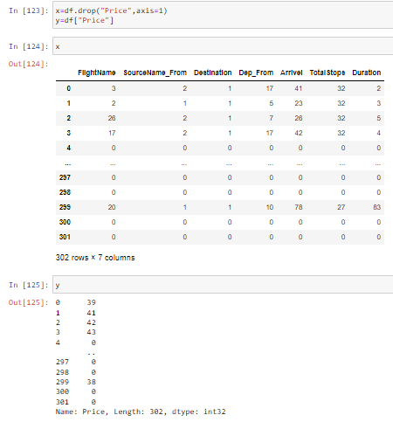
Steps
No need to check skewness & outliers for Categorical data.
It’s an invalid operation

Slide 9
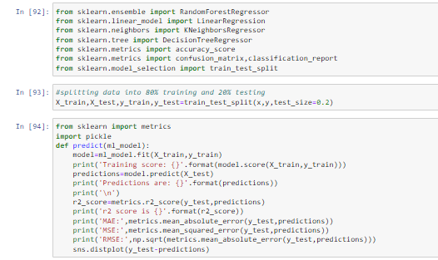
Scaling the model
For Training & Testing data using RandomForestRegressor model.

Slide 10
Building the Model
After Scaling the data need to build a model.
For model building using RandomForestRegressor (), LinearRegression(), DecisionTreeRegressor(), KNeighborsRegressor () are using.
In this used RandomForestRegressor method to build the model.
After that splitting the dataframe using Train test split method.
In train test split method finding the trained data & testing data and also finding predicted data.

Slide 11
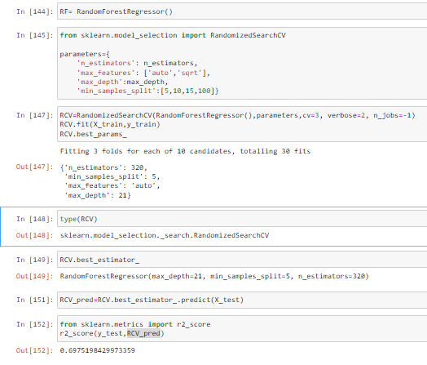
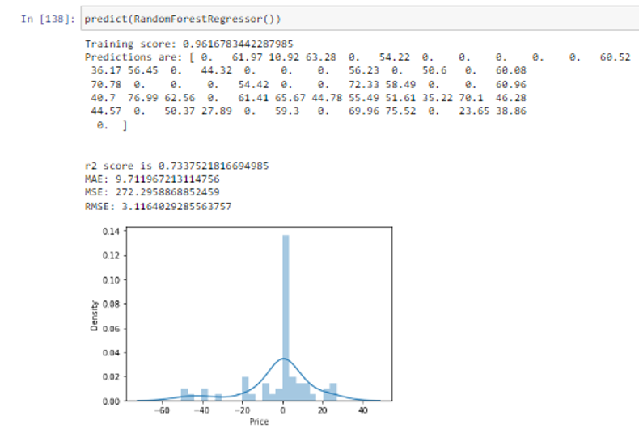
Model Selection
For this project RandomForestRegressor best method to built the model.
We have achieved approximately 69% accuracy but before when we used RandomForest the accuracy was around 73%, that’s the outcome of model hyperparameter tuning.

Slide 12
Cross Validation & gridSearchCV
Using cross validation method checking model performance.
After cross validation need to find the best classifier.
For findout best regressor using RandomizedSerachCV method
Using RandomizedSearchCV to find out best_params_ value
After that need to find out best estimator
Best estimator value is “RandomForestRegressor” Accuracy Score.

Slide 13
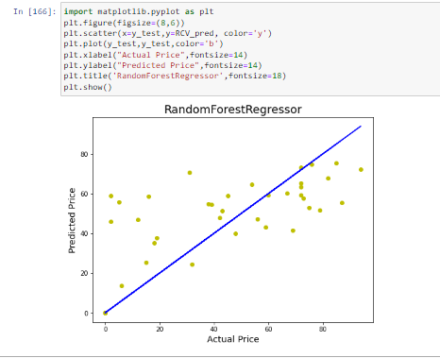
AUC ROC Curve
After completing the steps and process draw the AUC ROC curve.
In AUC ROC Curve its showing the Actual Price & Predicted Price data.
Below drawing AUC ROC Curve for Actual Price vs Predicted Price using RandomForestRegression method.

Slide 14
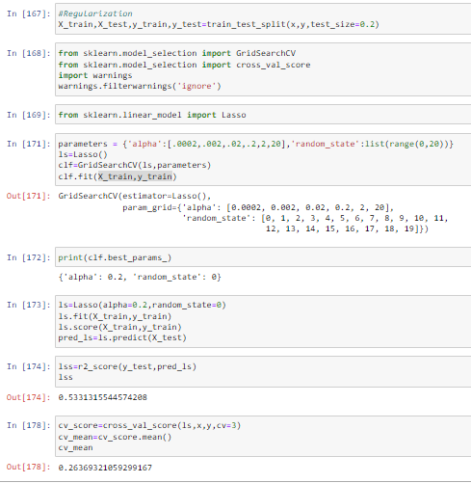
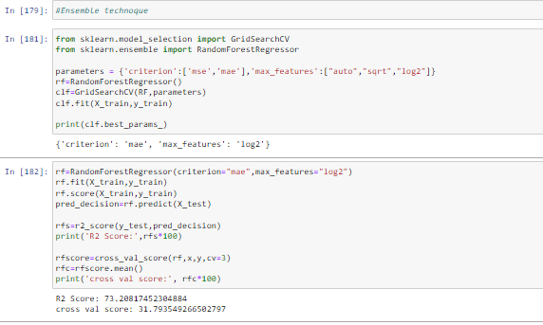
Interpretation of the Results
After Building a model need to Regularization technique for model checking.
After Regularization a model need to Ensemble technique for model checking

Slide 15
Conclusion
Key Findings and Conclusions of the Study
Using different models for Flight Price prediction. Four different types of Machine Learning methods including RandomForestRegressor, LinearRegression, DecisionTreeRegressor, KNeighborsRegressor are compared and analyzed for optimal solutions. Even though all of those methods achieved desirable results, different models have their own pros and cons. The Random Forest method has the lowest error on the training set but is prone to be overfitting. So using RandomForestRegressor method draw the AUC ROC Curve.
Learning Outcomes of the Study in respect of Data Science
As we checked in dataset present no null values.
Visualizing the categorical data using countplot.
Converted Categorical data into numerical data using Encoder method.
After this no need checked Skewness & Outliers due to Catgorical data.
As observed no need to do skewness & outliers checking if present many columns as Categorical data.
After all this split the data into train & test split.

Slide 16
Conclusion
As checked dataset we used Regression method due regression data & more independent columns are related to depedent column.
After we applied Regression methods like RandomForestRegressor, LinearRegression, DecisionTreeRegressor, KNeighborsRegressor .
After checked Cross validation train & test accuracy is good for RandomForestRegressor method.
After Regularization the data difference between r2 score & cross_val_score is very less so random forest is best method.

Slide 17
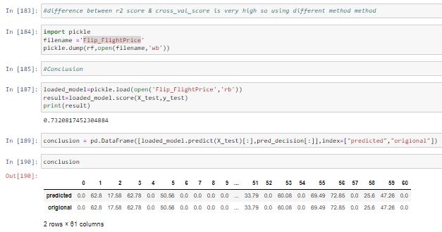
Conclusion
Limitations of this work and Scope for Future Work
The used pre-processing methods do help in the prediction accuracy. However, experimenting with different combination of pre-processing methods to achieve better prediction accuracy.
Make available features in combining the features and predict it may be improved performance.
The factors have been studied is weak correlation with Price.

