Slide 1

AI-Driven Multi-Objective Optimization
of a Medical Injection-Moulding Line
Progress presentation: from concept (Phase 1) to a working simulation (Phase 2)
Simulated case study: Gerresheimer medical-plastics plant, Pfreimd (Bavaria)
✓ PHASE 1
✓ RESEARCH
✓ PHASE 2
Proposal refined from a generic factory to one real medical moulding plant
Literature review with 25 references sets every design decision
Simulation, AI failure-risk model, optimizer and first tested results
MDM2 Case Study: Intelligent Systems in Production | 03 Nov 2026
Supervised by Prof. Dr.-Ing. Hamidreza Heidari • Team: Kuriakose Vettikattil Raju (Team Lead), Mahesh Koduri, Saurabhkumar Mahant

Slide 2
Our Journey So Far
From a generic idea to a tested simulation of one real moulding line
19 OCT
20 OCT
20 OCT
OCT–NOV
NOV
03 NOV
1
2
3
4
5
6
Concept
Feedback
Refocus
Research
Build
Tune & test
Generic five-station smart-factory line
Proposal review: anchor the study in one real factory
Proposal rebuilt around Gerresheimer Pfreimd
Literature review, 25 references, 3 research gaps
SimPy line + AI failure-risk model + optimizer
Calibrated model, results on unseen test runs
Phase 1 delivered
Proposal, concept deck, refined single-factory scope
Phase 2 delivered
Bibliography report, running simulation, baselines
Ahead of plan
AI model + optimizer (planned for P4) already working
03 NOV 2026 | PROGRESS: PHASE 1 → 2
MDM2 • Intelligent Systems in Production
02

Slide 3
Phase 1: Refocusing After Feedback
Feedback at proposal stage: tie the case study to one concrete factory, not a generic production line.
Aspect | Concept v0 (19 Oct) | Refined proposal (20 Oct)
Industrial setting | Generic discrete-part line | Medical injection moulding, Gerresheimer Pfreimd
Line | 5 generic workstations | Drying → clean-room moulding → camera inspection → assembly → packaging
Scheduling problem | Job sequencing | + mould changeovers and GMP line clearance
Energy | Machine active / idle power | + clean-room HVAC load, ISO 50001 context
KPIs | Throughput, lead time, kWh, recovery | + scrap / reject rate
AI model | Delay regression on simulated data | Failure-risk classifier on public AI4I 2020 data*
* Decided during the literature review: a public, labelled failure dataset is more credible than training on our own simulator output.
03 NOV 2026 | PROGRESS: PHASE 1 → 2
MDM2 • Intelligent Systems in Production
03

Slide 4
The Case: Gerresheimer Pfreimd
The plant (public information)
What it means for our model
• Medical plastic systems: inhalers, insulin pens, lancing devices
• Full chain: moulding, assembly, inspection, clean-room packaging
• GMP clean-room production for pharma customers
• ISO 50001 energy-management system
Many products share moulds
Changeover-aware sequencing
GMP rules
Line clearance on every product change
Clean rooms run 24/7
Constant HVAC energy load
Pharma delivery dates
Due dates, on-time rate, scrap tracking
Data reality: Gerresheimer publishes no operational data. Plant parameters come from the literature, failure data from the public AI4I 2020 dataset.
So we report policy-versus-policy comparisons under identical conditions, not predictions for the real plant.
03 NOV 2026 | PROGRESS: PHASE 1 → 2
MDM2 • Intelligent Systems in Production
04

Slide 5
Research: Literature → Design Decisions
Theme | Key sources | Our design decision
Scheduling & setups | Pinedo 2016; Allahverdi 2008 | FCFS, SPT and setup-aware baselines
Energy-efficient scheduling | Mouzon 2007; Gahm 2016 | Power states, idle shutdown, HVAC load
Breakdowns & rescheduling | Vieira 2003; Ouelhadj 2009 | Predicted risk feeds the policy
Predictive maintenance | Carvalho 2019; Matzka 2020 | Random Forest on AI4I 2020
Discrete-event simulation | Law 2015; Negahban 2014 | SimPy, many randomised scenarios, confidence intervals
Multi-objective optimization | Deb 2002; Akiba 2019 | NSGA-II search in Optuna
Gaps we address
• Changeovers, energy and breakdowns are rarely studied together
• Clean-room / facility energy is usually left out
• Private data and code limit reproducibility
Bibliography report: 25 references (peer-reviewed papers, textbooks, standards, company sources), searched in Google Scholar, IEEE Xplore, ScienceDirect, SpringerLink.
03 NOV 2026 | PROGRESS: PHASE 1 → 2
MDM2 • Intelligent Systems in Production
05

Slide 6
Phase 2: What We Built
1 The factory line (SimPy discrete-event model)
DRYING
MOULDING
INSPECTION
ASSEMBLY
PACKAGING
2 dryers
2 machines
changeovers · failures
Camera, rejects
60 units/min
Clean room
2 The AI decision loop
AI4I 2020
Risk model
Policy
Simulation
KPIs
NSGA-II
public failure data
Random Forest
dispatch + maintenance
100 random scenarios
time · energy · upkeep
tunes the policy
↺ NSGA-II feeds better settings back into the policy
4
4
22
1.9 s
policies: FCFS, SPT,
setup-aware, AI
scenarios: low, base,
high demand, harsh wear
automated tests
for model behaviour
per simulated
20 days of production
03 NOV 2026 | PROGRESS: PHASE 1 → 2
MDM2 • Intelligent Systems in Production
06

Slide 7
Test Plan: How We Verify the Simulation
Test area | What we check | Pass criterion
Reproducibility | Same seed repeats a run; all policies face identical orders | Identical results per seed and identical demand
Material flow | Orders move through all five stations in line order | All orders finish; output never exceeds input
Setups and dispatching | Sequence-dependent changeovers; each rule's job choice | Correct setup times; each rule picks the expected job
Energy | Empty-plant load; idle shutdown when the line is starved | Energy = HVAC + idle load; shutdown saves energy
Failures and maintenance | AI4I failure rules; repair versus planned maintenance | Correct failure mode; repair fixes one part, PM all
Risk model | Physics features; hold-out test data; ranking in simulation | Failure conditions rank above healthy; F1 and AUC reported
Policy comparison | Tuning seeds 0–2 versus test seeds 100–199; same scenarios | No seed overlap; 95 % CIs and paired tests
Status: 22 automated pytest tests pass; GitHub Actions runs them on every push. Still to test: larger plant model (P3), moulding failures and energy data (P4), sensitivity analysis (P5).
03 NOV 2026 | PROGRESS: PHASE 1 → 2
MDM2 • Intelligent Systems in Production
07

Slide 8
Fine-Tuning the Simulation: Found and Fixed
What we found | What we changed | Effect
Line under-loaded (21 % machine use): all rules looked the same | Recalibrated demand; added 4 scenarios | Rules now differ: setup-aware halves lead time at high demand
Wear failures never occurred: every repair reset all wear | Repairs fix only the failed part; PM restores all | Realistic tool-wear and overstrain failures
Risk model blind to heat-dissipation failures | Added physics features: ΔT, power, strain | F1 0.69 → 0.88 on AI4I test data
Risk from one nominal reading ignored sensor noise | Risk averaged over 16 noise draws | Failure ranking in simulation: AUC 0.80 → 0.88
Optimizer treated planned maintenance as free | Objective counts planned + unplanned hours | Fair comparison, gains still held
Risk model calls dominated run time | Reuse one prediction per decision | 3.4 s → 1.9 s per run, identical results
Each fix was checked by re-running the affected experiments; AUC = how well risk ranks jobs that actually fail.
03 NOV 2026 | PROGRESS: PHASE 1 → 2
MDM2 • Intelligent Systems in Production
08

Slide 9
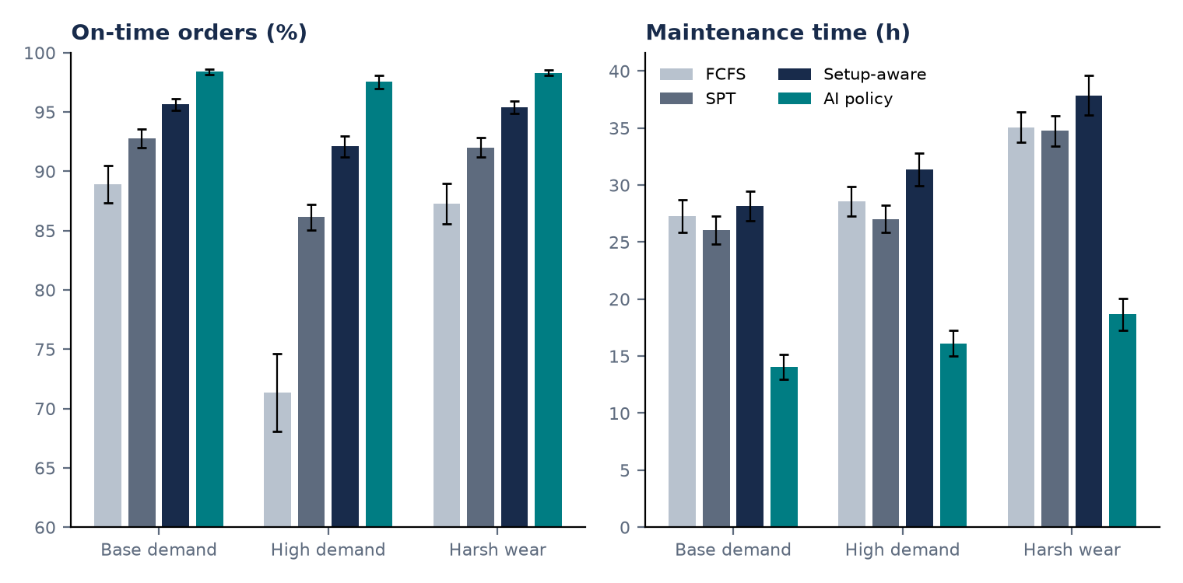
First Results on Unseen Test Runs
AI policy vs best baseline
• Maintenance: 49–51 % fewer hours
• On time: 92.1 → 97.5 % at high demand
• Lead time 2–9 % shorter; energy 1–2.5 % lower
• Trade-off: after a breakdown, orders clear slower at high demand (28.3 vs 22.3 h)
AI policy tuned with NSGA-II (192 trials) on 3 training scenarios, then tested on 100 new randomised scenarios it never saw; the harsh-wear setting was also never seen during tuning. Every policy runs the same 100 scenarios for a fair comparison. Error bars = 95 % confidence interval. Best baseline = setup-aware rule.
Ablation: the gain comes from risk-triggered maintenance; risk in job dispatching adds nothing measurable.
03 NOV 2026 | PROGRESS: PHASE 1 → 2
MDM2 • Intelligent Systems in Production
09

Slide 10
Limitations → Planned Improvements
Current limitation | Planned improvement | When
Small lots: machines change moulds more than they produce | Realistic campaign lot sizes; check against typical OEE of 60–85 % | P3
Only 2 moulding machines | 10–20 machines, mould–machine compatibility, setter crew, shifts | P3
Failure data comes from milling (AI4I) | Moulding failure modes (heaters, hydraulics, mould damage), mould maintenance | P3–P4
Energy barely differs between policies | Datasheet energy per kg of material, time-of-day electricity prices | P4
ML value vs a simple rule not yet shown | Benchmark against a wear-based maintenance rule | P4
No QA batch release, perfect camera | GMP release hold times; false rejects and missed defects | P4
Parameters are assumptions | Sensitivity analysis; ask Gerresheimer for ballpark figures | P5
03 NOV 2026 | PROGRESS: PHASE 1 → 2
MDM2 • Intelligent Systems in Production
10

Slide 11
Roadmap to the Final Submission
20 OCT
03 NOV
24 NOV
08 DEC
22 DEC
12 JAN
P1
P2
P3
P4
P5
Final
Proposal +
single-factory scope
Literature review +
simulation + results
Realistic plant model,
GitHub repo + CI
Failure & energy realism,
re-tune, rule benchmark
Sensitivity analysis,
dashboard, demo video
IEEE report +
final presentation
DONE
DONE
NEXT
PLANNED
PLANNED
PLANNED
Next steps (until 24 Nov)
Feedback we would value
• Push code, tests and results to the GitHub repository
• Scale the line: more machines, realistic lot sizes, setter crew
• Re-run tuning and the held-out comparison on the new model
• Is a literature-based model of one line acceptable without plant data?
• Priority: more plant realism, or proving the ML vs a simple rule?
• Any contact at Gerresheimer for rough plant figures?
03 NOV 2026 | PROGRESS: PHASE 1 → 2
MDM2 • Intelligent Systems in Production
11

