Slide 1


AI-Driven Multi-Objective
Injection-Moulding Optimization
Simulated case study: Gerresheimer medical-plastics plant, Pfreimd
SCHEDULING
ENERGY
DOWNTIME
Job sequencing and mould changeovers
Moulding machines and clean-room load
Failures and adaptive recovery
Concept Presentation | MDM2 Case Study: Intelligent Systems in Production
Supervised by Prof. Hamidreza Heidari • Team members: Mahesh, Kuriakose and Saurabh

Slide 2
Introduction
Medical injection moulding depends on connected decisions.
Job sequences set changeovers, GMP line clearance, and lead times.
Heated barrels and clean-room HVAC draw power even during idle time.
Mould or machine breakdowns delay pharma orders with fixed due dates.
Optimizing all three together can expose trade-offs missed by isolated methods.
19 OCT 2026 | CONCEPT
MDM2 • Intelligent Systems in Production
02

Slide 3
Project Scope
Aim: simulate a Gerresheimer Pfreimd-style moulding line and compare scheduling policies.
IN SCOPE
IN SCOPE
Drying, moulding, inspection, assembly, packing; orders, changeovers, variable demand.
Machine failures, repairs, power states, clean-room energy, and scrap.
IN SCOPE
OUT OF SCOPE
FCFS/SPT baselines, a predictive ML model, and an optimization policy.
Real Gerresheimer data, PLCs, sensors, live control, and physical deployment.
19 OCT 2026 | CONCEPT
MDM2 • Intelligent Systems in Production
03

Slide 4
Project Objectives
Build a reproducible discrete-event simulation of a five-stage medical moulding line.
Compare FCFS, SPT, and a setup-aware rule that groups jobs by mould.
Model machine and clean-room power, mould changeovers, breakdowns, and repairs.
Train a failure-risk model on the public AI4I 2020 maintenance dataset.
Use multi-objective optimization to examine speed, energy, and disruption trade-offs.
19 OCT 2026 | CONCEPT
MDM2 • Intelligent Systems in Production
04

Slide 5
Technology Stack
Component
Tool / framework
Purpose
Simulation
Python + SimPy
Jobs, queues, machines, downtime
Data and ML
pandas + scikit-learn
Features, failure-risk prediction
Optimization
Optuna / OR-Tools
Compare candidate operating policies
Evaluation
NumPy + Plotly
KPIs and visual comparisons
Dashboard
Streamlit
Interactive simulation scenarios
Collaboration
GitHub + pytest
Code, tests, reproducible runs
19 OCT 2026 | CONCEPT
MDM2 • Intelligent Systems in Production
05

Slide 6
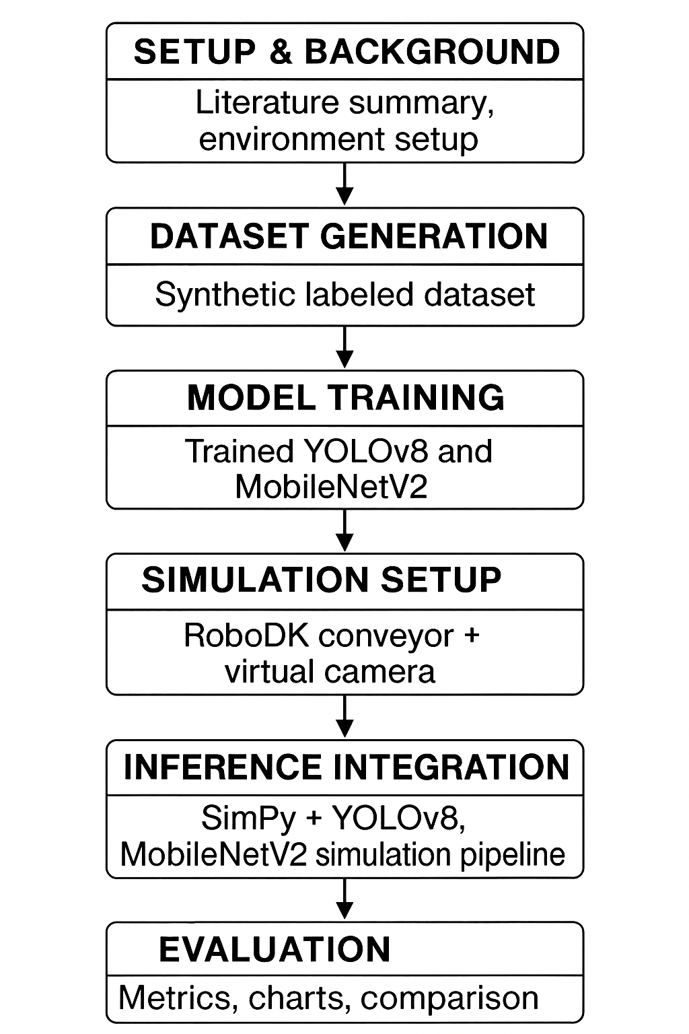
Project Flow Chart
SETUP
Requirements, literature and assumptions
↓
FACTORY DATA
Generate jobs, machine times, failures and power profiles
↓
SIMULATION
Implement SimPy production line and FCFS/SPT baselines
↓
PREDICTION
Train and validate an ML delay estimator
↓
OPTIMIZATION
Search scheduling and power-control policies
↓
EVALUATION & DEMO
Compare KPIs and demonstrate dashboard
19 OCT 2026 | CONCEPT
MDM2 • Intelligent Systems in Production
06

Slide 7
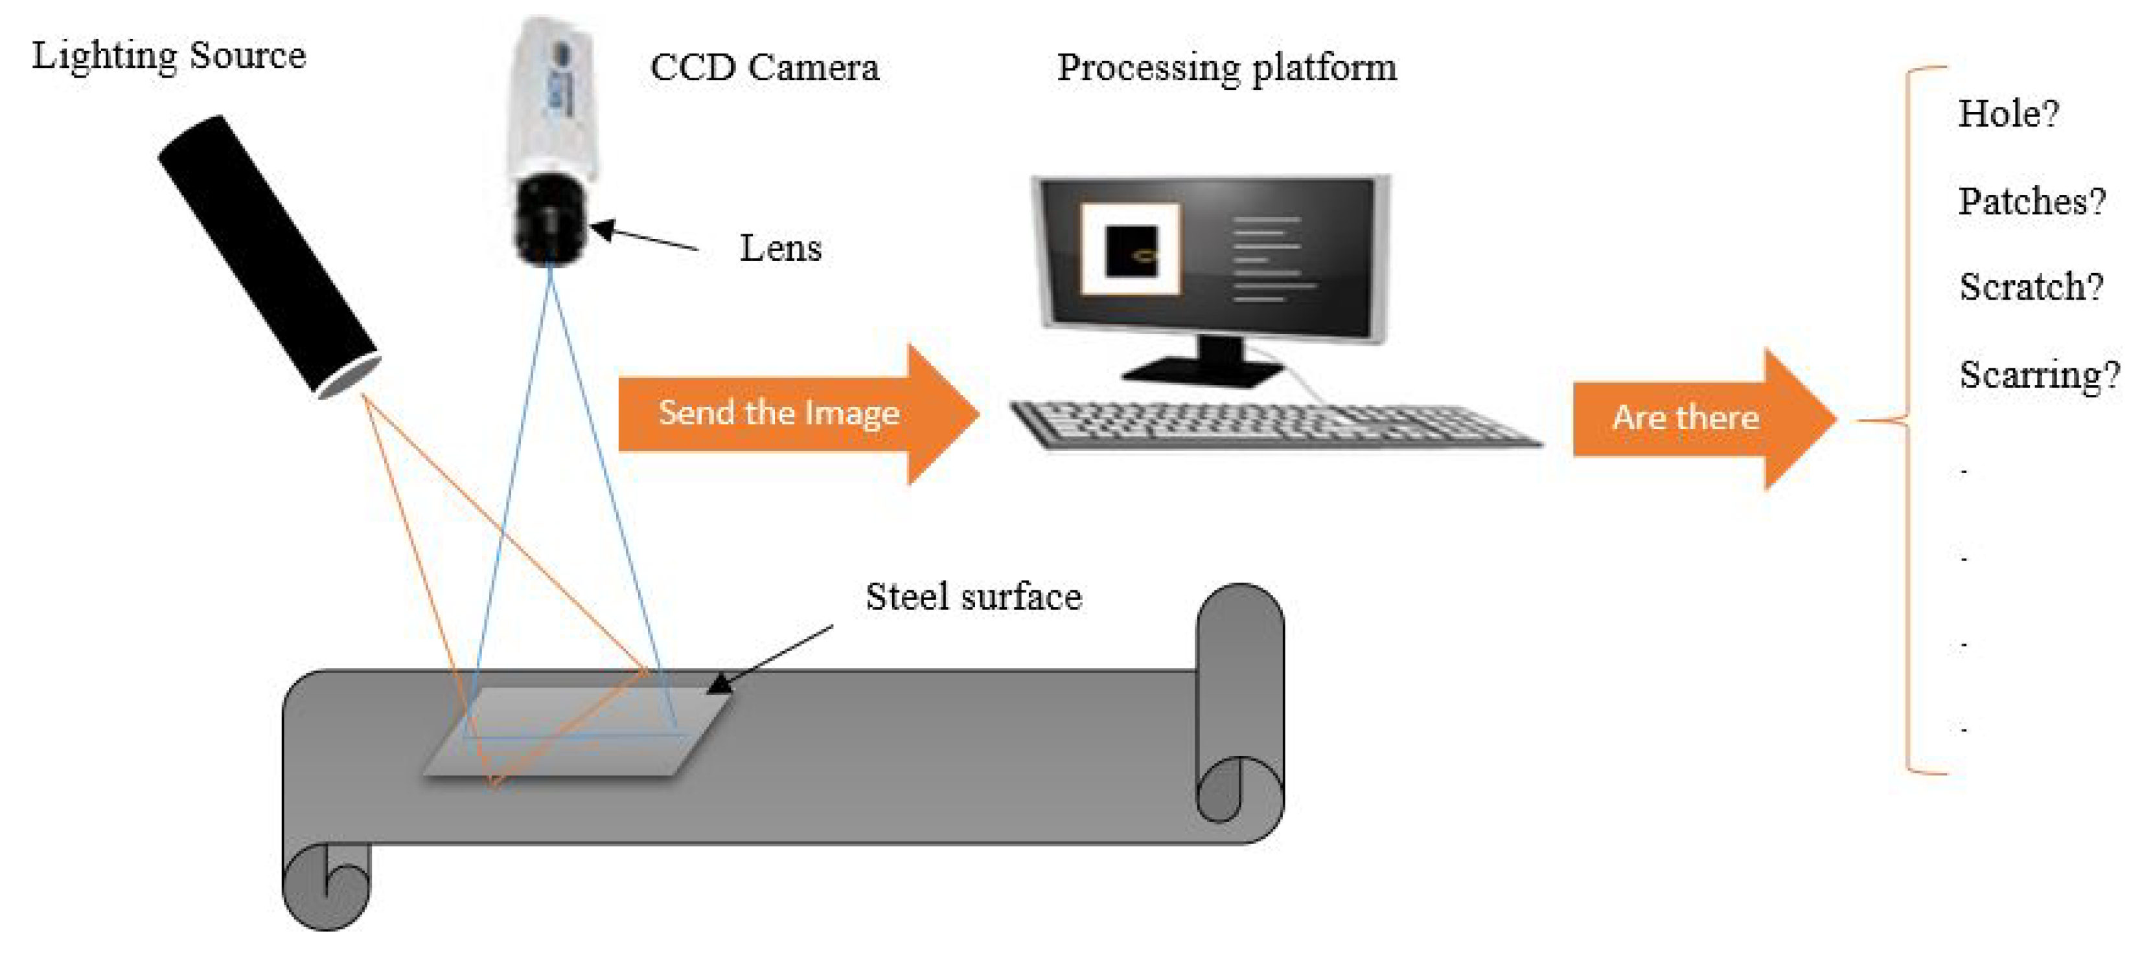
Working Methodology
1 Model the line
Drying, moulding, inspection, assembly, packing; cycle times, changeovers, energy, faults.
2 Establish baselines
Evaluate FCFS, SPT and setup-aware rules on common seeds and scenarios.
3 Add predictive AI
Train a failure-risk classifier on AI4I 2020 data; feed risk into scheduling.
4 Optimize & validate
Test candidate policies across repeated scenarios; report trade-offs and variability.
19 OCT 2026 | CONCEPT
MDM2 • Intelligent Systems in Production
07

Slide 8
Bill of Materials (BOM)
Resource
Requirement
Estimated cost
Laptop / CPU
Python simulation and small ML experiments
Existing device
Python libraries
SimPy, scikit-learn, Streamlit, Plotly
€0 (open source)
Synthetic dataset
Generated factory orders and machine events
€0
GitHub
Repository, issue tracking and version control
€0 (free tier)
Optional cloud compute
Only if experiments exceed local capacity
Optional / variable
No physical equipment, industrial sensors or laboratory setup is required.
19 OCT 2026 | CONCEPT
MDM2 • Intelligent Systems in Production
08

Slide 9
Expected Outcomes
Reproducible simulated medical moulding line with five configurable stations.
Comparison of FCFS, SPT, setup-aware, and AI-assisted policies.
KPIs: throughput, on-time %, lead time, energy (kWh), scrap, and recovery.
Trade-off plots showing situations where energy savings affect completion time.
Interactive dashboard and a documented GitHub repository.
Results shown during the final presentation will be measured, not assumed.
19 OCT 2026 | CONCEPT
MDM2 • Intelligent Systems in Production
09

Slide 10
Safety & Ethical Checklist
Simulation only: no machinery operation or physical safety exposure.
Synthetic, literature-based data; no proprietary Gerresheimer or personal data.
Record assumptions, random seeds, software versions, and evaluation protocols.
Clearly separate simulated improvements from proven real-world factory outcomes.
Check for unrealistic failure rates, biased scenarios, and overfitting to one factory setup.
19 OCT 2026 | CONCEPT
MDM2 • Intelligent Systems in Production
10

Slide 11
Future Work
Validate parameters with Gerresheimer Pfreimd if the site shares rough figures.
Extend beyond five stations to flexible job-shop layouts and shared resources.
Introduce electricity tariffs, peak demand limits, and more detailed power states.
Explore predictive maintenance or reinforcement learning after baseline validation.
Connect the simulation to a real industrial digital twin only with appropriate validation.
19 OCT 2026 | CONCEPT
MDM2 • Intelligent Systems in Production
11

Slide 12
Bibliography / Starting References
Pinedo, M. L. Scheduling: Theory, Algorithms, and Systems, 5th ed., Springer, 2016.
Allahverdi, A. et al. “A survey of scheduling problems with setup times or costs,” EJOR, 2008.
Deb, K. et al. “A Fast and Elitist Multiobjective Genetic Algorithm: NSGA-II,” IEEE TEC, 2002.
Duan & Wang (2021). Energy-efficient scheduling with machine breakdowns. Computers & Industrial Engineering, 161, 107677. DOI: 10.1016/j.cie.2021.107677
Gerresheimer AG. Pfreimd, Germany (site profile). gerresheimer.com, accessed Oct 2026.
Matzka, S. “Explainable AI for Predictive Maintenance Applications,” AI4I, 2020.
19 OCT 2026 | CONCEPT
MDM2 • Intelligent Systems in Production
12

Slide 13
Milestones & Gantt Chart
Oct 20
Nov 03
Nov 24
Dec 08
Dec 22
Jan 12
Proposal + technical stack
Literature + baseline simulation
Energy + breakdown model
ML + multi-objective search
Dashboard + experiments
Report + presentation
Course checkpoints: 20 Oct • 3 Nov • 24 Nov • 8 Dec • 22 Dec • 12 Jan
19 OCT 2026 | CONCEPT
MDM2 • Intelligent Systems in Production
13

Slide 14
Thank You
AI-Driven Multi-Objective Production Optimization
Questions & Discussion
GitHub repository: To be added

