Slide 1
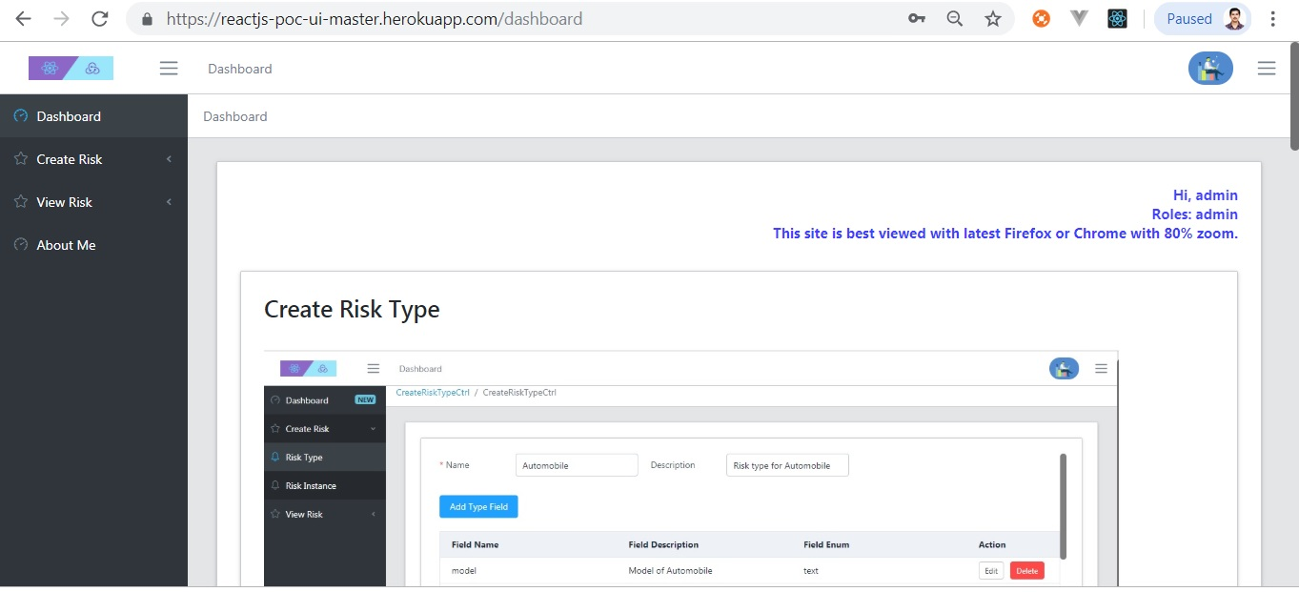
Home Screen

Slide 2
ReactJS PoC UI
https://apollo-reactjs-poc-ui-master.herokuapp.com Use above link to access UI.
Username :- admin (lower case)
Password :- poctest#1 (lower case)
Best viewed with Firefox with 80 % zoom
Above UI refers Web API at following location credentials are same.
https://django-poc-server-maheshbodas.herokuapp.com/

Slide 3
Salient features
Developed using ReactJS, Redux, redux-thunk, ES6, Element React library, Node JS, Serve as a Static server.
Used Redux as global data store for this application. Redux actions and reducers make is easy to shape and store data as needed by UI.
Used CoreUI React template so as to reuse Sidebar navigation, Breadcrumbs and common Layout for all pages.

Slide 4
Salient features (continued)
CoreUI React template itself build using Create React App. CRA is zero configuration template to build, unit test and deploy application on server.
CRA makes use of Enzyme and Jest for Unit testing. Does not need separate Jest installation or Web pack tweaking. Everything is taken care by CRA.

Slide 5
Salient features (continued)
Well thought React components to modularize code.
Made use of Typescript and React Typescript support to develop generic component that’s used in all screen to automate task like showing Page loading Icon, display UI when data is available and show error if any.
The above component has been reused in all screens of ReactJS PoC application.

Slide 6
Salient features (continued)
Role based authorization further limits access to screens and components use for creating RiskTypes.
User can add RiskType and associated RiskTypeFields in one go using header and details table in screen.
User can add Risk and Risk Fields in one go using header and details table in screen.

Slide 7
Salient features (continued)
Create Risk Instance screen collect data by dynamically adding controls related to various Risk type fields.
Create Risk Instance screen dynamically adds required field validation and field type specific validation for controls related to Risk type fields. i.e. Date / float / integer.
Successful model creation messages are displayed using MessageBox.
Display various model validation errors using MessageBox

Slide 8
Salient features (continued)
View Single Risk allows user to fetch details for given Risk and renders various read-only controls related to Risk Type fields.
View All Risks allow user to view All Risks entered in system based on RiskType filter.

Slide 9
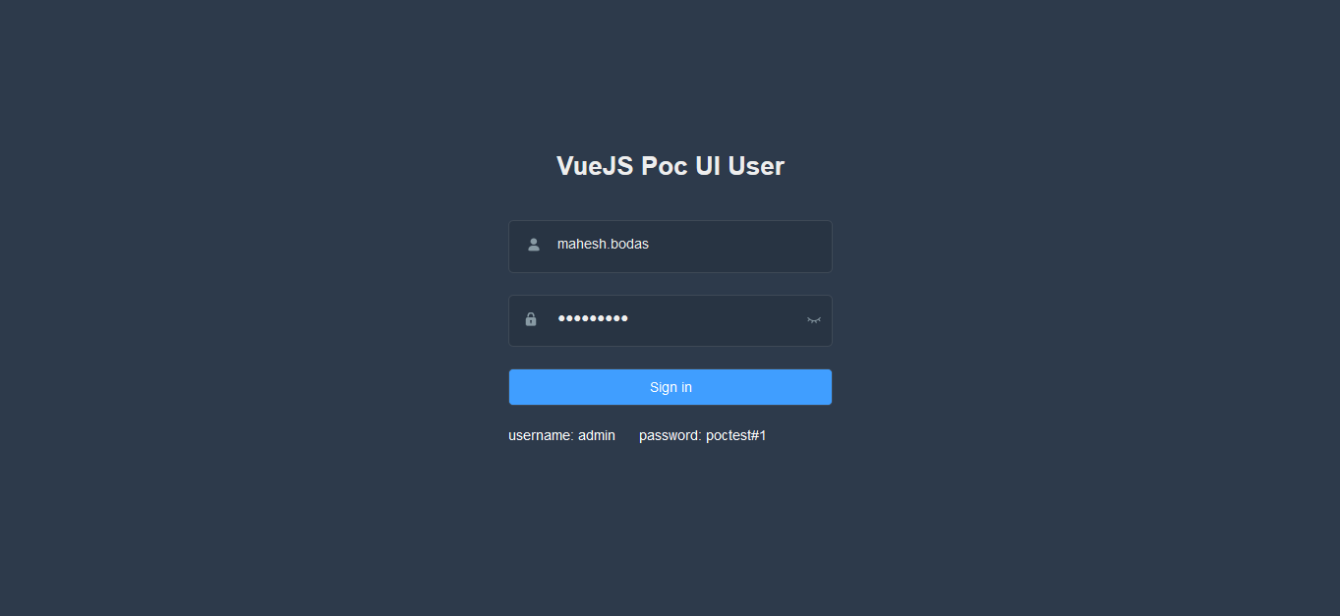
Login Screen

Slide 10
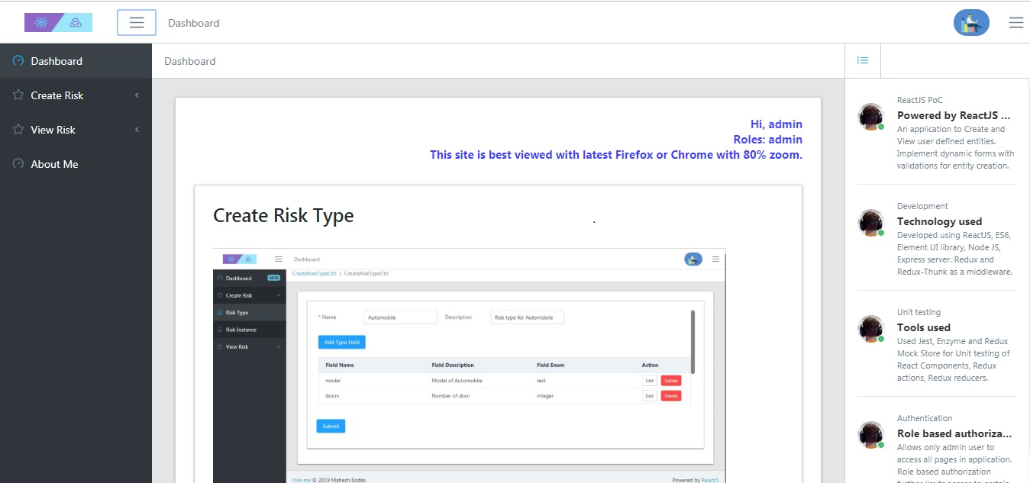
Dashboard showing app highlights

Slide 11
Create Risk Type screen
Admin User can define Risk types.
User Enters Risk type name and description.
Click Add Risk Type Field button to define Risk type fields.
Post Risk type after adding / editing Risk type fields.

Slide 12
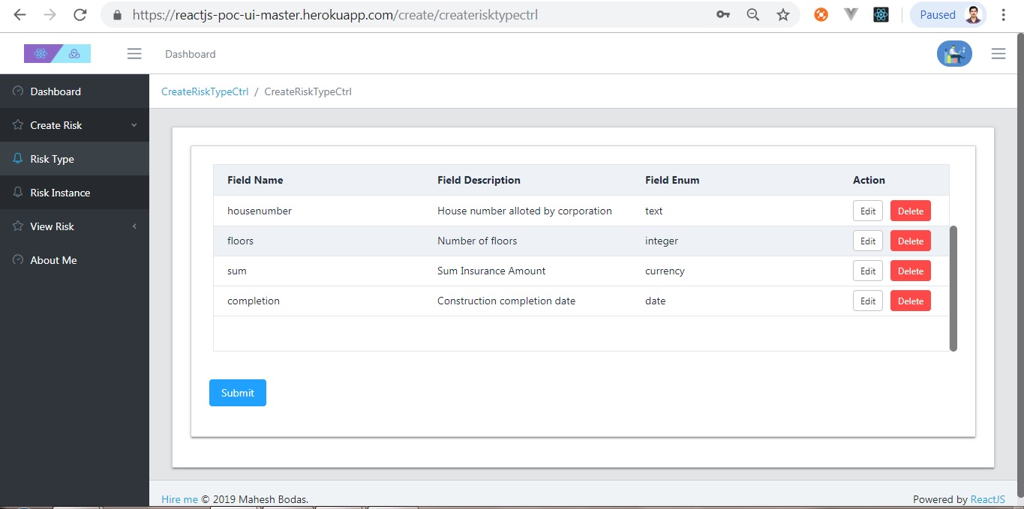
Create Risk Type Image

Slide 13
Risk Type Data posted to server

Slide 14
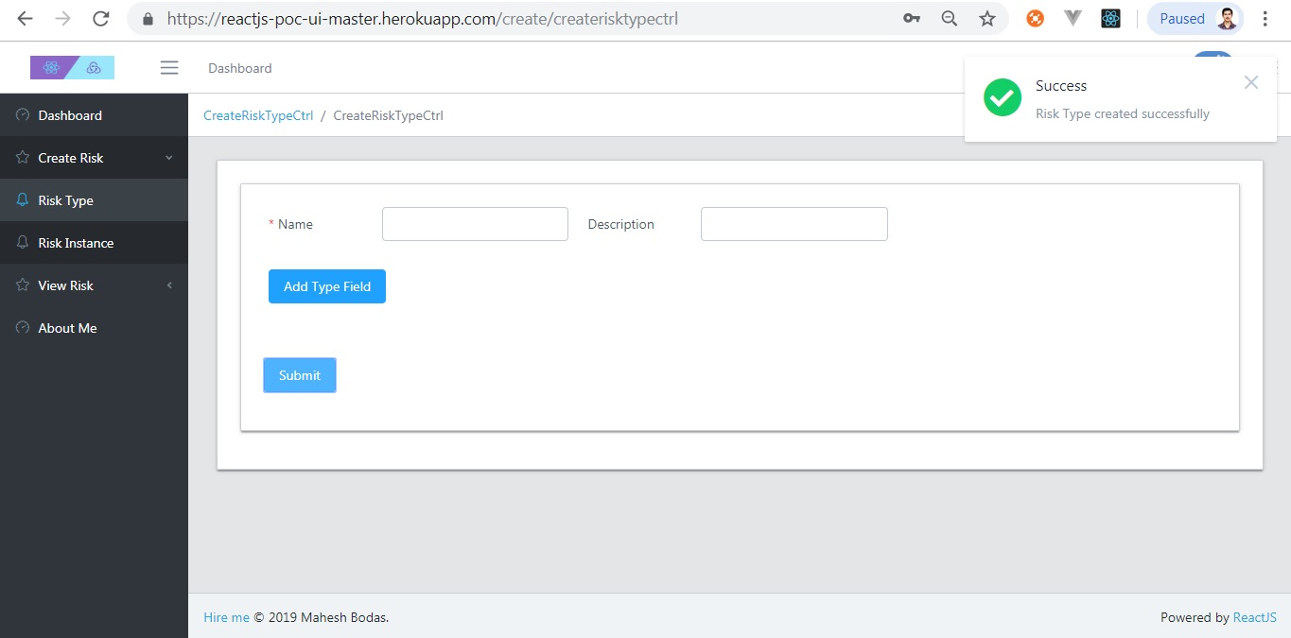
Create RiskType shows Success

Slide 15
Create Risk Instance screen.
User can create Risk Instance based on Risk types.
Select appropriate Risk Type from dropdown box.
Fill up all Risk Instance fields and submit form.
Admin user can define Risk Types.

Slide 16
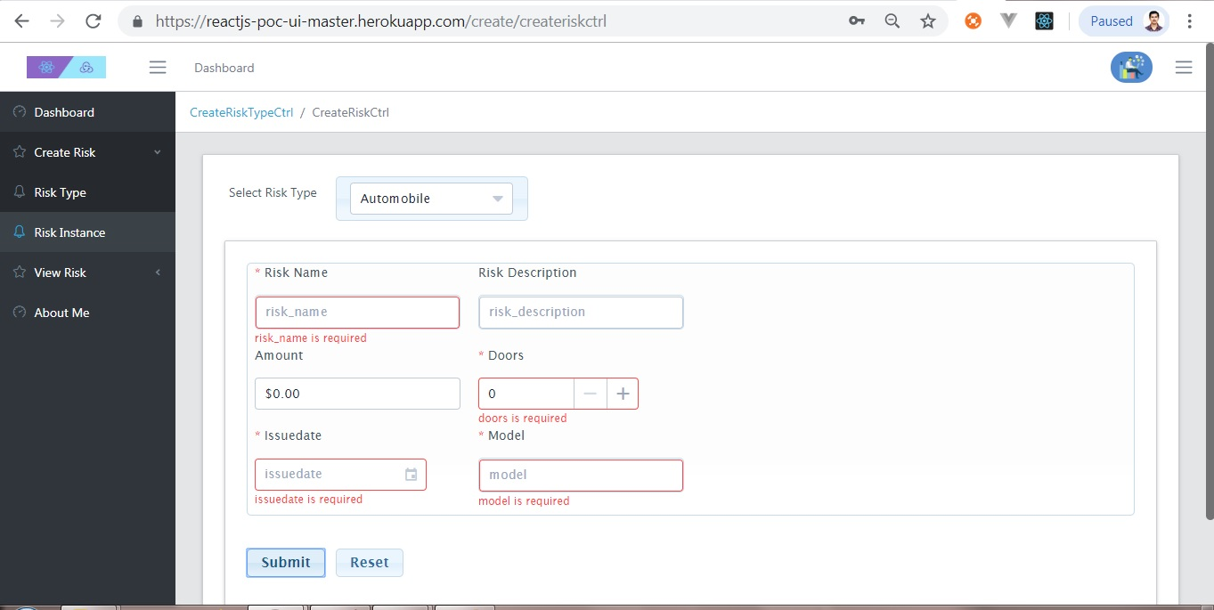
Screen showing field validation errors

Slide 17
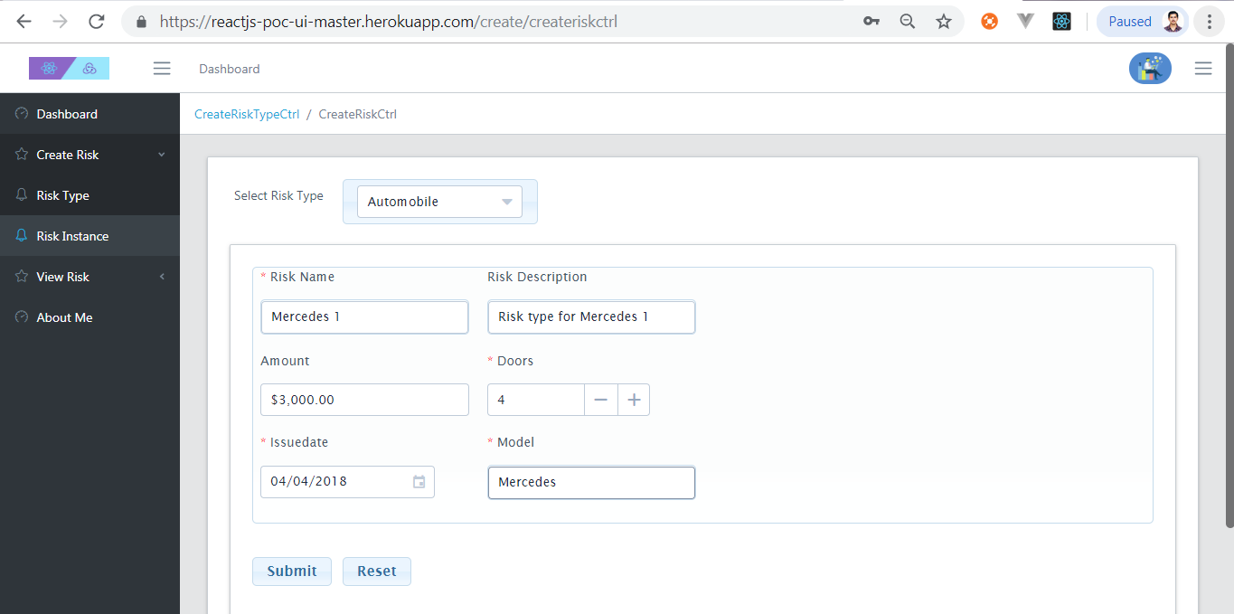
Submit when validation succeed

Slide 18
Posting Risk Instance data to server

Slide 19
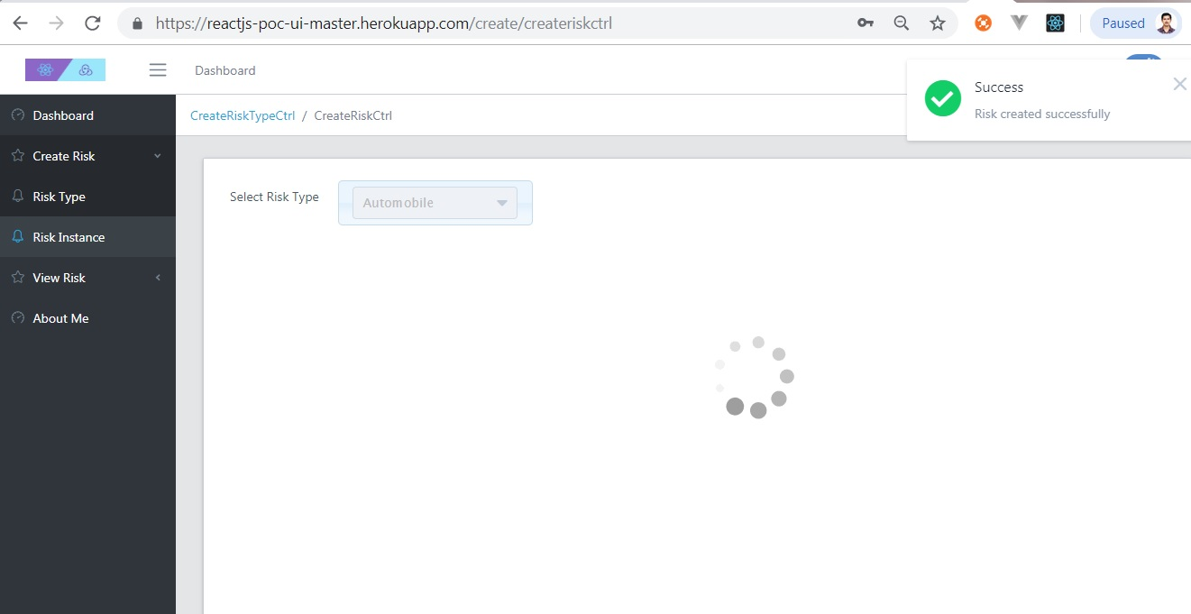
Create Risk Instance showing success

Slide 20
View Single Risk Instance
User can view single Risk Instance using this form.
Select appropriate Risk Name from Auto Complete dropdown box.
Screen will show Risk name and all Risk Instance fields (read-only).

Slide 21
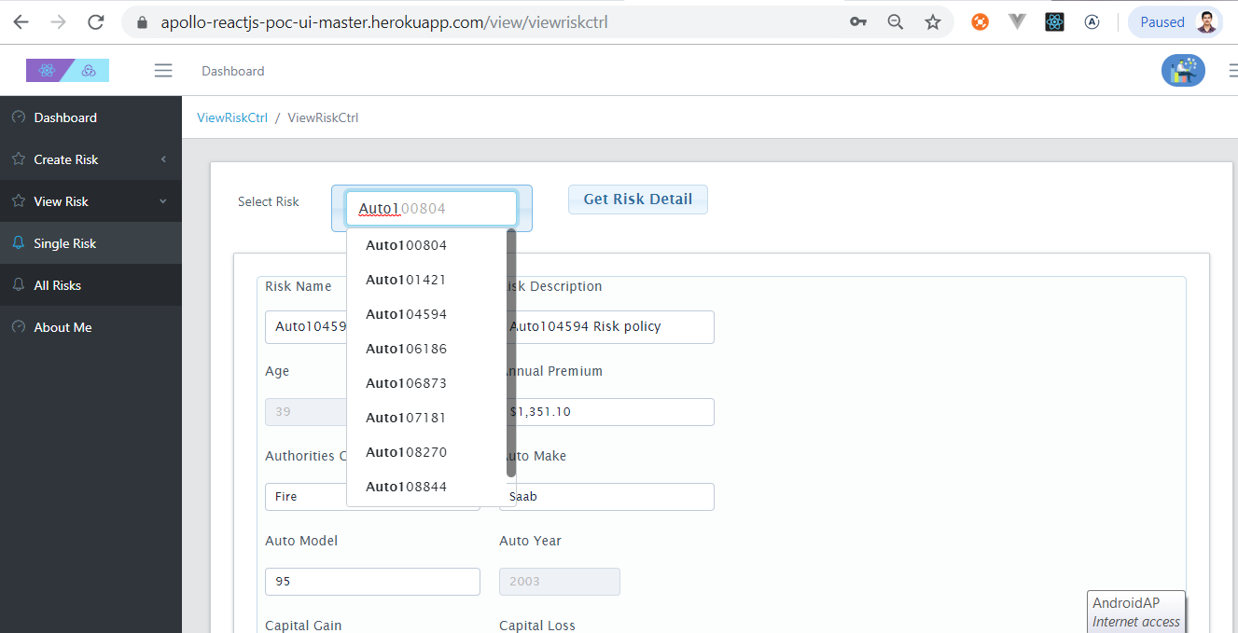
View Single Risk Screen

Slide 22
View All Risks
User can view Risk Instances using this form
Select appropriate Risk Type from dropdown box.
Screen will show one Page of Risk instances Risk Name and associated instance fields in tabular format for selected Risk Type.
User can paginate forward and backward through Risk records.

Slide 23
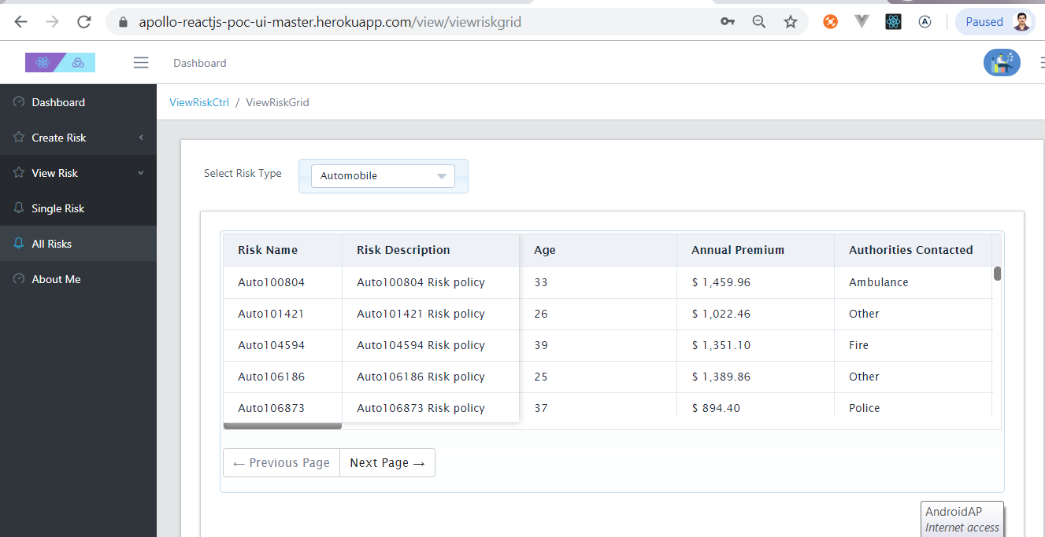
View All Risk Screen

Slide 24
Non Admin users
All above slides assumed user logged in has admin privilege.
Non admin user will be restricted from accessing Create Risk Type and Create Risk Instance page.
They can view Risk Instances added to system.
User : editor (lower case)
Password : test#123 (lower case)

Slide 25
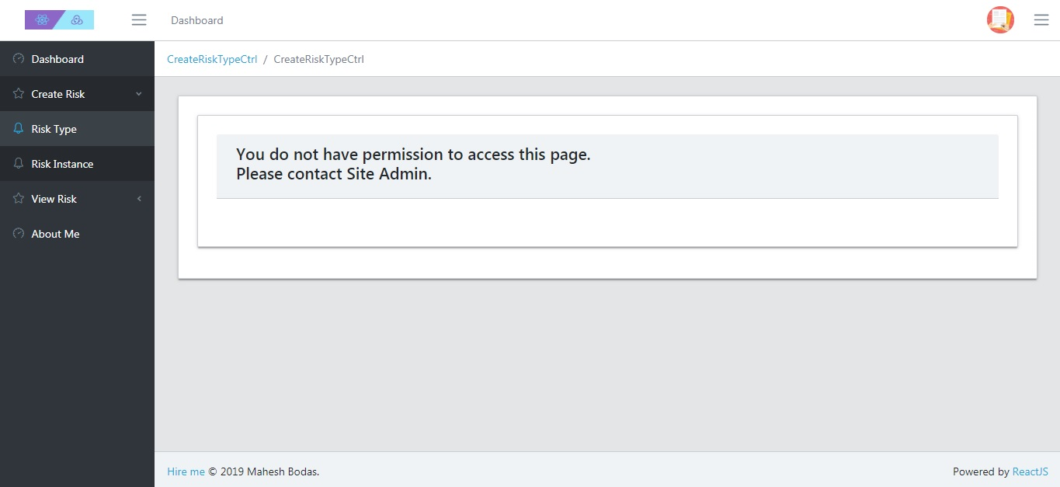
No access to Create Risk Type

Slide 26
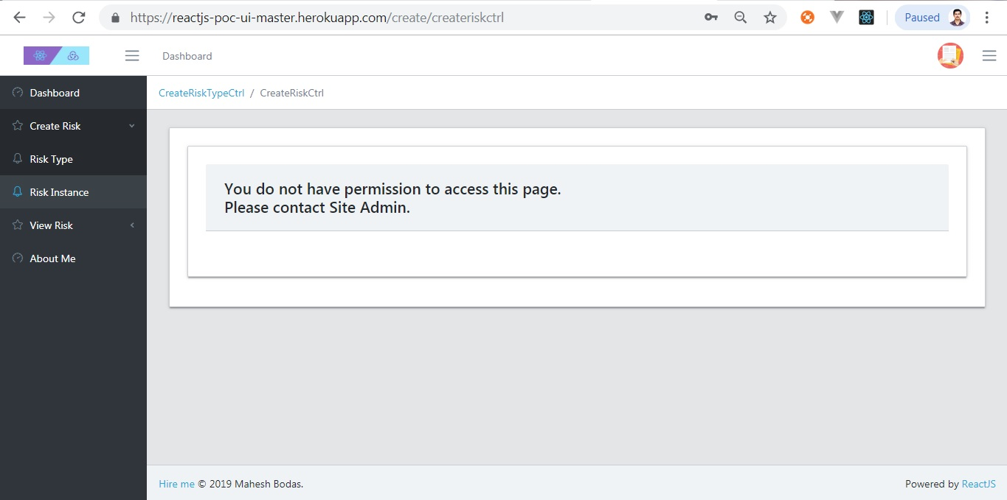
No access to Create Risk Instance

Slide 27
Unit testing.
Used Enzyme, Jest for unit testing React components.
Used Redux Mock Store for Unit testing of, Redux actions, Redux reducers.

Slide 28
Known issues.
Since Django Rest API and UI application are installed using free account on Heroku platform.
In case if Django Rest API is not invoked in last one hour or more Dyno assciated with it goes to sleep.
As a result it may be possible that when UI invokes API it might timeout.
In case if you get any error try refreshing page after 2/3 minutes.

Slide 29
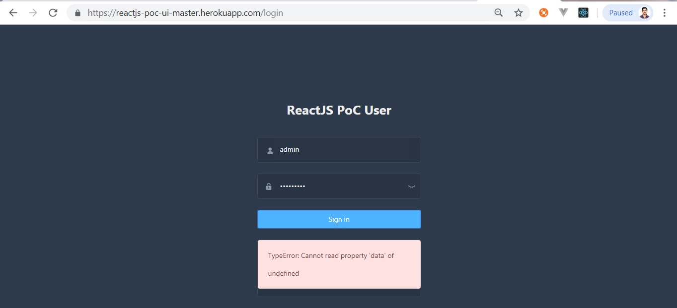
Known issue (continued)

