Slide 1
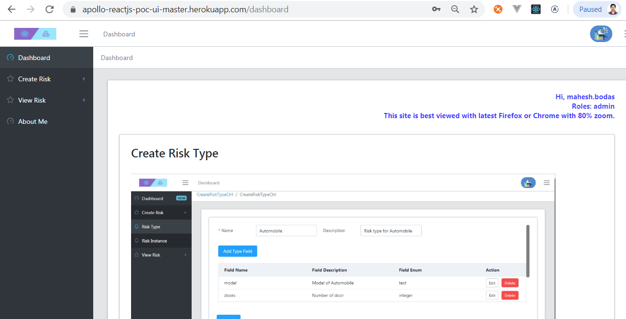
Home Screen

Slide 2
Apollo ReactJS PoC UI
https://apollo-reactjs-poc-ui-master.herokuapp.com Use above link to access UI.
Username :- admin (lower case)
Password :- poctest#1 (lower case)
Best viewed with Firefox with 80 % zoom
Above UI refers Web API at following location credentials are same.
https://django-poc-server-maheshbodas.herokuapp.com/

Slide 3
Salient features
Developed using ReactJS, ApolloClient, Redux, redux-thunk, ES6, Element React library, Node JS, Serve as a Static server.
ApolloClient is use to send GraphQL queries and Mutation to GraphQL based Django server.
Used Redux as global data store for this application. Redux actions and reducers make is easy to shape and store data as needed by UI.

Slide 4
Salient features (continued)
Used CoreUI React template so as to reuse Sidebar navigation, Breadcrumbs and common Layout for all pages.
CoreUI React template itself build using Create React App. CRA is zero configuration template to build, unit test and deploy application on server.
CRA makes use of Enzyme and Jest for Unit testing. Does not need separate Jest installation or Web pack tweaking. Everything is taken care by CRA.

Slide 5
Salient features (continued)
Well thought React components to modularize code.
Made use of Typescript and React Typescript support to develop generic component that’s used in all screen to automate task like showing Page loading Icon, display UI when data is available and show error if any.
The above component has been reused in all screens of ReactJS PoC application.

Slide 6
Salient features (continued)
Role based authorization further limits access to screens and components use for creating Risk Types.
User can define RiskType (Entity Name) and associated RiskTypeFields (Entity attributes) in one go using header and details table in Create Risk Type screen.
User can add Risk (Entity Instance Name) and Risk Fields (Entity attribute values) in one go using header and dynamically populated controls in Create Risk screen.

Slide 7
Salient features (continued)
Create Risk Instance screen dynamically adds required field validation and field type specific validation for controls related to Risk type fields. (Entity attributes) i.e. Date / float / integer.
Successful model creation messages are displayed using MessageBox.
Display various model validation errors using MessageBox

Slide 8
Salient features (continued)
View Single Risk display Auto Complete dropdown for selecting Risk Name. Upon selection user clicks Get Risk Detail button to fetch details for given Risk.
Single Risk Instance data is fetched from GraphQL API.
Single Risk Instance aggregates Risk Fields as well Field type information. View Single Risk control then dynamically renders appropriate read-only controls based on field type information found in a retrieved Single Risk instance.
Each dynamically populated Control’s value is set with corresponding Risk field (Entity attribute) value

Slide 9
Salient features (continued)
View All Risk screen allow user to select RiskType from drop down list.
Upon RiskType selection, screen fetches Risk instances filtered by selected RiskType and allows user to paginate through list of Risk Instances whose foreign key RiskType matches with the Selected RiskType in Dropdown box.
GraphQL only support forward pagination. Backward pagination is enabled programmatically by maintaining stack in Redux state store.

Slide 10
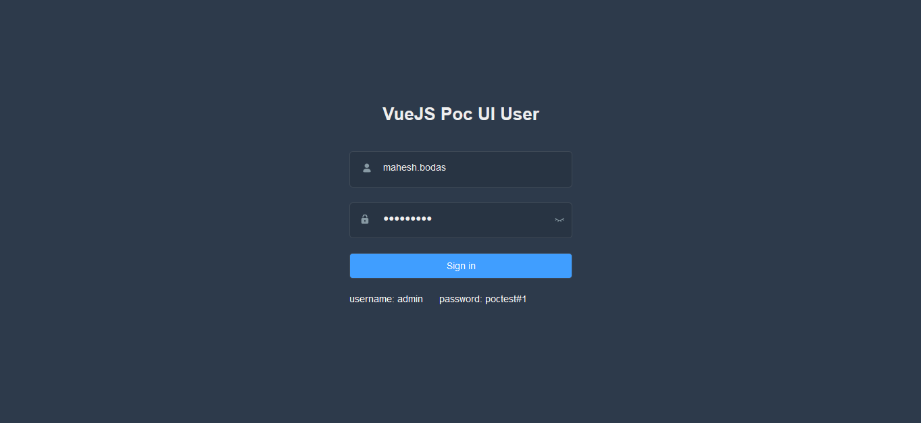
Login Screen

Slide 11
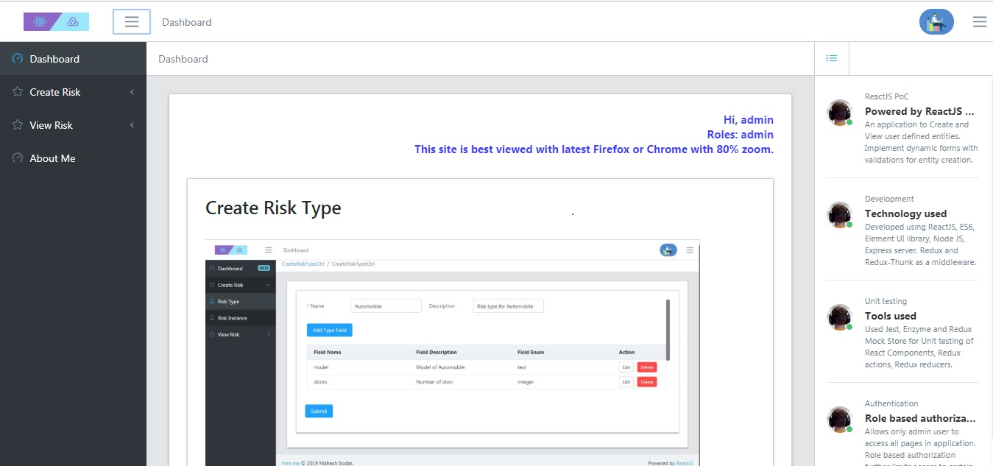
Dashboard showing app highlights

Slide 12
Create Risk Type screen
Admin User can define Risk types.
User Enters Risk type name and description.
Click Add Risk Type Field button to define Risk type fields (Entity attribute) i.e. Name and Type (String / Date / Integer / Currency).
Screen allows for editing and deleting Risk Type fields.
Post Risk type after adding / editing Risk type fields.

Slide 13
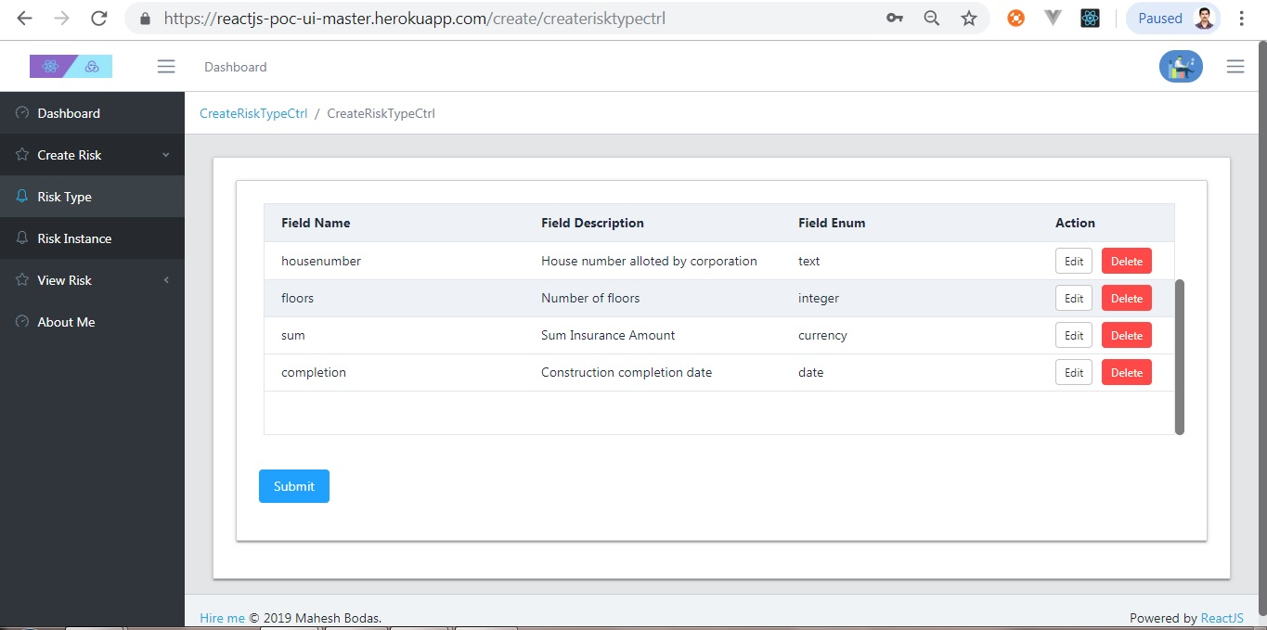
Create Risk Type Image

Slide 14
Risk Type Data posted to server

Slide 15
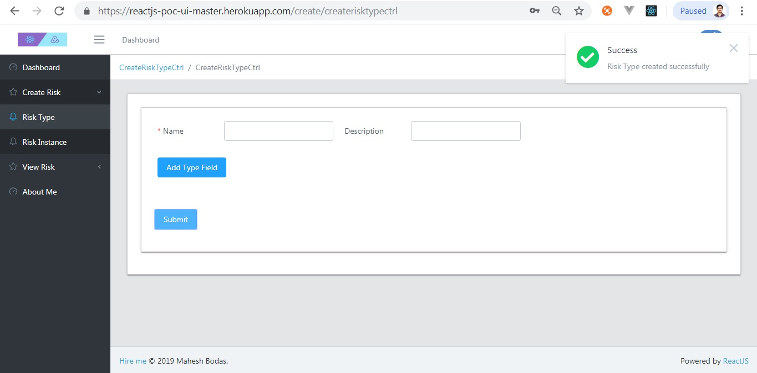
Create RiskType shows Success

Slide 16
Create Risk Instance screen.
User can create Risk Instance based on Risk types.
Select appropriate Risk Type from dropdown box. Screen will fetch Risk type details stored in backend. Dynamically populate appropriate controls based on Entity attributes.
Fill up all dynamically populated controls that corresponds each Risk Instance field and submit form.
Only Admin user can define Risk Types.

Slide 17
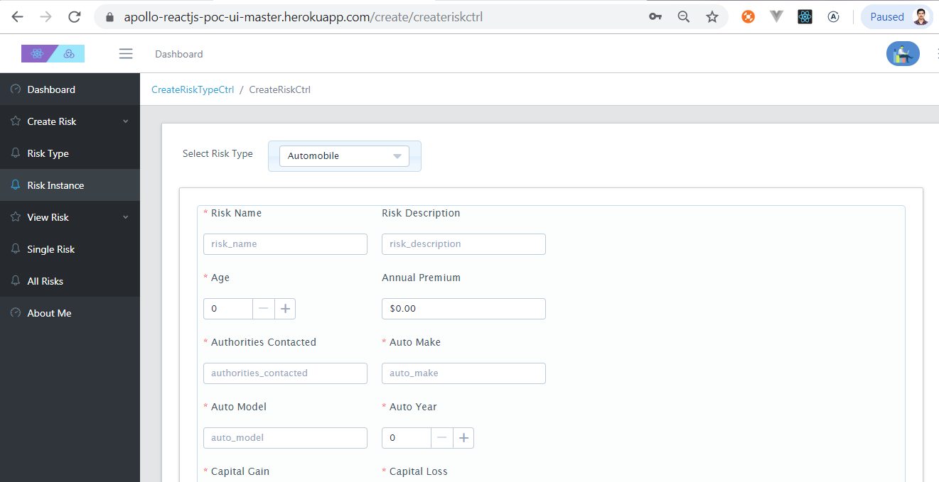
Screen shows dynamically populated controls. Ready to accept input values.

Slide 18
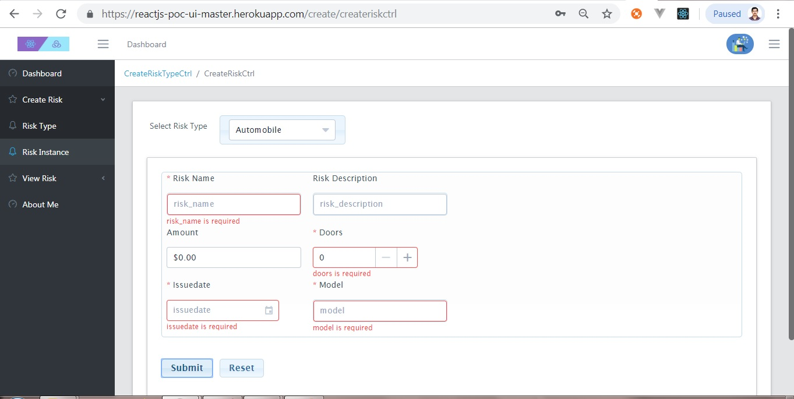
Screen showing field validation errors.

Slide 19
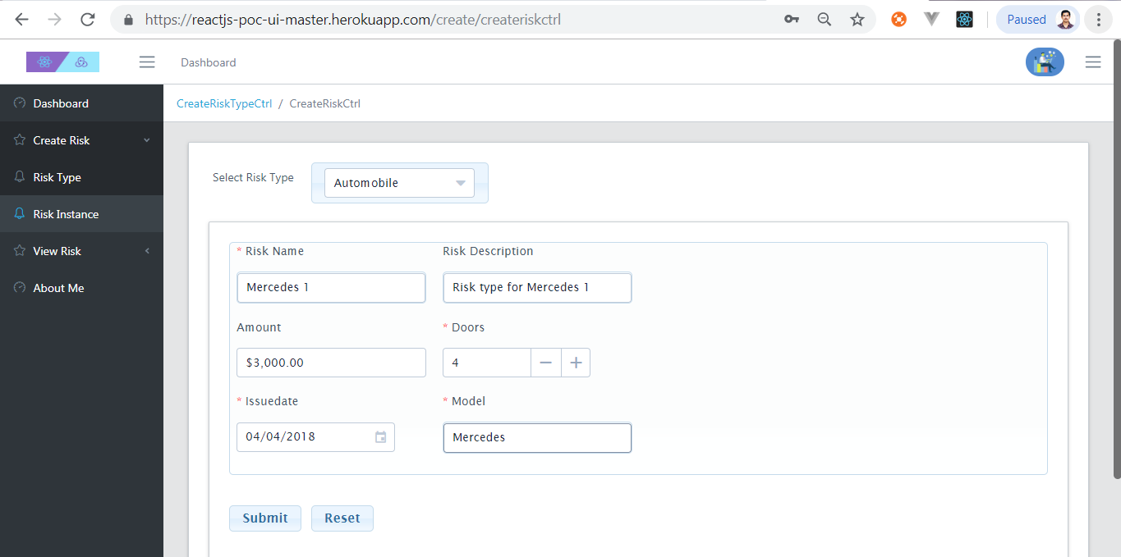
Submit when validation succeed

Slide 20
Posting Risk Instance data to server

Slide 21
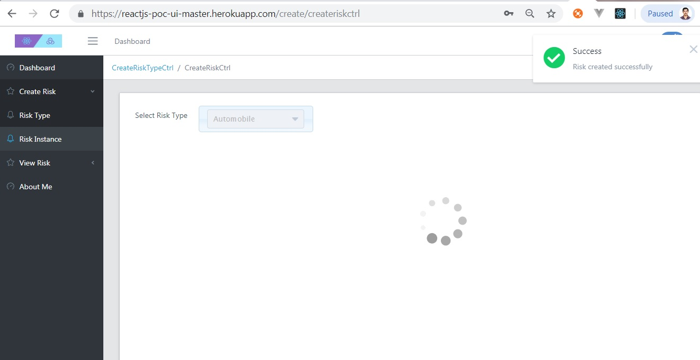
Create Risk Instance showing success

Slide 22
View Single Risk Instance
User can view single Risk Instance using this form.
Select appropriate Risk Name from Auto Complete dropdown box.
Screen will fetch Risk instance details for selected Risk name. Risk details like name and its attributes values are fetched. Screen will dynamically populate appropriate controls based on Entity attributes type also available in response.
Each dynamic control’s value is set with corresponding entity attribute value.

Slide 23
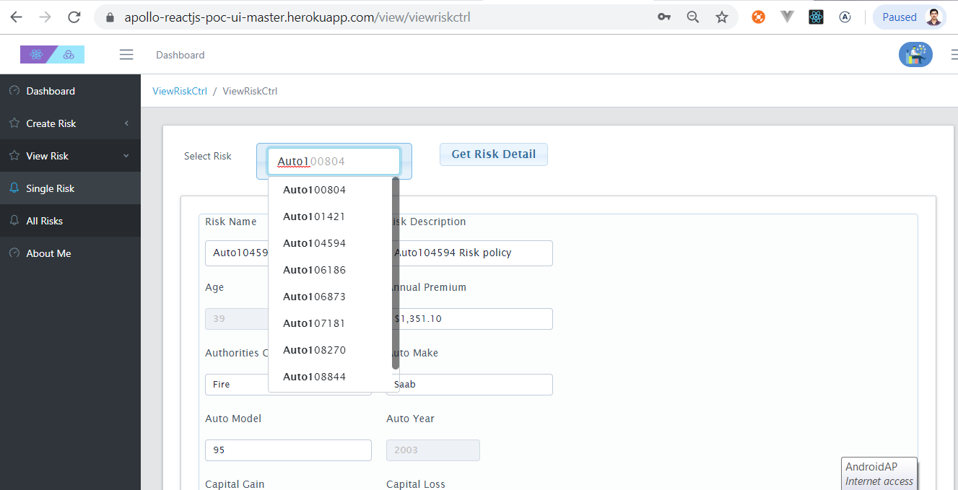
View Single Risk Screen

Slide 24
View All Risks
User can view Risk Instances using this form
Select appropriate Risk Type from dropdown box.
Screen will show one Page of Risk instances Risk Name and associated instance fields in tabular format for selected Risk Type.
User can paginate forward and backward through Risk records.

Slide 25
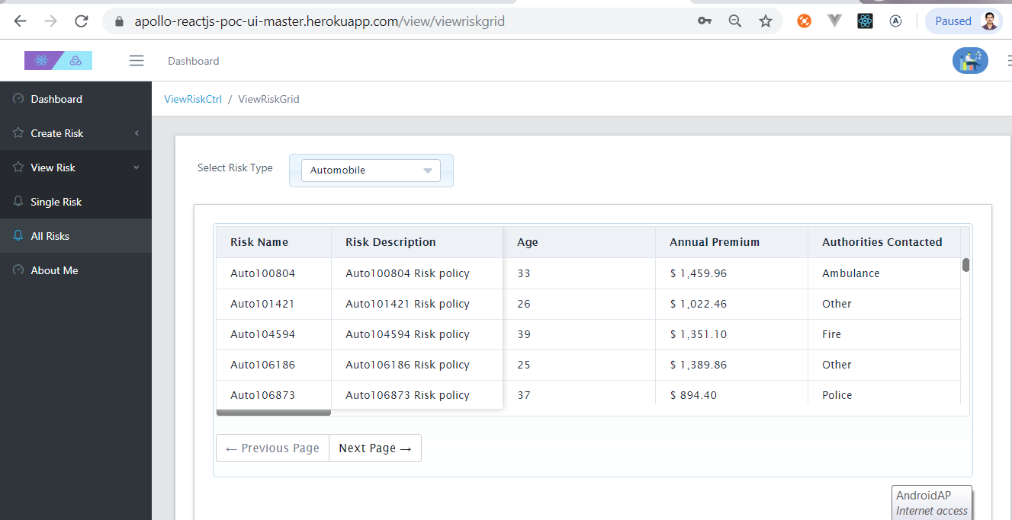
View All Risk Screen

Slide 26
Non Admin users
All above slides assumed user logged in has admin privilege.
Non admin user will be restricted from accessing Create Risk Type and Create Risk Instance page.
They can view Risk Instances added to system.
User : editor (lower case)
Password : test#123 (lower case)

Slide 27
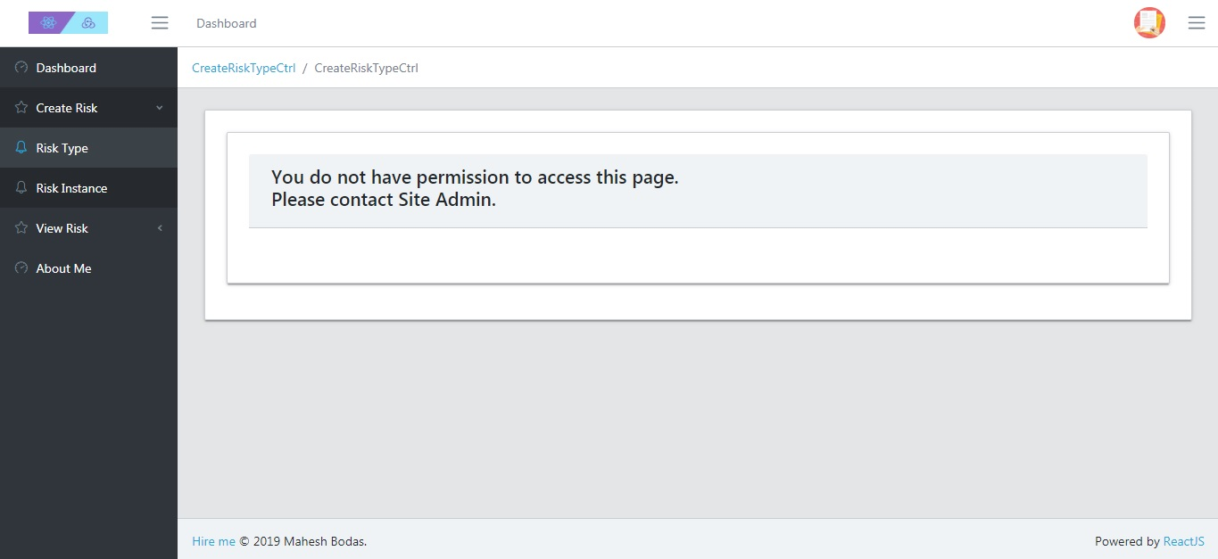
No access to Create Risk Type

Slide 28
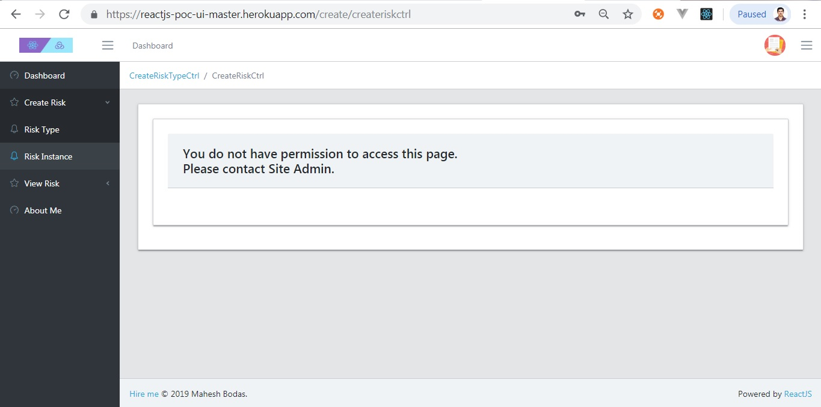
No access to Create Risk Instance

Slide 29
Unit testing.
Used Enzyme, Jest for unit testing React components.
Used Redux Mock Store for Unit testing of, Redux actions, Redux reducers.

Slide 30
Known issues.
Since Django Rest API and UI application are installed using free account on Heroku platform.
In case if Django Rest API is not invoked in last one hour or more Dyno associated with it goes to sleep.
As a result it may be possible that when UI invokes API it might timeout.
In case if you get any error try refreshing page after 2/3 minutes.

Slide 31
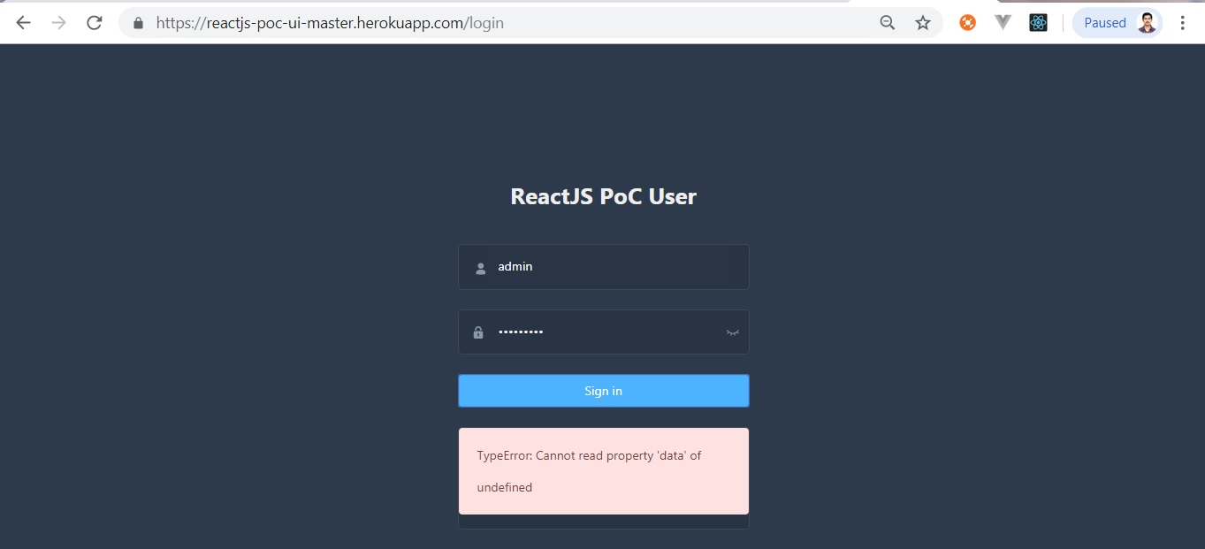
Known issue (continued)

