Slide 1
Node.Js
Server Side Javascript

Slide 2
WHAT IS NODE.JS ?
Server Side JavaScript
Event-driven
Runs on Single Thread
Non-blocking I/O model which makes it lightweight
User Event-Loop via java script callback functionality to support non-blocking I/O
Runs on Google's V8 JavaScript Engine

Slide 3
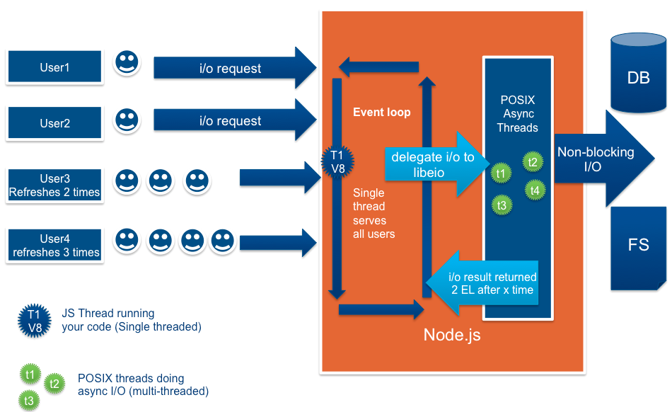
DESIGN FLOW
POSIX Asynchronous I/O: POSIX interface provides standard way to access I/O devices (files, drivers, sockets, fifos, etc.) defined by UNIX read() write() blocking sequence.
Notes:
Thread based servers like Apache server will serve each web request as individual threads which doesn’t fit well for concurrent connections.

Slide 4
WHAT IS UNIQUE ABOUT NODE.JS?
JavaScript used in client-side but node.js puts the JavaScript on server-side thus making communication between client and server will happen in same language
Servers are normally thread based but Node.JS is “Event” based. Node.JS serves each request in a Evented loop that can able to handle simultaneous requests.
Node.JS programs are executed by V8 Javascript engine the same used by Google chrome browser.
Notes:
Thread based servers like Apache server will serve each web request as individual threads which doesn’t fit well for concurrent connections.

Slide 5
WHAT CAN YOU DO WITH NODE ?
It is a command line tool. You download a tarball, compile and install the source.
It lets you Layered on top of the TCP library is a HTTP and HTTPS client/server.
The JS executed by the V8 javascript engine (makes Google Chrome so fast)
Node provides a JavaScript API to access the network and file system.

Slide 6
WHAT CAN’T DO WITH NODE?
Node is a platform for writing JavaScript applications outside web browsers. This is not the JavaScript we are familiar with in web browsers. There is no DOM built into Node, nor any other browser capability.
Node can’t run on GUI, but run on terminal

Slide 7
THREADS VS EVENT-DRIVEN
Threads | Asynchronous Event-driven
Lock application / request with listener-workers threads | only one thread, which repeatedly fetches an event
Using incoming-request model | Using queue and then processes it
multithreaded server might block the request which might involve multiple events | manually saves state and then goes on to process the next event
Using context switching | no contention and no context switches
Using multithreading environments where listener and workers threads are used frequently to take an incoming-request lock | Using asynchronous I/O facilities (callbacks, not poll/select or O_NONBLOCK) environments

Slide 8
WHY NODE.JS USE EVENT-BASED?
In a normal process cycle the webserver while processing the request will have to wait for the IO operations and thus blocking the next request to be processed.
Node.JS process each request as events, The server doesn’t wait for the IO operation to complete while it can handle other request at the same time.
When the IO operation of first request is completed it will call-back the server to complete the request.

Slide 9
NODE.JS VS APACHE
  It's fast
  It can handle tons of concurrent requests
  It's written in JavaScript (which means you can use the same code server side and client side)
Platform | Number of request per second
PHP ( via Apache) | 3187,27
Static ( via Apache ) | 2966,51
Node.js | 5569,30

Slide 10
CONCLUSION
Node.js faster than apache but it more hungry system’s CPU and memory because of Event loop.
No Match for Enterprise application level framework like Spring.
Node.js use event based programming, it make the server doesn’t wait for the IO operation to complete while it can handle other request at the same time

Slide 11
Questions ?

Slide 12
INSTALLATION

Slide 13
NODE/NPM BASIC COMMANDS
Node -v
Npm -v
npm install <package name> -g
npm uninstall <package name> -g
npm search <package name>
npm ls –g (List globally packages)
npm ls –gl (List globally packages details)
npm ls(List local packages)

Slide 14
HOW TO CREATE SAMPLE PROJECT
Open cmd/terminal.
Create project directory
Cd “dir_name”
Run ‘npm init’ command
Enter information as you need
It will create a default package.json
Add some libraries under ‘dependencies’ tag.
"dependencies": {
"express": ">0.0.0",
"bluebird": "~2.9.2",
"request": "^2.51.0",
"restify": "~4.0.4“
}

Slide 15
HOW TO CREATE SAMPLE PROJECT(CONTD..)
Create you own project directory structure.
Create a example.js file
var express = require('express')
var app = express()
app.get('/', function (req, res) {
res.send('Hello World!')
})
app.listen(3000, function () {
console.log('Example app listening on port 3000!')
})

Slide 16
HOW TO CREATE SAMPLE PROJECT(CONTD..)
Navigate to file directory
On cmd: run ‘node example.js’
On browser: http://127.0.0.1:3000/

Slide 17
GRUNT CONFIGURATION
Install the Grunt's command line interface (CLI)
npm install -g grunt-cli
Install ‘npm install grunt --save-dev’
Set PATH as ‘..\AppData\Roaming\npm’
Create ‘Gruntfile.js’
Open cmd and move to project directory
Run ‘grunt’

Slide 18
Sample Code Demo

Slide 19
Question ?

