Slide 1
Analytics Olympiad 2022
Name: Mahesh Chandra Duddu
Email: duddumaheshchandra@gmail.com

Slide 2
Problem Statement
Given a rich dataset consisting of thousands of rows of past records, more about customers’ behaviours, create an ML model to look at a case of an insurance claim and decide whether to reject or accept it. Using Log_loss as an evaluation metric.

Slide 3
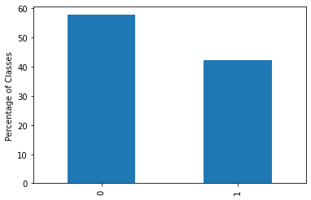
Data Understanding
Detailed overview of the data
Data Summary:
105000 rows, 17 columns in train data, 45000 rows, 16 columns in test data
'AGE','GENDER','DRIVING_EXPERIENCE','EDUCATION', 'INCOME','VEHICLE_YEAR', 'TYPE_OF_VEHICLE' - Categorical Features
'ID', 'CREDIT_SCORE', 'VEHICLE_OWNERSHIP', 'MARRIED', 'CHILDREN', 'POSTAL_CODE', 'ANNUAL_MILEAGE', 'SPEEDING_VIOLATIONS', 'DUIS', 'PAST_ACCIDENTS'-Numerical Features
Dependent Feature or Target Feature “OUTCOME” is imbalanced

Slide 4
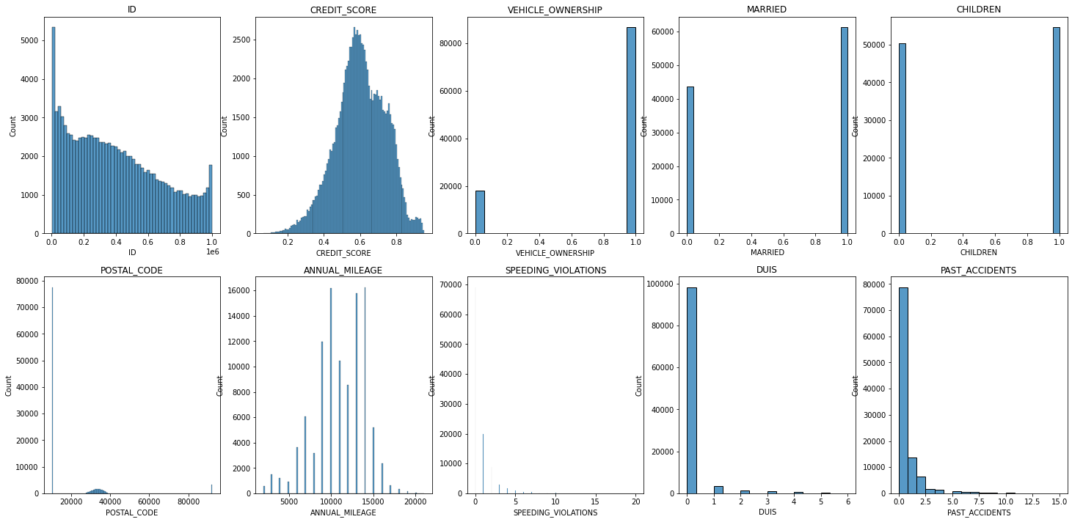
Data Understanding(Numerical Features)
Duplicate Values in ID.(Repeated data for same customer)
ANNUAL_MILEAGE, CREDIT_SCORE Features are almost following normal distribution.
VEHICLE_OWNERSHIP, MARRIED Features have only 2 values either 0 or 1.
POSTAL_CODE Feature have value as 10238 as 73% of the data, and a small bump for remaining percentage of data.

Slide 5
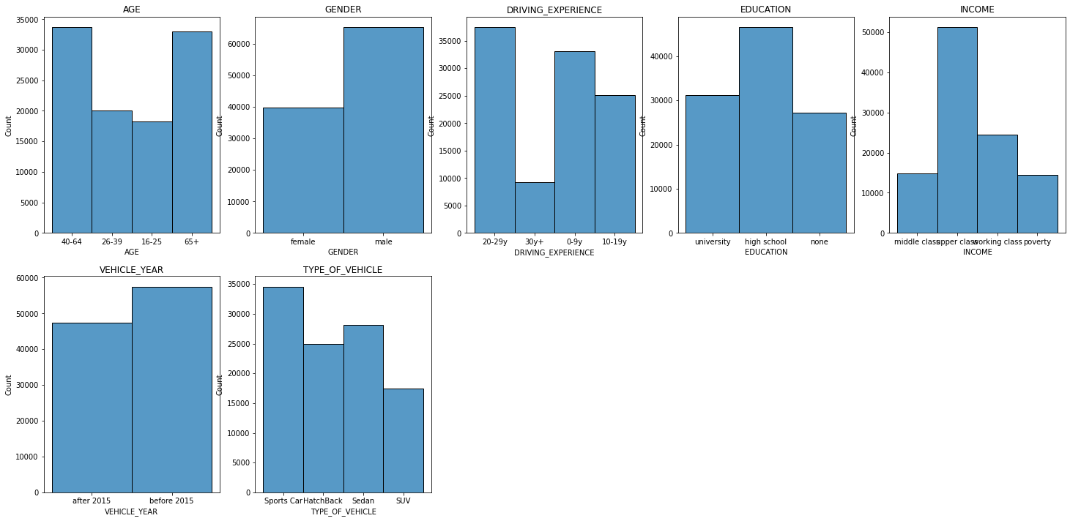
Data Understanding(Categorical Features)
AGE feature contains data of more customer in the 40+ age group.
DRIVING_EXPERIENCE feature contains less data of customer with 30+ years experience.
TYPE_OF_VEHICLE feature contains more data of customer with SPORTS car type
GENDER feature contains more data of customer with Male gender.
INCOME feature contains more data of customer with Upper class.

Slide 6
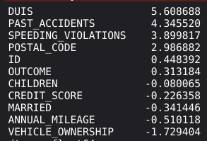
Data Preparation
How data was cleaned and prepared for building model.
Important points:
POSTAL_CODE, VEHICLE_OWNERSHIP, CHILDREN, MARRIAGE features are given as numerical features and hence are converted into categorical features
All categorical features except “POSTAL_CODE” are converted into numerical representation using One-Hot encoding
POSTAL_CODE feature is converted into 50 (5*10) numerical features by treating each digit and possible numbers (0-9) of POSTAL_CODE as a feature, value 1 for number presence else 0
Binning was performed on CREDIT_SCORE feature but yet score didn’t improve. CREDIT_SCORE values are given in the range of 0 to 1.
“DUIS”, “PAST_ACCIDENTS” and few other features are highly skewed. They are handled using Standardization followed by Normalization

Slide 7
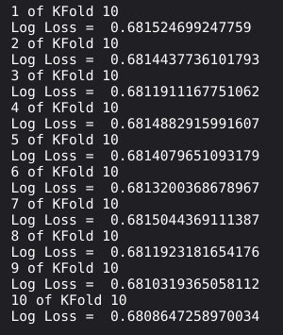
Model Building & Evaluation
Presenting a detailed overview of model(s) used and the results observed.
Important points:
Logistic Regression model is used. When compared with other models it performed well Most of the features values are either 0 or 1, hence logistic regression which is a linear generalizable model was able to predict probability of OUTCOME = 1 with given features
Hyperparameter tuning is performed using GridSearchCV, but didn’t improve the score
Stratified 10-Fold Cross Validation is performed for better generalizability of the model
Final predictions are probability of OUTCOME being 1 and follow a normal distribution with mean = 0.42.
Insurance claim reimbursement rejection is more probable than acceptance (if the probability criteria chosen as 0.5 for outcome being 1)

Slide 8
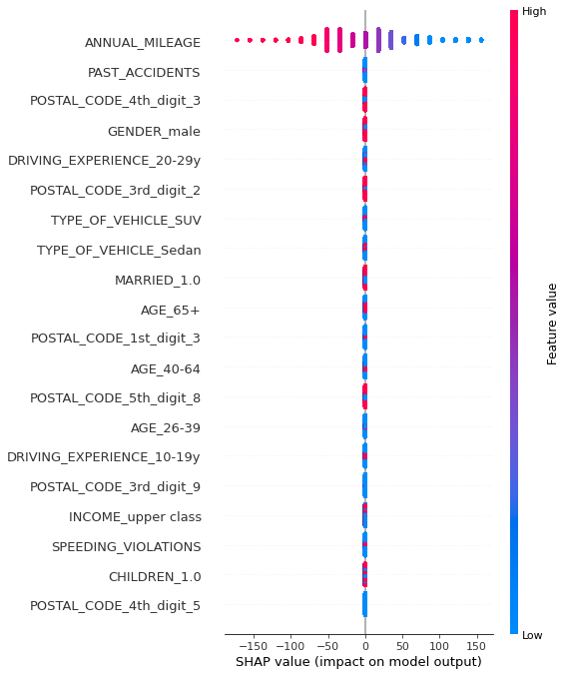
Business Insights
It is important for the Business to understand which feature contributes to the model better
We can see alongside from the SHAP summary plot that ANNUAL_MILEAGE single-handedly influences the model and this information can be used to improve the model around the most influencing features

Slide 9
Results and Recommendations
A summary of the important insights and results obtained and recommendations for deployment!
Important points:
Logistic Regression model is best suited for deployment as model is moderately scalable with 65 features and highly generalizable.
Predictions are the probability of OUTCOME being 1.
Predictions follow normal distribution.
Predictions indicate that there is higher probability for OUTCOME being 0 than 1.
Feature Selection didn’t improve the score. ID Feature is removed

Slide 10
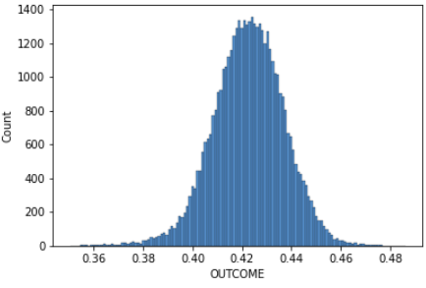
Recommendations
A summary of the important business outcomes /real life impact
From the test data predictions model was able to predict probabilities in the range of 0.35 to 0.48 for acceptance of vehicle insurance reimbursement claim
As the probability is less than 0.5, most of the vehicle insurance reimbursement claims get rejected. Based on the probability cutoff, the customer insurance reimbursement claim can be suggested

Slide 11
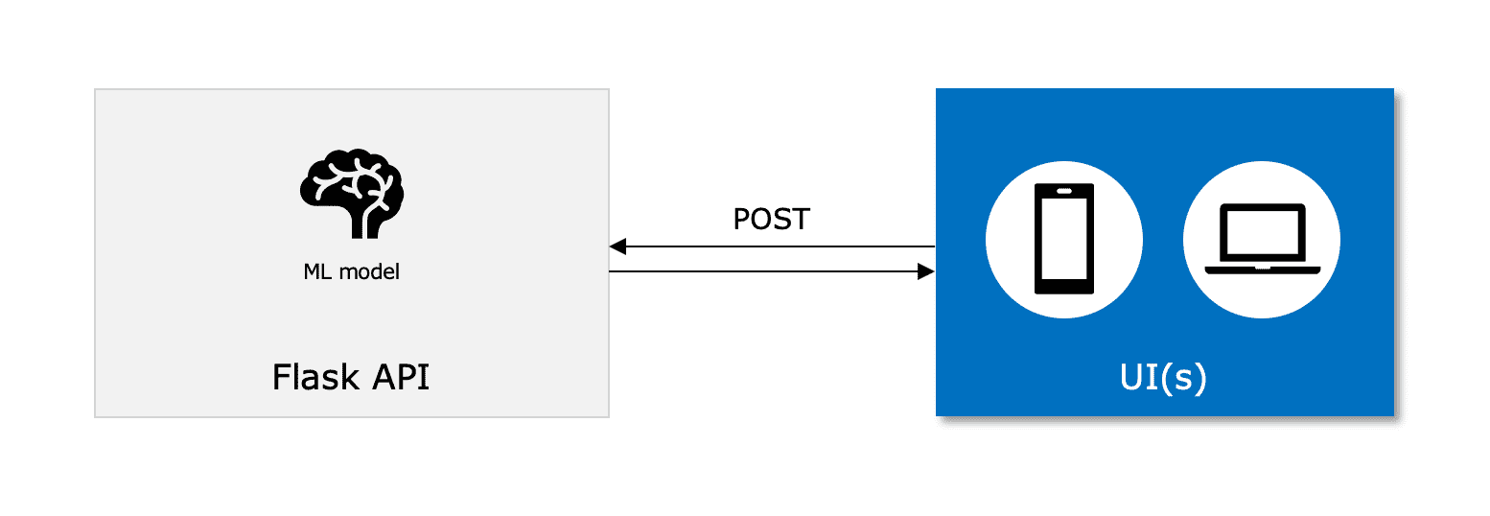
Recommendations
Logistic Regression model can be deployed using Flask or AWS.
Given the data of customer, it predicts the probability of vehicle insurance reimbursement claim to be accepted. Model takes input of 16 features, and then produces predictions based on the given data.
A summary of the innovative and new ideas proposed based on the analysis.

Slide 12
THANK YOU

