Slide 1

Credit Risk Prediction
Team 6
Mareedu Mahesh Chandra
Lokesh Vaddi
Nikhil Kumar Kanisetty
Shanmukha Yaswanth Reddy Kallam

Slide 2
Introduction
Banks lose a significant amount of money as a result of credit defaults, and it is ultimately ordinary customers who bear the brunt of this error.
Credit Risk Analysis is used by banks to ensure that credit is supplied to a trustworthy consumer.
Credit risk is defined as the risk of defaulting on a loan as a result of the borrower's failure to make mandatory debt payments on time.
From this project we have built a model to predict whether a person is eligible to get a credit or not.
The decision depends on his/her banking history and other parameters.

Slide 3
Dataset
The dataset we are using has data for 32,581 borrowers and 12 features related to each of them. Below listed are the features.
Numerical Variables:
person_age, person_income, person_emp_length, loan_amnt, loan_int_rate, loan_percent_income, cb_preson_cred_hist_length.
Categorical Variables:
person_home_ownership, loan_intent, loan_grade, cb_person_default_on_file, loan_status.
Target variable: loan_status is the target variable used for prediction.
Source : https://www.openml.org/search?type=data&status=active&id=43454&sort=runs

Slide 4
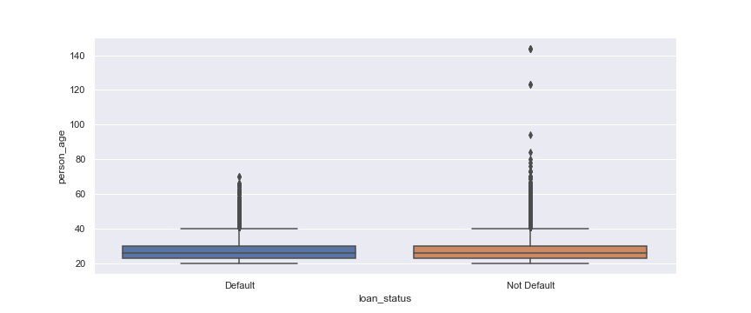
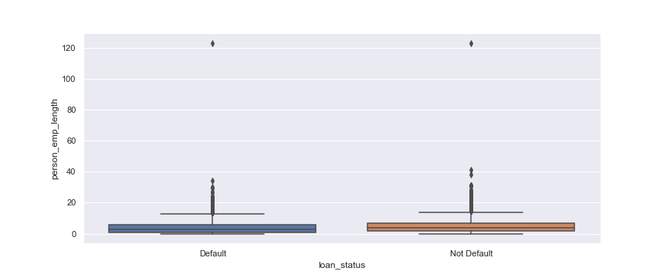
Analysis
Box plot of person age
Box plot of person emp length

Slide 5
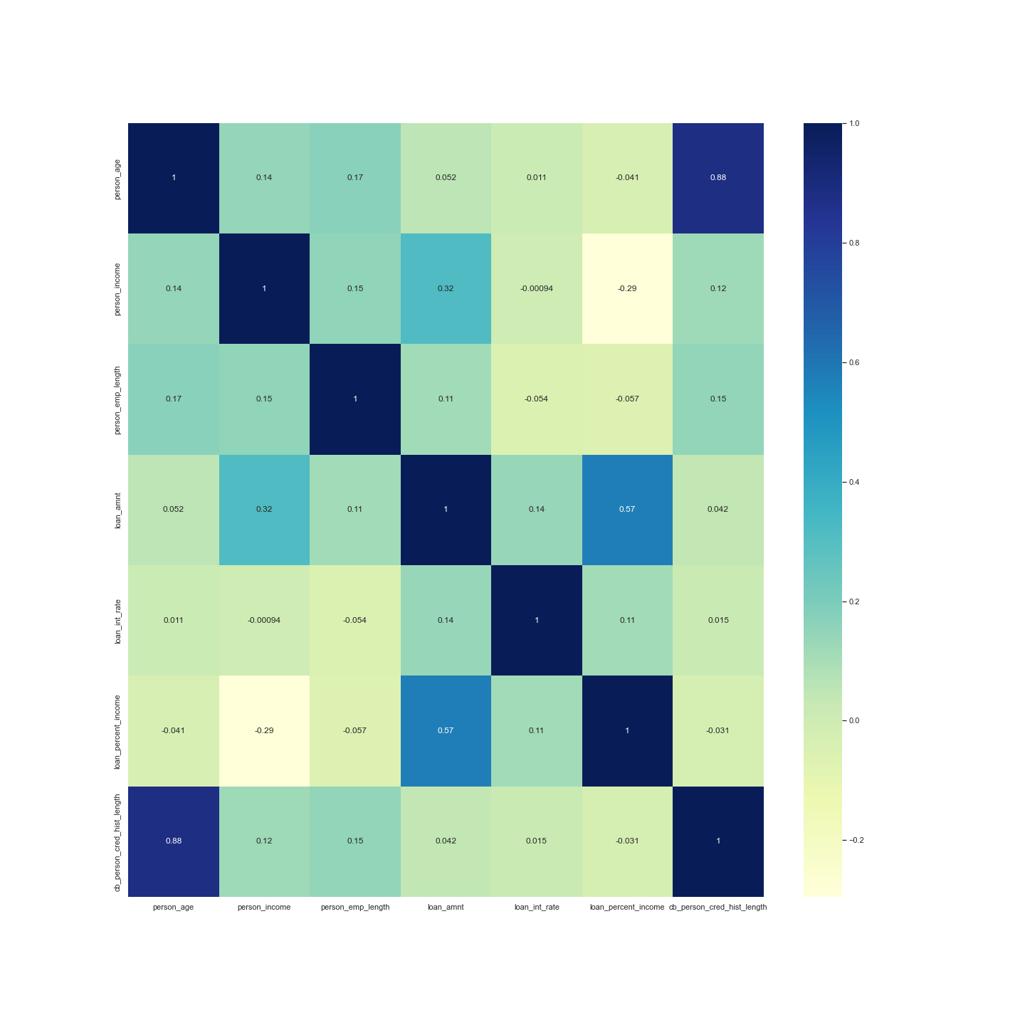
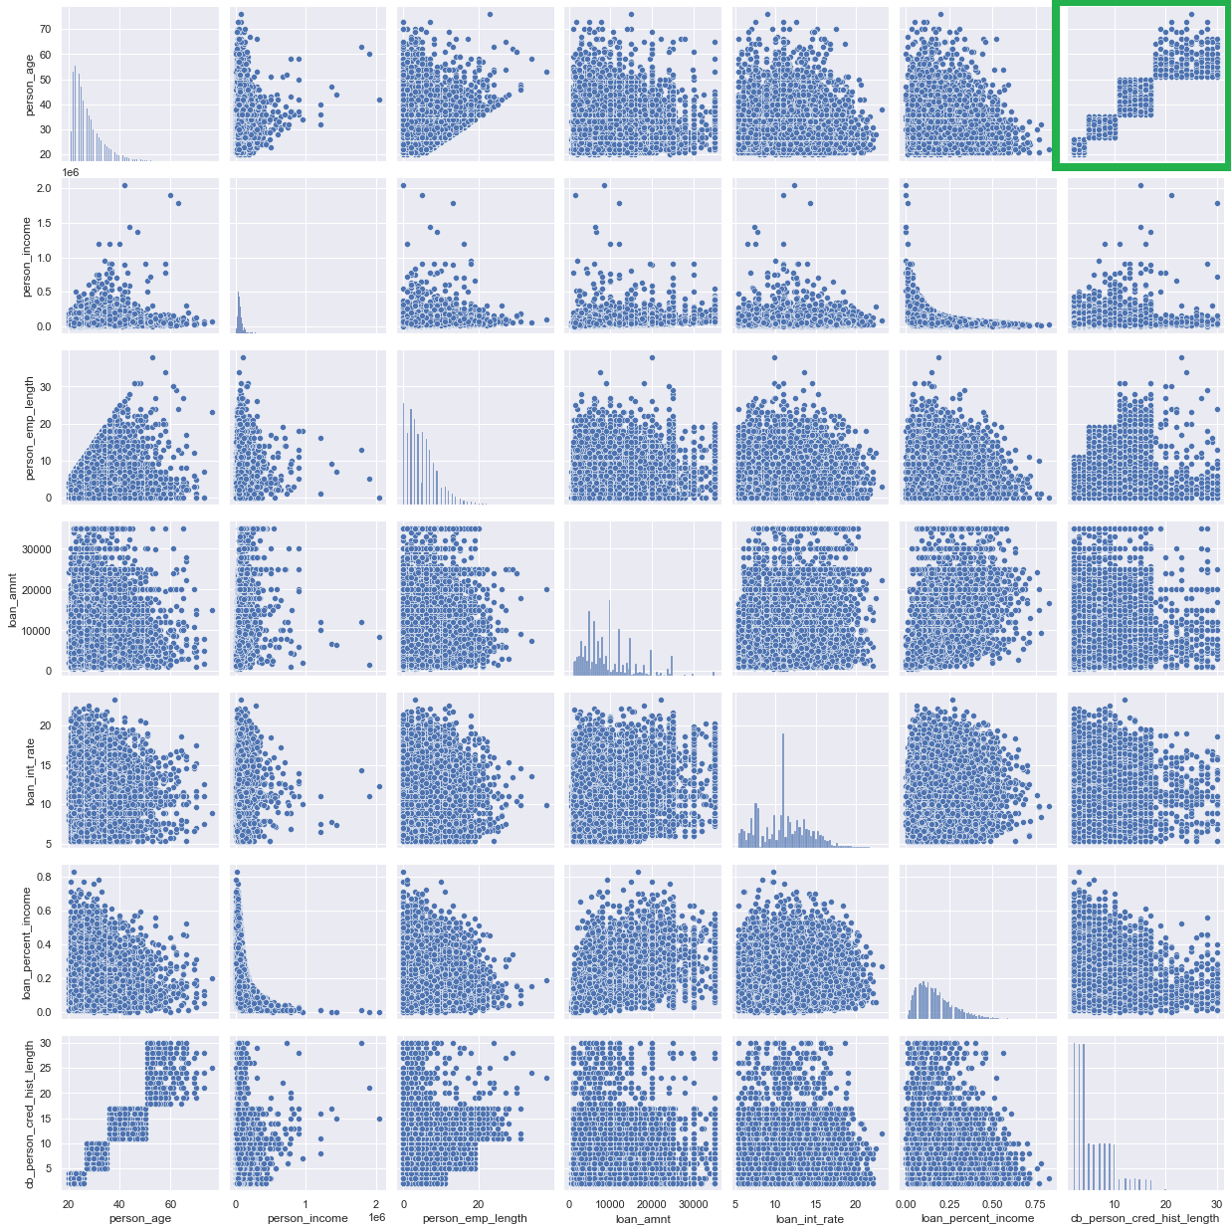
Analysis
Correlation Heat map
Pair plot among numerical features

Slide 6
Model Training
One hot encoding
Train Test Split
Upsampling the Training data
Notes:
One hot encoding: ,we performed one hot encoding on these features and make use of them in models like XGBoost.
Train Test Split: The dataset is divided into test subset and train subset. The train subset is used to fit the model and test subset is given as input to model and predictions are compared.
Upsampling the Training data: After dividing the test subset and train subset we perform upsampling on train subset, so that the model is not inclined towards the majority class.

Slide 7
Models
Logistic Regression
Decision Tree Classifier
Random Forest Classifier
XGBoost Classifier

Slide 8
Results
Monitored results from each model.
Compared the results to choose the best model.
Metrics used: Accuracy, Precision, Recall, f-1 score, ROC-AUC
Notes:
After applying multiple models on the dataset we have monitored results from each model.
We compare these results and come to a conclusion on the best model suited to solve this
problem. The metrics we have used to find the generalized model are:
Accuracy
Precision
Re-Call
F-1 Score
ROC-AUC

Slide 9
Result Analysis
Model | Accuracy | Precision | Recall | F1-Score
RandomForestClassifier | 0.900432 | 0.825745 | 0.690644 | 0.752176
DecisionTreeClassifier | 0.890249 | 0.73917 | 0.770099 | 0.754317
XGBClassifier | 0.933244 | 0.941986 | 0.74048 | 0.829166
LogisticRegression | 0.811767 | 0.550084 | 0.766808 | 0.640613

Slide 10
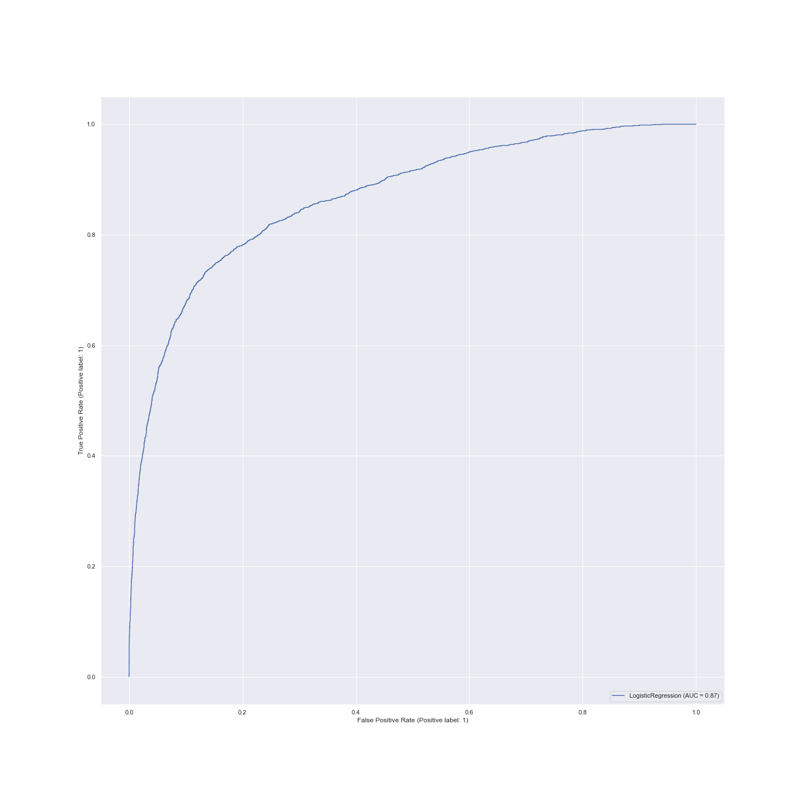
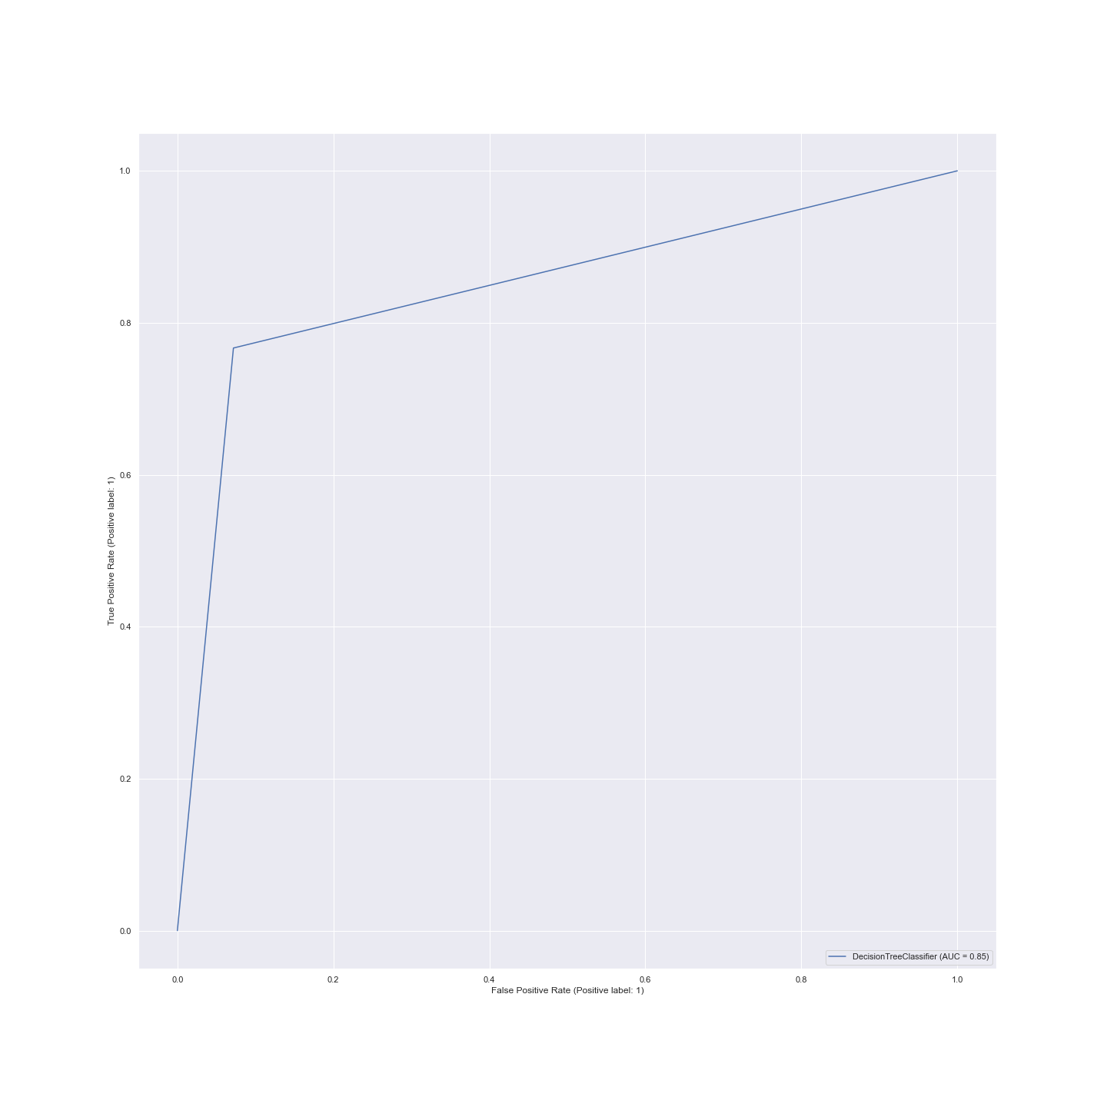
Result Analysis
Logistic Regression Classifier
Decision Tree Classifier

Slide 11
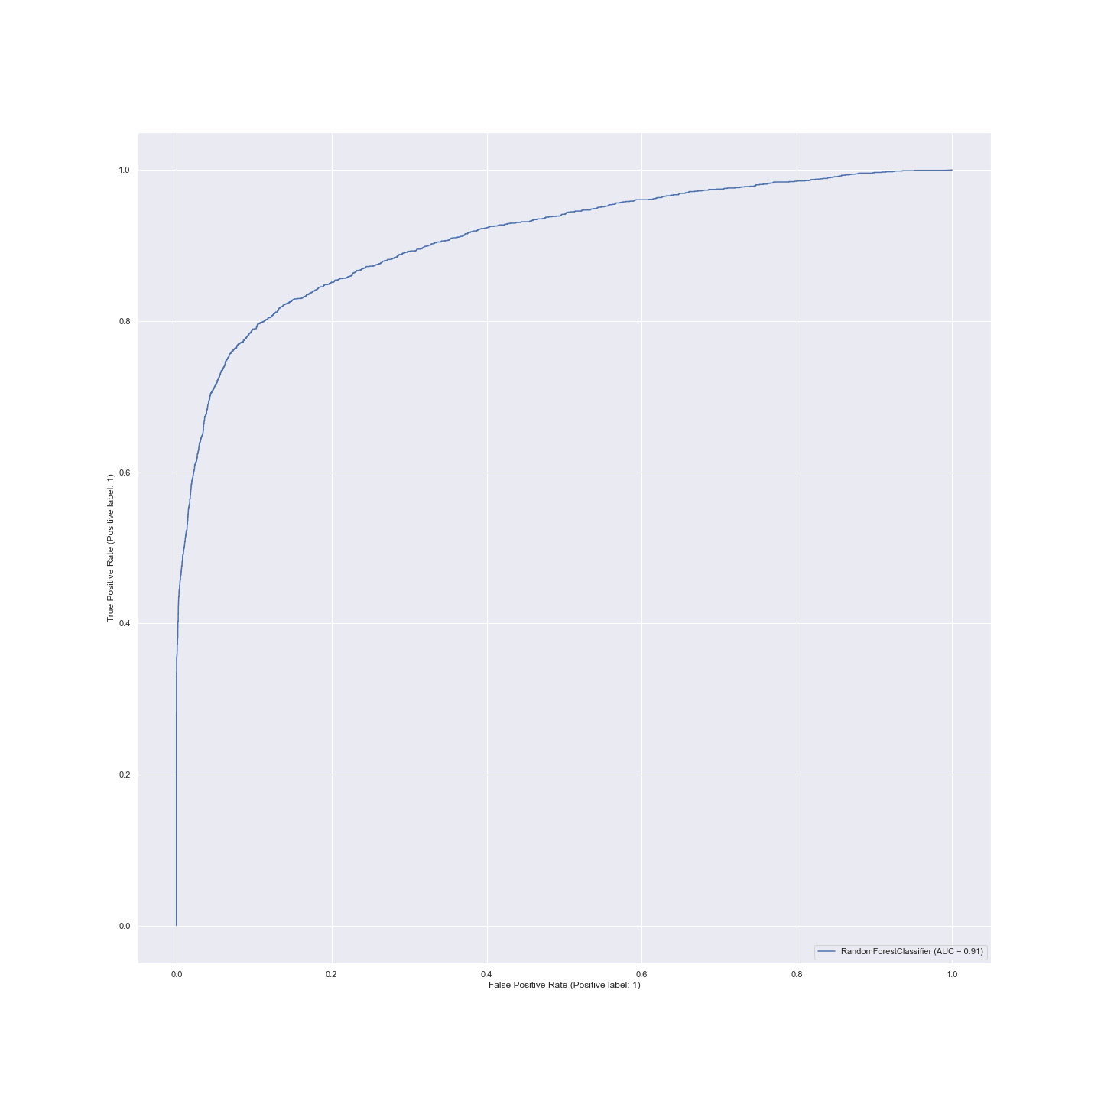
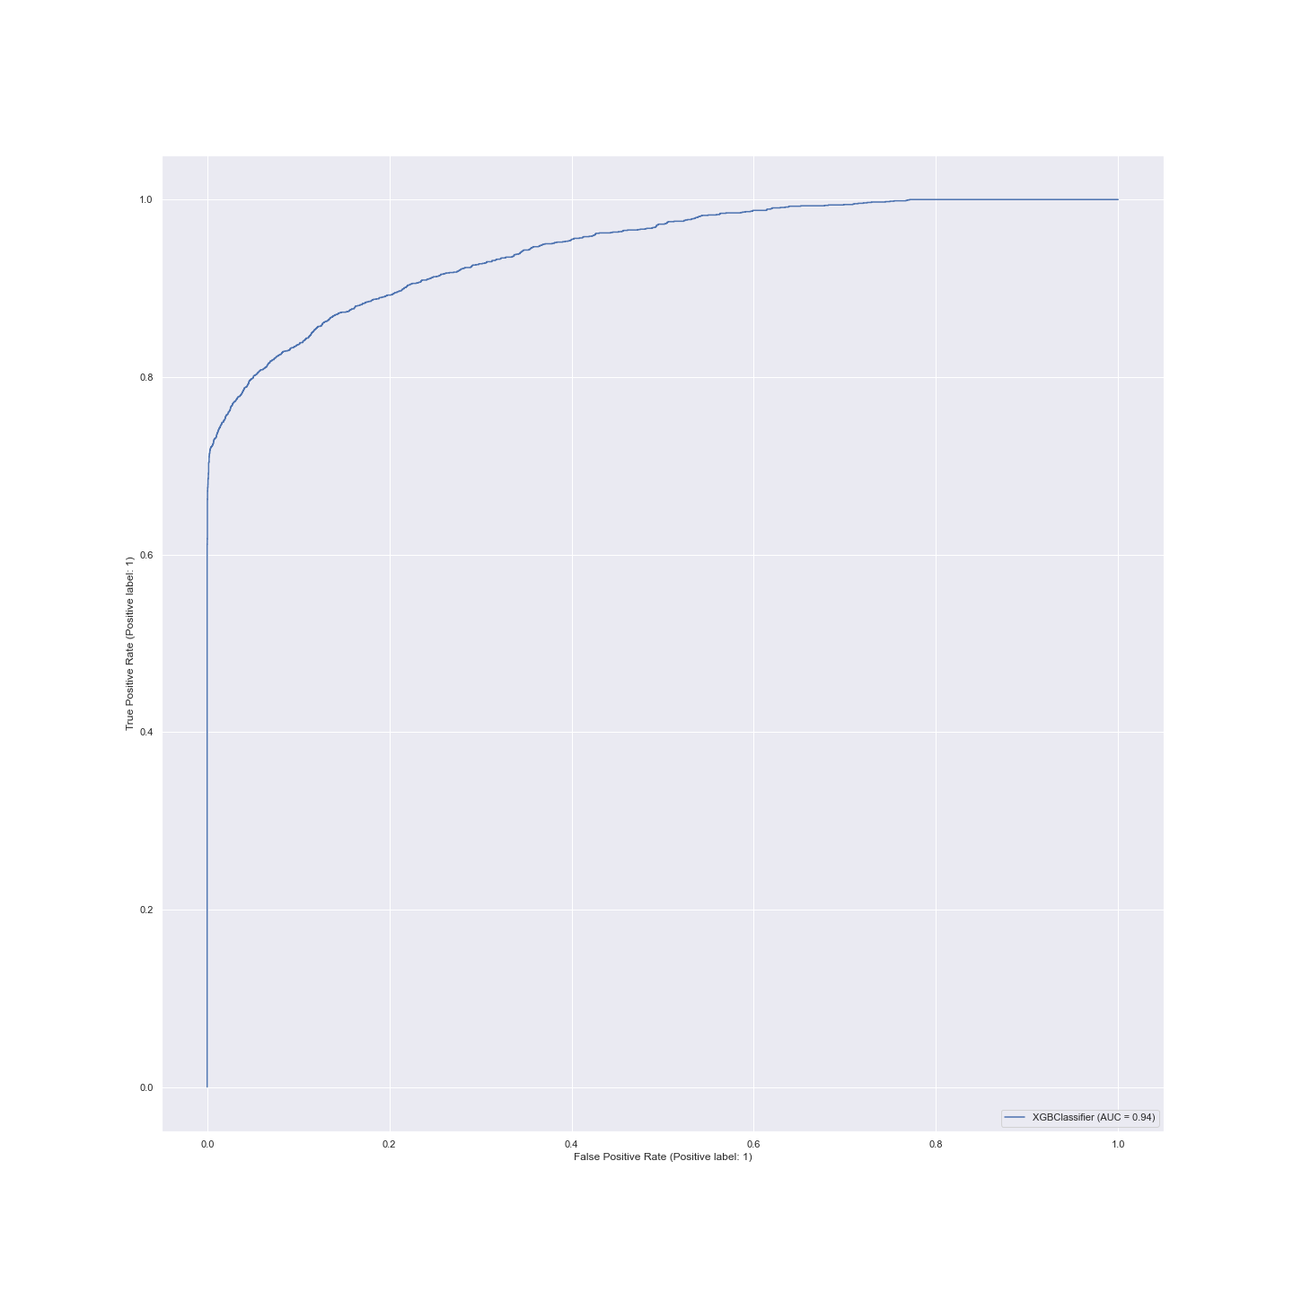
Result Analysis
Random Forest Classifier
XGB Classifier

Slide 12
Github Repository
https://github.com/MaheshChandrra/CMPE255-Credit-Risk-Prediction

Slide 13
Conclusion
Bagging models like Random Forest and Boosting models like XGBoost delivered similar results.
Though the dataset is balanced by duplicating the minority class, adding additional data points in future might make the model much robust.
To add strength to the model, in future we plan to add additional features to the dataset and testing it with neural networks.
Notes:
After evaluating the performance of all the models,we understand that tree based models are best suited for this dataset.

Slide 14

Thank you

