Slide 1

Project Name :- Employees Management System
Name: Mahesh Sanjay Dhanlobhe

Slide 2


Employee Management System is a distributed application, developed to maintain the details of employees working in any organization.
It maintains the information about the personal and official
details of the employees.

Slide 3
SCOPE OF PROJECT
Better Scope in Industries
Any Organisation.
Schools & college also can use to maintain their employees

Slide 4


This project aims to simplify the task of maintaining records of the employees of Company.
To develop an well-designed database to store employee information
Provides full functional reports to management of Company.
The objective of this project is to provide a comprehensive approach towards the management of employee information.

Slide 5

The records are maintained in registers.
Time consuming process.
Complicated searching, editing & updating.

Slide 6


Helps in maintaining the computerized employee details.

Slide 7


Provide computerized system for maintaining records.
More efficient & reliable.
Less time consuming and easy to use.
Huge data storage with less computer memory.
Avoid Human errors & efforts for Maintaining daily data.
Avoid Data manipulations.
Also avoids Data inconsistency & redundancy.

Slide 8
And In this Project code I have used the concept of Classes and Objects to solve the problem. I have created a menu for the user which consists of 5 different features
1. To add an employee
2. To view details of an employee
3. To remove an employee
4. To update info of an employee
5. To exit the Portal.
For each of these features I have created a separate class to maintain the decorum of the code. Also I have use the concept of Switch Cases to automate the task and make it more useful and user friendly. User need to just enter the numbers as per given and it will perform the task.

Slide 9

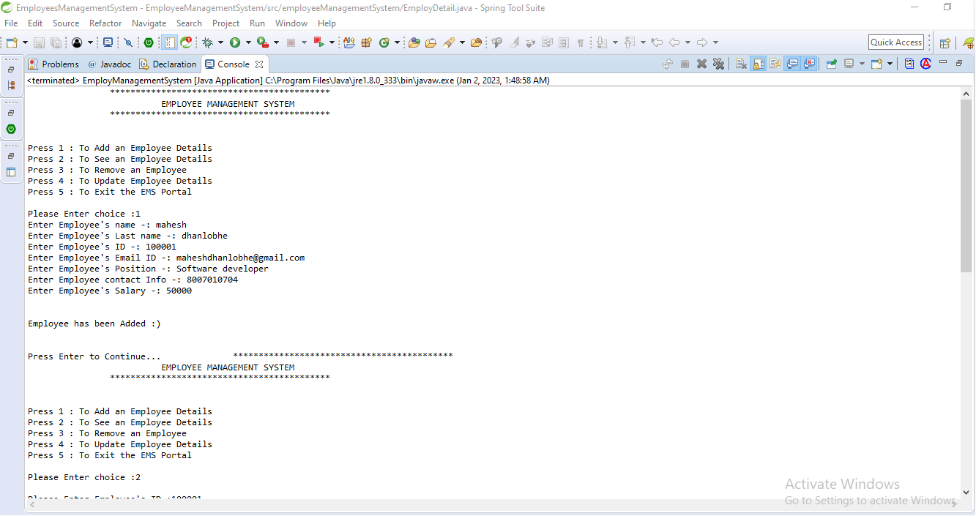
Output :-

Slide 10
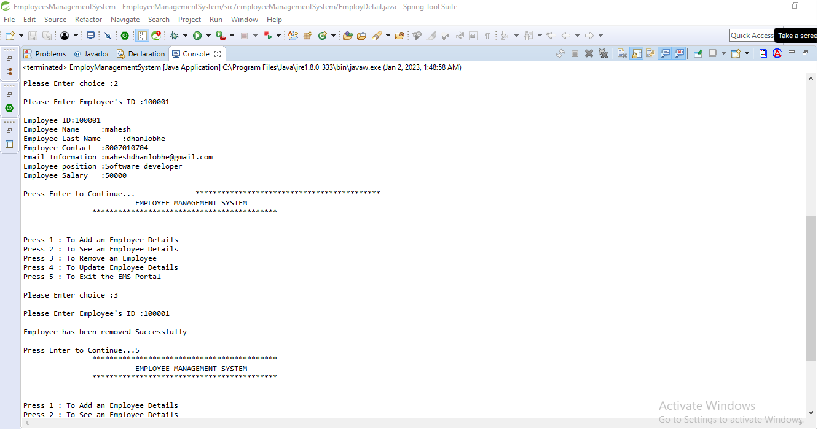

Slide 11
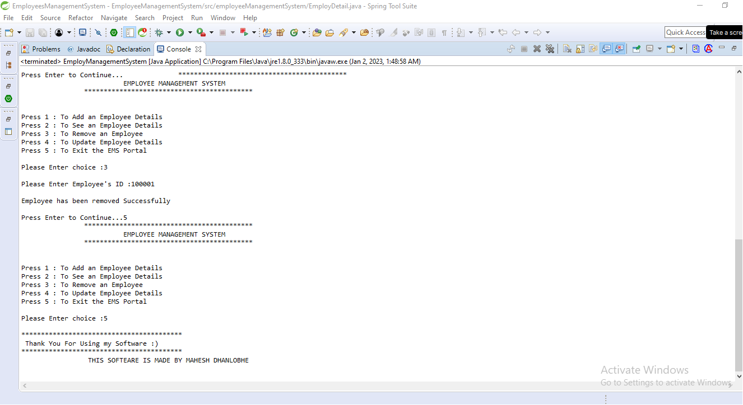

Slide 12
Thank you !

