Slide 1

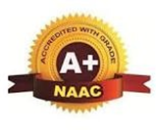
A PRESENTATION ON
Google Glasses For Blind People
By :-
Name Roll no. Guided by :-
Akanksha Vyavahare 42 Prof. Prajakta Lokhande
Gauri Joshi 12 Seminar Coordinator :-
Mahesh Doiphode 04 Prof. Namdeo Kedare
Ajay Kamble 14 Head of department :-
Prof. Rahul Ghode

Slide 2
OUTLINE
Abstract
Introduction
Problem Statement
Motivation
Literature Survey
Existing Work
Proposed Work
Project Objective
H/W,S/W Requirement
Conclusion
Future Work
References

Slide 3
ABSTRACT
More than a billion people around the world have vision problems for different reasons, and these numbers are increasing every year. This leads us to make different innovations in the field of computer vision, with the aim of providing a better quality of life for these people. In this document we present as a resource, the development of an intelligent lens, which incorporates a Raspberry Pi ZW connected to the Google Cloud Vision API through the Wifi of the user's mobile phone, where at the touch of a button, the Raspberry camera, captures the image, processes it in a few seconds and retrieves its main features, obtaining important information for mobilization such as: pedestrian crossings, bus stop sign, vehicles, green light, etc. 150 people from the National Union of the Blind of Peru (NUBP) were evaluated with different degrees of blindness, obtaining a 40.5% increase of independence for their mobilization.

Slide 4
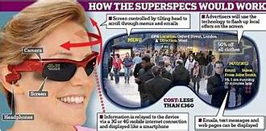
INTRODUCTION
According to the World Health Organization (WHO), in its October 2019 report, at least 2.2 billion people worldwide are visually impaired or blind, and according to reports from previous years, these numbers are increasing, affecting the most vulnerable people the most, such as the elderly, people with disabilities, ethnic minorities, indigenous populations and those on low incomes.
There are different devices that help blind people to move around fluently, however, many of These have not been very successful due to the lack of support when developing this Type of project. One of the first devices to appear was the white cane and guide dog; with technological advances, new tools are being created such as the use of Google Cloud Vision in assistive technology scenarios, where the benefits of this Google tool, remote processing of images in the cloud and audio output on a speaker are presented; Today, devices have been created that further facilitate the daily activity of a person, as is the case of Google Assistant implementation in Raspberry Pi, processor that is used in this document, connecting it with the API of Google Cloud, focusing on blind people.

Slide 5
PROBLEM STATEMENT
Problem Statement :-
To design Glasses Connected to Google Vision that Inform Blind People about what is in Front of Them.
Scope of the problem statement :-
Visual impairments limit the ways the person can interact with others, access information or develop his/her own knowledge and experience, therefore a need for an assisting aids with multitasks feature to cope with different situations is an important issue. The available aids and technologies in the market nowadays are expensive to the normal or low level of income people which are the majority of the users, therefore new devices with similar tasks and cheaper prices are needed.

Slide 6
MOTIVATION
Now-a-days the people with disabilities are not able to live their life as normal people does, their disability becomes a big barrier for it. But as of Science and technology has reached at a very high level that most types disabilities people suffering from are living a normal life with other people. People who have lower limb differences need assistance for mobility and science has worked greatly for that by innovating prosthetic devices, wheelchairs, walkers, crutches, canes, etc. People suffering from ear problems, being deaf have hearing aids which at a very extent help deaf people hear. As same there are techniques or maybe some solutions which includes surgery and all exist for blind people too, but as in IT field we wanted to do something for the blind people and here we are with an idea that can help blind people be independent in their life at least for some extent. The problems faced by the blind people and their dependency on other people for their living everytime was the point why we selected this topic for our project.

Slide 7
LITERATURE SURVEY
SR No. | PAPER NAME | Author, Journals | Year of Publishing | WORK
1. | Using Google Cloud Vision in Assistive Technology Scenarios. | D. Mulfari, A. Celesti, M. Fazio, M. Villar and y A. Puliafito, IEEE Workshop on ICT solutions for eHealth. | 2016 | A computer vision system evaluates data from an image source, typically a camera, and extracts information about Captured images and audio output on a speaker are presented.
2. | A Performan- ce Evaluation of Raspberry Pi Zero W Based Gateway Running MQTT Broker for IoT. | D. B. C. Lima, R. M. B. d. S. Lima, D. d. F. Medeiros, R. I. S. Pereira, C. P. d. Souza and y O. Baiocchi, IEEE 10th Annual Information Technology Electronics and Mobile Communication Conference (IEMCON). | 2019 | Rasberry Pi Zero W, this family of raspberries is considered one of the most ideal for IOT because of its low energy power. Since, our user will carry the lenses in his daily life, so their energy consumption should be very small.

Slide 8
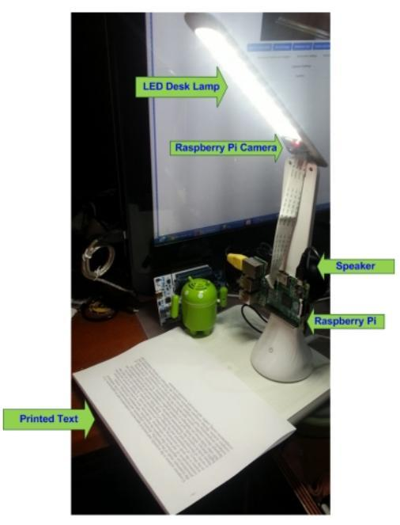
EXISTING WORK
• Using Google Cloud Vision in Assistive Technology Scenarios :-
With technological advances, new tools are being created
such as the use of Google Cloud Vision in assistive technology
scenarios, where the benefits of this Google tool, remote processing
of images in the cloud and audio output on a speaker are presented.
A computer vision system evaluates data from an image
source, typically a camera, and extracts information about captured
images. The equipment used includes a Raspberry Pi 2 Model B
Board, used for the instantiation of our application, and a Raspberry
camera module, as vision sensor. Then, exploit the Google Cloud
Vision API to process images on the Google Cloud Platform.

Slide 9
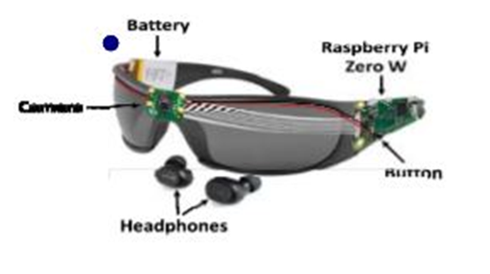
PROPOSED WORK
An embedded lens prototype will be developed with Rasberry Pi Zero W, this family of raspberries is considered one of the most ideal for IOT because of its low energy power, according to an evaluation of the performance of rasberry Pi Zero W, since our user will carry the lenses in his daily life, so their energy consumption should be very small; will be connected to a camera in the front, in which the user will press a button, the camera will take a picture, will process it remotely by means of the RES Google Vision API and will inform by audio, connected by means of bluetooth, the Result of the image processing, being able to detect between places, logos, letters in front, gestures in the faces, etc.

Slide 10
GLASSES ARE DESIGNED TO BE THE EYE FOR THE BLIND PERSON AND PEOPLE WHO SUFFER FROM VISION DIFFICULTIES TO MAKE THEIR LIFE EASIER AND BE ABLE TO CONTINUE LIVING THEIR LIFE AS A NORMAL HUMAN TO FOLLOW UP AND ACHIEVE THEIR GOALS AND DREAMS. • CONVERT PRINTED TEXT TO AUDIO. • IT MAKES THEIR LIFE EASIER AND THEY WILL BE ABLE TO LIVE A NORMAL LIFE. • INCREASE EDUCATION LEVEL BECAUSE “SMART GLASSES” WILL HELP ALL PEOPLE WITH VISION DIFFICULTIES TO STUDY WITH THESE GLASSES WITH NORMAL PEOPLE IN ANY SCHOOL AND UNIVERSITY.
Project Objective

Slide 11
H/W,S/W REQUIREMENT
HARDWARE, SOFTWARE REQUIREMENT :-
Raspberry Pi ZERO W: Used as our computer, it is very small, ideal for IOT projects, composed of an ARM processor, wifi connection and bluetooth.
Google Cloud Vision API: A powerful image recognition tool, this API recognizes and classifies images quickly, is able to detect individual objects and faces, and reads printed words that appear in images.
Internet: The user will provide internet access through his mobile phone by means of the wifi integrated in the Rasberry pi Zero W
Battery. Integrated into the embedded system, considering that the Rasberry pi Zero W is a low power consumption hardware very useful for IOT projects.

Slide 12
Glasses: Preferably medium size and lightweight plastic tool for comfort, this will support the wiring system.
Cámara Raspberry Pi: This high definition (HD) Raspberry Pi camera board connects to the Raspberry Pi W for photo capture.
Lens Prototype: Testss are carried out with the prototype already created and configured.

Slide 13
CONCLUSION
You get a non-invasive lens, aesthetic, portable and easy to use, achieving the implementation of the connection with Google Cloud Vision for effective capture, processing and audio output to the user, achieving the detection of the necessary images, generating greater autonomy in the mobilization of blind users. Given the results obtained, the indicators of autonomy are improved by 40.5%; likewise, the persons evaluated indicated that the prototype of the intelligent lens helps to become independent from guide persons and that they would use the product.

Slide 14
FUTURE WORK
While the team members were working on the implementation, they thought of many ideas and improvements for the “Google Glasses”. However, they wished they have more time and knowledge to do them. “Google Glasses” can be improved in the future for blind people and people who have vision difficulties by adding new techniques. For instance, direction and warning messages to prevent expected accidents, messages to tell . The user about the battery level, video detection to provide a full healthy life for people with vision difficulties, develop mobile application to control “Google Glasses”, use 270 camera to have more wider view angle., provide the glasses with GPS notification and develop the glasses’ design to have little, small and light components so the user can wear it easily.

Slide 15
REFERENCES
[1] 2020 International Conference on e-Health and Bioengineering (EHB) – Michael Cabanillas-Carbonell; Alexander Aguilar Chávez; Jeshua Banda Barrientos, "Glasses Connected to Google Vision that Inform Blind People about what is in Front of Them” Site: https://ieeexplore.ieee.org/document/9280268/, vol. #, no. #, pp.5, Oct 2020.
[2] “In Peru about 160,000 people are blind for various reasons”, Andina, 17 nov 2014. [Online]. Available: https://andina.pe/agencia/noticia-enperu-cerca-160000-personasson-invidentes-diversas-causas531943.aspx.
[3] “NATIONAL UNION OF THE BLIND OF PERU – NUBP”, [Online]. Available: https://uncp.pe/. [Último acceso: 14 Jan 2019].
[4] A. Garcia, “Products that make life easier for blind people”, Consumer, 05 May 2009. [Online]. Available: http://www.consumer.es/web/es/solidaridad/proyectos_y_campanas/200 9/05/05/185103.php.
[5] D. Mulfari, A. Celesti, M. Fazio, M. Villar y A. Puliafito, Using Google Cloud Vision in Assistive Technology Scenarios, IEEE Workshop on ICT solutions for eHealth , 2016.
[6] S. Mischie, L. Mâiu-Iovan y G. GŠpresc, «Implementation of Google Assistant on Rasberry Pi,» IEEE - International Symposium on Electronics and Telecommunications (ISETC), 2018.
[7] D. B. C. Lima, R. M. B. d. S. Lima, D. d. F. Medeiros, R. I. S. Pereira, C. P. d. Souza y O. Baiocchi, «A Performance Evaluation of Raspberry Pi Zero W Based Gateway Running MQTT Broker for IoT,» IEEE 10th Annual Information Technology, Electronics and Mobile Communication Conference (IEMCON), 2019.
[8] Google Cloud Vision, «Get started with Vision AI, » [En línea]. Available: https://cloud.google.com/vision/overview/docs/get-started. [Último acceso: 18 jan 2020]. ‘
[9] “Cámara Raspberry Pi v2 - 8 Megapixels”, BricoGeek, [En línea]. Available: https://tienda.bricogeek.com/accesorios-raspberry-pi/822- camara-raspberry-pi-v2-8-megapixels.html.
[10] Api, google cloud, “Google Cloud Vision API”, ackstorm, 11 Jan 2018. [Online]. Available: https://www.ackstorm.com/google-cloud-visionapi/

Slide 16


