Slide 1
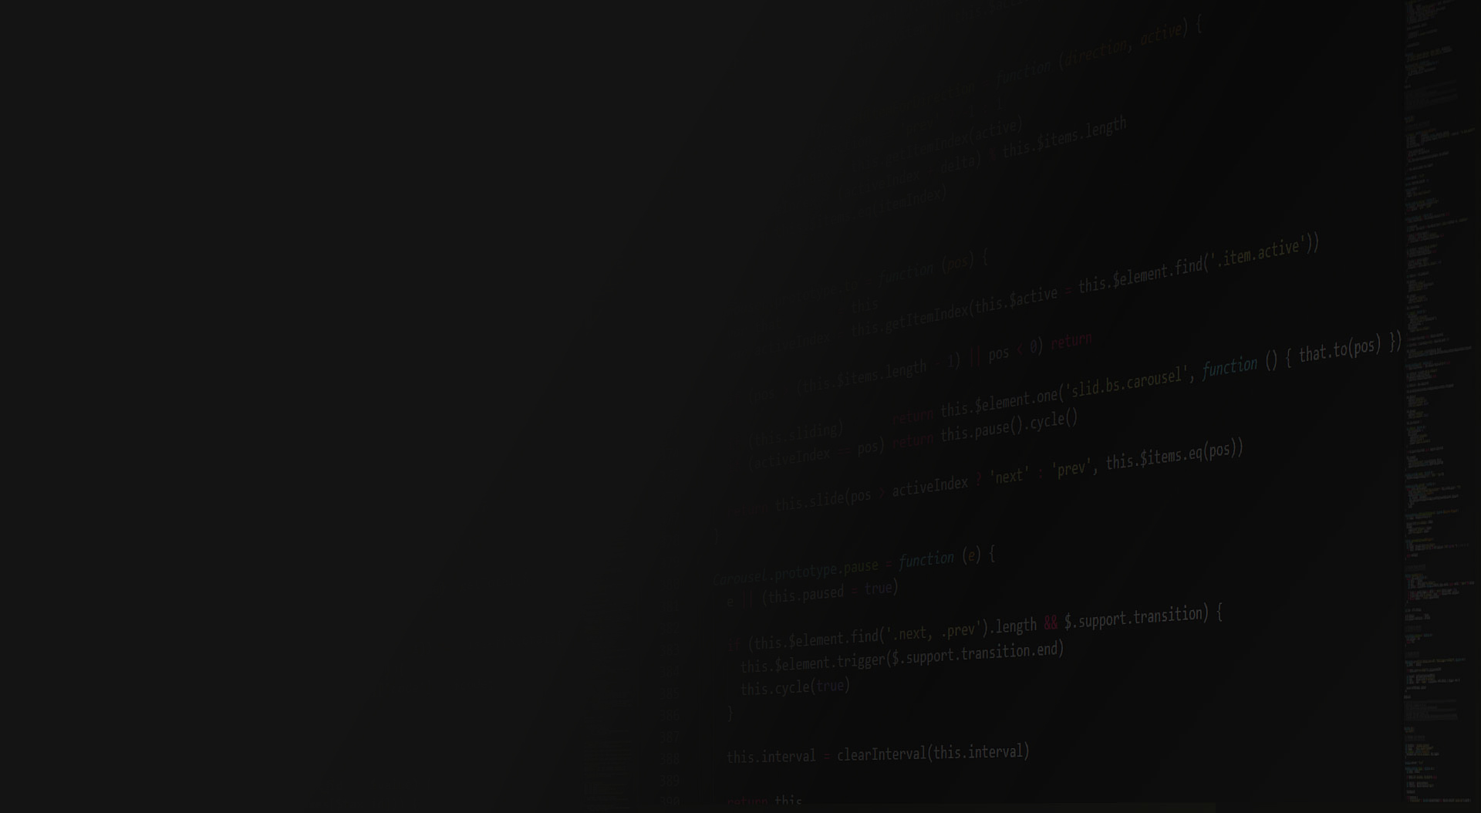


Amplitude 2017 #cashlessbanoindia

Slide 2


TechnoRocks
Executive pitch
Hackathon Theme
Create Metadata driven workflow based rules platform

Slide 3
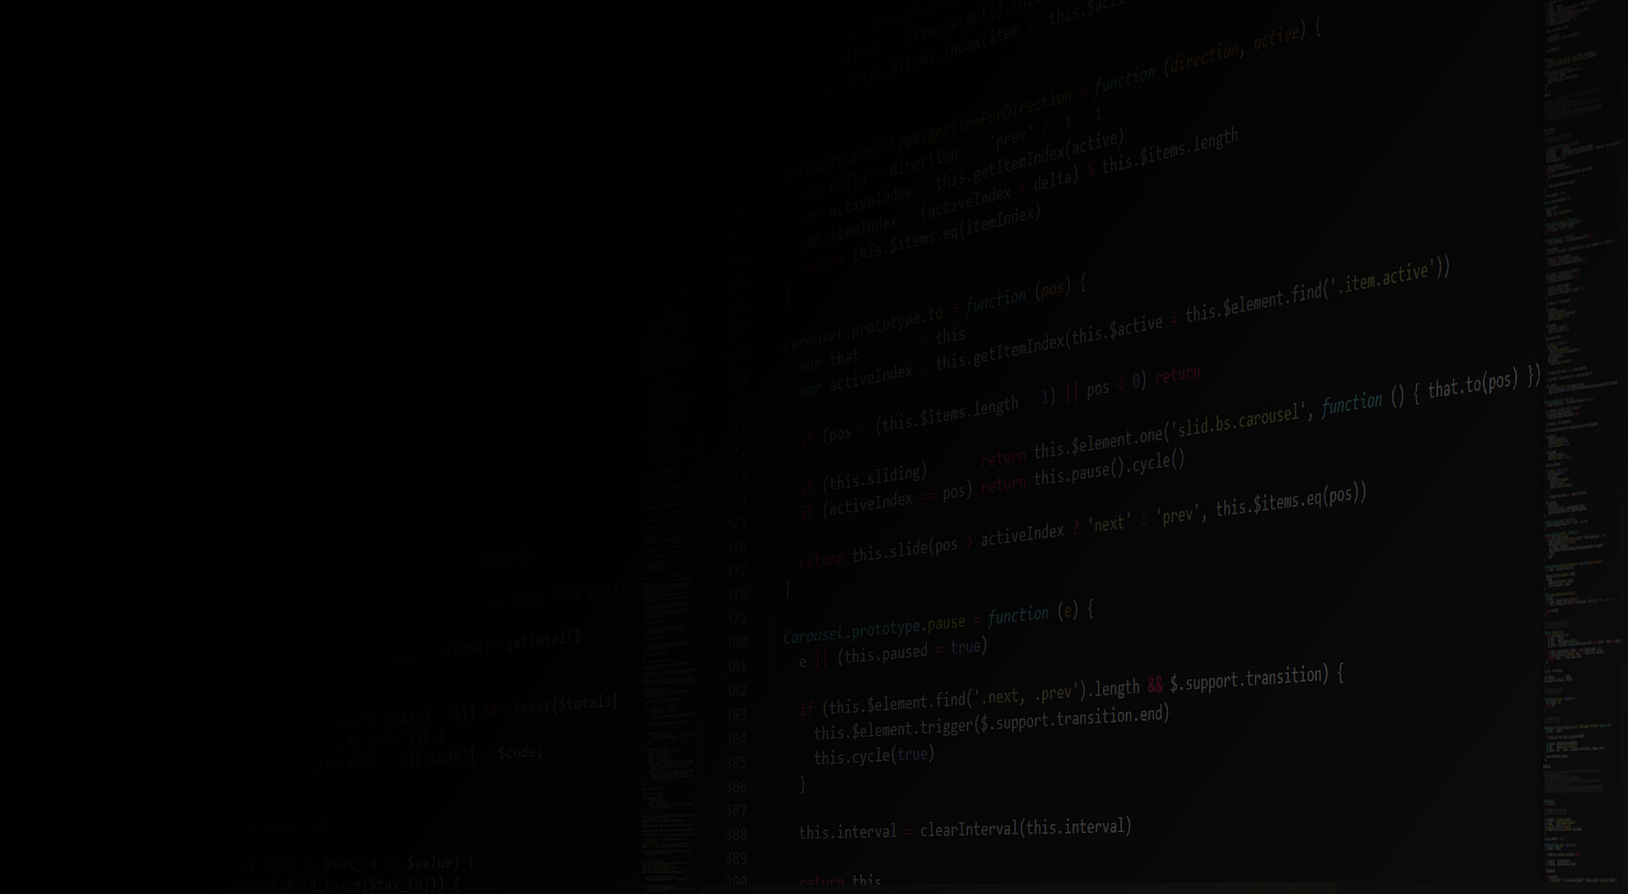
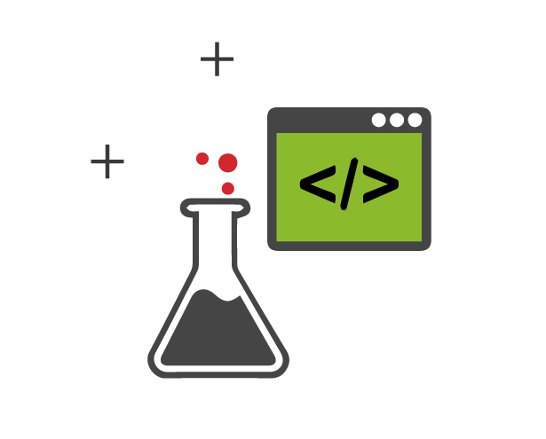
What are the Pain Point(s) addressed ?
Change business rules at runtime
GUI based application to define rules
Capability to test defined rules
Set validity for rules
Scalability
Notes:
Is there a clear pain-point their idea is addressing? Does their idea clearly meet the needs of this pain point?

Slide 4

What is Your Solution to Address Pain Point(s)?
Dynamic development and deployment of rules
Implementation of Domain Specific Language
No exposure to any coding language is required.
Zero Coding approach
Zero Downtime
Simulation using REST Service.
Easy maintenance & scalability.
Time-based Rules
Notes:
To what degree is the solution a viable technical solution that promotes a great user experience?

Slide 5

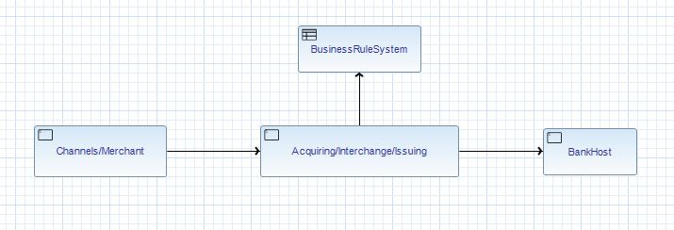
Where this can be implemented?
Payment Transactional context
Can be used for any other system/business

Slide 6
How to Implement Your Solution?
Define Business Rules from GUI based tool
Define Validity period of Business Rule
Export Rule-based file in REST service
REST API service will refer loaded workflow file and workflow will get executed.
Application that will implement this solution will only have to call up REST API Service.

Slide 7
What are the GoToMarket strategies ?
Early market captures will benefit business revenue
Reduces time to implement the change
Saved time will be utilized developing new features in product

Slide 8
Q & A

